Slide 1
Chapter -2 PowerShell
Arrays ,Hash Table

Slide 2
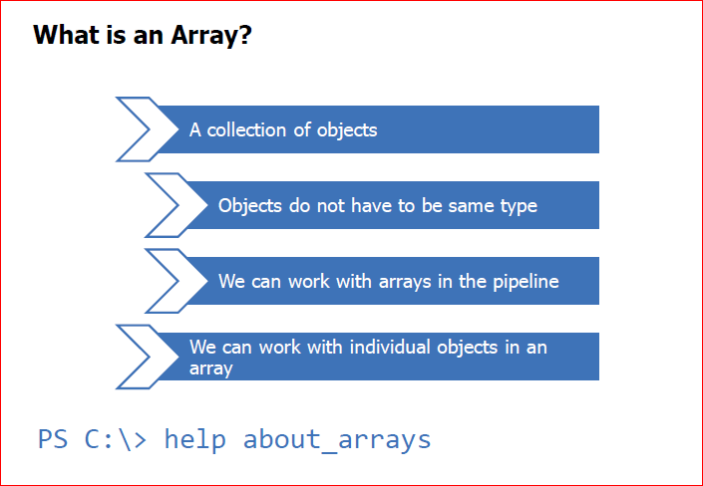

Slide 3
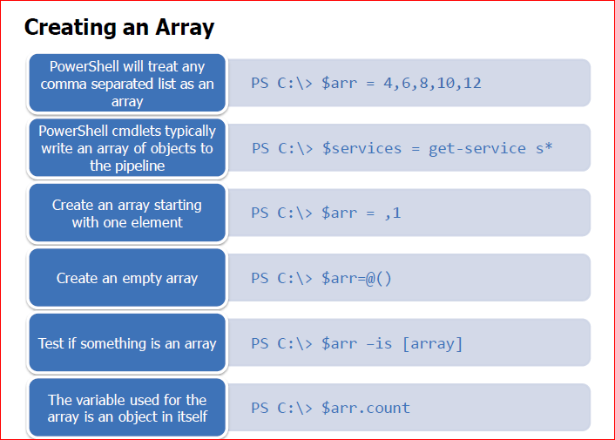

Slide 4
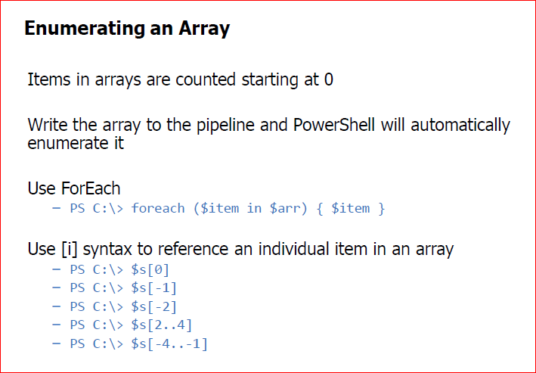

Slide 5
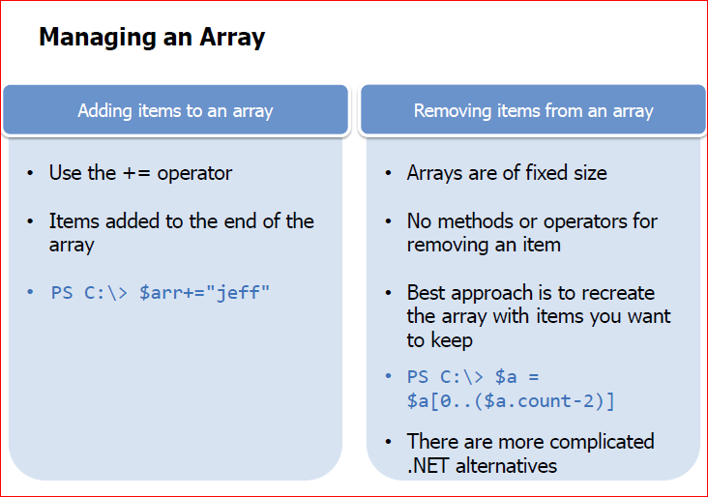

Slide 6
Array Demonstration

Slide 7
2.1 Hash Tables
PS chap 2 exercise 1.2

Slide 8
What is Hash Table ?
Collection of key/value pairs
Value can be any object or collection of objects
The hash table is its own type of object
PS C:\> help about_hash_tables

Slide 9
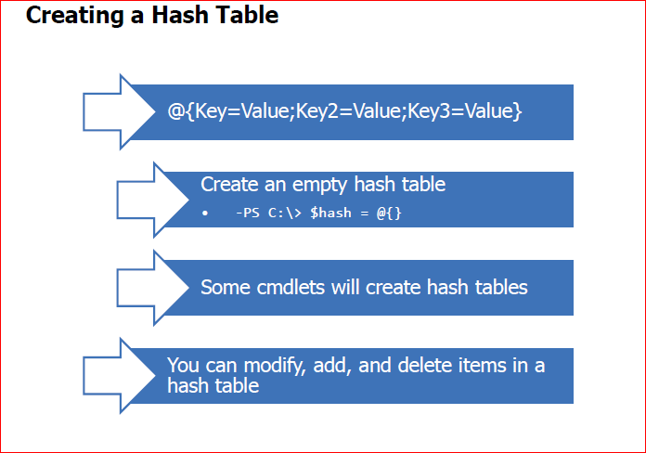

Slide 10
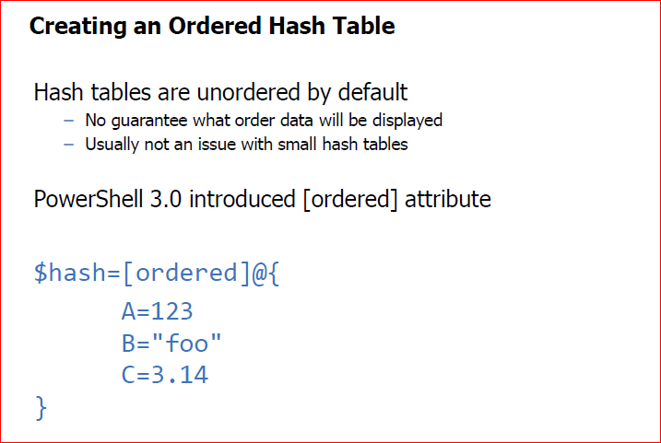

Slide 11
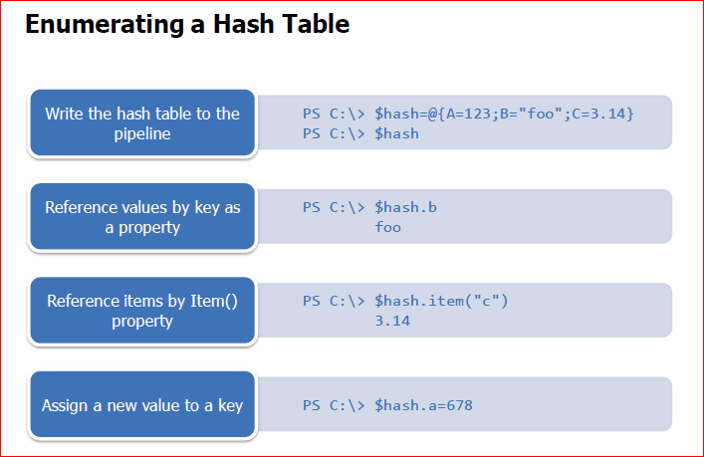

Slide 12
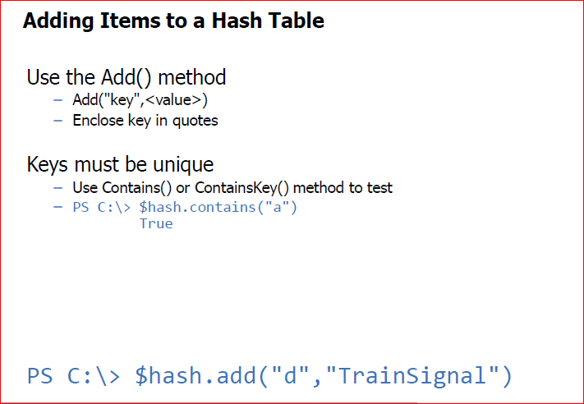

Slide 13
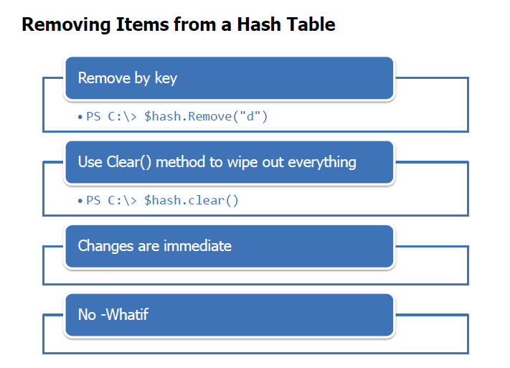

Slide 14
Hash Table -Demonstration

