Slide 1
Core PowerShell Cmdlets
PS 2.2

Slide 2
PowerShell Cmdlets
Designed to work with objects
Common Cmdlets you will use all the time
Provide core functionality
Read full help and examples for all Cmdlets in this lesson

Slide 3
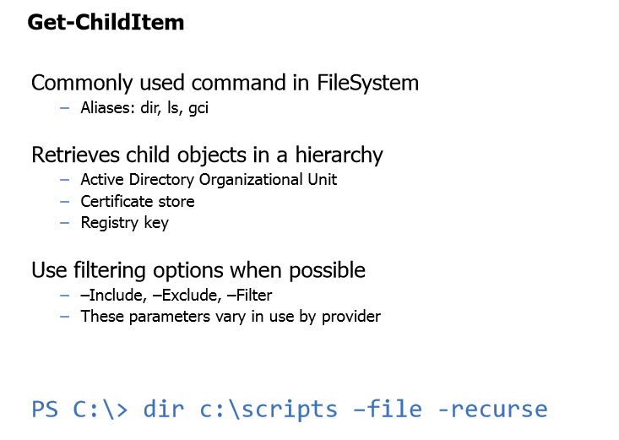

Slide 4
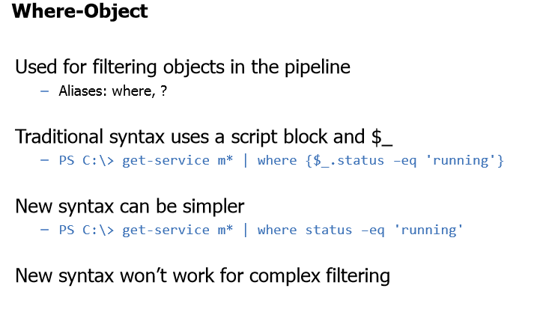

Slide 5
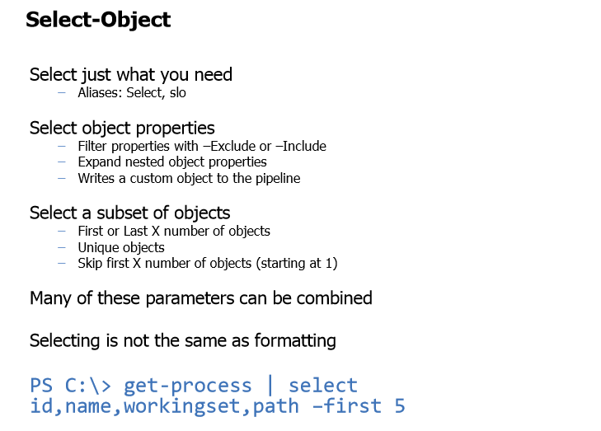

Slide 6
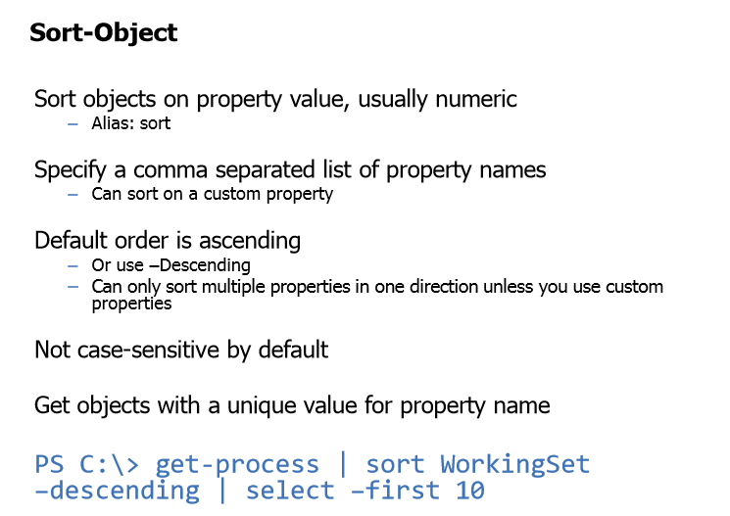

Slide 7
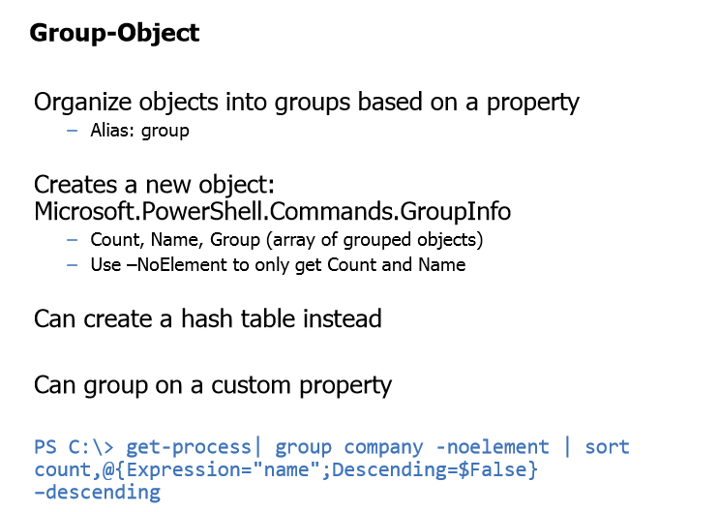

Slide 8
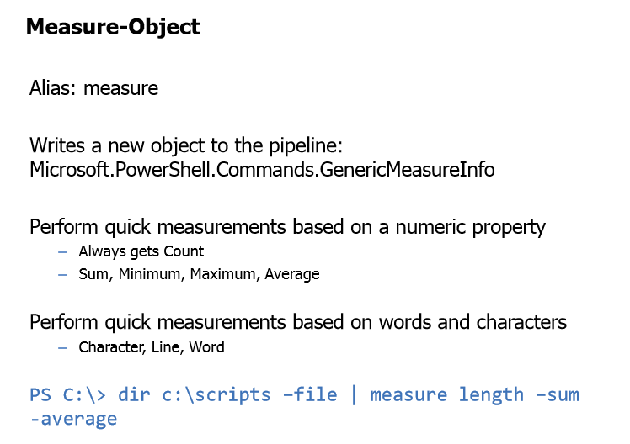

Slide 9
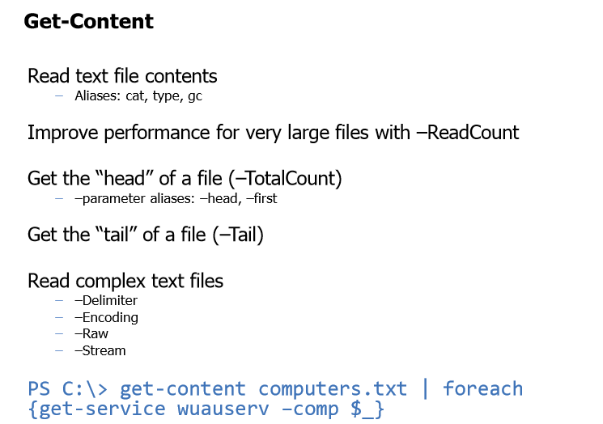

Slide 10
Core Cmdlets Demonstrations

