Slide 1
Web Cmdlets
Powershell

Slide 2
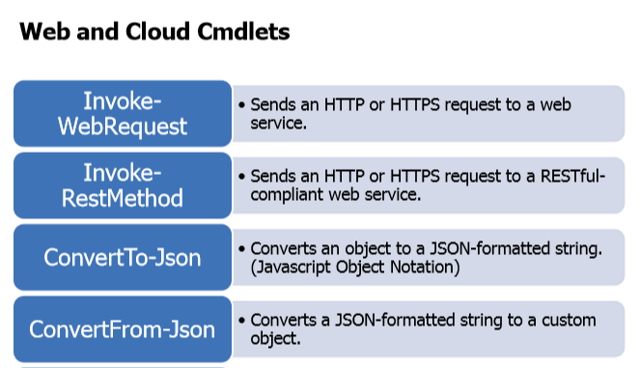

Slide 3
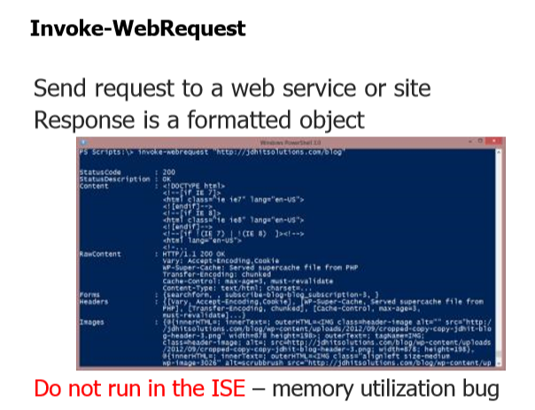

Slide 4
