Slide 1
Script Constructs
Ps

Slide 2
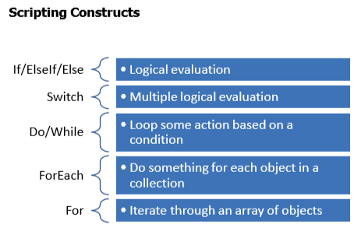

Slide 3
Writing a PowerShell Script
Any commands you can run in the console can be put into a script (.ps1 file)
Scripts can accept parameters
#requires –version 3.0
Param(<PARAMETER>,<PARAMETER>)
#Main part of script <PowerShell commands

Slide 4
PowerShell Basic Functions
A function is a single purpose -re-usable tool
Defined in script files
Can use parameters
Functions need to be “loaded” into your PowerShell session
Function <FUNCTION NAME> { Param(<PARAMETER>,<PARAMETER>)
#Main part of function <FUNCTION CODE THAT WRITES OBJECTS TO THE PIPELINE>
} #end of function

Slide 5
Scripting Best Practices
No aliases – use full cmdlet names
Use full parameter names
Start with comment-based documentation
Use standard Verb-Noun naming convention
Use common parameter names
Do not include formatting cmdlets

Slide 6
