Slide 1
PowerShell Script Error Handling & Debugging
ps

Slide 2
Understanding Exceptions and Errors
In PowerShell the error is the message you see when there is a problem
An exception is the object that contains the error
Exceptions stored in $Error automatic variable
Default is 256 exceptions ($MaximumErrorCount)

Slide 3
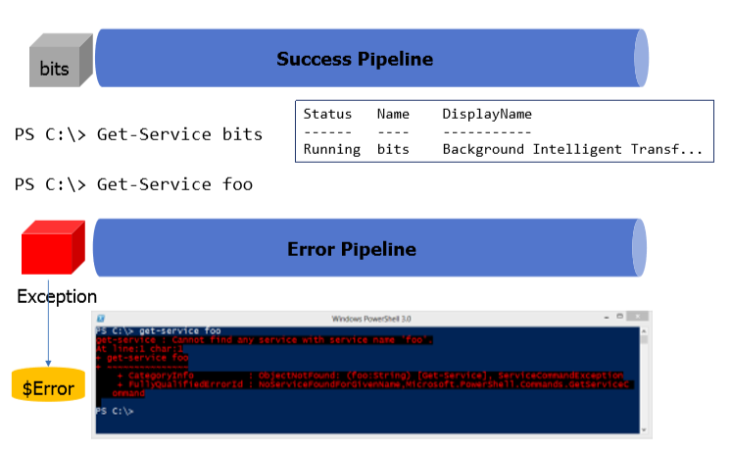
The Error Pipeline

Slide 4
ErrorActionPreference
Preferences
– SilentlyContinue
– Stop
– Continue [this is the default behavior]
– Ignore
Set at scope level: $ErrorActionPreference

Slide 5
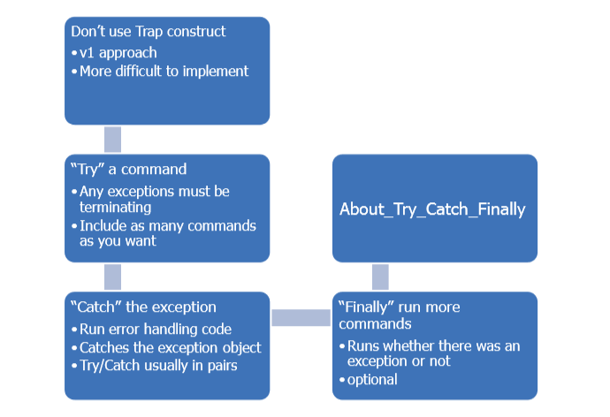
Error Handling With Try/Catch/Finally

Slide 6
Try/Catch
Try {
$computer = "Chi-dc03"
Get-CimInstance win32_bios –computer $computer –erroraction Stop
}
Catch {
Write-Warning "Failed to connect to $Computer“
$_
}
Finally { Write-host "Finished" –foreground green
}

Slide 7
Debugging Your Script
Debugging is determining where reality diverges from expectation
Reduce bug opportunities from the beginning
– Write your scripts in a scripting editor
…like PowerShell ISE
– Layout your script
PS C:\> Help about_debuggers

Slide 8
