Slide 1

Visualizing U.S. Industrial Emissions: An Analysis of CH4, NO2, and CO2
-RAMESH DASARI

Slide 2
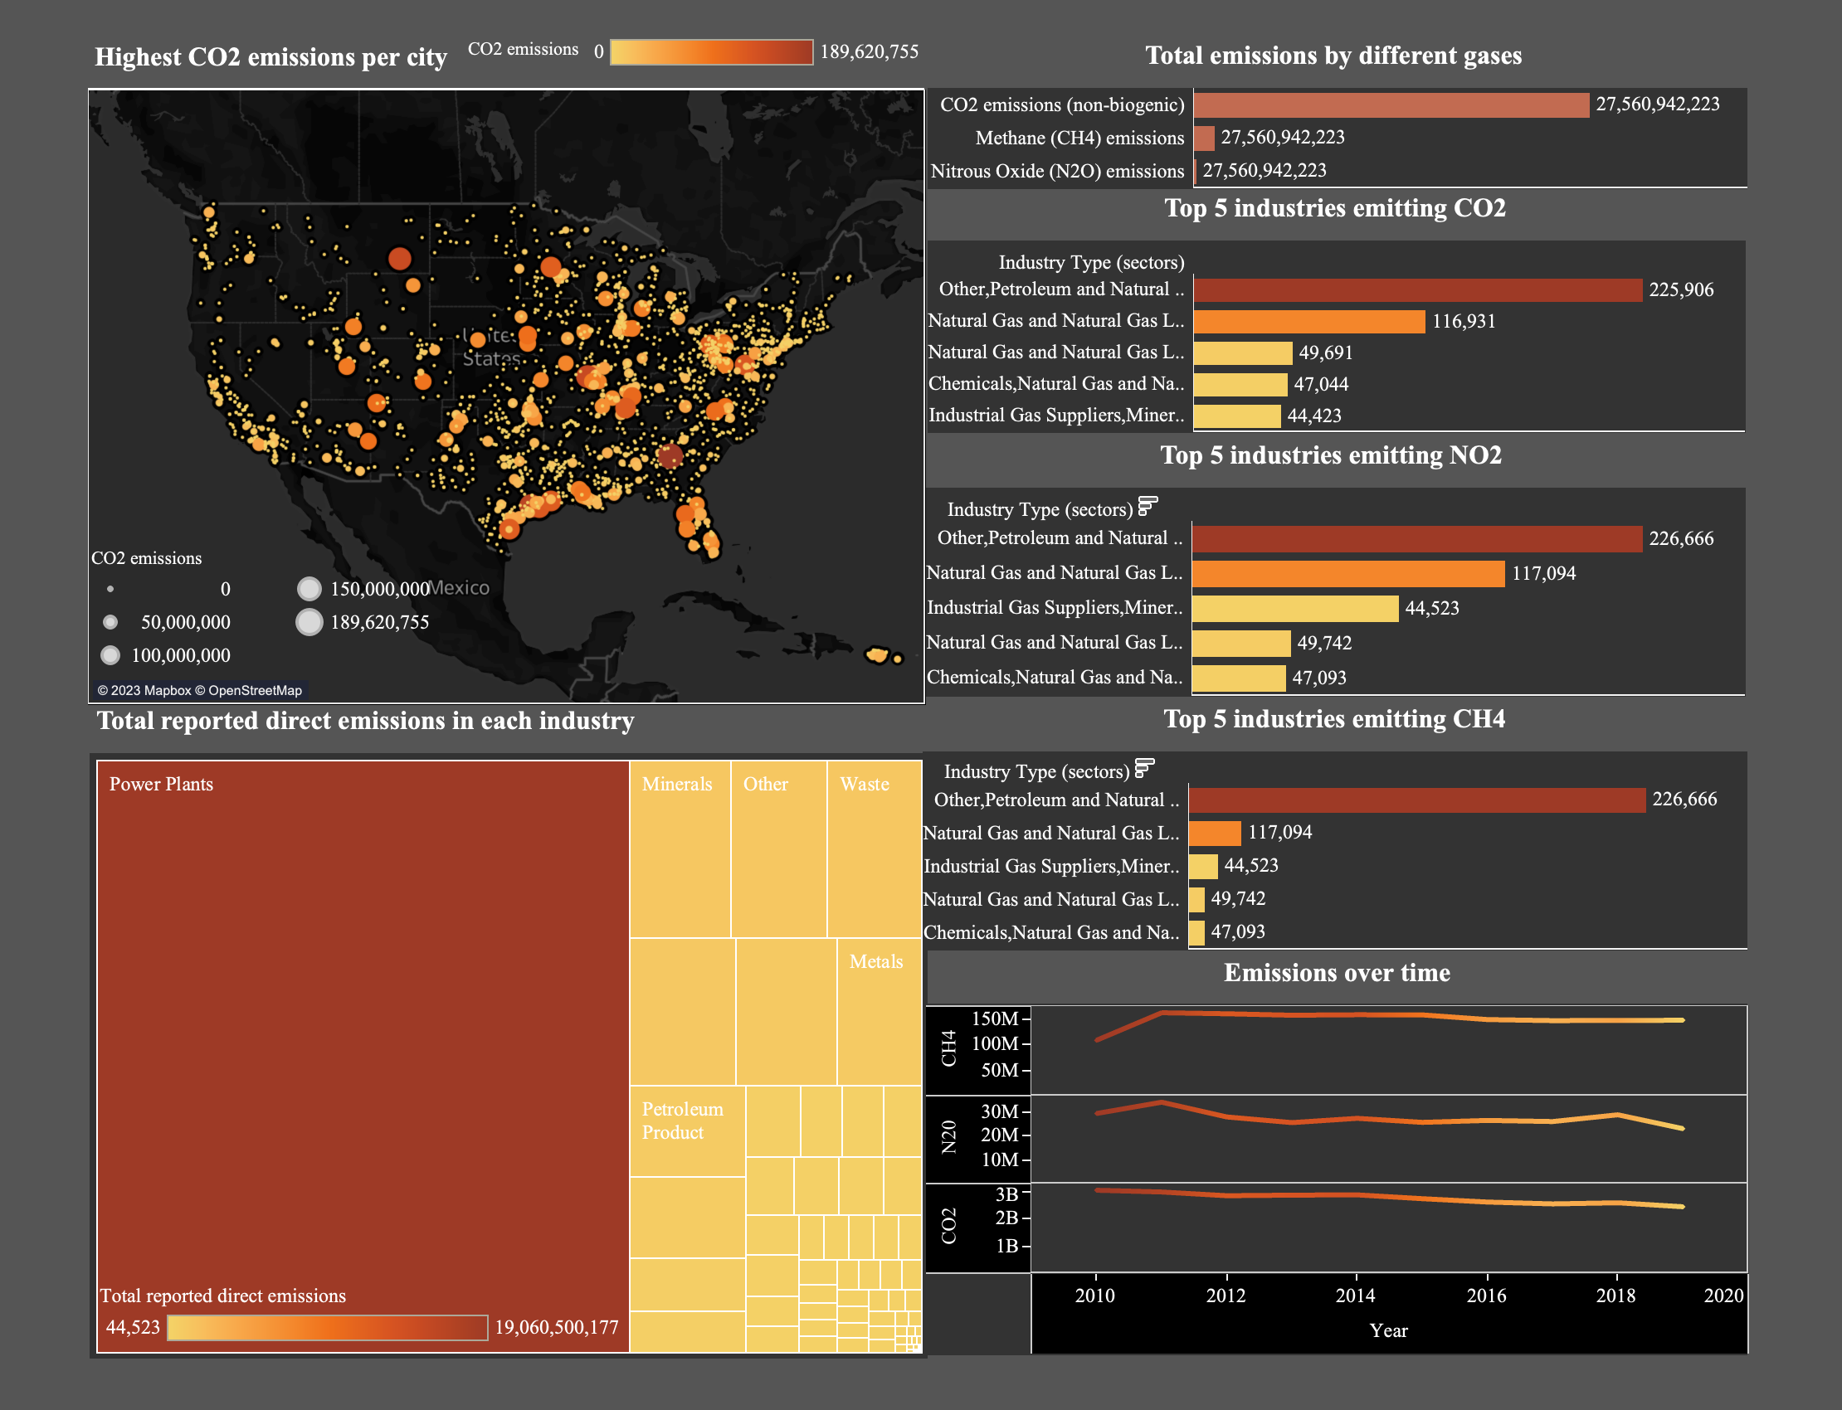

Slide 3
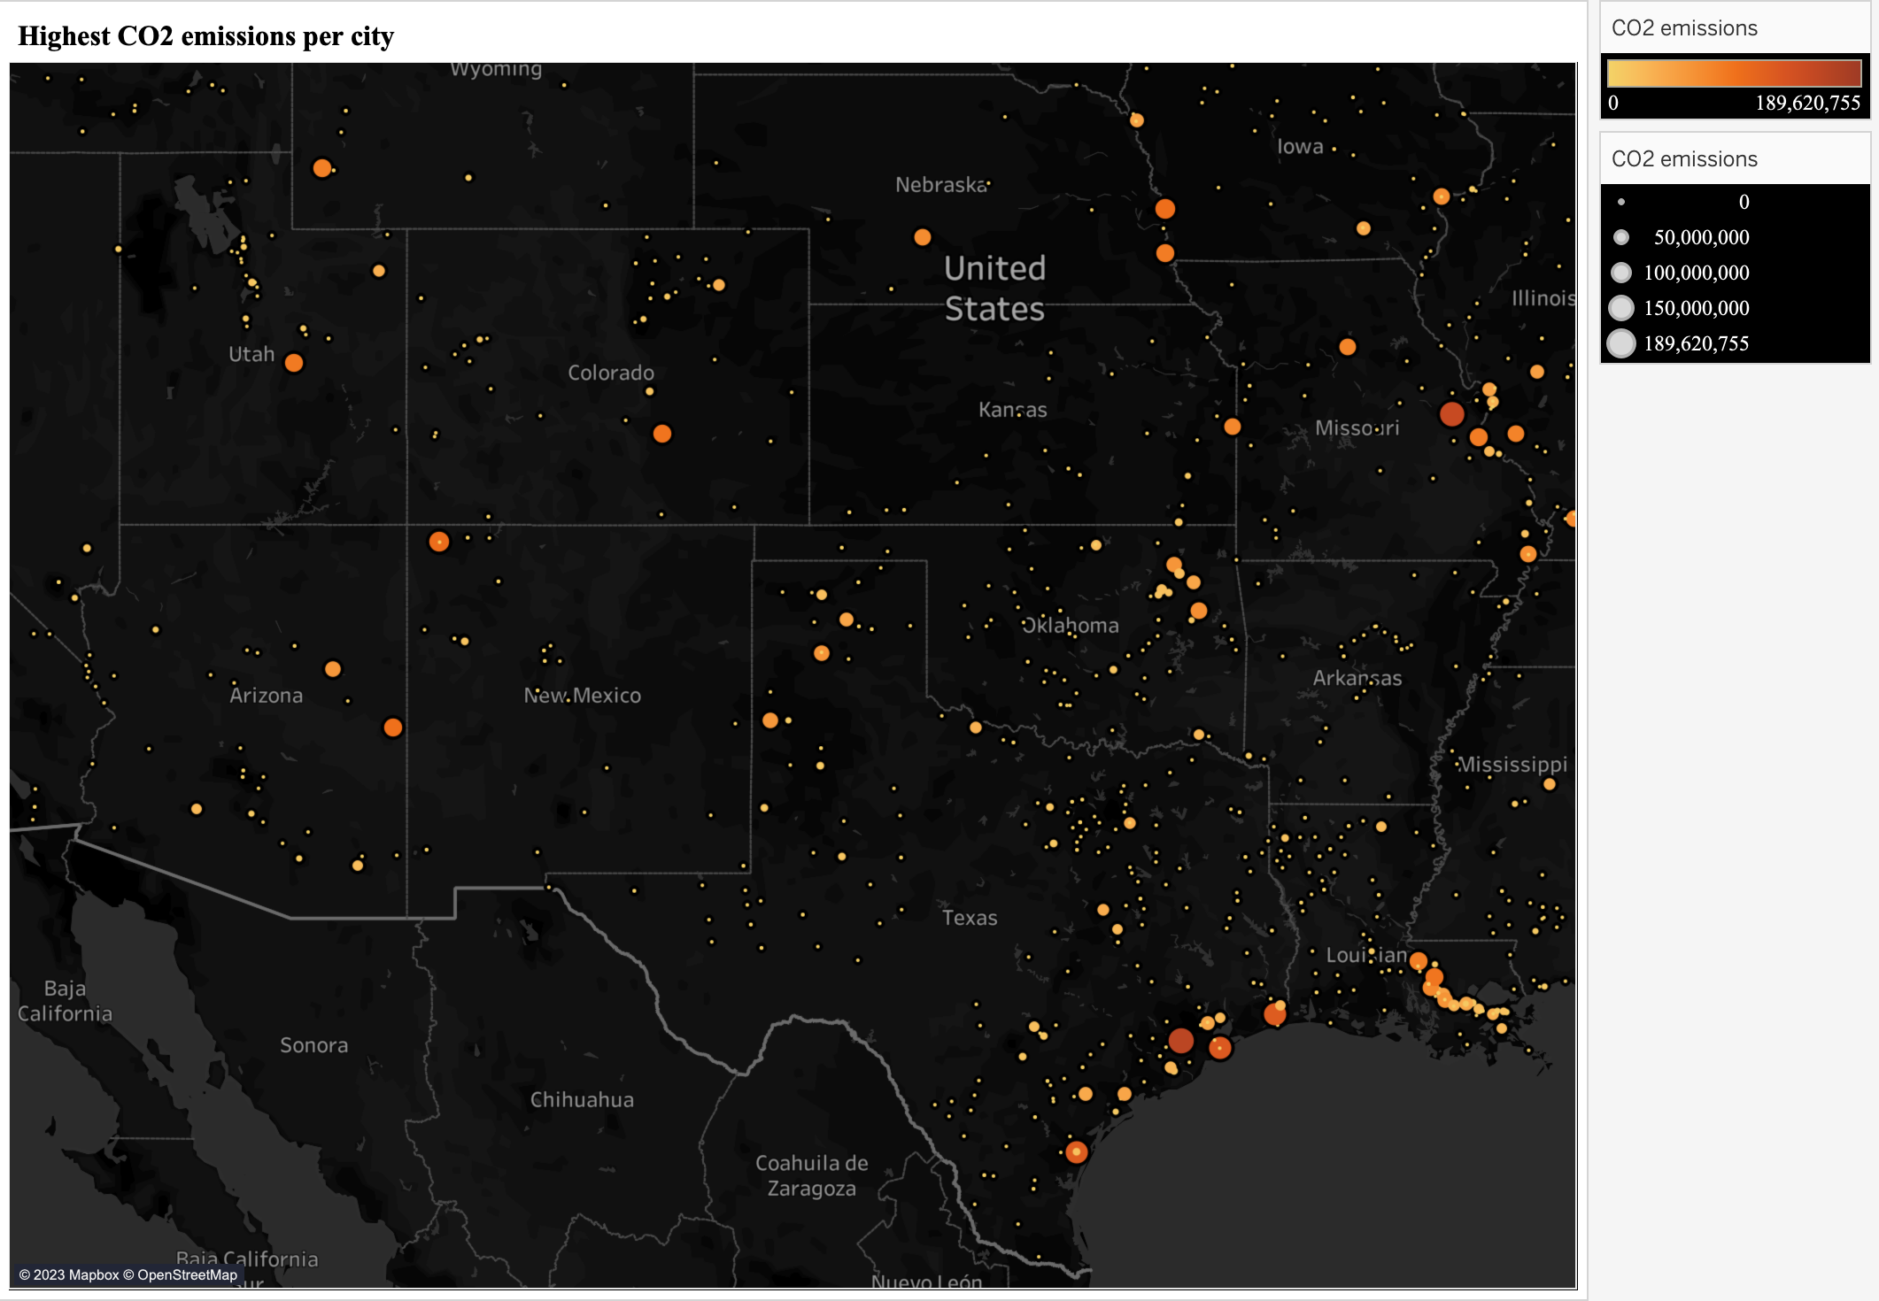
Highest Co2 Emissions per city
Notes:
The map visualization provides an excellent way to identify the areas with the highest and lowest CO2 emissions. We can see that Juliette stands out as the location with the highest CO2 emissions of 189620754.60 (189.62 million). This information can be crucial for policymakers and environmental agencies to focus their efforts on reducing emissions in this area. It also highlights the importance of regulating emissions from power plants and industrial facilities in this region.
On the other hand, we can also see that there are several cities with zero CO2 emissions, such as Angelton, Buena vista, Broad view heights, and Morgan field. This information is equally important as it shows that some areas have been successful in reducing their emissions. This could be due to a range of factors, such as the adoption of renewable energy sources, implementing energy-efficient practices, or other environmental initiatives.
Overall, the map visualization highlights the disparity in CO2 emissions across different locations, which can help inform policy decisions and encourage sustainable practices to reduce emissions.

Slide 4
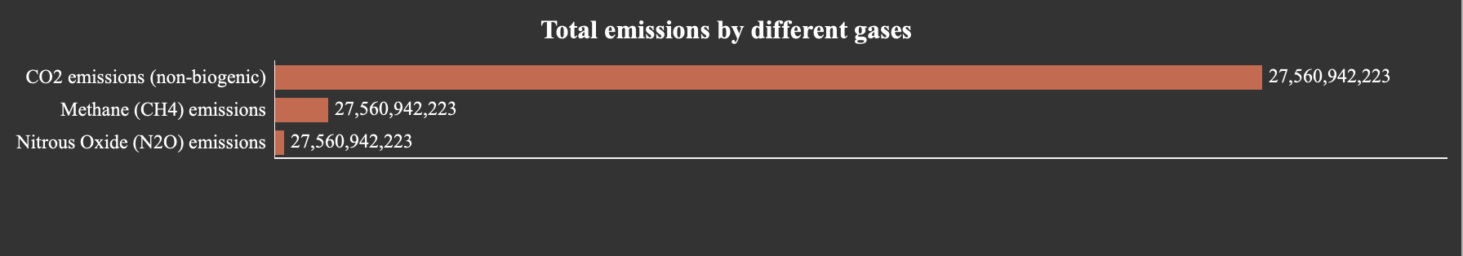
Total emissions by different gases

Slide 5
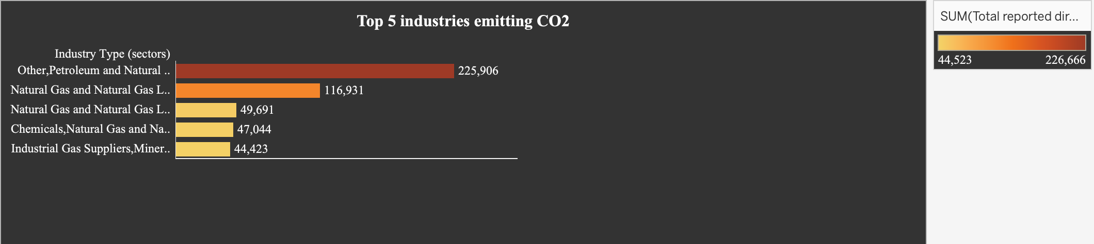
Top 5 Industries Emitting CO2

Slide 6
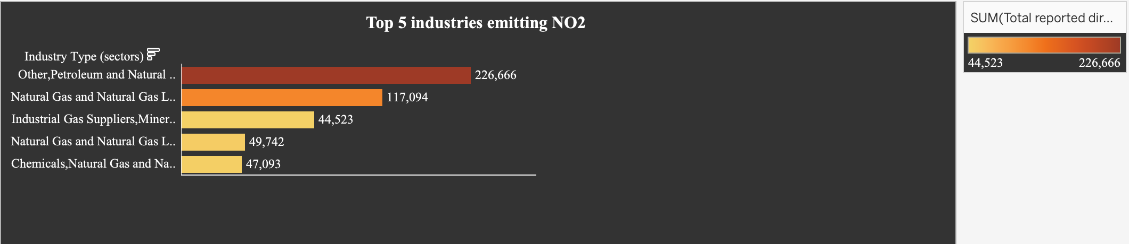
Top 5 Industries Emitting NO2

Slide 7
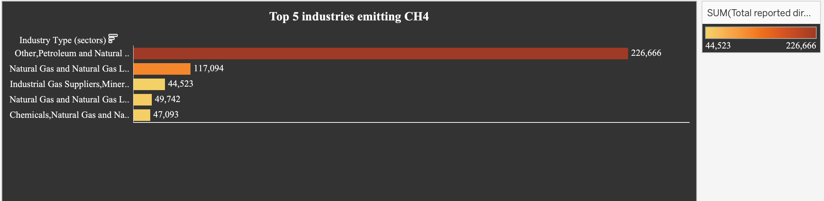
Top 5 Industries Emitting CH4

Slide 8
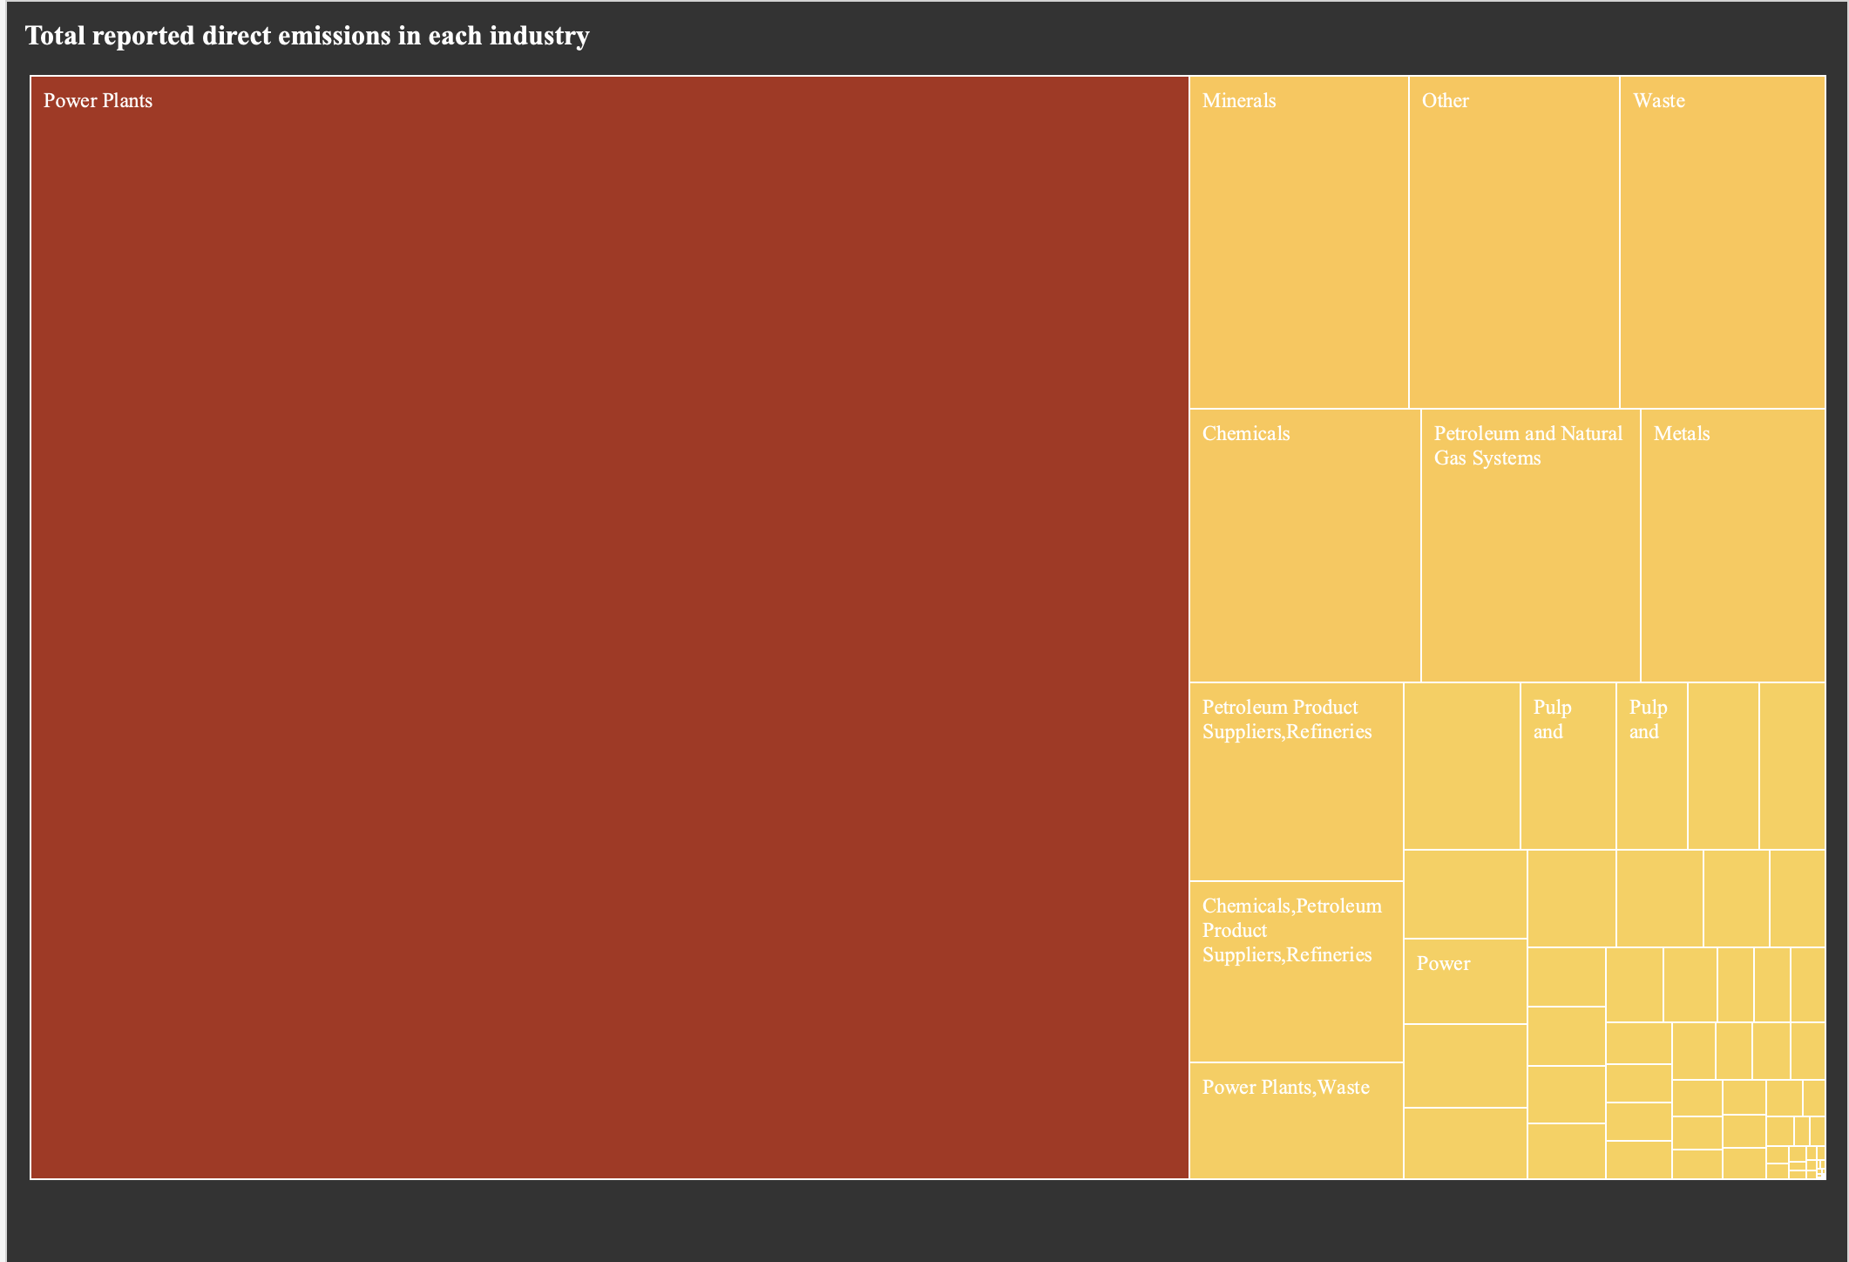
Total reported direct emissions in each Industry

Slide 9
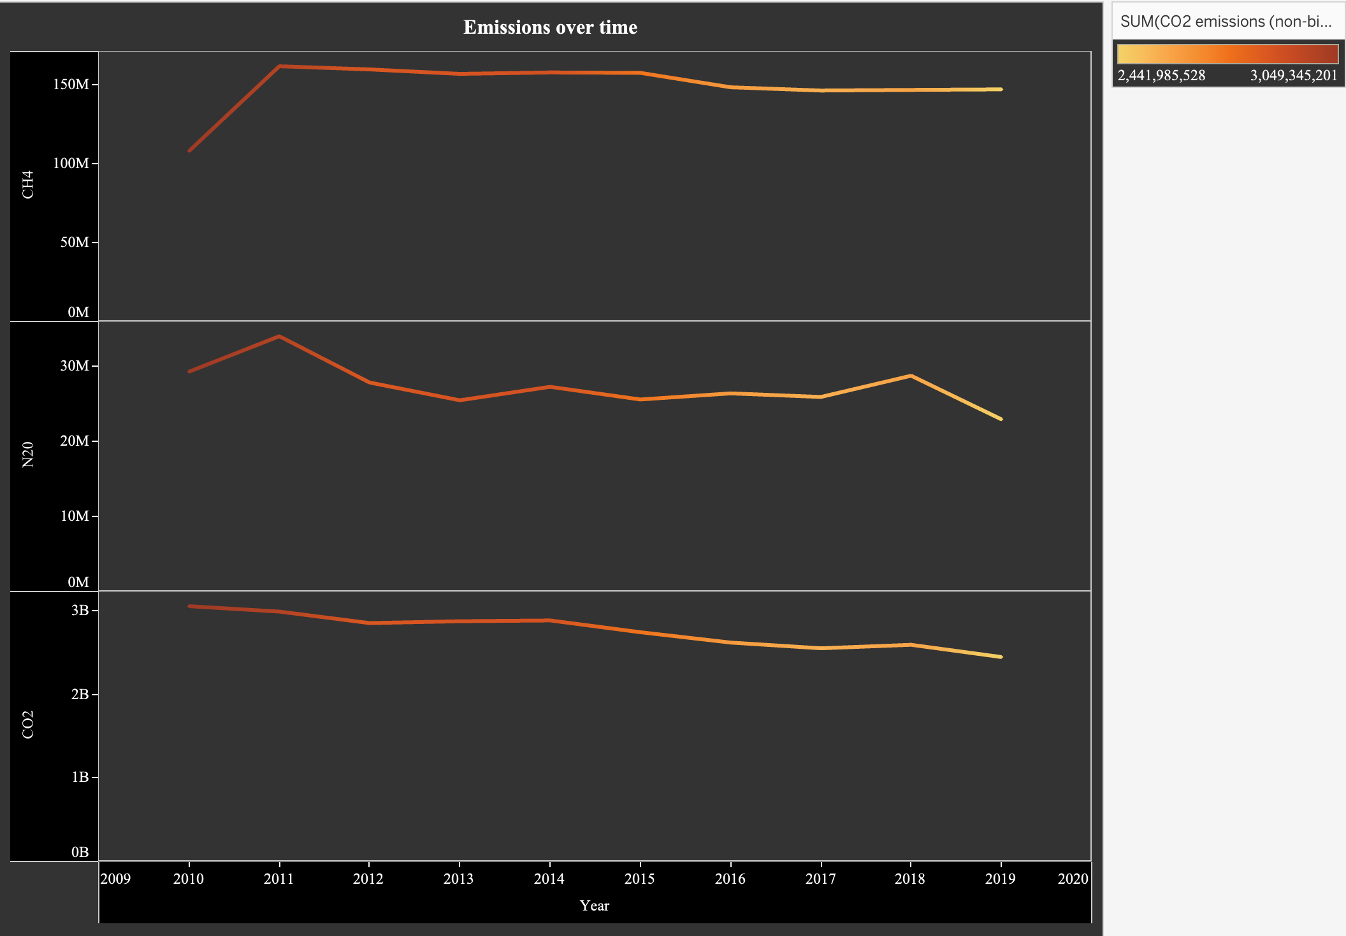
Emissions over time

Slide 10

Thank you

