Slide 1

Final Review
TOPIC :License Plate Recognition Using Yolo
In Phyboard Pollux Imx8mp
MASTER OF COMPUTER APPLICATION
Domain : Embedded IOT
Guided by :
Dr. A B Arockia Christopher
Professor and Head
MCA
Presented by
RAMESHKUMAR T S
(23205040)

Slide 2
OUTLINE
OUTLINE
DOMAIN
INTRODUCTION
SOFTWARE’S
HARDWARE’S
LITERATURE REVIEW
PROPOSED SYSTEM
DATAFLOW DIAGRAM
ER DIAGRAM
NUMBER OF MODULES
DATA COLLECTION
CIRCUIT DIAGRAM
CODE
OUTPUT
GRAPH
CONFUSION MATRIX
REFERENCE

Slide 3
DOMAIN
Domain : License Plate Recognition Using Yolo In Phyboard Pollux Imx8mp
Embedded System
Artificial Intelligence

Slide 4
INTRODUCTION
Detecting license plate numbers using computer vision, especially with the integration of YOLO (You Only Look Once) and Optical Character Recognition (OCR), offers a range of practical applications and benefits. Here's an introduction to why this process is valuable.In the ever-evolving landscape of technology, the integration of computer vision has brought forth innovative solutions, and one particularly compelling application is the detection of license plate numbers. This technology has proven to be immensely useful in various domains, offering a blend of efficiency, accuracy, and automation.One primary utility of license plate detection through computer vision lies in enhancing security and surveillance systems. By leveraging advanced algorithms, such as YOLO, to detect license plates in real-time, it becomes possible to monitor and track vehicles seamlessly. This is particularly advantageous in the context of law enforcement, where quick identification of vehicles is essential for tasks ranging from traffic management to criminal investigations.

Slide 5
SOFTWARE’S
Operating System:
Python3.10 - Development and Debugging
OpenCV.
YOLO (You Only Look Once).
Tesseract OCR
LabelImg
TensorFlow / PyTorch (Based on selected YOLO version)
Operating System in Linux.

Slide 6
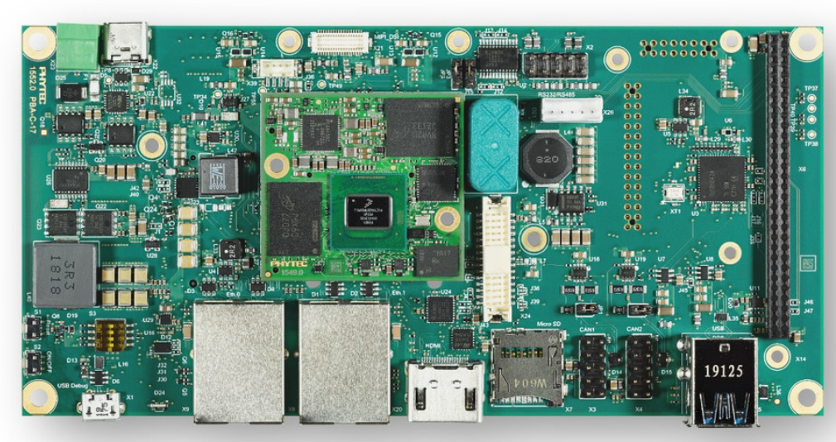
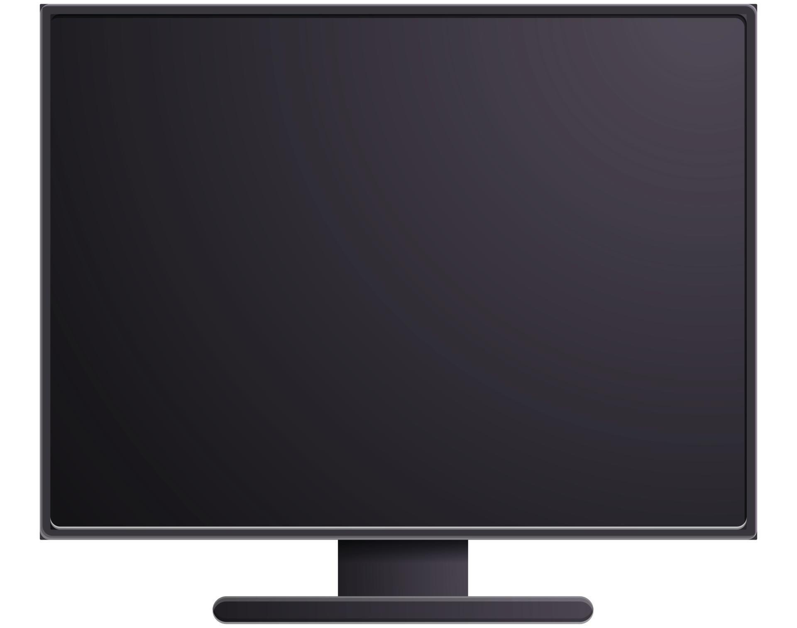
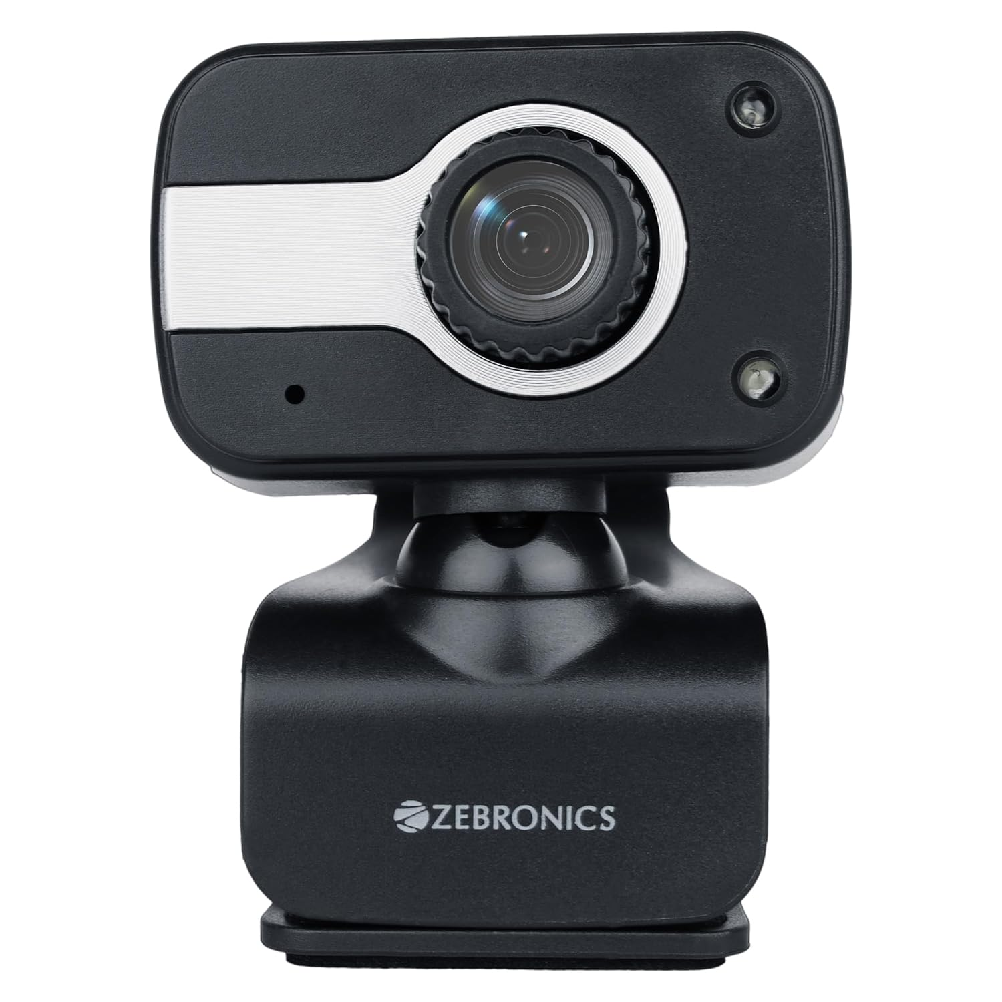
HARDWARE’S
1.
Phyboard Pollux I.mx8m Plus
LCD Display/Monitor
Camera Module/USB Camera
2.
3.

Slide 7
LITERATURE REVIEW
YOLO and CNNs improve LPR accuracy and speed (Smith et al., 2022; Patel et al., 2020).
OCR combined with YOLO enhances character recognition (Johnson & Lee, 2021; Chen et al.,).
Embedded platforms (i.MX 8M Plus) enable real-time LPR with low latency (Singh & Sharma)
Many systems lack real-time power monitoring.
LPR aids traffic management and anomaly detection (Smith et al., 2021; Garcia & Lee, 2019).
Encryption and blockchain ensure secure LPR data transmission (Wang et al., 2021; Chen & Zhang, 2020).

Slide 8
PROPOSED SYSTEM
Enable real-time vehicle recognition and monitoring using local edge processing with no dependency on internet or cloud platforms.
Camera Module (USB/MIPI) for live video feed.
Plate recognition results displayed on an HDMI monitor or display module.
PhyBOARD Pollux i.MX8MP with built-in NPU for AI inference.
YOLO + OCR (Tesseract/PaddleOCR) for license plate detection and recognition.
Local Storage (e.g., SD card, SQLite) for storing recognized data.
No Cloud or Internet Connection Required

Slide 9
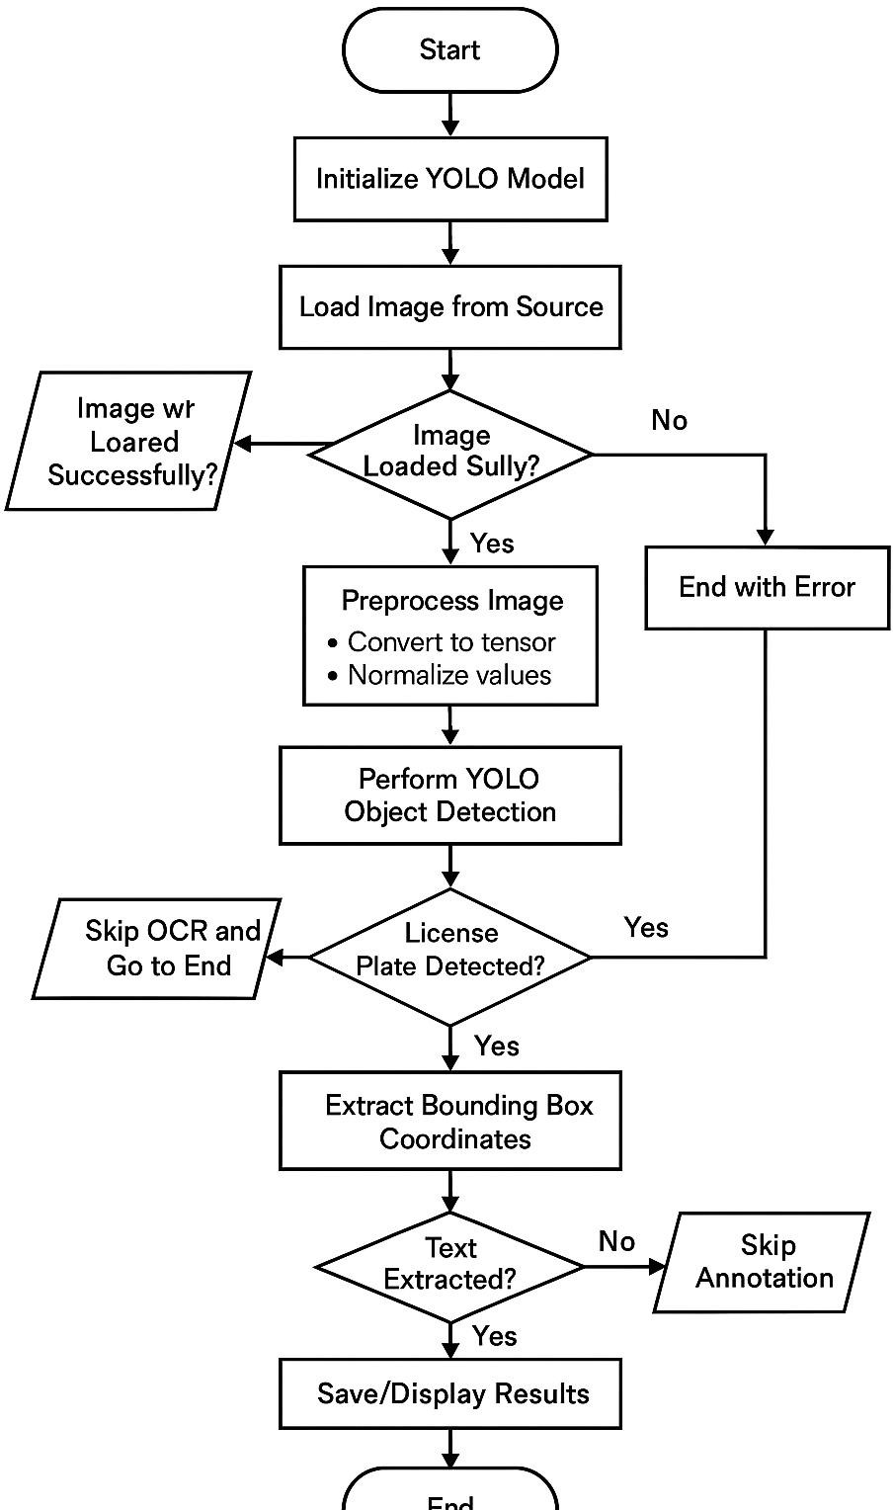
DATAFLOW DIAGRAM

Slide 10
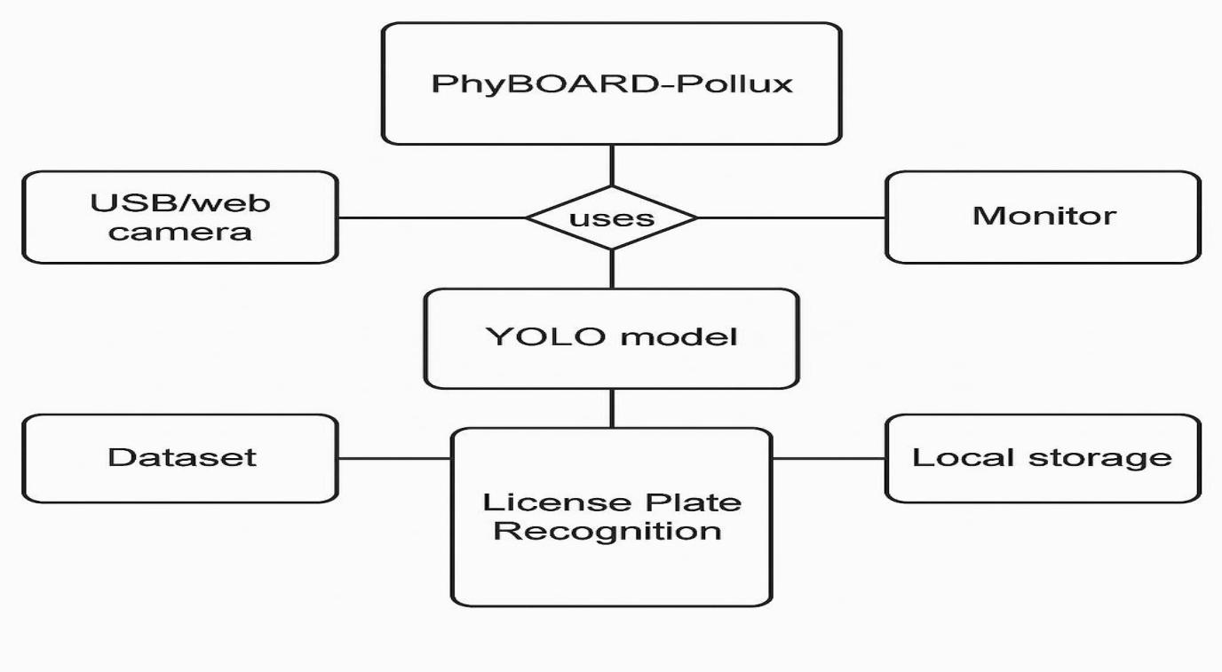
ER DIAGRAM

Slide 11
DATA COLLECTION
Real-time Data Collection:
The camera continuously captures vehicle images, which are processed in real-time by the YOLO model running on the i.MX8MP.
Plate Detection & Recognition:
The system identifies and extracts license plate regions from the captured frames. Optical Character Recognition (OCR) is applied to convert the plate image into text.
Local Data Storage:
The recognized license plate numbers, along with the corresponding images, are stored locally on the device for immediate access and analysis.

Slide 12
NUMBER OF MODULES
Data Collection Modules:
Camera Module: Captures real-time vehicle images for processing.
YOLO Model (Detection Module): Detects license plates from the captured images.
OCR Module (Recognition Module): Extracts text from the detected license plate images using OCR.
Communication Modules:
Display Module (HDMI/Local Display): Displays the detected license plate number and any alerts on a local monitor.
MPU & MCU Module (i.MX8MP): Processes the image data using the YOLO model for license plate detection and handles communication with other components.
Processing Modules

Slide 13
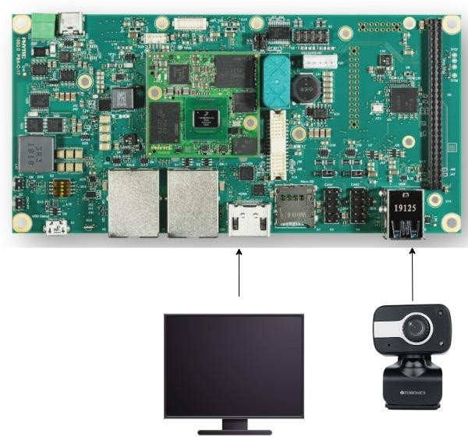
CIRCUIT DIAGRAM
lb

Slide 14
CODE
if len(result) > 1 and len(res[1]) > 6 and res[2] > 0.2:
text = res[1]
return str(text)
class DetectionPredictor(BasePredictor):
def get_annotator(self, img):
return Annotator(img, line_width=self.args.line_thickness, example=str(self.model.names))
def preprocess(self, img):
img = torch.from_numpy(img).to(self.model.device)
img = img.half() if self.model.fp16 else img.float()
31img /= 255
return img
def postprocess(self, preds, img, orig_img):
preds = ops.non_max_suppression(preds, self.args.conf, self.args.iou,
agnostic=self.args.agnostic_nms, max_det=self.args.max_det)
for i, pred in enumerate(preds):
shape = orig_img[i].shape if self.webcam else orig_img.shape
pred[:, :4] = ops.scale_boxes(img.shape[2:], pred[:, :4], shape).round()
return preds
def write_results(self, idx, preds, batch):
# Ultralytics YOLO, GPL-3.0 License
import hydra
import torch
import cv2
import easyocr
from ultralytics.yolo.utils import DEFAULT_CONFIG, ROOT, ops
from ultralytics.yolo.utils.checks import check_imgsz
from ultralytics.yolo.utils.plotting import Annotator, colors, save_one_box
reader = easyocr.Reader(['en'], gpu=True)
def ocr_image(img, coordinates):
x, y, w, h = int(coordinates[0]), int(coordinates[1]), int(coordinates[2]), int(coordinates[3])
img = img[y:h, x:w]
gray = cv2.cvtColor(img, cv2.COLOR_RGB2GRAY)
result = reader.readtext(gray)
text = ""
for res in result:
if len(result) == 1:
text = res[1]

Slide 15
p, im, im0 = batch
log_string = ""
if len(im.shape) == 3:
im = im[None]
self.seen += 1
im0 = im0.copy()
if self.webcam:
log_string += f'{idx}: '
frame = self.dataset.count
else:
frame = getattr(self.dataset, 'frame', 0)
self.data_path = p
self.txt_path = str(self.save_dir / 'labels' / p.stem) + ('' if self.dataset.mode == 'image' else
f'_{frame}')
log_string += '%gx%g ' % im.shape[2:]
self.annotator = self.get_annotator(im0)
det = preds[idx]
self.all_outputs.append(det)
if len(det) == 0:
32return log_string
for c in det[:, 5].unique():
n = (det[:, 5] == c).sum()
line = (cls, *xywh, conf) if self.args.save_conf else (cls, *xywh)
with open(f'{self.txt_path}.txt', 'a') as f:
f.write(('%g ' * len(line)).rstrip() % line + '\n')
if self.args.save or self.args.save_crop or self.args.show:
c = int(cls)
label = None if self.args.hide_labels else (self.model.names[c] if self.args.hide_conf
else f'{self.model.names[c]} {conf:.2f}')
text_ocr = ocr_image(im0, xyxy)
label = text_ocr
self.annotator.box_label(xyxy, label, color=colors(c, True))
if self.args.save_crop:
imc = im0.copy()
save_one_box(xyxy, imc, file=self.save_dir / 'crops' / self.model.model.names[c] /
@hydra.main(version_base=None, config_path=str(DEFAULT_CONFIG.parent),
if __name__ == "__main__":
predict()

Slide 16
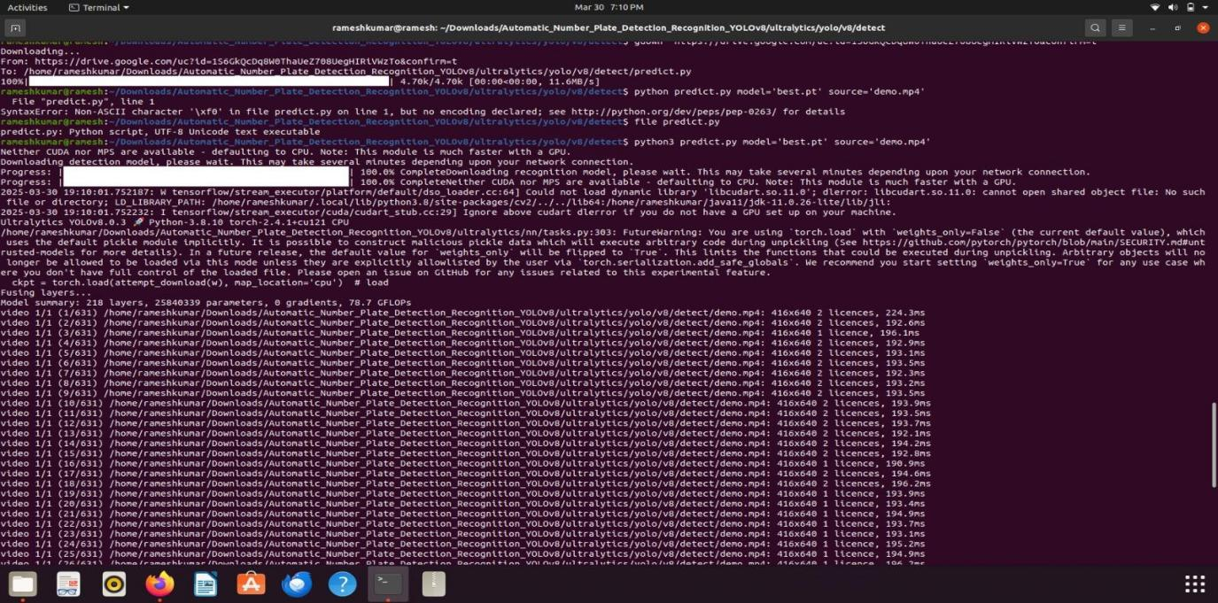
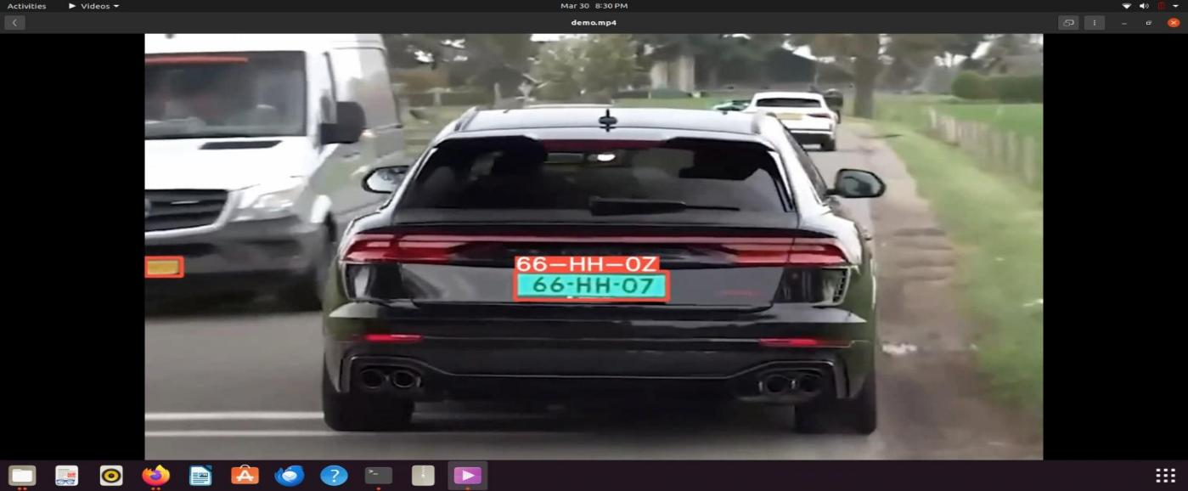
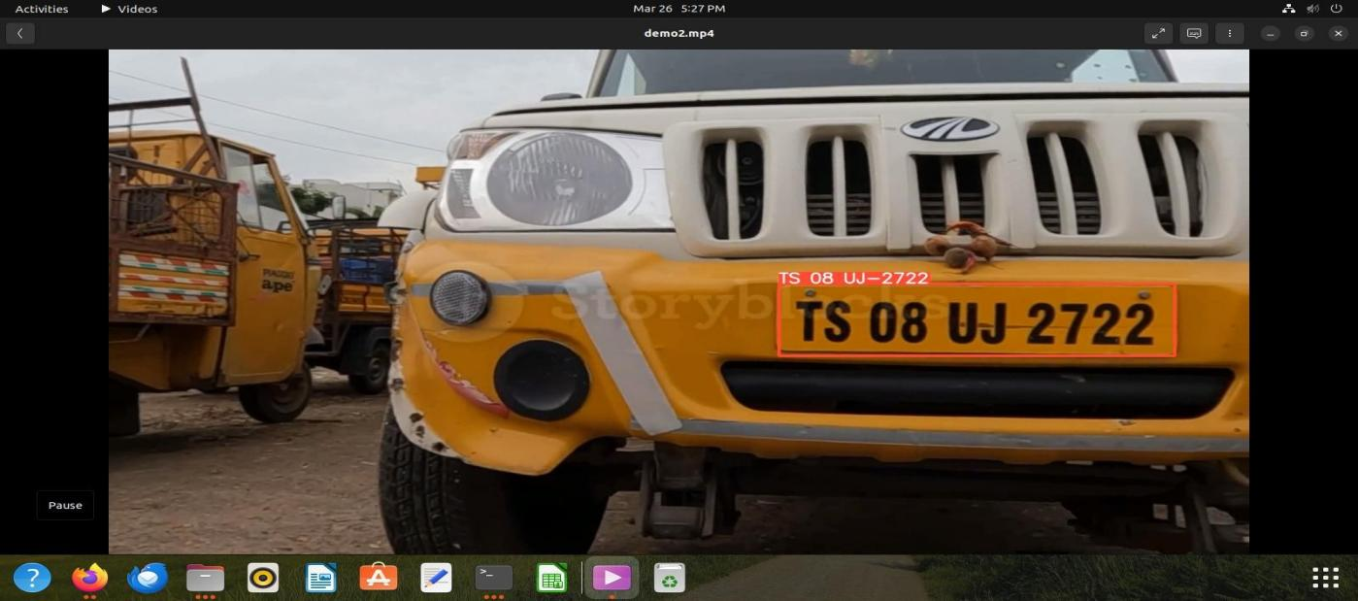
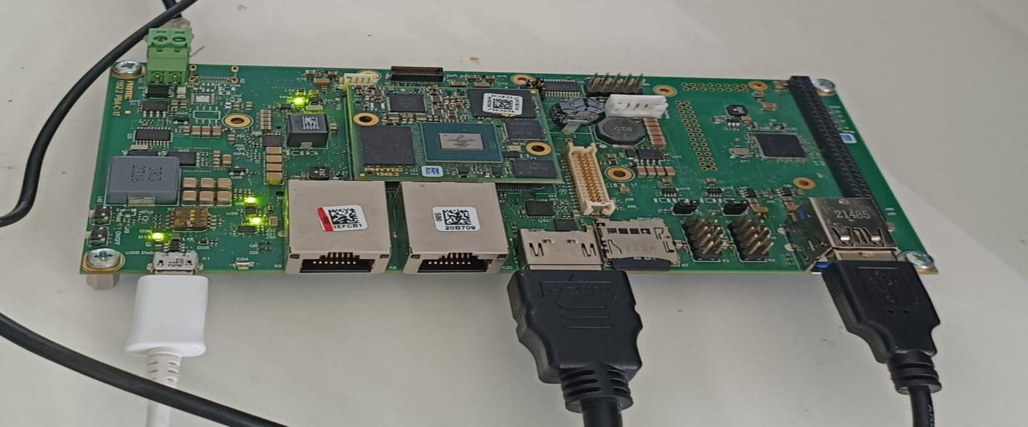
OUTPUT

Slide 17
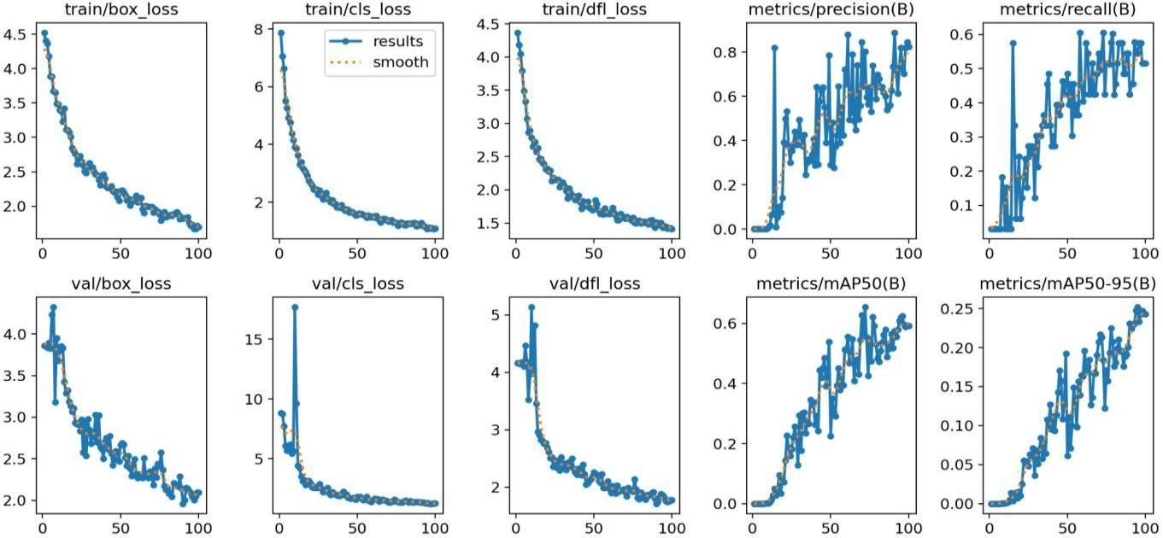
GRAPH

Slide 18
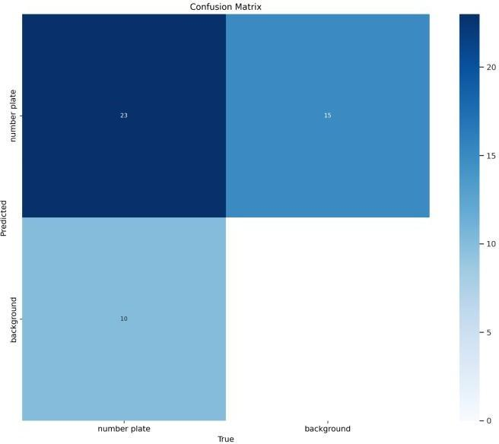
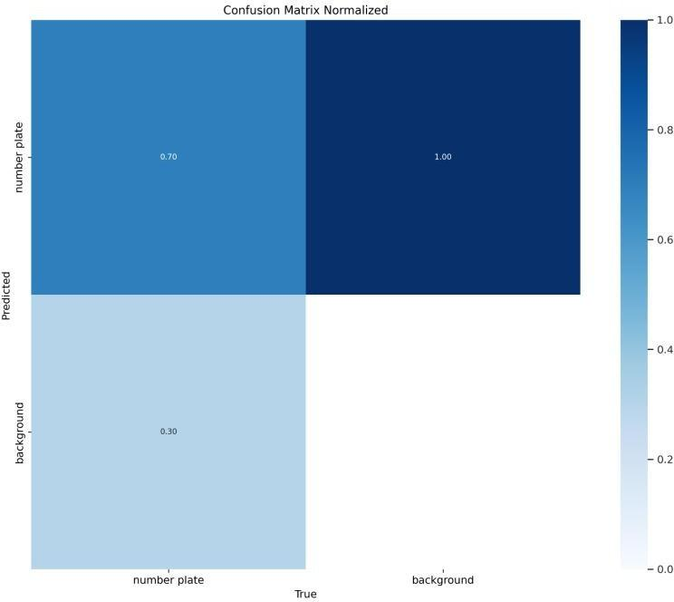
CONFUSION MATRIX

Slide 19
REFERENCES
PHYBOARD POLLUX I.MX8M PLUS
ReferenceManual: Phyboard Pollux I.mxm plux Reference Manual.(https://www.phytec.eu/en/produkte/system-on-modules/phycore-imx-8m-plus/#downloads/)
Hardware,Software&BSP Guide : Phyboardpollux imx8mp.(https://www.phytec.de/cdocuments/?doc=LAC7Ig)
PHYTEC CAMERA MODULE
Datasheet: Camera Module Datasheet.(https://www.phytec.com/product/phycam-m-mipi-csi-2/)
ULTRALYTICS YOLO
Yolo-You Only Look Once:Yolo For License plate Detection.(https://docs.ultralytics.com/tasks/detect/)
TENSORFLOW LITE
TensorFlow Lite Documentation:tensorflow lites models for tiny devices( https://www.tensorflow.org/lite)

Slide 20

