Slide 1
Strings

Slide 2
Strings
A string is a sequence of zero or more characters.
In Java Class Library, java.lang.String represents strings.
Each string literal is automatically converted to a String object in Java.
In Java, each String literal is a single String object.
In the following segment, both str1 and str2 point to the same object. (only one String object is created)
String str1, str2;
str1 = "Hello";
str2 = "Hello";
A String object can also be constructed by using String constructor.
new String("Hello")

Slide 3
Strings
Each String object created by using new operator is a individual object.
In the following segment, both str1 and str2 point to different object. (two String objects are created)
String str1, str2;
str1 = new String("Hello");
str2 = new String("Hello");
String class is immutable and final.
Java also provides another class StringBuffer which is functionally identical to String class, but it is not immutable.

Slide 4
Example
class StringDemo {
public static void main(String args[]) {
// declare strings in various ways
String str1 = new String("Java strings are objects.");
String str2 = "They are constructed various ways.";
String str3 = new String(str2);
System.out.println(str1);
System.out.println(str2);
System.out.println(str3);
}
}
Java strings are objects.
They are constructed various ways.
They are constructed various ways.

Slide 5
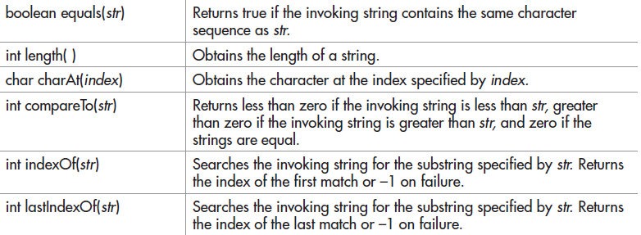
Commonly used String services

Slide 6
Example
class StrOps {
public static void main(String args[]) {
String str1 = "When it comes to Web programming, Java is #1.";
String str2 = new String(str1);
String str3 = "Java strings are powerful.";
int result, idx;
char ch;
System.out.println("Length of str1: " + str1.length());
Length of str1: 45

Slide 7
W h e n i t c o m e s t o W e b p r o g r a m m i n g , J a v a i s # 1 .
// display str1, one char at a time.
for(int i=0; i < str1.length(); i++)
System.out.print(str1.charAt(i) + " ");
System.out.println();
if(str1.equals(str2))
System.out.println("str1 equals str2");
else
System.out.println("str1 does not equal str2");
result = str1.compareTo(str3);
if(result == 0)
System.out.println("str1 and str3 are equal");
else if(result < 0)
System.out.println("str1 is less than str3");
else
System.out.println("str1 is greater than str3");
str1 equals str2
str1 is greater than str3

Slide 8
// assign a new string to str2
str2 = "One Two Three One";
idx = str2.indexOf("One");
System.out.println("Index of first occurence of One: " + idx);
idx = str2.lastIndexOf("One");
System.out.println("Index of last occurence of One: " + idx);
}
}
Index of first occurence of One: 0
Index of last occurence of One: 14

Slide 9
Exercise 4
Print a string reversely.

Slide 10
Sub-string Example
class SubStr {
public static void main(String args[]) {
String orgstr = "Java makes the Web move.";
// construct a substring
String substr = orgstr.substring(5, 18);
System.out.println("substr: " + substr);
}
}
substr: makes the Web

Slide 11
Arrays of strings
Syntax form 1
<base-type> <array-name> = {<initializer-list>};
Syntax form 2
<array-name> = new <base-type>[]{<initializer-list>};
The initializers are separated by using comma.
The length of an array is determined by the number of initializers.
In the form 2, the length cannot be specified.

Slide 12
Example
double a[] = new double[10];
class StringDemo2 {
public static void main(String args[]) {
String str[] = new String[3];
str[0] = "Java strings are objects.";
str[1] = "They are constructed various ways.";
str[2] = str[1];
String anotherStr[] = {"aaa", "bbb", "ccc"};
System.out.println(str[0]);
System.out.println(str[1]);
System.out.println(str[2]);
System.out.println(anotherStr[0]);
System.out.println(anotherStr[1]);
System.out.println(anotherStr[2]);
}
}
Java strings are objects.
They are constructed various ways.
They are constructed various ways.
aaa
Bbb
ccc

Slide 13
Example
class StringArrays {
public static void main(String args[]) {
String strs[] = { "This", "is", "a", "test." };
System.out.println("Original array: ");
for( String s : strs )
System.out.println(s);
strs[1] = "was";
System.out.println("Modified array: ");
for( String s : strs )
System.out.println(s);
}
}
Original array:
This
is
a
test.
Modified array:
This
was
a
test.

Slide 14
Switch Statement Example
class StringSwitch {
public static void main(String args[]) {
String command = "cancel";
switch(command) {
case "connect":
System.out.println("Connecting");
break;
case "cancel":
System.out.println("Canceling");
break;
case "disconnect":
System.out.println("Disconnecting");
break;
default:
System.out.println("Command Error!");
break;
}
}
}

