Slide 1
HNDIT2411
Enterprise Architecture
Principles of distributed
software development

Slide 2
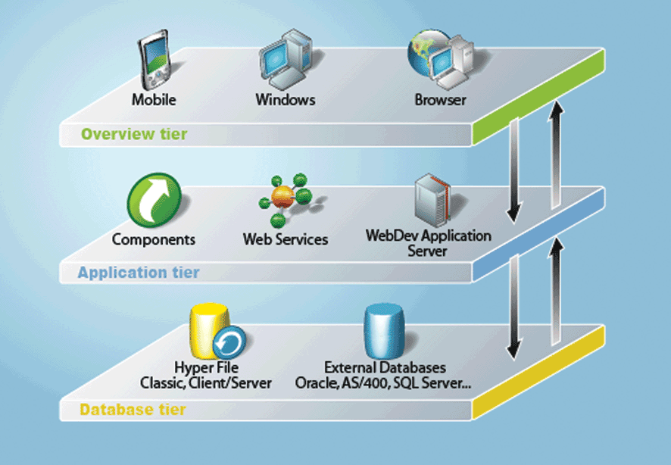
Introduction to Multi-Tiered Architecture

Slide 3
Enterprise Computing
Computing that is distributed across the network.
Support the need to build distributed, transactional, and portable applications that leverage the speed, security, and reliability of server side technology.
J2EE
  Provides a set of tools to design , develop, assemble and deploy platform independent server based applications more quickly.
  Provides a distributed, component based, loosely coupled , reliable and secure, platform independent and responsive application environment.

Slide 4
Enterprise Computing
Challenges Portability Diverse Environments Time-to-market Core Competence Assembly Integration | Key Technologies J2SE™ J2EE™ JMS Servlet JSP Connector XML Data Binding XSLT | Products App Servers Web Servers Components Databases Object to DB tools
 |  | Legacy Systems Databases TP Monitors EIS Systems

Slide 5
Enterprise Applications
Applications designed to solve problems encountered by large enterprises
Used by large corporations, governments, etc.
Useful for even small organizations in an increasingly networked world
Large-scale • Scalable
Reliable • Secure

Slide 6
Multi-tiered Architecture
Functionality of application separated into isolated functional areas called ‘tiers’
3-tiered architecture:
Client tier - client program makes requests to middle tier
Middle tier - handles client requests by processing
application data (business logic – business tier)
Data tier - persistent data store
(database / legacy system / etc.)

Slide 7
Enterprise Applications
PLSQL
Standalone
Web
Mobile
Business
Logic
Tables
Network Communication
Transaction Management
Client Session Management
Database Connectivity
Authentication / Security
Load Balancing
Client
Middle Tier
Database
Pooling / Caching
Failover
In addition to business logic, we have to implement the other middle-tier services (‘middleware’)
Very Complex
Needs technical expertise
Time consuming
Very costly

Slide 8
Enterprise Applications
We don’t worry about these
We do only this
Business
Logic
Network Communication
Client Session Management
Authentication / Security
Pooling / Caching
Transaction Management
Database Connectivity
Load Balancing
JEE
Java Enterprise Edition
Failover

Slide 9
Java Technology
Programming language + platform
3 Platforms of the Java programming language:
  Java Platform, Standard Edition (Java SE)
  Java Platform, Micro Edition (Java ME)
  Java Platform, Enterprise Edition (Java EE)

Slide 10
Java Technology
Java Platform, Standard Edition (Java SE)
“When you think of Java programming language, you think of Java SE”
API
Provides core functionality of Java
Basic types and objects
Input/Output
Networking
Security
GUI development
Database access
XML processing
Development tools,
deployment technologies,
other class libraries
JVM

Slide 11
Java Technology
Java Platform, Micro Edition (Java ME)
API
Cut-down version of Java SE API’s
Basic types and objects
Input/output
Networking
GUI development
Database access
A small footprint JVM

Slide 12
Java Technology
Java Platform, Enterprise Edition (Java EE)
API
For developing and running large-scale,
multi-tiered, scalable, reliable and
secure enterprise applications
Development Model
Runtime environments
(“containers”)
Java EE
API
Provides core functionality of Java
Basic types and objects
Input/Output
Networking
Security
GUI development
Database access
XML processing
Development tools,
deployment technologies,
other class libraries
Java SE
JVM

Slide 13
Multi-tiered Applications
JavaEE Application Server
Web browser
Web application
Business Logic
Database
Standalone Application
Client tier
Middle tier
Data tier

Slide 14
Multi-tiered Applications
JavaEE Application Server
Web browser
Web Container
Web application
Servlets / JSP
EJB Container
Business Logic
EJB’s
Database
Standalone Application
Business Logic
Client tier
Middle tier
Data tier

Slide 15
Distributed Multitiered Applications
The J2EE platform uses a distributed multitiered application model for enterprise applications.
Application logic is divided into components according to function, and the various application components that make up a J2EE application are installed on different machines depending on the tier in the multitiered J2EE environment to which the application component belongs.

Slide 16
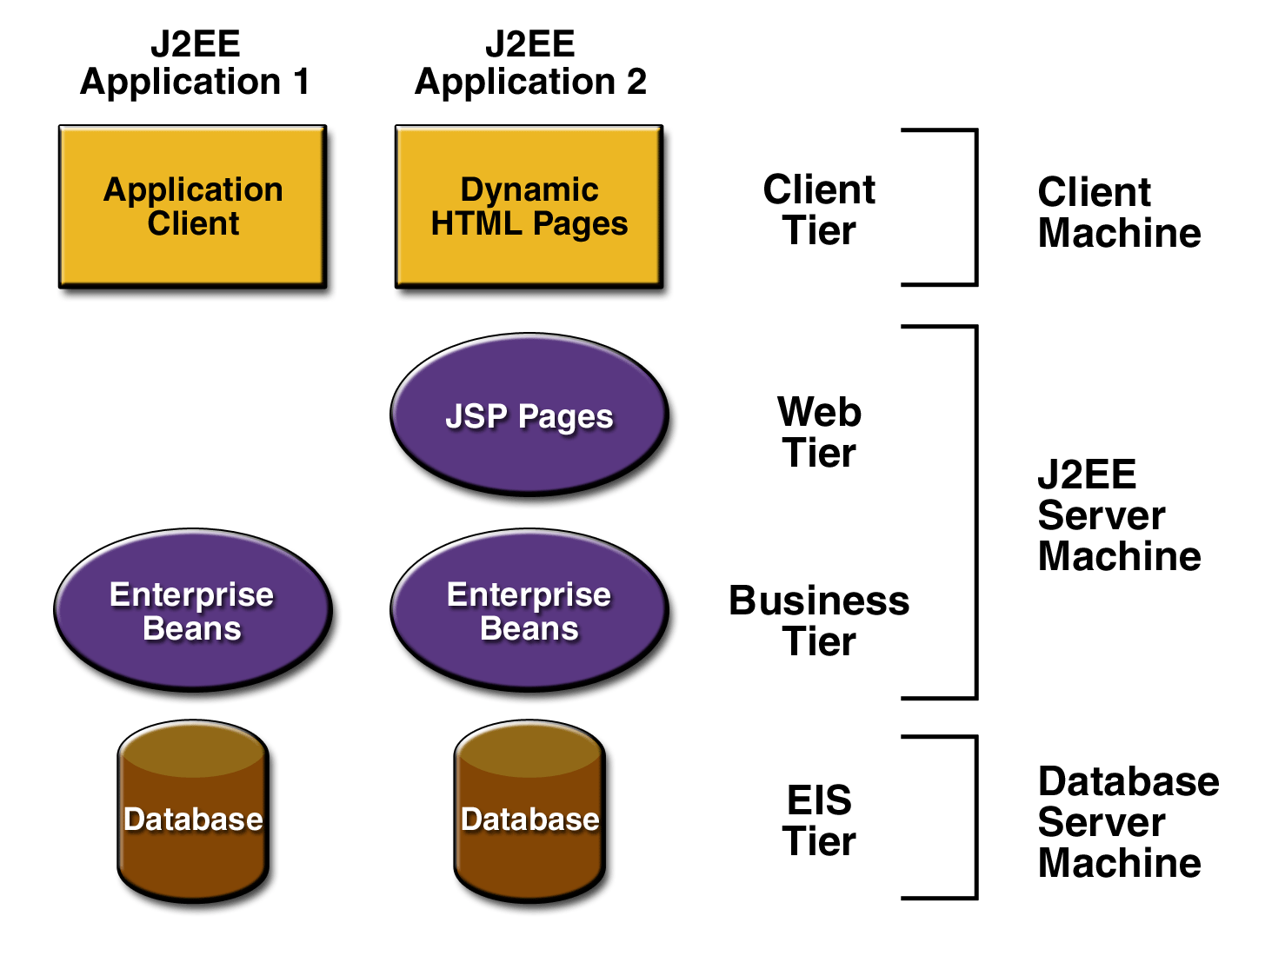
Distributed Multitiered Applications
Client-tier components run on the client machine.
Web-tier components run on the J2EE server.
Business-tier components run on the J2EE server.
Enterprise information system (EIS)-tier software runs on the EIS server.

Slide 17
Security in Multitiered Applications
The Java EE security environment enables security constraints to be defined at deploy time.
Java EE applications are portable to many security implementations .
The Java EE provides
  Standard declarative access control rules that are defined by the developer and interpreted when the application is deployed on the server.
  Standard login mechanism.

Slide 18
Java EE components
J2EE applications are made up of components.
A J2EE component is a ;
Self contained functional software unit that is assembled into a J2EE application with its related classes and files and that communicates with other components.

Slide 19
Java EE components
J2EE components are java classes.
The difference between J2EE components and “Standard” Java classes :
  J2EE components are assembled into a J2EE applications
  Verified to be well formed.
  Should be in compliance with the Java EE specification.
  Are deployed to production, where they are run and managed by the J2EE server.

Slide 20
Components defined in the Java EE Specification
Application clients and applets are components that run on the clients.
Java servlet, JavaServerFaces and Java Server Pages (JSP) technology components are web components that run on the server.
Enterprise Java Beans (EJB™) component are business components that run on the Server.

Slide 21
Java EE Clients
contains various types of markup language (HTML, XML, and so on)
Java EE Clients
Web clients
Dynamic web pages
Web browser
Application Clients
GUIs
created from the Swing or the Abstract Window Toolkit (AWT) API

Slide 22
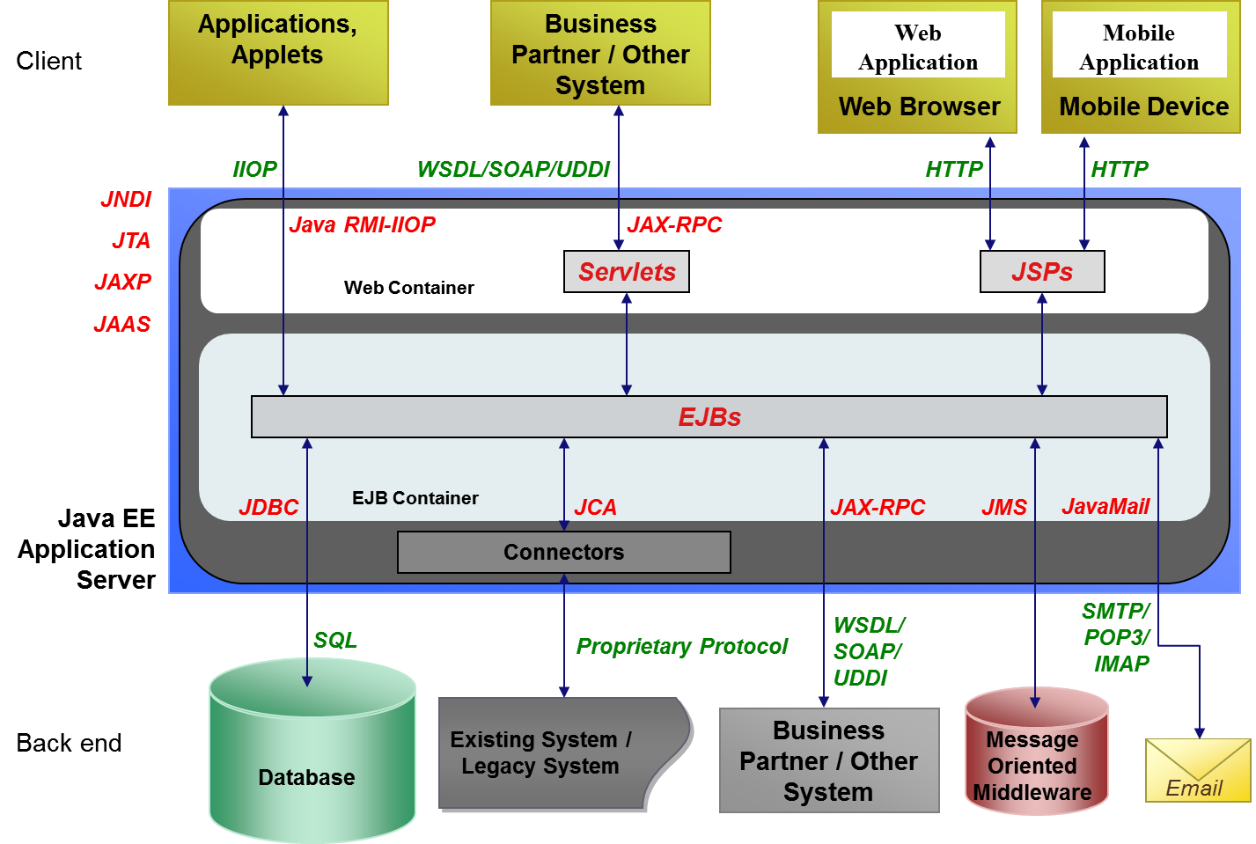
Java EE Application Model + API s

Slide 23


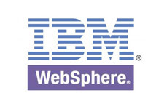
Application Server
“An application server is a server that provides software applications with services such as security, data services, transaction support, load balancing, and management of large distributed Systems”
                Source : Wikipedia
Source : Wikipedia

Slide 24
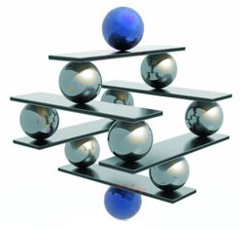
Introduction to SOAP, WSDL & Web Services

Slide 25
What is SOAP
RPC is an obvious and popular paradigm for implementing the client-server model of distributed computing.
Different RPC protocols exist today.
  Sun RPC, DCE/RPC, DCOM, CORBA
Most of the RPC protocols are too low level and certainly not compatible among each other (gateways are needed)
Since RPC represents a compatibility and security problems, firewalls and proxy servers will normally block this kind of traffic.
To address this problem, XML was used to define SOAP.
Soap uses HTTP/SMTP as the communication protocol

Slide 26
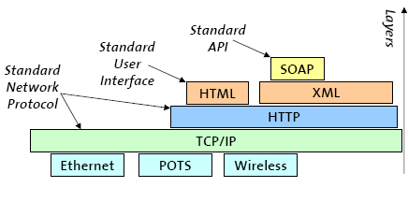
Why is SOAP
XML-based protocol for exchanging information between applications
Primary focus of SOAP is Remote Procedure Calls transported via HTTP
Similar to DCOM, CORBA, and Java RMI, the main difference is that SOAP messages are written entirely in XML
SOAP is therefore uniquely platform and language independent
For example, a SOAP Java client running on Linux or a Perl client running on Solaris can connect to a Microsoft SOAP server running on Windows 2000

Slide 27
How SOAP works
RPC Using HTTP
  At the Client
    Turns the RPC call into a XML document
  Transports the XML data over HTTP (or SMTP) (Client to Server)
  At the Server
    Turns the XML document into a procedure call
    Turns the procedure’s response into a XML document
  Transports the XML data over HTTP (or SMTP) (Server to Client)
  At the Client
    Turns the XML data into the response to the RPC

Slide 28
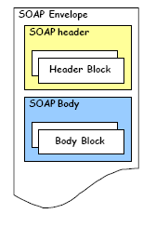
Structure of a SOAP Message
SOAP is based on message exchanges.
Messages are seen as envelopes where the application encloses the data to be sent.
A message has two main parts; header and body, which both can be divided into blocks.
SOAP does not specify what to do in the body, it only states that the header is optional and the body is mandatory.
The use of header and body, however, is implicit. The body is for application level data. The header is for infrastructure level data.

Slide 29
SOAP Header
The header is intended as a generic place holder for information that is not necessarily application dependent (the application may not even be aware that a header was attached to the message).
Typical uses of the header are: coordination information, identifiers (for, e.g.: transactions) and security information (e.g.: certificates)

Slide 30
SOAP Body
The body is intended for the application specific data contained in the message.
Also it may contain a Fault entry Section (for reporting errors in processing a SOAP message)

Slide 31
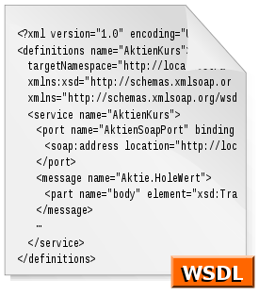
Introduction to WSDL

Slide 32
What is WSDL?
WSDL stands for Web Services Description Language
WSDL is as XML document
WSDL is used to describe Web services
  It specifies the location of the service and the operations (or methods) the service exposes
WSDL is also used to locate Web services

Slide 33
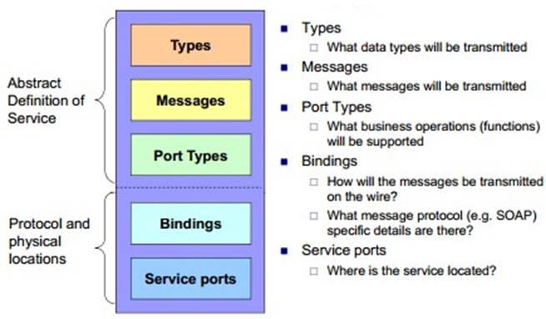
The WSDL Document Structure
A WSDL document describes a web service using these major elements:

Slide 34
WSDL Types
The <types> element defines the data types that are used by the web service.
For maximum platform neutrality, WSDL uses XML Schema syntax to define data types.

Slide 35
WSDL Messages
The <message> element defines the data elements of an operation.
<message name="newTermValues">
<part name="term" type="xs:string"/>
<part name="value" type="xs:string"/>
</message>
Each message can consist of one or more parts. The parts can be compared to the parameters of a function call in a traditional programming language.

Slide 36
WSDL Port
A WSDL port describes the interfaces (legal operations) exposed by a web service.
It defines a web service, the operations that can be performed, and the messages that are involved.
Operation Types
  One-way
  Request-response
  Solicit-response
  Notification

Slide 37
One-Way Operation
<message name="newTermValues">
<part name="term" type="xs:string"/>
<part name="value" type="xs:string"/>
</message>
<portType name="glossaryTerms">
<operation name="setTerm">
<input name="newTerm" message="newTermValues"/>
</operation>
</portType >

Slide 38
Request-Response Operation
<message name="getTermRequest">
<part name="term" type="xs:string"/
</message>
<message name="getTermResponse">
<part name="value" type="xs:string"/>
</message>
<portType name="glossaryTerms">
<operation name="getTerm">
<input message="getTermRequest"/>
<output message="getTermResponse"/>
</operation>
</portType>

Slide 39
WSDL Binding
WSDL bindings defines the message format and protocol details for a web service.
The binding element has two attributes - name and type.
  The name attribute defines the name of the binding, and the type attribute points to the port for the binding.
The soap:binding element has two attributes - style and transport.
The operation element defines each operation that the port exposes
  For each operation the corresponding SOAP action has to be defined. You must also specify how the input and output are encoded. .
Notes:
When you create a WSDL binding that maps a portType's operations to SOAP messages sent over HTTP, you have to specify whether the SOAP messages contain literal or encoded instances of the schema constructs the operations use. If you choose "literal," you are saying that the XML Schema constructs your WSDL definitions refer to are concrete specifications of what will appear in your SOAP message bodies. If you choose "encoded," you are saying that the XML Schema constructs your WSDL definitions refer to are abstract specifications of what will appear in your SOAP message bodies; these can be made concrete by applying the rules defined by SOAP encoding. (The WSDL specification allows other encoding schemes as well, but alternatives are rarely if ever used.)

Slide 40
Question & Answer

