Slide 1
1. Client-tier components run on the client machine.
2. Web-tier components run on the J2EE server.
3. Business-tier components run on the J2EE server.
4. Enterprise information system (EIS)-tier software runs on the EIS server.

Slide 2
1. Service-oriented computing is an emerging cross-disciplinary paradigm for distributed computing, which is changing the way software applications are designed, delivered and consumed.
2. SOA is an architectural style for building software applications that use services available in a network such as the web. It promotes loose coupling between software components so that they can be reused. Applications in SOA are built based on services.
3. Cloud Computing that is distributed across the network' Support the need to build distributed, transactional, and portable applications that leverage the speed, security, and reliability of server side technology'
4. Web Services is a software application identified by a URI' whose interfaces and bindings are capable of being defined, described and discovered as XML artifacts' A Web service supports direction interactions with other software agents using XML based messages exchanged via the Internet based protocols'

Slide 3


Slide 4
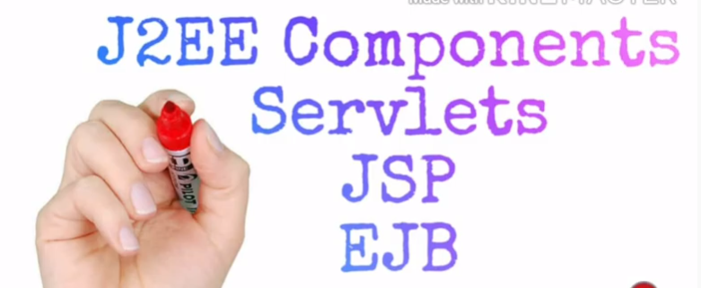

Slide 5
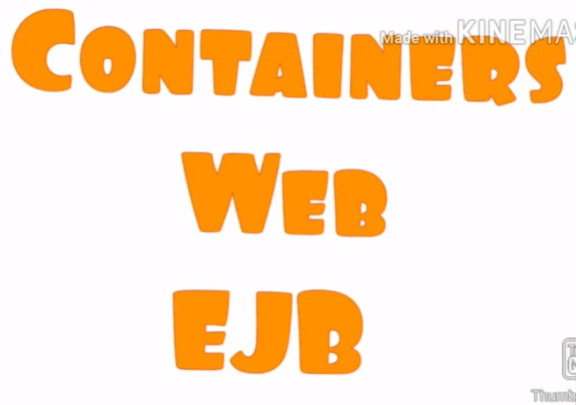

Slide 6


Slide 7
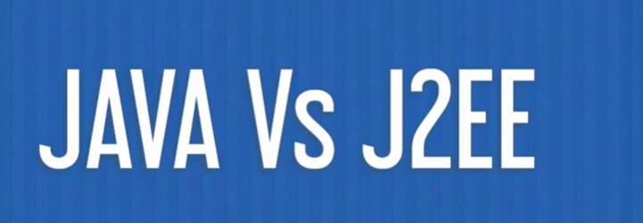

Slide 8
Assignment Title:
You are required to develop knowledge on EA methodology, EA Framework, data model and emerging EA.

