Slide 1
HNDIT2411: Enterprise Architecture
Lecture 3

Slide 2
Programming with concurrency and multithreading

Slide 3
Introduction
Operating systems on single-processor computers create the illusion of concurrent execution by rapidly switching between activities, but on such computers only a single instruction can execute at once.
Java makes concurrency available to you through the language and APIs.
You specify that an application contains separate threads of execution
  each thread has its own method-call stack and program counter
  can execute concurrently with other threads while sharing application wide resources such as memory with them.
This capability is called multithreading.

Slide 4
What is concurrency?
Concurrency is the ability to run several programs or several parts of a program in parallel. If a time consuming task can be performed asynchronously or in parallel, this improve the throughput and the interactivity of the program.
A modern computer has several CPU's or several cores within one CPU. The ability to leverage these multi-cores can be the key for a successful high-volume application.

Slide 5
Multitasking
Process-based
Multitasking
Allows your computer to run two or more programs
concurrently.
Ex: Running Java compiler and the text editor at the same
time
Each process has own variables
Thread-based
Single program performs two or more tasks
simultaneously.
Ex: Text editor formatting text and at the same time it is
printing
Threads share the same data
Process-based multitasking is not under the
control of Java
3

Slide 6
Process
A process runs independently and isolated of other processes.
It cannot directly access shared data in other processes. The resources of the process, e.g. memory and CPU time, are allocated to it via the operating system

Slide 7
Thread
A thread is a so called lightweight process.
It has its own call stack, but can access shared data of other threads in the same process.
Every thread has its own memory cache. If a thread reads shared data it stores this data in its own memory cache.
A thread can re-read the shared data.

Slide 8
Processes vs. Threads
Because threads share address space, it is
relatively simple to communicate between them
(e.g. shared objects)
This can be a danger as well…
Processes have it more difficult - pipes, files,
sockets, etc. are typical ways to do IPC.
Switching between processes is called context-
switching and is relatively expensive compared to
switching between threads inside a process
4

Slide 9
Multithreaded Programming in
Java
Java is the first widely used programming
language to provide support for concurrent
programming at the language level
Java supports concurrency through the use
of threads, and provides mechanisms for
synchronization between threads

Slide 10
The Main Thread
When a Java program starts up, main thread
runs immediately.
Main thread can be controlled through
Thread object.
Thread t = Thread.currentThread();
Thread.sleep (1000);

Slide 11
Using Java Threads
In Java, thread instances come in two
varieties:
java.lang.Thread
Extend the java.lang.Thread class (and
override its run() method)
java.lang.Runnable
Have your class implement the
java.lang.Runnable interface and associate an
instance of your class with java.lang.Thread.
Implement run() method

Slide 12
Using Java Threads
Most important method: run()
The default version of this method does
nothing so it must be overridden.
Should call start() to begin execution of
the new thread.
If you are not overriding any of
Thread’s other methods, can simply
implement runnable.

Slide 13
Example: extending Thread
Public class PrintThread extends Thread {
public static void main( String[] args ) {
PrintThread p = new PrintThread();
p.start();
while(true) { System.out.println( “main”); }
}
public void run() {
while(true) { System.out.println( “thread” ); }
}
}

Slide 14
Example: Runnable interface
Public class PrintRunnableThread implements Runnable {
public static void main(String[] args) {
Thread t = new Thread(new PrintRunnableThread());
t.start();
while(true) { System.out.println(“main”); }
}
public void run() {
while( true ) { System.out.println( “Thread” ); }
}
}

Slide 15
Controlling Threads
Thread.sleep() method puts the current
running thread to pause execution
sleep( long milliseconds )
sleep( long ms, long ns )
A thread that is sleeping can be interrupted, so
you must handle a InterruptedException if
you put a thread to sleep
try {
Thread.sleep( 5000 )
} catch( InterruptedException ie ) {
System.out.println( “Interrupted” );
}

Slide 16
What happens to new threads?
Main thread continues
New threads execute the run method and die
when they are finished
If any thread calls System.exit(0), it will kill all
threads.
Think of each run() as its own main
Program does not exit until all non-daemon
threads die.

Slide 17
Controlling Threads
Thread.yield()method allows other
threads a chance to execute.
The JVM thread scheduler is generally
fair, but in intensive operations a
thread can monopolize. Adding in a
random chance of yielding can improve
fairness.

Slide 18
Thread Ops
isAlive() - Tests if this thread is alive. A thread is
alive if it has been started and has not yet died.
join() - Waits for this thread to die.
Thread.activeCount() - returns number of
active threads
Thread.enumerate() - fills an array with the
currently active threads
Thread.currentThread() - returns the current
thread
Thread.dumpStack() - useful for debugging

Slide 19
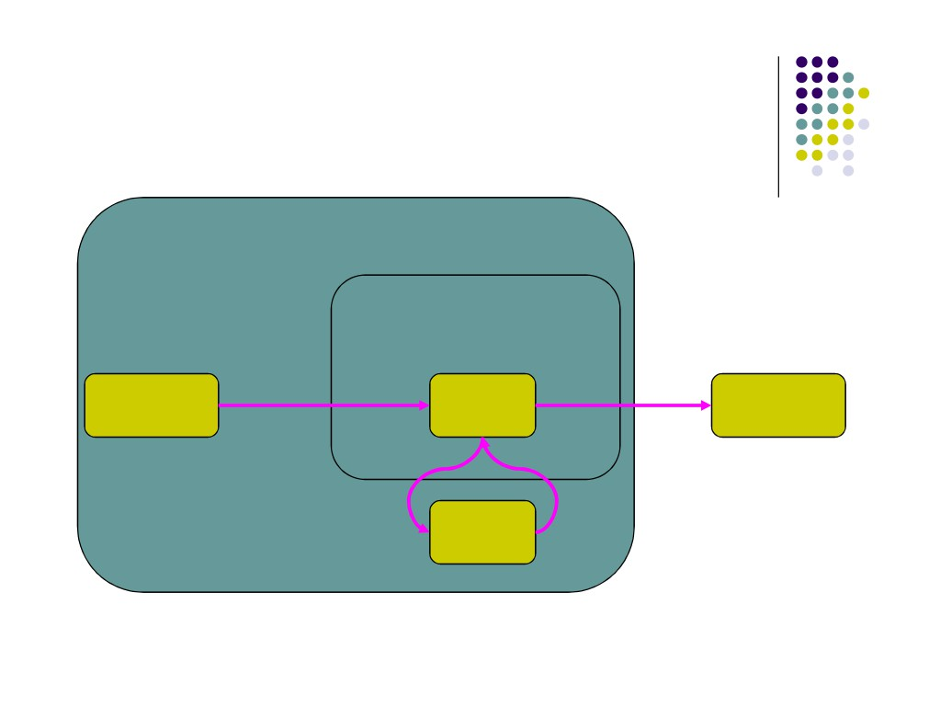
Thread State Diagram
Alive
Running
new CounterThread();
while (…) { … }
Dead Thread
run() method returns
New Thread
Thread.start();
Runnable
Object.wait()
Thread.sleep()
blocking IO call
Blocked
waiting on a monitor

Slide 20
Thread Scheduling
Execution of multiple threads on a single CPU in
some order is called scheduling.
The JRE uses fixed-priority scheduling which schedules
threads on the basis of their priority.
Thread priorities in the range Thread.MIN_PRIORITY and
Thread.MAX_PRIORITY
The chosen thread runs until one of the following conditions is
true:
A higher-priority thread becomes runnable.
The thread yields, or its run method exits.
On systems that support time-slicing, the thread's time
allotment has expired.

Slide 21
Thread Scheduling
Unlike most aspects of Java, Threading does not act
the same on different platforms. Two areas of
difference are Thread scheduling and Thread
priorities. The two approaches to scheduling are
Preemptive
Time slicing
If at any time a thread with a higher priority than all
other Runnable threads becomes Runnable, the
runtime system chooses the new higher-priority
thread for execution. The new thread is said to
preempt the other threads.
thread-scheduling algorithm is preemptive
A thread created from another thread inherits its
priority from the parent thread
Thread.setPriority( int priority )

Slide 22
Example 01
Try the following program out.
Try to understand what happen there.
class Thread01 extends Thread {
int threadID;
public Thread01(int a){
threadID = a;
}
public static void main(String args[]) {
for (int i=1; i<6; i++) {
Thread t = new Thread01(i);
System.out.println("Thread "+i+" created");
t.start();
System.out.println("Thread "+i+" started");
}
System.out.println("Main Thread exit");
}

Slide 23
Example 01 ….
public void run() {
while(true) {
System.out.println("Thread "+threadID+" running");
try
{
Thread.sleep((int)(10000*Math.random()));
}
catch (InterruptedException e){
}
}
}
}

Slide 24
Example 01 ….
The above program create 6 threads. Main Thread and 5 child threads.
When we run the program Main Thread will be created and Main Thread execute the main() method.
Main thread go through a for loop with 5 iterations.
In each iteration Main Thread create a child thread and start it. (create 5 child threads)
Then Main Thread terminate.
Each child Thread executes run() method.
Each child Thread sleep for a random time between 0 and 10 seconds and print that they are running and go to sleep again

Slide 25
Example 02
Try the following program out.
Try to understand what happen there.
public class Thread02 implements Runnable {
public static void main(String[] args) {
Thread t = new Thread(new Thread02());
t.start();
while(true) {
System.out.println(“Main Thread");
try {
Thread.sleep((int)(10000*Math.random()));
}
catch (InterruptedException e){}
}
}

Slide 26
Example 02 ….
public void run() {
while( true ) {
System.out.println( “Child Thread" );
try
{
Thread.sleep((int)(10000*Math.random()));
}
catch (InterruptedException e){}
}
}
}

Slide 27
Example 02 ….
The above program create 2 threads (Main Thread and a child Thread).
Main Thread execute the main() method.
Main Thread create a child Thread and start it.
Then Main thread goes to a never ending loop.
Within the loop Main thread display a message and goes to sleep for a time duration between 0 and 10 seconds.
Child thread executes run() method.
Child thread also goes to a never ending loop.
Within the loop child thread display a message and goes to sleep for a time duration between 0 and 10 seconds.

Slide 28
Example 01 & 02
Example 01 and 02 create thread using 2 ways.
Example 01 extends Thread class and override run() method to create threads.
Example 02 implements Runnable Interface and implements the run() method to create threads.

Slide 29
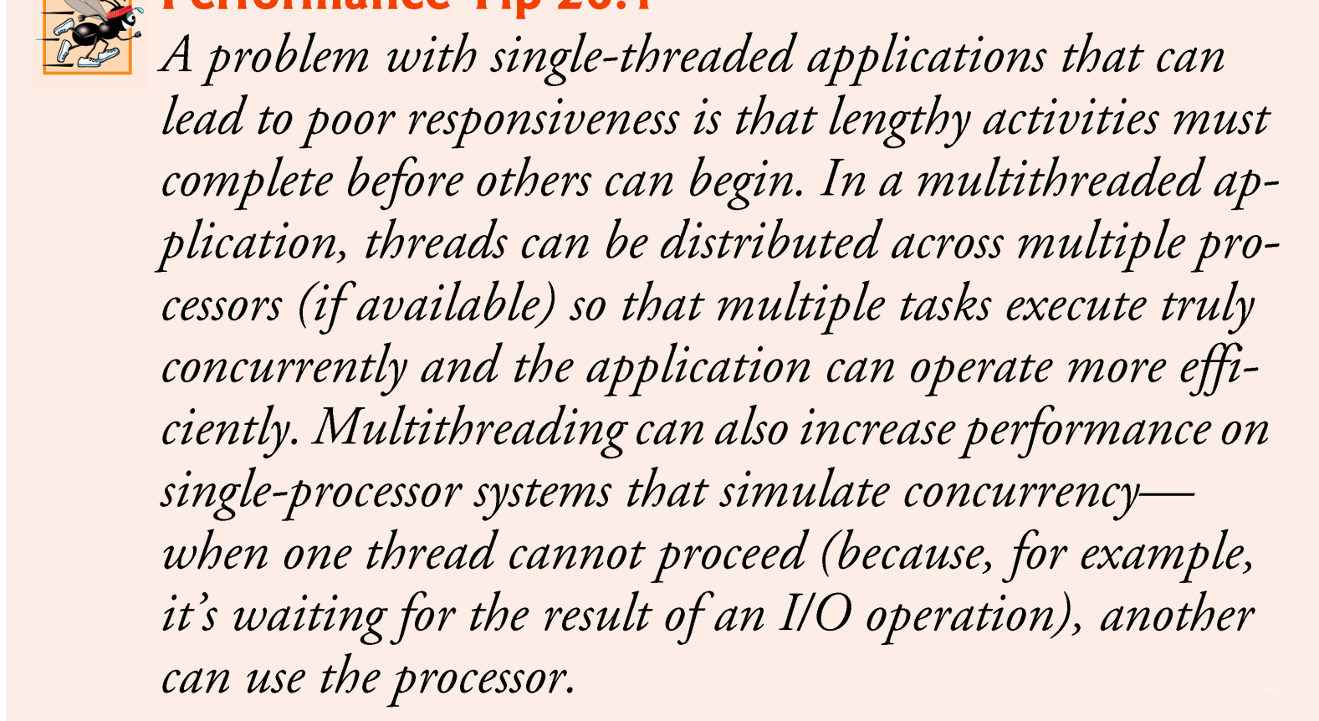
Single –threaded applications

Slide 30
Thread Synchronization
When multiple threads share an object and it is modified by one or more of them, indeterminate results may occur unless access to the shared object is managed properly.
The problem can be solved by giving only one thread at a time exclusive access to code that manipulates the shared object.
  During that time, other threads desiring to manipulate the object are kept waiting.
  When the thread with exclusive access to the object finishes manipulating it, one of the threads that was waiting is allowed to proceed.
This process, called thread synchronization, coordinates access to shared data by multiple concurrent threads.
  Ensures that each thread accessing a shared object excludes all other threads from doing so simultaneously—this is called mutual exclusion.

Slide 31
Thread Synchronization (cont.)
A common way to perform synchronization is to use Java’s built-in monitors.
  Every object has a monitor and a monitor lock (or intrinsic lock).
  Can be held by a maximum of only one thread at any time.
  A thread must acquire the lock before proceeding with the operation.
  Other threads attempting to perform an operation that requires the same lock will be blocked.
To specify that a thread must hold a monitor lock to execute a block of code, the code should be placed in a synchronized statement.
  Said to be guarded by the monitor lock

Slide 32
Thread Synchronization (cont.)
The synchronized statements are declared using the synchronized keyword:
    synchronized ( object )
    {
    statements
    } // end synchronized statement
where object is the object whose monitor lock will be acquired
  object is normally this if it’s the object in which the synchronized statement appears.
When a synchronized statement finishes executing, the object’s monitor lock is released.
Java also allows synchronized methods.

Slide 33
Thank you

