Slide 1
Introduction to Distributed Computing Paradigm and Service-oriented Computing Paradigm
Chapter 1
HNDIT2411: Enterprise Architecture

Slide 2
4.Service-Oriented Computing (SOC)
Service-oriented computing represents a new generation distributed computing platform.
As such, it encompasses many things, including its own design paradigm and design principles, design pattern catalogs, pattern languages, a distinct architectural model, and related concepts, technologies, and frameworks.

Slide 3
Service-Oriented Computing (SOC) ,Cont’
Started in late 1990s. Java and C# are the two major programming languages on which SOC is built.
SOC uses existing services to compose applications. The key to enable pervasive code reuse is the standardization of service interfaces leading to platform-independent code reuse. Incorporated with the Internet and search engines, service discovery is vital to SOC

Slide 4
SOC-Definition
SOC is an emerging cross-disciplinary paradigm for distributed computing that is changing the way software applications are designed, architected, delivered and consumed
SOC is a new computing paradigm that utilizes services as the basic constructs to support the development of rapid, low-cost and easy composition of distributed applications even in heterogeneous environments

Slide 5
Innovation
The major innovation in SOC is the move from the object oriented paradigm to a service oriented one
  Object Oriented:
    Object: stateful
  Service Oriented:
    Service: stateless

Slide 6
Stateful and stateless are adjectives that describe whether a computer or computer program is designed to note and remember one or more preceding events in a given sequence of interactions with a user, another computer or program, a device, or other outside element.
Stateful means the computer or program keeps track of the state of interaction, usually by setting values in a storage field designated for that purpose.
Stateless means there is no record of previous interactions and each interaction request has to be handled based entirely on information that comes with it.
Stateful and stateless are derived from the usage of state as a set of conditions at a moment in time. (Computers are inherently stateful in operation, so these terms are used in the context of a particular set of interactions, not of how computers work in general.)

Slide 7
Object oriented vs Service oriented
Features | Object-oriented computing | Service-oriented computing
Methodology | Application development by identifying tightly coupled classes. Application architecture is hierarchical based on the inheritance relationships. | Application development by identifying loosely coupled services and composing them into executable applications.
Level of abstraction and cooperation | Application development is often delegated to a single team responsible for the entire life cycle of the application. Developers must have knowledge of application domain and programming. | Development is delegated to three independent parties: application builder, service provider, and service broker. Application builders need to understand application logic and may not know how individual services are implemented. Service providers can program but do not have to understand the applications that use their services.
Code sharing and reuse | Code reuse through inheritance of class members and through library functions. Library functions have to be imported at compilation time and are platform dependent. | Code reuse at the service level. Services have standard interfaces and are published on Internet repository. They are platform-independent and can be searched and remotely accessed. Service brokerage enables systematic sharing of services.
Dynamic binding and recomposition | Associating a name to a method at runtime. The method must have been linked to the executable code before the application is deployed. | Binding a service request to a service at runtime. The services can be discovered after the application has been deployed. This feature allows an application to be recomposed at runtime.
System maintenance | Users need to upgrade their software regularly. The application has to be stopped to perform the upgrading. | The service code resides on service providers' computers. Services can be updated without users' involvement.

Slide 8
Who is using SOC?
All major computer corporations, including BEA, IBM, Microsoft, Oracle, HP, SAP, Intel, Cisco, Juniper, SAP, and Sun Microsystems, have moved towards the SOC paradigm
SOC is being adopted by major computer uses, including banks (Web banking services), retailers (Web shopping services), airlines (Web booking services)…

Slide 9
SOC Elements
Service Oriented Architecture
Service Orientation
Service Oriented Solution Logic
Services
Service Compositions
Service Inventory

Slide 10
Service Oriented Architecture - Definition
An architectural style of building software applications that promotes loose coupling between components so that you can reuse them and work within a distributed systems architecture
This architecture has been wide-accepted
Some SOA product has been built by Oracle (SOA Suite), IBM(Websphere), Microsoft(BizTalk)

Slide 11
Business Process
Customer
Supplier
Sales & Marketing Department
Purchasing Department
Inventory (Stores)
Manufacturing

Slide 12
Customer
Supplier
Customer Order
Purchase Order
Delivery
Receipt
Customer
Order
Purchasing
Receipt (Components)
Reservation
Picking
Receipt
Purchase Requisition
Inventory
Receipt (Finish Goods)
Manufacturing
Requisition
Material Issue

Slide 13

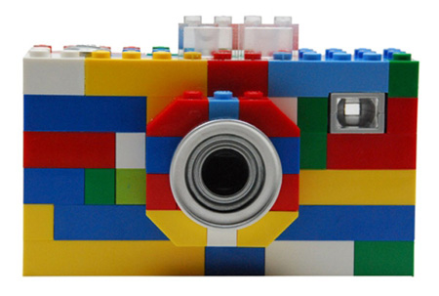
SOA Approach

Slide 14
SOA Approach
Service
Registry
(UDDI)
CRM
Profile
Service 1
Service 2
Service N
Auth
Service
Trans.
Engine
Service Exposure
Set of Atomic Services

Slide 15
Service-Oriented Architecture 1(2)
A SOA is a group of services that communicate with each other.
SOA provides methods for systems development and integration where systems package functionality as interoperable services.
SOA separates functions into distinct units, or services, which developers make accessible over a network in order that users can combine and reuse them in the production of applications.
SOA builds applications out of software services. Services comprise intrinsically unassociated, loosely coupled units of functionality that have no calls to each other embedded in them.

Slide 16
Service-Oriented Architecture 1(2)
Underlying and enabling all of this requires metadata in sufficient detail to describe not only the characteristics of these services, but also the data that drives them.
Programmers have made extensive use of XML in SOA to structure data that they wrap.
WSDL typically describe the services themselves
SOAP describes the communication protocols.

Slide 17
Importance of Service-Oriented Architecture
Web services technology has now advanced so that functionalities available in ERPs and various other systems can easily be published into intranets and internet for remote execution using SOAP, WSDL and UDDI.
SOA, now brings web services implemented using BPM tools.
It makes it possible to automate invocation of web services according to business rules.

Slide 18
Traditional Systems Development vs. SOA
Traditional systems development focused on creating, workflow diagrams, systems flowcharts, process models and then coded in a programming language by hand, manually tested and deployed.
SOA with BPM tools eliminates manual coding and testing. Diagrams are created and then tested for correctness using simulation methods. Verified diagrams are then used to automatically generate XML based BPM language code.
The SOA approach with BPM tools make it very easy to change logic and rules.

Slide 19
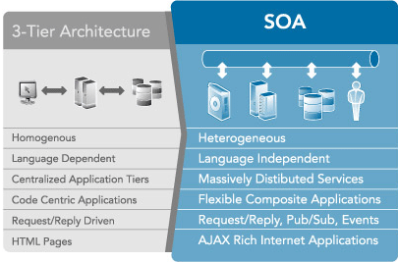
Traditional Systems Development vs. SOA

Slide 20
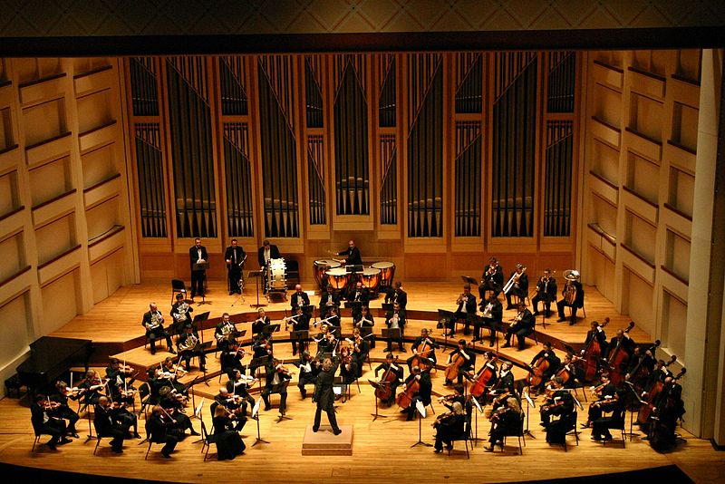
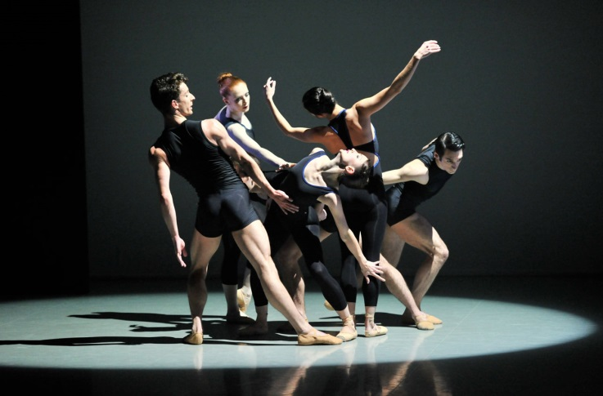
Service Orchestration vs. Service Choreography
Orchestration
  Orchestration or arrangement is the study and practice of arranging music for an orchestra or musical ensemble.
  In practical terms it consists of deciding which instruments should play which notes in a piece of music.
Choreography
  The arrangement and movement of performers onstage; though the term customarily applies to dancers, it is also used to denote the orchestrated movement of actors, especially in stage combat

Slide 21
Service Orchestration vs. Service Choreography
Orchestration == Executable Process
  Web Service Orchestration relates to the execution of specific business processes.
  WS-BPEL is a language for defining processes that can be executed on an orchestration engine.
Choreography == Multi-party Collaboration
  Web Service Choreography relates to describing externally observable interactions between web services.
  WS-CDL is a language for describing multi-party contracts and is somewhat like an extension of WSDL: WSDL describes web services interfaces, WS-CDL describes collaborations between web services.

Slide 22
Web Service Business Process Execution Language (WS-BPEL)
WS-BPEL is an OASIS standard for service orchestration.
BPEL is a comprehensive workflow definition execution language specified in XML.
It can be thought of as a programming language but is more likely to be automatically generated from workflow diagrams.

Slide 23
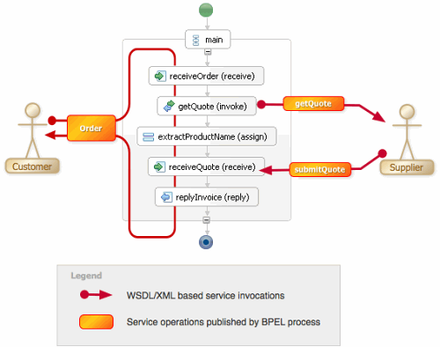
Web Service Business Process Execution Language (WS-BPEL)

Slide 24
BPEL Commands
Following are some commands of BPEL.
  Invoke an operation of a web service. <invoke>
  Wait for an external message. <receive>
  Generate a response for input. <reply>
  Wait for some time. <wait>
  Copy data between locations. <assign>
  Indicate that an error occurred or something went wrong. <throw>
  Terminate the entire service instance. <terminate>
  Define a sequence of steps. <sequence>
  Branch using a case statement. <switch>
  Define a loop. <while>
  Execute one alternative. <pick>
  Execute in parallel. <flow>

Slide 25
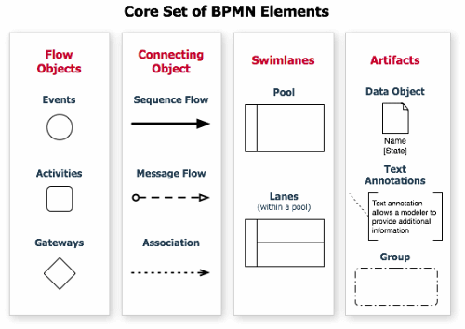
Business Process Management Notation

Slide 26
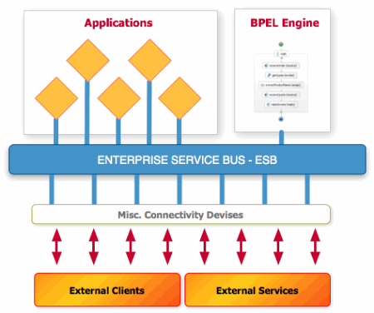
Enterprise Service Bus (ESB)
In computing, an enterprise service bus (ESB) consists of a software architecture construct which provides fundamental services for complex architectures via an event-driven and standards-based (the bus) - Wikipedia

Slide 27
Enterprise Service Bus (ESB)
The idea of an ESB is that many components can connect in a standardized way and then communicate over the bus with any other component.
Standardized (usually WSDL/XML based) messages are exchanged on that bus.
Set of adapters act as gateways between a protocol like e.g. SOAP over HTTP, email, FTP and RMI

Slide 28
Reference
[1] SOA: Principles of Service Design, Thomas Erl, Prentice Hall
[2] Introduction to Service oriented computing, W.T.Tsai & Yinong Chen
[3] Service oriented computing: Key concepts and principles, Michael N. Huhns & Munindar P.Singh

