Slide 1
HNDIT2411
Enterprise Architecture
Principles of distributed
software development

Slide 2
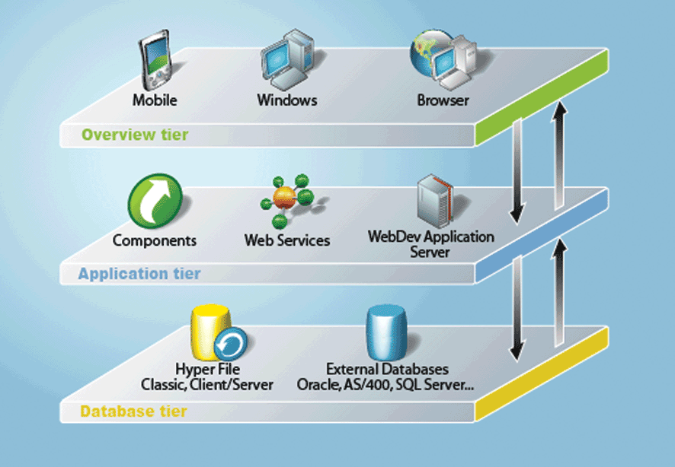
Introduction to Multi-Tiered Architecture

Slide 3
Enterprise Computing
Computing that is distributed across the network.
Support the need to build distributed, transactional, and portable applications that leverage the speed, security, and reliability of server side technology.
J2EE
  Provides a set of tools to design , develop, assemble and deploy platform independent server based applications more quickly.
  Provides a distributed, component based, loosely coupled , reliable and secure, platform independent and responsive application environment.

Slide 4
Enterprise Computing
Challenges Portability Diverse Environments Time-to-market Core Competence Assembly Integration | Key Technologies J2SE™ J2EE™ JMS Servlet JSP Connector XML Data Binding XSLT | Products App Servers Web Servers Components Databases Object to DB tools
 |  | Legacy Systems Databases TP Monitors EIS Systems

Slide 5
Enterprise Applications
Applications designed to solve problems encountered by large enterprises
Used by large corporations, governments, etc.
Useful for even small organizations in an increasingly networked world
Large-scale • Scalable
Reliable • Secure

Slide 6
Multi-tiered Architecture
Functionality of application separated into isolated functional areas called ‘tiers’
3-tiered architecture:
Client tier - client program makes requests to middle tier
Middle tier - handles client requests by processing
application data (business logic – business tier)
Data tier - persistent data store
(database / legacy system / etc.)

Slide 7
Enterprise Applications
PLSQL
Standalone
Web
Mobile
Business
Logic
Tables
Network Communication
Transaction Management
Client Session Management
Database Connectivity
Authentication / Security
Load Balancing
Client
Middle Tier
Database
Pooling / Caching
Failover
In addition to business logic, we have to implement the other middle-tier services (‘middleware’)
Very Complex
Needs technical expertise
Time consuming
Very costly

Slide 8
Enterprise Applications
We don’t worry about these
We do only this
Business
Logic
Network Communication
Client Session Management
Authentication / Security
Pooling / Caching
Transaction Management
Database Connectivity
Java EE
Load Balancing
Failover

Slide 9
Java Technology
Programming language + platform
3 Platforms of the Java programming language:
  Java Platform, Standard Edition (Java SE)
  Java Platform, Micro Edition (Java ME)
  Java Platform, Enterprise Edition (Java EE)

Slide 10
Java Technology
Java Platform, Standard Edition (Java SE)
“When you think of Java programming language, you think of Java SE”
API
Provides core functionality of Java
Basic types and objects
Input/Output
Networking
Security
GUI development
Database access
XML processing
Development tools,
deployment technologies,
other class libraries
JVM

Slide 11
Java Technology
Java Platform, Micro Edition (Java ME)
API
Cut-down version of Java SE API’s
Basic types and objects
Input/Output
Networking
GUI development
Database access
A small footprint JVM

Slide 12
Java Technology
Java Platform, Enterprise Edition (Java EE)
API
For developing and running large-scale,
multi-tiered, scalable, reliable and
secure enterprise applications
Development Model
Runtime environments
(“containers”)
Java EE
API
Provides core functionality of Java
Basic types and objects
Input/Output
Networking
Security
GUI development
Database access
XML processing
Development tools,
deployment technologies,
other class libraries
Java SE
JVM

Slide 13
Multi-tiered Applications
JavaEE Application Server
Web browser
Web application
Business Logic
Database
Standalone Application
Client tier
Middle tier
Data tier

Slide 14
Multi-tiered Applications
JavaEE Application Server
Web browser
Web Container
Web application
Servlets / JSP
EJB Container
Business Logic
EJB’s
Database
Standalone Application
Business Logic
Client tier
Middle tier
Data tier

Slide 15
Distributed Multitiered Applications
The J2EE platform uses a distributed multitiered application model for enterprise applications.
Application logic is divided into components according to function, and the various application components that make up a J2EE application are installed on different machines depending on the tier in the multitiered J2EE environment to which the application component belongs.

Slide 16
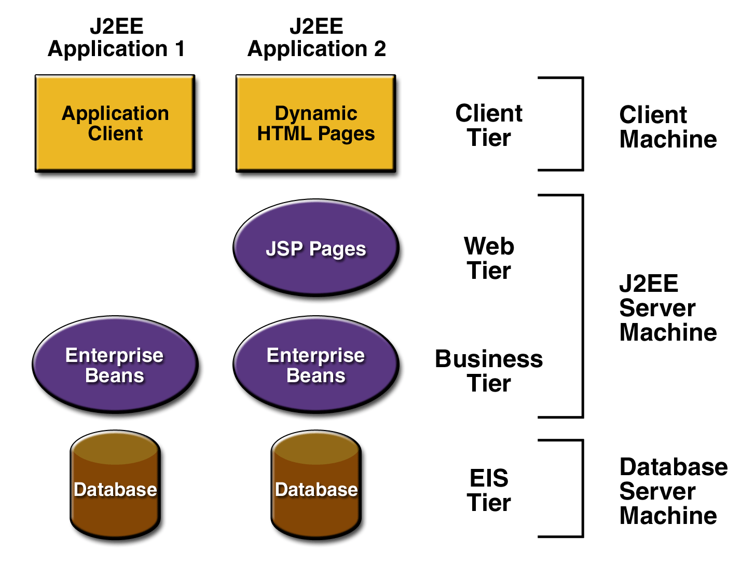
Distributed Multitiered Applications
Client-tier components run on the client machine.
Web-tier components run on the J2EE server.
Business-tier components run on the J2EE server.
Enterprise information system (EIS)-tier software runs on the EIS server.

Slide 17
Security in Multitiered Applications
The Java EE security environment enables security constraints to be defined at deploy time.
Java EE applications are portable to many security implementations .
The Java EE provides
  Standard declarative access control rules that are defined by the developer and interpreted when the application is deployed on the server.
  Standard login mechanism.

