Slide 1
HNDIT2411
Enterprise Architecture
Principles of distributed
software development

Slide 2
Java EE components
J2EE components are java classes.
The difference between J2EE components and “Standard” Java classes :
  J2EE components are assembled into a J2EE applications
  Verified to be well formed.
  Should be in compliance with the Java EE specification.
  Are deployed to production, where they are run and managed by the J2EE server.

Slide 3
Components defined in the Java EE Specification
Application clients and applets are components that run on the clients.
Java servlet, JavaServerFaces and Java Server Pages (JSP) technology components are web components that run on the server.
Enterprise Java Beans (EJB™) component are business components that run on the Server.

Slide 4
Java EE Clients
contains various types of markup language (HTML, XML, and so on)
Java EE Clients
Web clients
Dynamic web pages
Web browser
Application Clients
GUIs
created from the Swing or the Abstract Window Toolkit (AWT) API

Slide 5
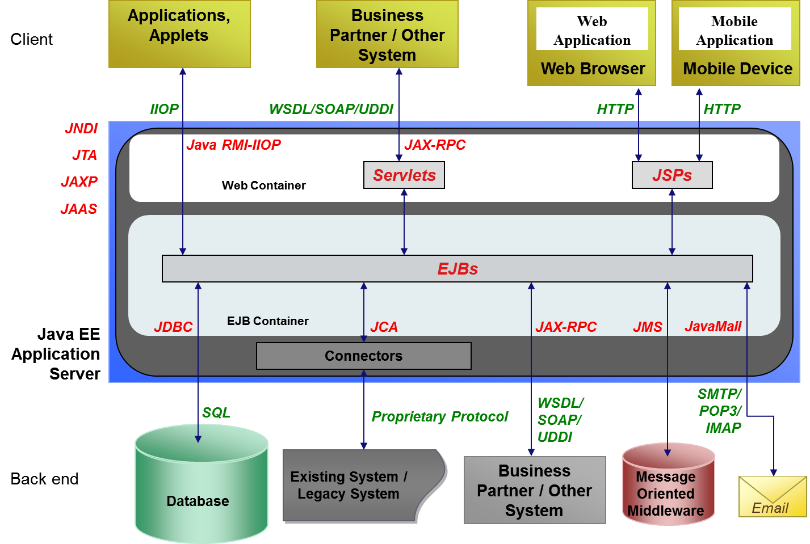
Java EE Application Model + API s

Slide 6


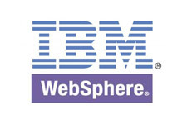
Application Server
“An application server is a server that provides software applications with services such as security, data services, transaction support, load balancing, and management of large distributed Systems”
                Source : Wikipedia
Source : Wikipedia

Slide 7
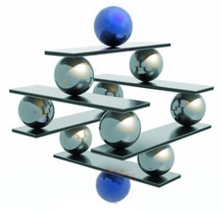
Introduction to SOAP, WSDL & Web Services

Slide 8
What is SOAP
RPC is an obvious and popular paradigm for implementing the client-server model of distributed computing.
Different RPC protocols exist today.
  Sun RPC, DCE/RPC, DCOM, CORBA
Most of the RPC protocols are too low level and certainly not compatible among each other (gateways are needed)
Since RPC represents a compatibility and security problems, firewalls and proxy servers will normally block this kind of traffic.
To address this problem, XML was used to define SOAP.
Soap uses HTTP/SMTP as the communication protocol

Slide 9
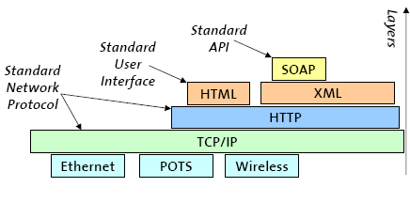
Why is SOAP
XML-based protocol for exchanging information between applications
Primary focus of SOAP is Remote Procedure Calls transported via HTTP
Similar to DCOM, CORBA, and Java RMI, the main difference is that SOAP messages are written entirely in XML
SOAP is therefore uniquely platform and language independent
For example, a SOAP Java client running on Linux or a Perl client running on Solaris can connect to a Microsoft SOAP server running on Windows 2000

Slide 10
How SOAP works
RPC Using HTTP
  At the Client
    Turns the RPC call into a XML document
  Transports the XML data over HTTP (or SMTP) (Client to Server)
  At the Server
    Turns the XML document into a procedure call
    Turns the procedure’s response into a XML document
  Transports the XML data over HTTP (or SMTP) (Server to Client)
  At the Client
    Turns the XML data into the response to the RPC

Slide 11
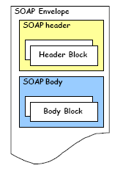
Structure of a SOAP Message
SOAP is based on message exchanges.
Messages are seen as envelopes where the application encloses the data to be sent.
A message has two main parts; header and body, which both can be divided into blocks.
SOAP does not specify what to do in the body, it only states that the header is optional and the body is mandatory.
The use of header and body, however, is implicit. The body is for application level data. The header is for infrastructure level data.

Slide 12
SOAP Header
The header is intended as a generic place holder for information that is not necessarily application dependent (the application may not even be aware that a header was attached to the message).
Typical uses of the header are: coordination information, identifiers (for, e.g.: transactions) and security information (e.g.: certificates)

Slide 13
SOAP Body
The body is intended for the application specific data contained in the message.
Also it may contain a Fault entry Section (for reporting errors in processing a SOAP message)

Slide 14
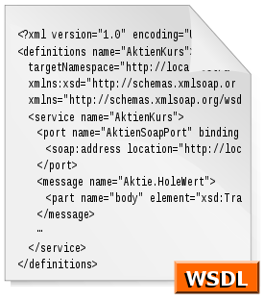
Introduction to WSDL

Slide 15
What is WSDL?
WSDL stands for Web Services Description Language
WSDL is as XML document
WSDL is used to describe Web services
  It specifies the location of the service and the operations (or methods) the service exposes
WSDL is also used to locate Web services

Slide 16
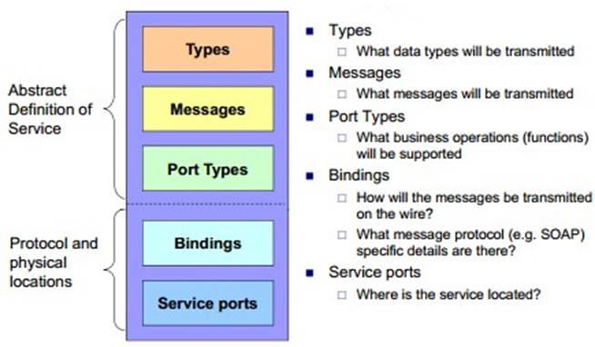
The WSDL Document Structure
A WSDL document describes a web service using these major elements:

Slide 17
WSDL Types
The <types> element defines the data types that are used by the web service.
For maximum platform neutrality, WSDL uses XML Schema syntax to define data types.

Slide 18
WSDL Messages
The <message> element defines the data elements of an operation.
<message name="newTermValues">
<part name="term" type="xs:string"/>
<part name="value" type="xs:string"/>
</message>
Each message can consist of one or more parts. The parts can be compared to the parameters of a function call in a traditional programming language.

Slide 19
WSDL Port
A WSDL port describes the interfaces (legal operations) exposed by a web service.
It defines a web service, the operations that can be performed, and the messages that are involved.
Operation Types
  One-way
  Request-response
  Solicit-response
  Notification

Slide 20
One-Way Operation
<message name="newTermValues">
<part name="term" type="xs:string"/>
<part name="value" type="xs:string"/>
</message>
<portType name="glossaryTerms">
<operation name="setTerm">
<input name="newTerm" message="newTermValues"/>
</operation>
</portType >

Slide 21
Request-Response Operation
<message name="getTermRequest">
<part name="term" type="xs:string"/
</message>
<message name="getTermResponse">
<part name="value" type="xs:string"/>
</message>
<portType name="glossaryTerms">
<operation name="getTerm">
<input message="getTermRequest"/>
<output message="getTermResponse"/>
</operation>
</portType>

Slide 22
WSDL Binding
WSDL bindings defines the message format and protocol details for a web service.
The binding element has two attributes - name and type.
  The name attribute defines the name of the binding, and the type attribute points to the port for the binding.
The soap:binding element has two attributes - style and transport.
The operation element defines each operation that the port exposes
  For each operation the corresponding SOAP action has to be defined. You must also specify how the input and output are encoded. .
Notes:
When you create a WSDL binding that maps a portType's operations to SOAP messages sent over HTTP, you have to specify whether the SOAP messages contain literal or encoded instances of the schema constructs the operations use. If you choose "literal," you are saying that the XML Schema constructs your WSDL definitions refer to are concrete specifications of what will appear in your SOAP message bodies. If you choose "encoded," you are saying that the XML Schema constructs your WSDL definitions refer to are abstract specifications of what will appear in your SOAP message bodies; these can be made concrete by applying the rules defined by SOAP encoding. (The WSDL specification allows other encoding schemes as well, but alternatives are rarely if ever used.)

