Slide 1

HNDIT2411: Enterprise Architecture
Web-based application development and state management

Slide 2
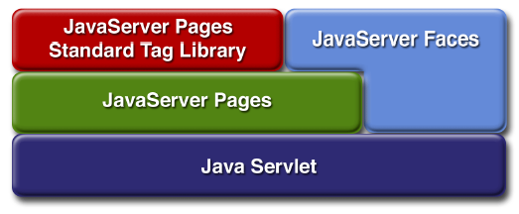
Web Applications
web application (sometimes shortened to web app) is a collection of.
  Servlets
  Java server pages (JSPS)
  HTML documents
  Images
  Templates, and other web resources
that are set up in such a way as to be portable deployed across any servlet-enabled web server.
i.e. All the files under
server_root/webapps/ROOT belong to a single web application (the root one)

Slide 3
Web Modules
In the J2EE architecture, web components and static web content files such as images are called web resources.
A web module is specification. In addition to web components and web resources, a web module can contain other files: the smallest deployable and usable unit of web resources.
A J2EE web module corresponds to a web application as defined in the Java Servlet

Slide 4
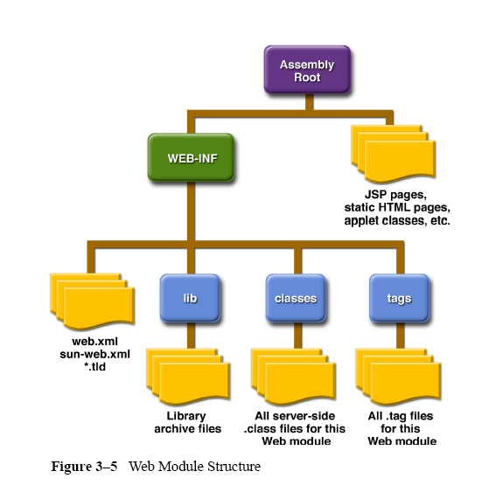
Web Modules
A web module has a specific structure. The top-level directory of a web module is the document root of the application. The document root is where JSP pages, client-side classes and archives, and static web resources, such as images, are stored.
The document root contains a subdirectory named /WEB-INF/, which contains the following files and directories:
• web.xml: The web application deployment descriptor
• Tag library descriptor files
• classes: A directory that contains server-side classes: servlets, utility classes, and JavaBeans components
• tags: A directory that contains tag files, which are implementations of tag libraries
• lib: A directory that contains JAR archives of libraries called by server side classes

Slide 5
The WEB-INF Directory
The WEB-INF directory is special. The files inside WEB-INF are not served directly to the client, instead, they contain java classes and configuration information for the web app
The WEB-INF/classes directory contains the class files for this web app’s servlets and support classes.
WEB-INF/lib contains classes stored in JAR files.

Slide 6
The Development Descriptor
The web.xml file in the WEB –INF directory is known as a deployment descriptor.
This file contains configuration information about the web app in which it resides. It’s an XML file with a standardized DTD.
Everything between <web-app>and </web-app>, provide information to the server about this web application.
Tags in a web.xml are order dependent. For example, the <servlet-class> to ensure everything work.

Slide 7
Web App Deployment
Packaged web apps are archived into one file (.war file) and deployed on servlet containers.
Since the file structure is pre-agreed among the vendors, the effort required to port web app running on the servlet container of one vender to another is minimal.
However, if you use vendor specific extensions in the web app development, porting would not be so easy.

Slide 8
Web Archives (wars)
To simplify deployment, web app files can be bundled in to a single archive file and developed to another server merely by placing the archive file in to a specific directory.
These archive files files have the extension, war. Which stands for web application archive.
WAR files are actually JAR files (creted using the jar utility) saved with an alternate extension.

Slide 9
Servlet - Definition
A servlet is a Java programming language class used to extend the capabilities of servers that host applications accessed via a request-response programming model.
They can be loaded dynamically into and run by a special web server
This servlet-aware web server, is known as servlet container
Servlets interact with clients via a request-response model based on HTTP
Therefore, a servlet container must support HTTP as the protocol for client requests and server responses
The javax.servlet and javax.servlet.http packages provide interfaces and classes for writing servlets.
All servlets must implement the Servlet interface, which defines life-cycle methods.

Slide 10
Servlet Container Architecture
HTTP Request
Servlet
Container
Servlet
Browser
HTTP
Server
HTTP Response
Static
Content

Slide 11
How Servlet Works
is servlet
loaded?
Receive
Request
No
Yes
is servlet
current?
No
Load Servlet
Yes
Send
Response
Process Request

Slide 12
Servlet API
Every servlet must implement javax.servlet.Servlet interface
Most servlets implement the interface by extending one of these classes
  javax.servlet.GenericServlet
  javax.servlet.http.HttpServlet
The API provides support in four categories :
  Servlet lifecycle management.
  Access to the servlet context.
  Utility classes.
  HTTP – specific support classes.

Slide 13
Servlet API
  javax.servlet. GenericServlet
    A generic Servlet should override its service() method to handle requests as appropriate for the Servlet.
    The service() method accepts two parametes :
      A request object and
      A response object
  javax.servlet. http.HttpServlet
    An HTTP Servlet does not override the service() method. Instead , it overrides doGet() to handle GET requests and doPost() to handle POST request.
    The service method of HttpServlet handles the setup and dispatching to all the doXxx() methods, which is why it usually should not be overridden.
    An HTTP servlet can also override doPut() , doDelete() requests.However , HTTP servlet usually don’t override doTrace() or doOptions() methods as the default implementations are almost sufficient.

Slide 14
Generic Servlet Vs. HTTP Servlet
GenericServlet
Client
request
Server
service ( )
response
HTTPServlet
Browser
request
doGet()
HTTP Server
service ( )
response
doPost()

Slide 15
Interface javax.servlet.Servlet
The Servlet interface defines methods
  to initialize a servlet
  to receive and respond to client requests
  to destroy a servlet and its resources
  to destroy a servlet and its resources
  to return basic information about itself, such as its author, version and copyright
  Developers need to directly implement this interface only if their servlets cannot (or choose not to) inherit from GenericServlet or HttpServlet.

Slide 16
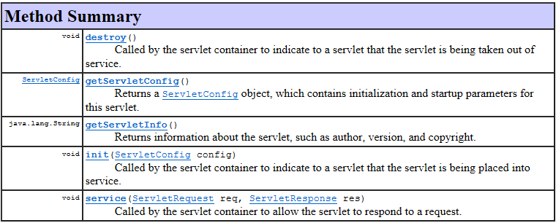
Generic Servlet - Methods

Slide 17
Servlet Functions
Act as a middle-tier process
Act as proxies to client process such as Applets.
Protocol Support- Any protocol that follows a request/response computing model can be implemented by a servlet. This could include : HTTP , SMTP, POP, FTP , etc.

Slide 18
Characteristics of Servlets
Servlets are efficient
Servlets are portable
Servlets are robust
Servlets are persistence

Slide 19
Servlet Container
Servlets run inside a special container called the servlet container as part of the same process as the web server itself.
The servlet container is responsible for initializing , invoking, and destroying each servlet instance.
Three primary tasks of the servlet container :
  Creating the Request Object.
  Creating the Response Object.
  Invoking the service method of the servlet, passing the request and response objects.

Slide 20
Servlet Life Cycle
Initialization
init()
Service
service()
doGet()
doPost()
doDelete()
doHead()
doTrace()
doOptions()
Concurrent
Threads
of Execution
Destruction
destroy()

Slide 21
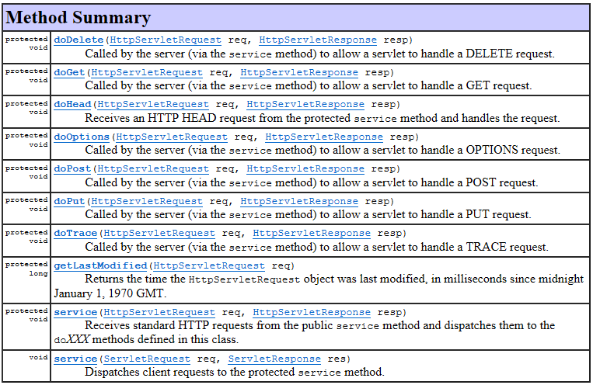
HTTPServlet - Methods

Slide 22
Servlet Request Objects
Provides client request information to a servlet
The servlet container creates a servlet request object and passes it as an argument to the servlet's service method
The ServletRequest interface define methods to retrieve data sent as client request:
  Parameter name and values
  Attributes
  Input stream
  HTTPServletRequest extends the ServletRequest interface to provide request information for HTTP servlets

Slide 23
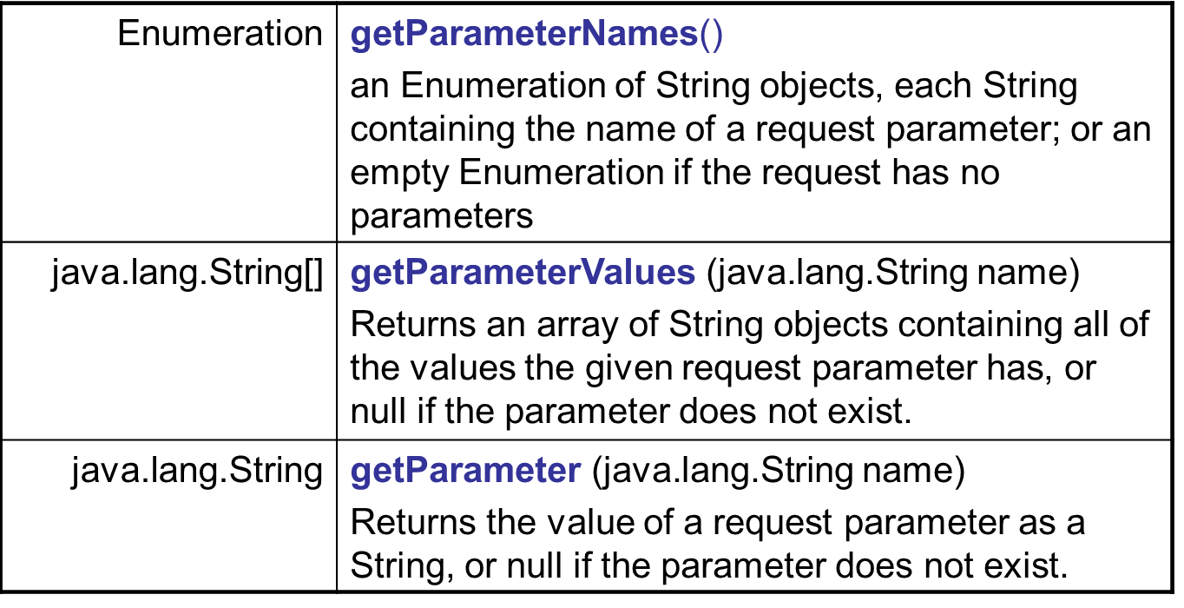
HTTPServletRequest - Methods

Slide 24
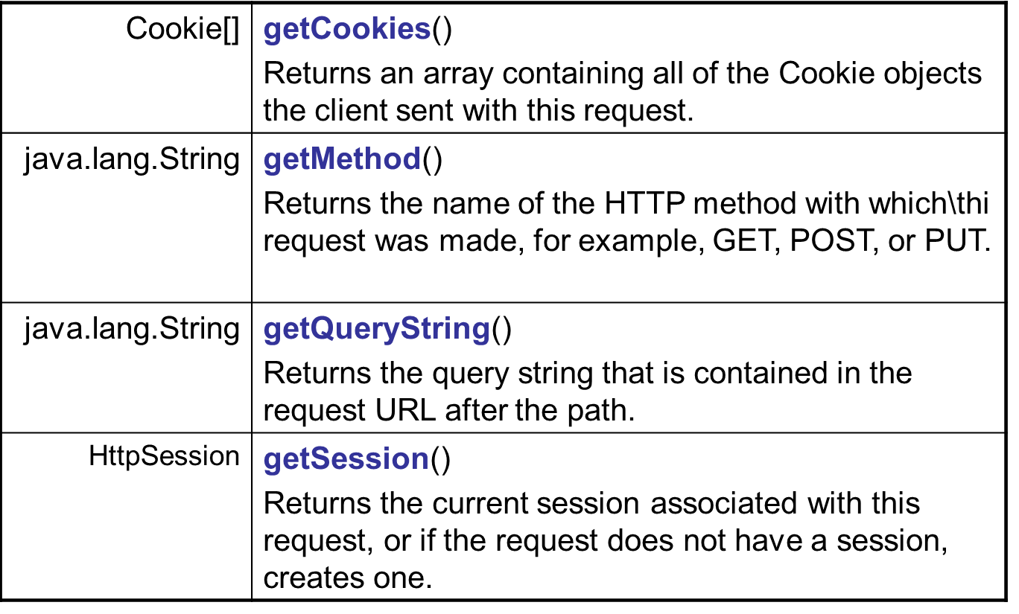
HTTPServletRequest - Methods

Slide 25
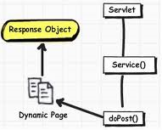
Servlet Response Objects
Defines an object to assist a servlet in sending a response to the client
The servlet container creates a ServletResponse object and passes it as an argument to the servlet's service method

Slide 26
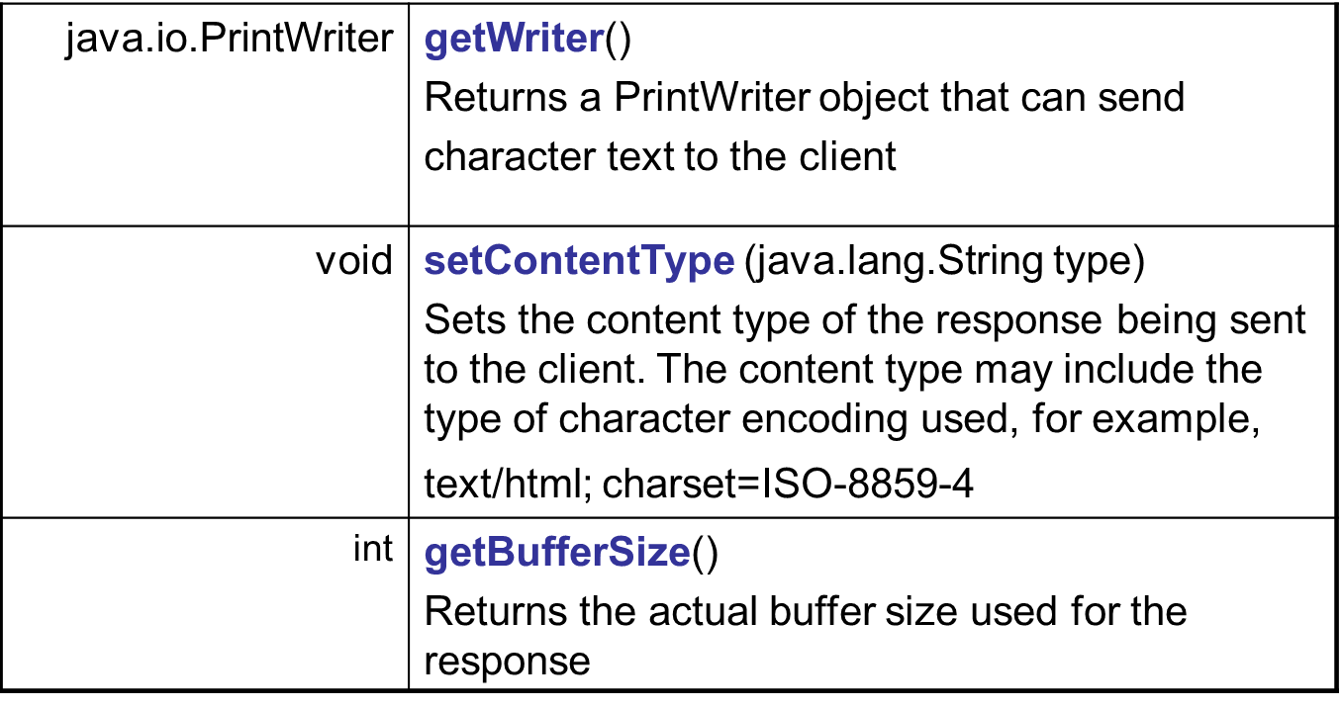
HttpServletResponse - Methods

Slide 27
Write the Servlet Code
Servlets implement the javax.servlet.Servlet interface
Because most servlets extend web servers that use the HTTP protocol to interact with clients, the most common way to develop servlets is by specializing the javax.servlet.http.HttpServlet class
The HttpServlet class implements the Servlet interface by extending the GenericServlet base class, and provides a framework for handling the HTTP protocol.
Its service() method supports standard HTTP requests by dispatching each request to a method designed to handle it.

Slide 28
Step by step servlet Designing
Import packages which contain classes that are use by servlet
Declare the servlet class which extends javax.servlet.http.HTTPServlet.
Over ride HTTPServlet doGet (), doPost()
In doGet() or doPost() use set contentType () of the HTTPServlet response object to set the contain type of the response that we are going to send. All response headers must be set before a PrintWriter is requested to write body data to the response.
Now obtain a PrintWriter object from ServletResponse
PrintWriter out=res.getWriter ();
Use the PrintWriter to write a text or text/html→ eg: out.printIn(“Hello”);
Close the PrintWriter after finishing writing to it. The web server closes the PrintWriter automatically when the service called return. An explicit call is done when you want to do some post processing after the response to the client has been fully written. → out.close ();
If you wish to give some information like the servlet name, version, author, & copyright notice etc, over ride the getServletInfo() which is suppose to return information about the servlet.

Slide 29
Servlet Example
1: import java.io.*;
2: import javax.servlet.*;
3: import javax.servlet.http.*;
4: public class MyServlet extends HttpServlet{
5: protected void doGet(HttpServletRequest req,HttpServletResponse res){
6: res.setContentType("text/html");
7: PrintWriter out = res.getWriter();
8: out.println( "<HTML><HEAD><TITLE> Hello You!” +
9: “</Title></HEAD>” +
10: “<Body> Hello You!!!</BODY></HTML>“);
11: out.close();
12: }
13: public String getServletInfo(){
14: return "MyServlet version 1“;
15: }
16: }

Slide 30
An Example Servlet
Lines 1 to 3 import some packages which contain many classes which are used by the Servlet (almost every Servlet needs classes from these packages)
1: import java.io.*;
2: import javax.servlet.*;
3: import javax.servlet.http.*;
The Servlet class is declared in line 4. Our Servlet extends javax.servlet.http.HttpServlet, the standard base class for HTTP Servlets
4: public class MyServlet extends HttpServlet{
5: protected void doGet(HttpServletRequest req,
HttpServletResponse res)
.. ...
12: }
In lines 5 through 12 HttpServlet's doGet method is getting overridden

Slide 31
An Example Servlet
In line 6 we use a method of the HttpServletResponse object to set the content type of the response that we are going to send.
All response headers must be set before a PrintWriter or ServletOutputStream is requested to write body data to the response.
6: res.setContentType("text/html");
In line 7 we request a PrintWriter object to write text to the response message.
7: PrintWriter out = res.getWriter();
In lines 8, 9 and 10 we use the PrintWriter to write the text of type text/html (as specified through the content type).
8: out.println( "<HTML><HEAD><TITLE> Hello You!” +
9: “</Title></HEAD>” +
10: “<Body> HelloYou!!!</BODY></HTML>“);

Slide 32
An Example Servlet
The PrintWriter gets closed in line 15 when we are finished writing to it.
11: out.close();
In lines 18 through 21 we override the getServletInfo() method which is supposed to return information about the Servlet, e.g. the Servlet name, version, author and copyright notice.
This is not required for the function of the HelloClientServlet but can provide valuable information to the user of a Servlet who sees the returned text in the administration tool of the Web Server.
13: public String getServletInfo(){
14: return "MyServlet version 1“;
15: }

Slide 33
Compile the Servlet
Compile the Servlet class
The resulting MyServlet.class file should go under myApp/WEB-INF/classes

Slide 34
Deploy the Servlet
In the Servlet container each application is represented by a servlet context
each servlet context is identified by a unique path prefix called context path
  For example our application is identified by /myApp which is a directory under webapps
The remaining path is used in the selected context to find the specific Servlet to run, following the rules specified in the deployment descriptor

Slide 35
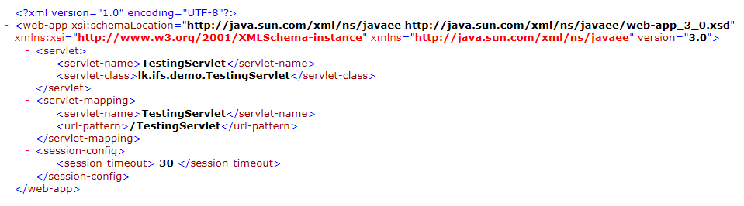
Deployment Descriptor
The deployment descriptor is a XML file called web.xml that resides in the WEB-INF directory within an application.

Slide 36
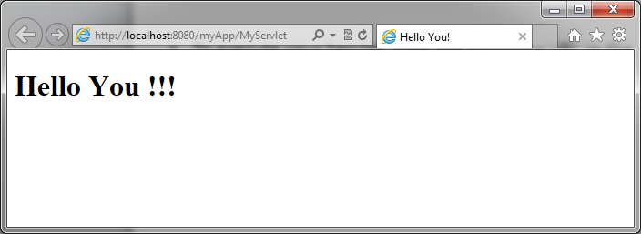
Run the Servlet
To execute your Servlet, type the following URL in the Browser’s address field:
  http://localhost:8080/myApp/MyServlet

Slide 37
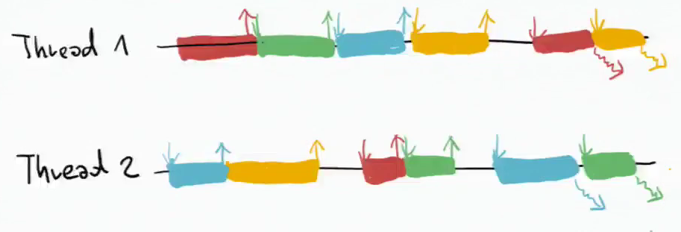
Running service() on a single thread
By default, servlets written by specializing the HttpServlet class can have multiple threads concurrently running its service() method.
If you would like to have only a single thread running a service method at a time, then your servlet should also implement the SingleThreadModel interface.
  This does not involve writing any extra methods, merely declaring that the servlet implements the interface.

Slide 38
Example
public class SurveyServlet extends HttpServlet implements SingleThreadModel
{
/* typical servlet code, with no threading concerns
* in the service method. No extra code for the
* SingleThreadModel interface. */
...
}

