Slide 1
Servlet

Slide 2
Java servlets
server-side programs (running inside a web server) that handle clients' requests and return a customized or dynamic response for each request.
The dynamic response could be based on user's input (e.g., search, online shopping, online transaction) with data retrieved from databases or other applications, or time-sensitive data (such as news and stock prices).
Java servlets typically run on the HTTP protocol. HTTP is an asymmetrical request-response protocol.
The client sends a request message to the server, and the server returns a response message as illustrated.

Slide 3
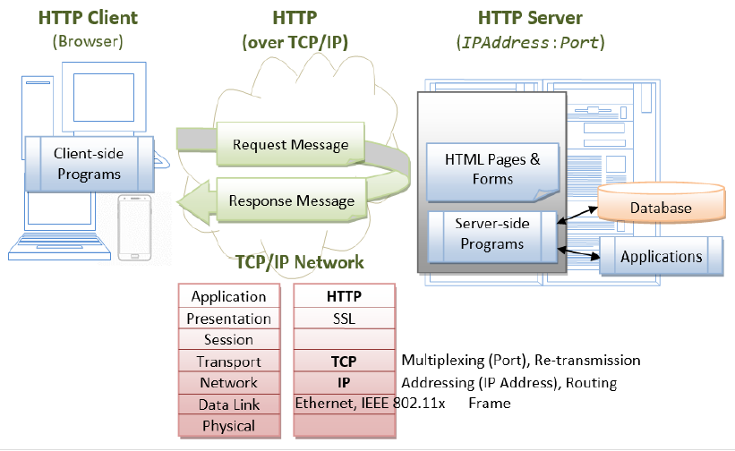

Slide 4
Server-Side Technologies
There are many (competing) server-side technologies available: Java-based (servlet, JSP, JSF, Struts, Spring, Hibernate), ASP, PHP, CGI Script, and many others.
Java servlet is the foundation of the Java server-side technology, JSP (JavaServer Pages), JSF (JavaServer Faces), Struts, Spring, Hibernate, and others, are extensions of the servlet technology.

Slide 5
package mypkg;
import java.io.*;
import javax.servlet.*;
import javax.servlet.http.*;
public class HelloServlet extends HttpServlet {
@Override
public void doGet(HttpServletRequest request, HttpServletResponse response)
throws IOException, ServletException {
// Set the response message's MIME type
response.setContentType("text/html;charset=UTF-8");
// Allocate a output writer to write the response message into the network socket
        PrintWriter out = response.getWriter();

Slide 6
// Write the response message, in an HTML page
try {
out.println("<!DOCTYPE html>");
out.println("<html><head>");
out.println("<meta http-equiv='Content-Type' content='text/html; charset=UTF-8'>");
out.println("<title>Hello, World</title></head>");
out.println("<body>");
out.println("<h1>Hello, world!</h1>"); // says Hello
out.println("</body>");
out.println("</html>");
} finally {
out.close(); // Always close the output writer
}
}
}

