Slide 1
IT2402-Free and Open Source Software Solutions
LINUX SECURITY MODEL

Slide 2
File Permissions
Types of file permissions
  Read (r)
  Write (w)
  Execute (x)
Try to display level of permission for items
  ls -l

Slide 3
Sections of a file/directory permission
Permission determines the level of access to the resources
Each resource( file / directory) has an owner & a group
Owner and group is identified by uid & gid associated with it

Slide 4
d r w x r – x r - x
File Type
UID = Owner Permissions
GID = Group Permission
Others Permissions

Slide 5
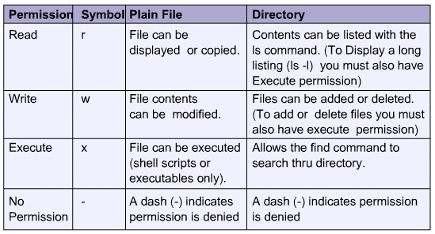
Files & Directory permissions
Default file = - r w - r w - r - -
Default directory = d r w x r w x r - x

Slide 6
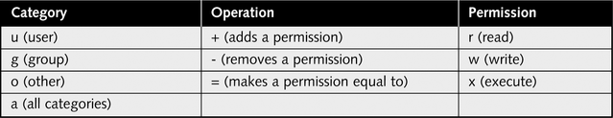
Assigning Permission
Symbolic mode
  Symbolic uses a specified ‘id’ letter which refers to a specific mode section
Octal Mode
  Octal grants the 3 characters within each of the 3 sections a value
    Read(r): 4 Write(w):2 Execute(x):1

Slide 7
Changing Permissions
  chmod- Change mode (permissions) of files or directories
    chmod permission file/directoryname
    Ex: chmod 0600 myfile.txt
  chgrp- Change group owner of a file or directory
    (Only super user can use this)
    chgrp new-owner file/directoryname
    Ex: chgrp myuser myfile
  Chown - Change ownership of a file or directory
        (Only super user can use this)
    chown new-owner file/directoryname
    Ex:

Slide 8
Symbolic Permission
Who - Category you are working with
  u = user
  g = group
  o = others
  a = all
Op - Operator
  set (=)
  remove (-)
  give (+)
Ex:
would give read, write and executable permission to the filename specified to ALL users
  chmod a+rwx <filename>
would give the group and world read permission but remove write and execute permissions to the file
  chmod go+r, go-wx <filename>

Slide 9
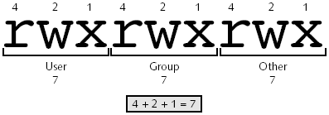
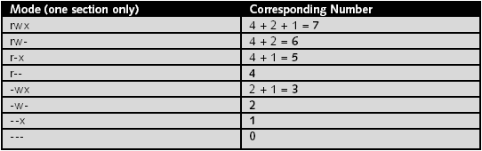
Octal Permission

Slide 10
Octal Permission
Octal Permission Notes
chmod 644 perm 644 rw-r--r-- Default for files
chmod 755 perm 755 rwxr-xr-x Default for Directories
chmod 555 perm 555 r-xr-xr-x
chmod 744 perm 744 rwxr--r-- Typical for user scripts
chmod 777 perm 777 rwxrwxrwx All permissions to all

