Slide 1
IT2402
Free and Open Source Software Solutions
Local user management

Slide 2
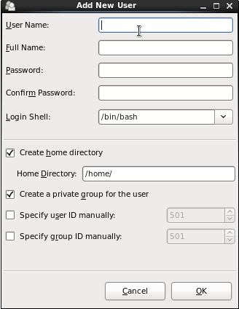
Adding a New User using the User Management tool

Slide 3
Adding a New User from the command-line
useradd --home /home/john john
passwd john
Useradd user_name
/etc/default/useradd file specifies the home.

Slide 4
/etc/passwd file
This is the file in Linux system that contains all the relevant information related to user login.

Slide 5
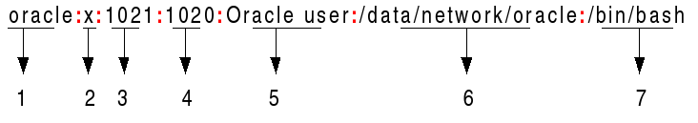
/etc/passwd File Format
User name –User login name ( 1-32 characters in length.)
Password: An x character indicates that encrypted password
User ID (UID): Each user must be assigned a user ID (UID).
  UID 0 (zero) is reserved for root
  UIDs 1-99 are reserved for other predefined accounts.
  UID 100-999 are reserved by system for administrative and system accounts/groups.

Slide 6
/etc/shadow File Format
stores actual password in encrypted format for user's account with additional properties related to user password

Slide 7
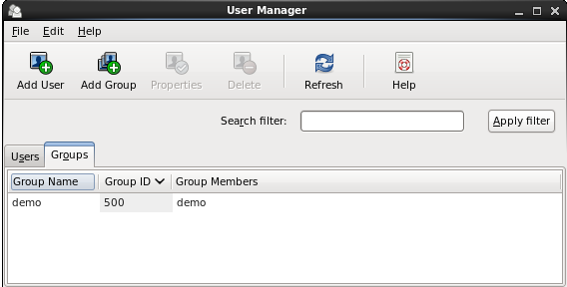
Adding a New Group using the User Management tool

Slide 8
Adding a New Group from the command line
groupadd accounts

Slide 9
Group management
add an existing user to an existing group
usermod -G accounts john
add an existing user to a number of existing groups:
  usermod -G accounts,sales,support john
To retain any current group memberships, use the -a flag to append the new group memberships:
usermod -a -G accounts,sales,support john

Slide 10
END.

