Slide 1
IT2402
Free and Open Source Software Solutions
Cron

Slide 2
Cron
cron is a unix, solaris utility that allows tasks to be automatically run in the background at regular intervals by the cron daemon.

Slide 3
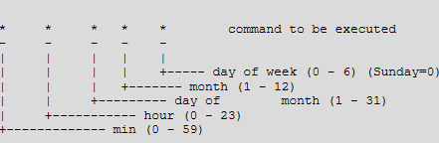
Crontab file
Crontab syntax
A crontab file has five fields for specifying day , date and time followed by the command to be run at that interval.

Slide 4
Schedule a Job For More Than One Instance (e.g. Twice a Day)
This example executes the specified incremental backup shell script (incremental-backup) at 11:00 and 16:00 on every day.
00 11,16 * * * /home/ramesh/bin/incremental-backup

Slide 5
Cron Job every weekday during working hours
This example checks the status of the database every weekday (i.e excluding Sat and Sun) during the working hours 9 a.m – 6 p.m.
00 09-18 * * 1-5 /home/ramesh/bin/check-db-status

Slide 6
Schedule a Background Cron Job For Every 10 Minutes.
*/10 * * * * /home/ramesh/check-disk-space

Slide 7
Schedule a Cron Job Beginning of Every Month using @monthly
@monthly /home/ramesh/suse/bin/tape-backup

Slide 8
Execute a Linux Command After Every Reboot using @reboot
@reboot CMD

Slide 9
View Root Crontab entries
View Current Logged-In User’s Crontab entries
ramesh@dev-db$ crontab -l
View Root Crontab entries
Login as root user (su – root) and do crontab -l as shown below.
root@dev-db# crontab -l
View Other Linux User’s Crontabs entries
root@dev-db# crontab -u sathiya -l

Slide 10
Specify PATH Variable in the Crontab
Instead of specifying /home/ramesh/tape-backup, if you want to just specify tape-backup
ramesh@dev-db$ crontab –l
PATH=/bin:/sbin:/usr/bin:/usr/sbin:/home/ramesh
@yearly annual-maintenance */10 * * * * check-disk-space

Slide 11
END.

