Slide 1
IT2402
Free and Open Source Software Solutions
Local Mail Server Using Postfix, Dovecot And Squirrelmail

Slide 2
Postfix
Postfix is a free and open-source mail transfer agent (MTA) that routes and delivers electronic mail.
Sendmail is the default MTA on the RedHat Linux distribution

Slide 3
Dovecot
As an IMAP and POP3 server, Dovecot provides a way for Mail User Agents (MUAs) to access their mail. So when a user's MUA contacts the mail server, the software which answers that request is an IMAP or POP3 server.

Slide 4
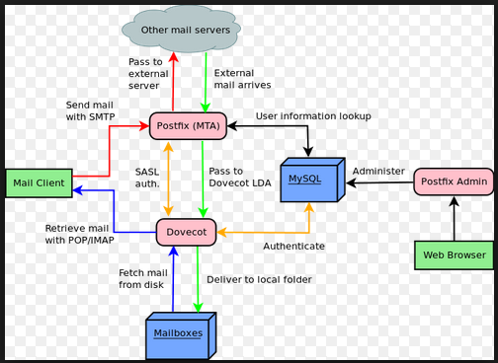
Dovecot

Slide 5
Internet Message Access Protocol (IMAP)
is a protocol for e-mail retrieval and storage developed as an alternative to POP.

Slide 6
Internet Message Access Protocol
(IMAP)
IMAP, unlike POP, specifically allows multiple clients simultaneously connected to the same mailbox,
different clients accessing the same mailbox at the same or different times can detect state changes made by other clients.

Slide 7
POP vs IMAP
IMAP allows you to view your email from more than one place. E.g. from your desktop computer at work and from your laptop at home and from abroad and from your mobile device - multiple locations.

Slide 8
POP vs IMAP
POP (Post Office Protocol)
POP is suitable if you have no need to check your email in multiple locations. If you only ever check your UCL email on your computer at work, for example, then POP is fine for this purpose.

Slide 9
POP3 (Post Office Protocol 3)
POP3 (Post Office Protocol 3) is the most recent version of a standard protocol for receiving e-mail.

Slide 10
Command to install EPL
wget http://dl.fedoraproject.org/pub/epel/6/x86_64/epel-release-6-8.noarch.rpm sudo rpm -Uvh epel-release-6*.rpm

Slide 11
END.

