Slide 1
Centre for Development of Advanced Computing (A Scientific Society of the Ministry of Communications and Information Technology, Govt. of India) No 4, Rajiv Gandhi Salai, Tidel Park Taramani, Chennai – 113
Restaurant Billing System
Submitted in partial fulfillment of the requirements
Post Graduate Diploma in Advanced Computing
March 2022
By
Mr. Barole Rameshwar Mr. Bharskar Yogesh T.
(PRN Number: 220360820006) (PRN Number: 220360820009)
Guided by:-
Mr. Prakash

Slide 2

INDEX
INTRODUCTION
WHY THIS RESTAURANT BILLING SYSTEM
SYSTEM REQUIREMENTS & SPECIFICATIONS
DATA FLOW DIAGRAM
FLOW CHARTS
INTERFACE
ADVANTAGES

Slide 3
INTRODUCTION
The project is "Restaurant Billing System" software for monitoring and controlling the transactions in a Restaurant.
Restaurant Billing System is a windows application designed to help users maintain & organize Restaurant.
The system processes transaction and stores the resulting data. Reports will be generated from these data which help the manager to make appropriate business decisions for the restaurant.

Slide 4

Why This Restaurant Billing System

Slide 5
System Requirements & Specifications:
Hardware Requirements :
1) 2 GB RAM or above
2) Intel i3 Processor or above
3) 32 Bit System or above
This are the basic need of the system to run this billing system

Slide 6
System Requirements & Specifications:
Back-end Software Requirements :
1) WebJava (SPRING BOOT)
2) MySQL for storage and data.
Front-end Software Requirements :
1) React.js

Slide 7
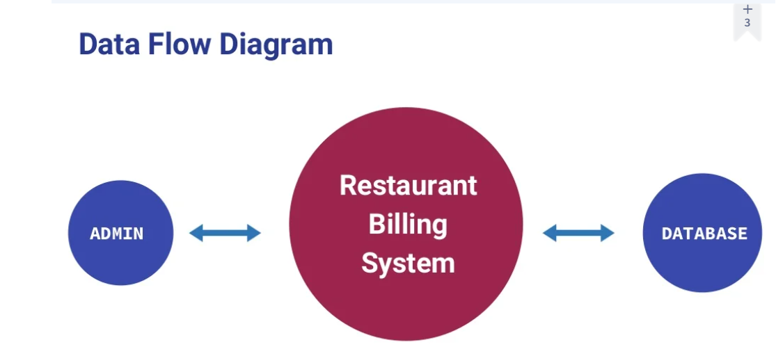

Slide 8
FLOW CHART

Slide 9
INTERFACE

Slide 10
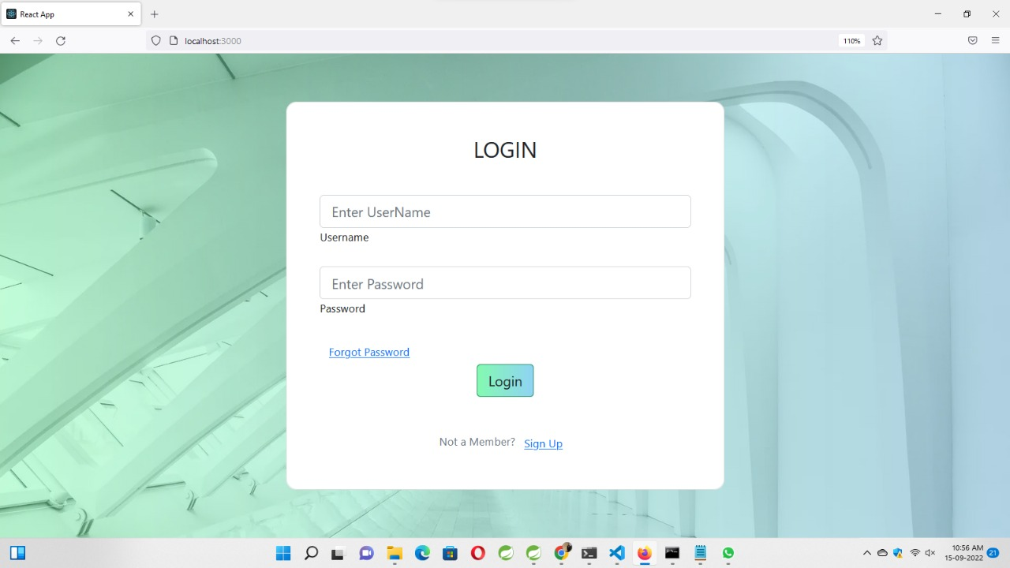
INTERFACE

Slide 11
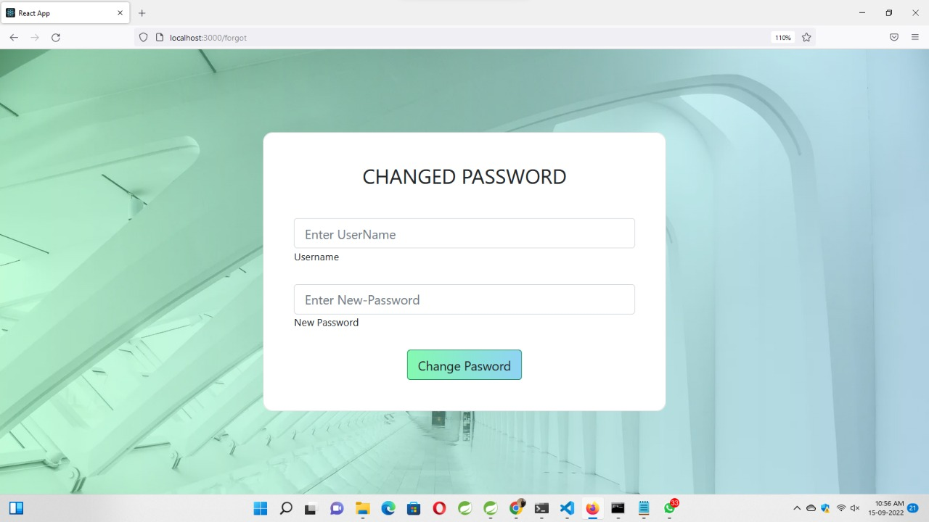

Slide 12
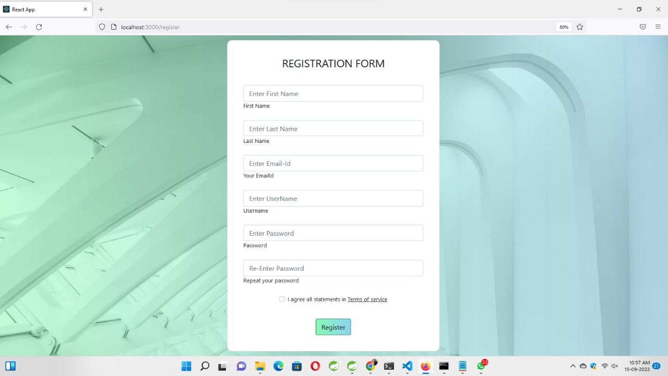

Slide 13
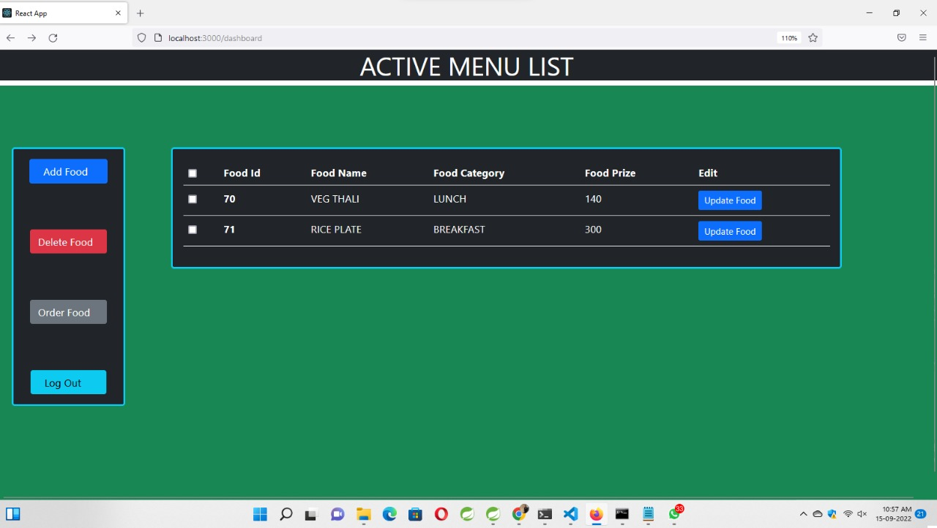

Slide 14
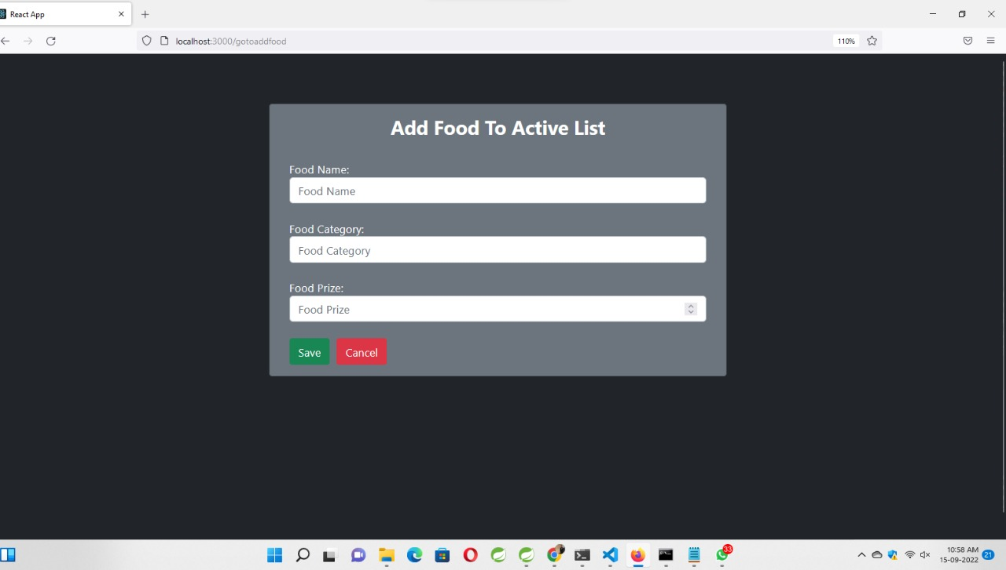

Slide 15
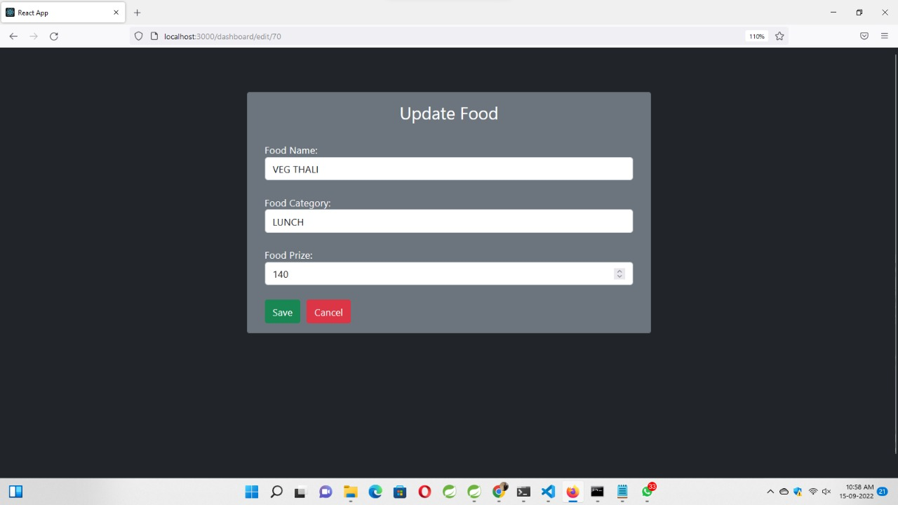

Slide 16
ADVANTAGES
Easy to handle this system
Fast working
No need of skilled workers
User-friendly interface

Slide 17


