Slide 1
SRE Reliability Model: SLI / SLO / SLA
Artem Samuilo
09.02.2026

Slide 2
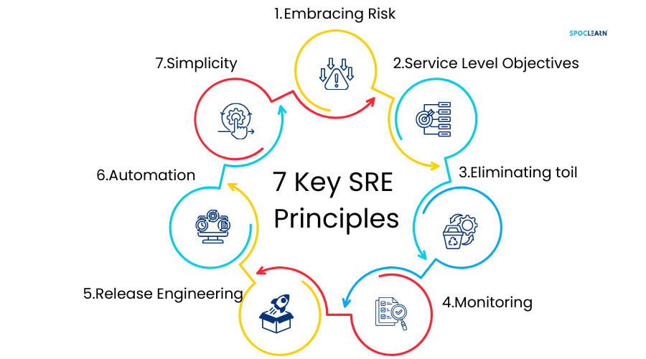
Google SRE Core Principle
Measure what users experience, not what infrastructure reports.
  In SRE, reliability is defined by user experience, not by infrastructure health.
  A system can be ‘green’ from an infrastructure perspective and still be unusable for customers. That’s why Google measures what users can actually do, end-to-end.

Slide 3
Our Current Approach for SaaS 2
  Script innovator_login.ps1:
    The script sends a request to /server/DBList.aspx.
    Publishes the execution time to the Prometheus server.
    Link: https://dev.azure.com/ArasCorp/Managed%20Services/_search?action=contents&text=innovator_login&type=code&lp=code-Project&filters=ProjectFilters%7BManaged%20Services%7DRepositoryFilters%7BInternalTools%7D&pageSize=25&result=DefaultCollection/Managed%20Services/InternalTools/GBdevelopment//dockerImages/innovator-health/innovator_login.ps1

Slide 4
Our Current Approach for SaaS 2
Query:
  count_over_time( (sum(innovator_server_method_ServerInfo_execution_latency_microseconds) by (innovator_instance_name) > 0)[365d:5m]) / count_over_time((sum(innovator_server_method_ServerInfo_execution_latency_microseconds) by(innovator_instance_name) >= 0)[365d:5m])
Meaning:
  We look at all 5-minute windows over the last 365 days.
  A window counts as successful if ServerInfo_execution_latency_microseconds > 0 (at least one call occurred).
  We divide the number of successful windows by the number of windows where the metric reported any data.
  Windows without data are excluded.

Slide 5
Our Current Approach for SaaS 2
Pros
Objective and fully metric-driven approach
Near real-time visibility of SLA impact during incidents
Captures partial outages and degraded performance
Does not depend on incident creation or severity classification
Cons
Requires clear definition and explanation of the SLI logic
Failures during planned maintenance currently affect SLA
More complex to explain to non-technical audiences

Slide 6
This is an SLI (Not an SLA)
Script success rate = Service Level Indicator​
It measures real user experience​
But it is not a contractual commitment

Slide 7
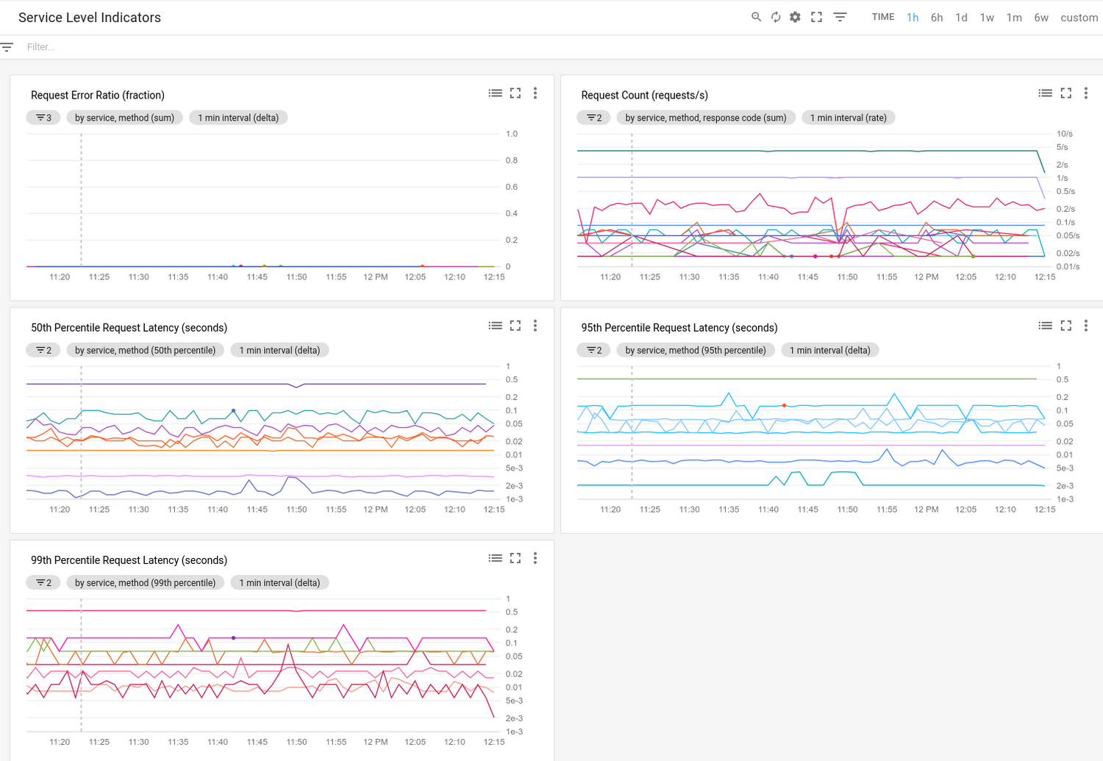
Google Cloud SLIs

Slide 8
SLA Based on Incident Duration
Another possible way of SLA calculation is calculation based on the total duration of incidents affecting the service availability within a defined period (typically a calendar month). Incident start and resolution times are used to determine downtime.

Slide 9
SLA Based on Incident Duration
Pros
Simple and widely accepted industry approach
Easy to explain to customers and auditors
Aligns well with Pager Duty
Naturally excludes planned maintenance windows
Cons
SLA impact depends on incident classification and handling accuracy
Does not reflect performance degradation (latency, partial failures)
Manual processes (incident approval, severity) can affect accuracy

Slide 10
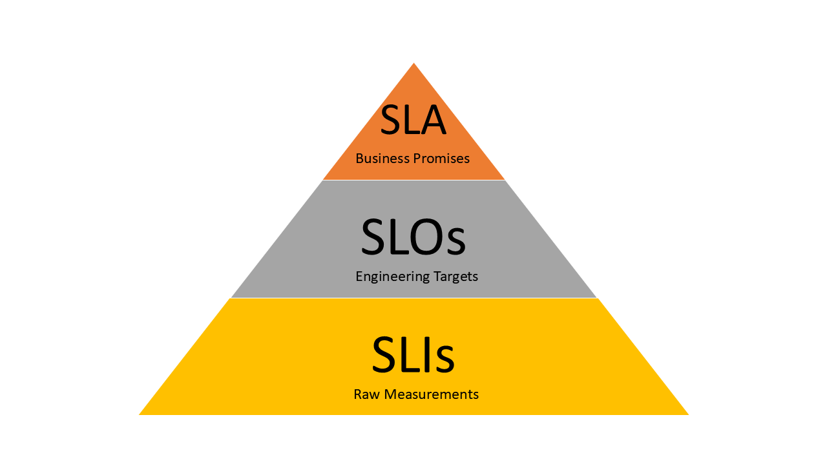
SLI vs SLO vs SLA
  SLA - external legal commitment
  SLI - what we measure
  SLO - internal reliability target
  They must not be equal

Slide 11
What is SLO
The SLO is the specific goal that the service must meet in order to be in compliance with the SLA.
According to Google, an SLO should “define the lowest level of reliability that you can get away with for each service.”

Slide 12
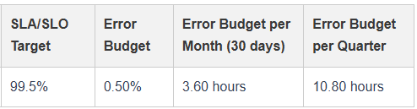
Error Budget
Error budget accounts for all user-visible service unavailability, including planned maintenance and third-party outages.
Error Budget = 1 − SLO

Slide 13
Why SLA Must Be Lower Than SLO
SLA protects the business
Cloud outages are unavoidable
Typical model:
SLO 99.9% → SLA 99.5%

Slide 14
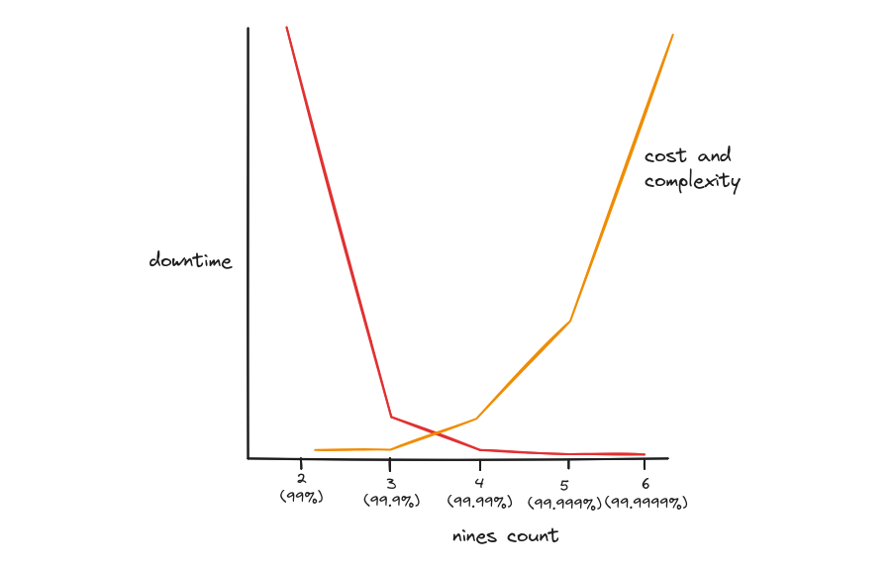
Why Not 99.99%+
Each extra '9' increases cost exponentially
Multi-layer systems amplify failure modes
Higher SLOs reduce delivery velocity

Slide 15
Recommended Time Windows
SLI - Real-time
Continuous measurement
Operational visibility
SLO - Rolling windows
30d / 7d / 24h
SLA - Calendar month
Fixed reporting
Customer contracts
Annual SLA
Monthly aggregation
Executive reporting

Slide 16
SLA Improvements and Next Steps
    Introduce Maintenance Mode for SLA calculation
      Exclude known maintenance periods from SLA impact
      Prevent artificial SLA degradation during planned work
    Define a global SLO target of 99.9%
      Focus on consistently meeting this target for all customers
    Actively monitor SLI levels
      Detect early signs of degradation
      React before SLA targets are violated
    Continue providing monthly SLA reports to customers
      Clear, consistent, calendar-based SLA reporting
    Calculate SLA based on SLI metrics
      Use Innovator server method execution latency as the primary SLI
      Ensure accurate, metric-driven SLA measurement

