Slide 1
LDPC Decoding
E24104024 李姿穎

Slide 2





Block Diagram
$$c$$
$$x={\left(−1\right)}^{c}$$
$$u$$
Encoder
Modulator
False
AWGN
Calculate
syndrome
$$\hat{u}$$
Top down
Bottom up
initialization
$$y=x+z$$

Slide 3
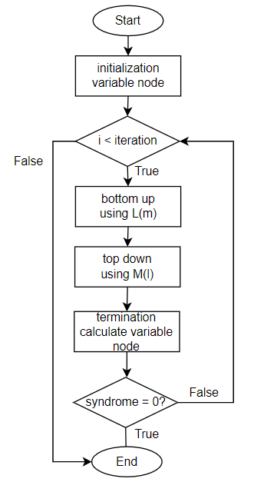
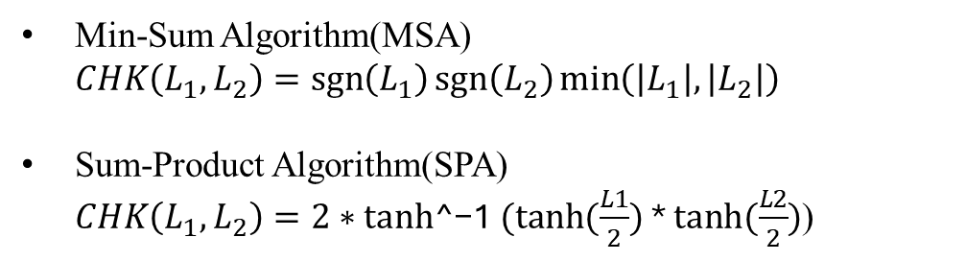
Flow Chart ( for SPA and MSA )
Min-Sum Algorithm(MSA) $CHK\left(L_{1},L_{2}\right)=\operatorname{sgn}\left(L_{1}\right)\operatorname{sgn}\left(L_{2}\right)\min\left(\left|L_{1}\right|,\left|L_{2}\right|\right)$
Sum-Product Algorithm(SPA) $CHK\left(L_{1},L_{2}\right)=2∗tanh\text{^−1}⁡ (tanh⁡(\frac{L1}{2})$ * $tanh⁡(\frac{L2}{2})$)

Slide 4
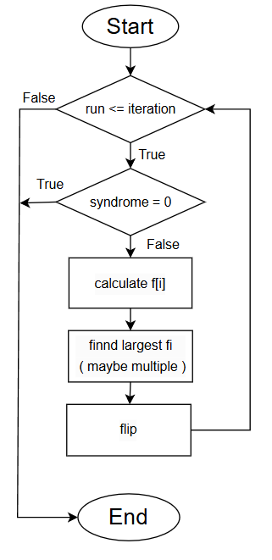
Flow Chart ( for BF )

Slide 5
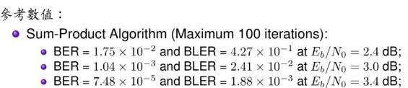
Data ( for SPA )
Parameter | Value
iteration | 100
Seed | -2024
SNR | 1.0 | 1.4 | 1.8 | 2.2 | 2.4 | 2.6 | 2.8 | 3.0
Decoded Block | 100 | 100 | 100 | 1000 | 1000 | 1000 | 1000 | 1000
BER | 0.082177 | 0.072036 | 0.058387 | 0.03842 | 0.023735 | 0.011544 | 0.004988 | 0.001352
BLER | 1 | 1 | 0.93 | 0.684 | 0.437 | 0.216 | 0.095 | 0.025
Average iteration | 100 | 100 | 93.68 | 71.438 | 48.757 | 27.555 | 15.166 | 7.513
SNR | 3.2 | 3.4 | 3.8 | 4.0 | 4.2 | 4.4
Decoded Block | 1000 | 10000 | 10000 | 10000 | 10000 | 10000
BER | 0.000411 | 0.000062 | 0.000004 | 0 | 0 | 0
BLER | 0.007 | 0.0011 | 0.0001 | 0 | 0 | 0
Average iteration | 4.091 | 2.701 | 1.9844 | 1.784 | 1.5815 | 1.3596

Slide 6
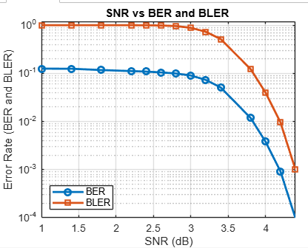
Simulation Diagram ( for SPA )

Slide 7

Data ( for MSA )
Parameter | Value
iteration | 100
Seed | -2024
SNR | 1.0 | 1.4 | 1.8 | 2.2 | 2.4 | 2.6 | 2.8 | 3.0
Decoded Block | 100 | 100 | 100 | 1000 | 1000 | 1000 | 1000 | 1000
BER | 0.125198 | 0.124699 | 0.117183 | 0.111471 | 0.10883 | 0.104702 | 0.099237 | 0.090312
BLER | 1 | 1 | 1 | 1 | 0.997 | 0.987 | 0.96 | 0.882
Average iteration | 100 | 100 | 100 | 100 | 99.709 | 98.739 | 96.109 | 88.523
SNR | 3.2 | 3.4 | 3.8 | 4.0 | 4.2 | 4.4
Decoded Block | 1000 | 10000 | 10000 | 10000 | 10000 | 10000
BER | 0.073014 | 0.050811 | 0.011861 | 0.003807 | 0.000919 | 0.000098
BLER | 0.731 | 0.514 | 0.1228 | 0.0398 | 0.0096 | 0.001
Average iteration | 73.797 | 52.586 | 14.0989 | 5.7704 | 2.5871 | 1.5069

Slide 8
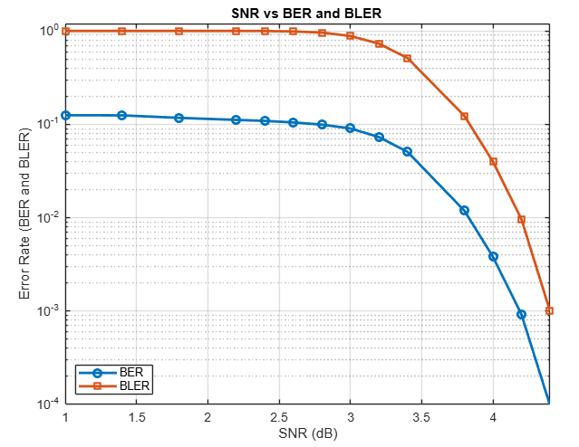
Simulation Diagram ( for MSA )

Slide 9
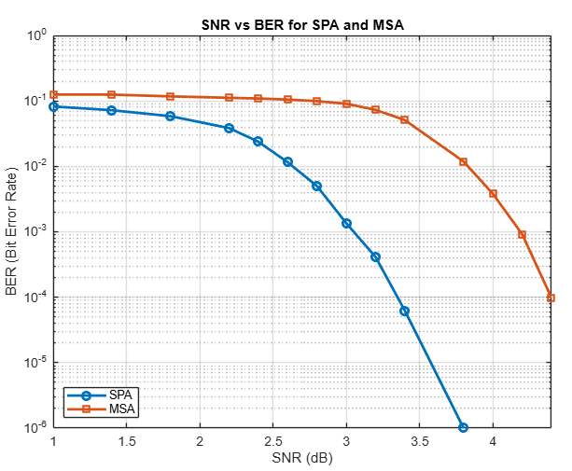
Simulation Diagram ( BER : SPA compare MSA )

Slide 10
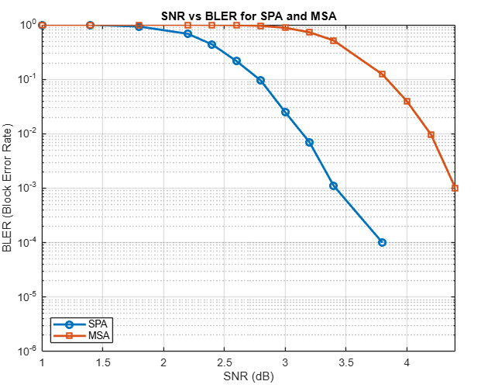
Simulation Diagram ( BER : SPA compare MSA )

Slide 11
Data ( BF with different iteration )
Parameter | Value
Seed | -2024
SNR | 1.0 | 1.2 | 1.4 | 1.6 | 1.8 | 2.0 | 2.2 | 2.4 | 2.6 | 2.8 | 3.0
Iteration =100 BER | 0.133534 | 0.125736 | 0.114942 | 0.128649 | 0.11605 | 0.121951 | 0.114115 | 0.109945 | 0.098298 | 0.087037 | 0.088235
Iteration =50 BER | 0.133636 | 0.125659 | 0.114379 | 0.124245 | 0.11589 | 0.121027 | 0.111012 | 0.109606 | 0.09798 | 0.085442 | 0.086732
Iteration =21 BER | 0.112561 | 0.107357 | 0.102087 | 0.099616 | 0.099661 | 0.091202 | 0.087789 | 0.083138 | 0.077483 | 0.072145 | 0.066322
SNR | 3.2 | 3.4 | 3.6 | 3.8 | 4.0 | 4.2 | 4.6 | 5.0
Iteration =100 BER | 0.074566 | 0.06197 | 0.04365 | 0.026641 | 0.014349 | 0.0055 | 0.000634 | 0.000074
Iteration =50 BER | 0.068327 | 0.061414 | 0.043195 | 0.026017 | 0.014112 | 0.005473 | 0.000629 | 0.000074
Iteration =21 BER | 0.05701 | 0.045649 | 0.032396 | 0.019244 | 0.009992 | 0.004304 | 0.000424 | 0.000073

Slide 12
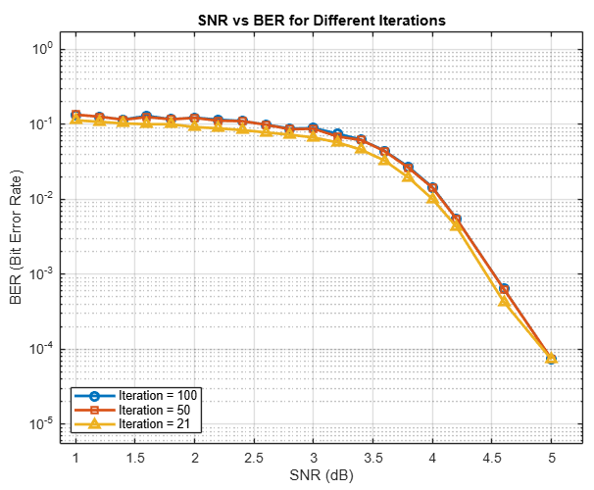
Simulation Diagram ( BF with different iteration )

Slide 13
Data ( for BF )
Parameter | Value
iteration | 100
Seed | -2024
SNR | 1.0 | 1.2 | 1.4 | 1.6 | 1.8 | 2.0 | 2.2 | 2.4 | 2.6 | 2.8 | 3.0
Decoded Block | 100 | 100 | 100 | 200 | 200 | 1000 | 1000 | 1000 | 1000 | 1000 | 10000
BER | 0.133534 | 0.125736 | 0.114942 | 0.128649 | 0.11605 | 0.121951 | 0.114115 | 0.109945 | 0.098298 | 0.087037 | 0.088235
BLER | 1 | 1 | 1 | 1 | 1 | 1 | 1 | 0.999 | 0.999 | 0.987 | 0.9571
Average iteration | 93.55 | 97.97 | 96.8 | 93.55 | 94.975 | 94.94 | 96.427 | 95.066 | 95.066 | 95.426 | 91.996
SNR | 3.2 | 3.4 | 3.6 | 3.8 | 4.0 | 4.2 | 4.6 | 5.0
Decoded Block | 10000 | 10000 | 10000 | 10000 | 10000 | 10000 | 10000 | 50000
BER | 0.074566 | 0.06197 | 0.04365 | 0.026641 | 0.014349 | 0.0055 | 0.000634 | 0.000074
BLER | 0.8844 | 0.7519 | 0.5725 | 0.3686 | 0.2 | 0.0981 | 0.0244 | 0.001384
Average iteration | 86.2428 | 75.1617 | 59.6204 | 42.065 | 27.0404 | 17.5334 | 9.4136 | 6.86724

Slide 14
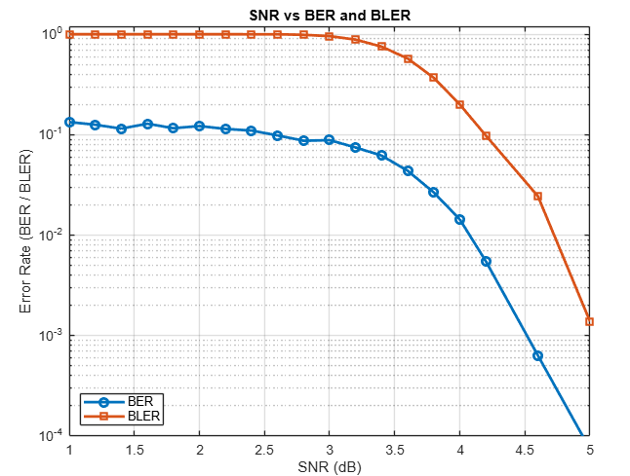
Simulation Diagram ( for BF )

Slide 15
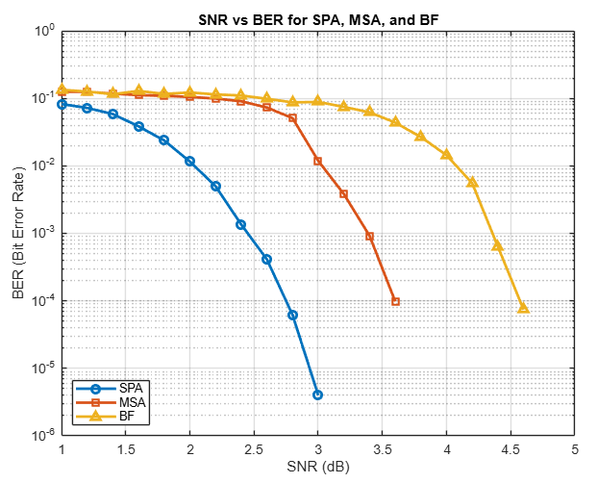
Simulation Diagram (BER : SPA ＆ MSA ＆ BF )

Slide 16
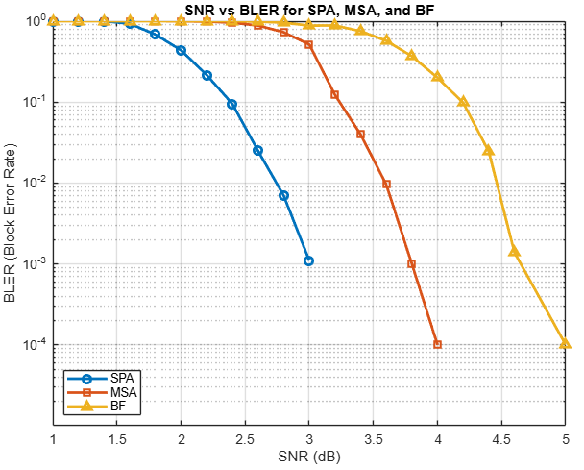
Simulation Diagram (BLER : SPA ＆ MSA ＆ BF )

