Slide 1
B37VR
Robotics Project
3 Characterising motors and driving robot

Slide 2
A mystery…..
I was debugging my Arduino a few days ago, and I wanted to connect the OUTPUTs of my Arduino board to the INPUTS to read the signal and make sure that everything was working.
I wanted to test that the correct values were being sent to the PINs and that all the wires worked correctly.
Then I noticed something strange – even when the wires weren’t connected, the INPUT pin sometimes read a signal.
So, I did a little research….

Slide 3
I found that Arduino PINs don’t need much current to activate them. Therefore random fluctuations in the air, nearby electric wires or whatever, can cause a very small voltage to randomly appear in the pin. This is especially noticeable when nothing is connected to it.
This is actually a common problem in electronic circuits. Sometimes the state of a pin is unknown. If it is not definitely supplying or sinking current, the value of it is random and can easily change. It is called “floating”, and there is an easy way to solve it. We use PULLUP RESISTORS or PULLDOWN RESISTORS.

Slide 4
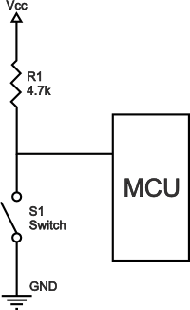
Pullup resistor
Pull-up resistors are resistors used in logic circuits to ensure a well-defined logical level at a pin under all conditions. As a reminder, digital logic circuits have three logic states: high, low and floating (or high impedance). The high-impedance state occurs when the pin is not pulled to a high or low logic level, but is left “floating instead.
Pull-up resistors are used to solve the dilemma for the microcontroller by pulling the value to a logical high state, as seen in the figure. If it weren’t for the pull-up resistor, the MCU’s input would be floating when the switch is open and brought down only when the switch is closed.

Slide 5
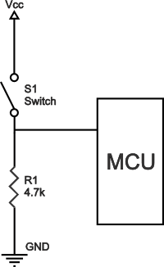
pulldown resistor
Pull-down resistors work in the same manner as pull-up resistors, except that they pull the pin to a logical low value.
They are connected between ground and the appropriate pin on a device. In such a circuit, when the switch is closed, the micro-controller input is at a logical high value, but when the switch is open, the pull-down resistor pulls the input voltage down to ground (logical zero value), preventing an undefined state at the input. The pull-down resistor must have a larger resistance than the impedance of the logic circuit, or else it might be able to pull the voltage down by too much and the input voltage at the pin would remain at a constant logical low value – regardless of the switch position.

Slide 6
Arduino has the answer
This is a common problem, so, of course there are solutions. Arduino actually has built-in pullup resistors. We can turn them off and on using our code.
I’ll show you how later.

Slide 7
digital input
pinMode(testDPin1, INPUT);
pinMode(testDPin1, INPUT_PULLUP);
This tells Arduino that this DIGITAL pin will be used for input.
INPUT disables the built-in PULLUP RESISTOR
INPUT_PULLUP enables the built-in PULLUP RESISTOR.
NOTE: The INPUT_PULLUP may reverse the inputs you get from your pin as it needs to be connected to ground. Switches and sensors may give different results than you initially expected. Please experiment first.

Slide 8
digital output
pinMode(in1Pin, OUTPUT);
This tells Arduino that this DIGITAL pin will be used for output.
Arduino has 14 digital pins (0-13).
If we don’t use pinMode to declare a pin as OUTPUT, it will still work, but not very well. The internal PULLUP RESISTOR will be enabled which will reduce the current.

Slide 9
PWM pins
The Arduino Uno has 14 Digital pins, but not all of them are PWM capable.
If you look, there is usually a small symbol, like ~ next to it.
We know from last week that PWM pins receive an integer from the code and send pulses of HIGH or LOW.
If you try to do an analogRead of a PWM output you will get lots of “1023” and “0” results.

Slide 10
digital Pin 13
Arduino Digital pin 13 is a special pin. It can be used for input and output, but there is a problem with it. This pin is on the same part of the circuit as some other things on the Arduino board. It gets random power fluctuations, and the pin sometimes works at a different frequency to the rest of the Arduino.
If you can, it is better not to use it.

Slide 11
summary
LEARNING RESOURCES AVAILABLE
  Kit of parts to make robot
  Motor drive code
LEARNING ACTIVITIES
  Show operation of motors
  Discuss what is needed in characterisation experiments
TASKS TO BE COMPLETED
  Build up robot kit
  Attach Arduino board, L298 board and battery to robot
  Wire up motors to operate
  Adjust speed of motor by editing code
  Characterise the robot for driving motors at different speeds as indicated in separate sheet

Slide 12
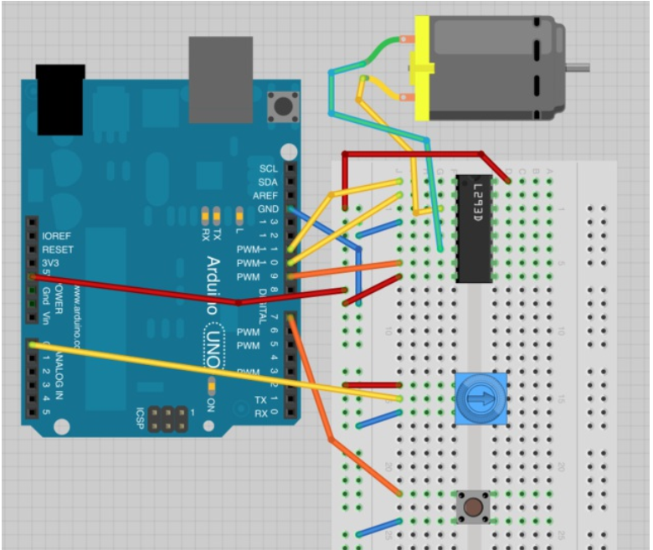
Last week we made this circuit
But it is a little too complicated to power our robot car. We also have the problem that our Arduino doesn’t provide much power to the motor. We need to add a stronger power supply.

Slide 13
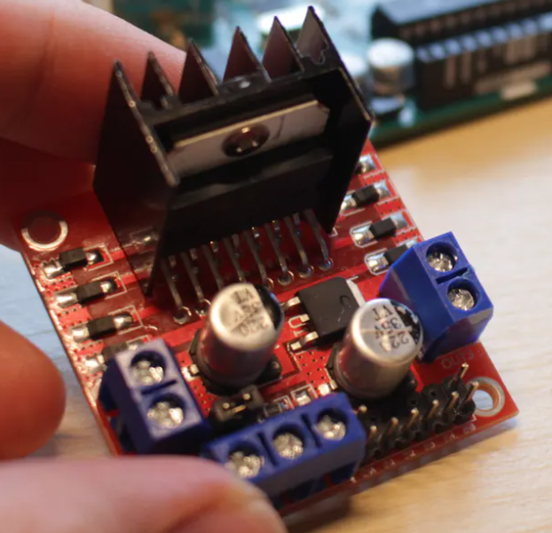
L298 Motor driver board
The L298N Motor Driver is a controller that uses an H-Bridge to easily control the direction and speed of up to 2 DC motors. It operates in a similar way to the L293 that we used previously, but it has a built in voltage regulator and screw terminals that make its use for controlling the robot easier.

Slide 14
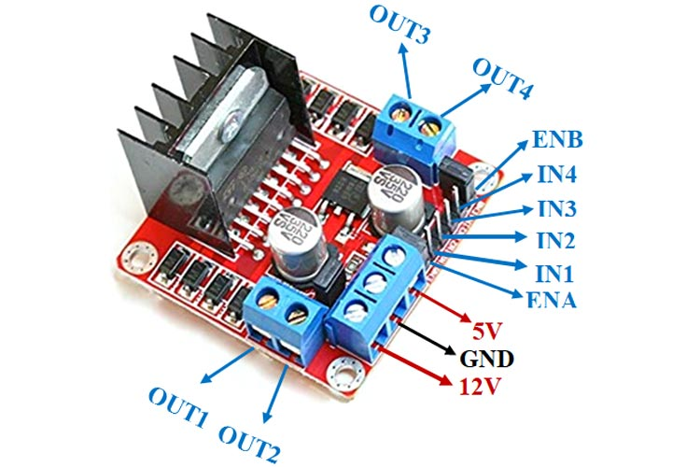
L298
Power LED

Slide 15
12V – This board can take a DC input between 7V and 36V. But there are some rules.
This board has a voltage regulator. If the input voltage terminal is 12V or lower and the regulator is enabled, the regulator will provide 5V to power the board. The 5V terminal will OUTPUT +5V to power an Arduino or something similar.
If this jumper is connected the voltage regulator is enabled.

Slide 16
If this board is being given more than 12V you need to remove this jumper. This will disable the voltage regulator. The 5V pin is now an INPUT +5V to power the circuits.

Slide 17
Warning!
If you provide more than 12V to the board, and the regulator is enabled it will BREAK YOUR BOARD.
Decide on your power supply, then add or remove the regulator jumper before you connect the power.

Slide 18
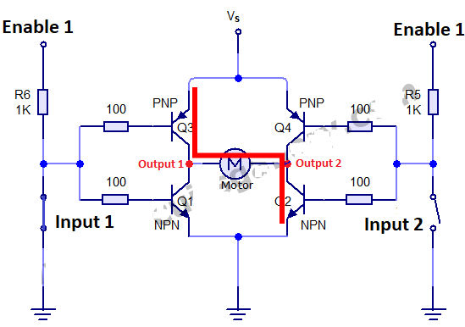
h bridge

Slide 19
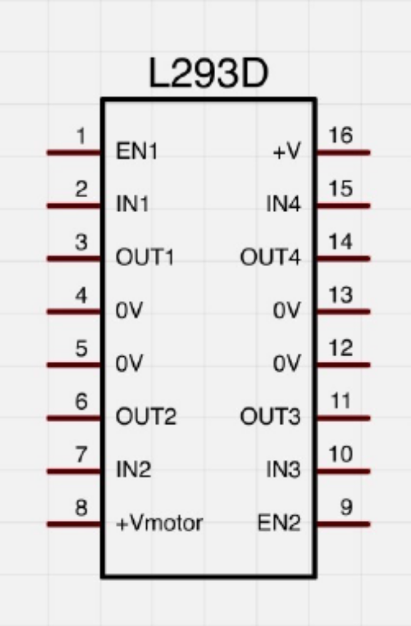

Slide 20
The L298 comes with a jumper on ENA and ENB. This is only really useful for Stepper motors. We should just use the front pin for a normal motor.
If IN1 is set to HIGH and IN2 is set to LOW the motor will turn at the maximum speed in one direction.
If we reverse IN1 and IN2 the motor will turn at the maximum speed in the other direction.
Later you will do a practical experiment to prove this yourself.
If we connect a PWM signal to ENA it will control the speed of the motor connected to OUT1 and OUT2.
IN3, IN4 and ENB control the motor connected to OUT3 and OUT4.

Slide 21
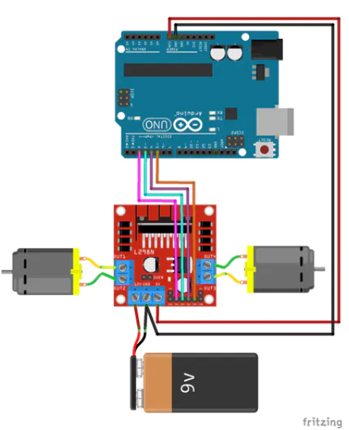
L298 Wiring
This shows how the L298 should be wired up
Ensure the ground is connected between the Arduino and the controller
We connected pins:
2 -> IN1
3 -> IN2
4 -> IN3
5 -> IN4
V_{in} -> +5V
GND -> GND
The voltage regulator should be enabled!

Slide 22
use the following code to test the motors
int in1Pin = 2;
int in2Pin = 3;
int in3Pin = 4;
int in4Pin = 5;
bool reverse = false; //change this to change direction of motors
void setup()
{
pinMode(in1Pin, OUTPUT);
pinMode(in2Pin, OUTPUT);
pinMode(in3Pin, OUTPUT);
pinMode(in4Pin, OUTPUT);
}
void loop()
{
setMotor(); // subroutine to control motor
delay(5000);
reverse = ! reverse;
}
void setMotor()
{
digitalWrite(in1Pin, ! reverse);
digitalWrite(in2Pin, reverse);
digitalWrite(in3Pin, ! reverse);
digitalWrite(in4Pin, reverse);
}
Check that the motors both turn in the same direction. If they are different you can remove the
“reverse = ! reverse” section of the code, then change the OUT terminals so the motors both go forwards.

Slide 23
Can we vary the speed?
We know that we can use PWM to control the speed of a DC motor using an L293D chip or L298 board.
But this uses 3 Arduino pins. IN1, IN2 and EN1.
Can we control the speed of a DC motor using 2 Arduino pins, or even just 1?

Slide 24
Yes, we can.
Our IN1 and IN2 pins can be used to control the speed. Look at this table for the logic of IN1 and IN2. By leaving one input at LOW and switching the other to HIGH or LOW we can control the speed. We can simulate PWM.
Arduino PWM is actually about 500Hz, and as the value is between 0-255, every pulse lasts around 2 milliseconds.
IN1 | IN2 | DC Motor
LOW | LOW | OFF
LOW | HIGH | REVERSE
HIGH | LOW | FORWARD
HIGH | HIGH | OFF

Slide 25
How can we use this?
Any ideas?

Slide 26
void setup() {
pinMode(motor1pin1, OUTPUT);
pinMode(motor1pin2, OUTPUT);
pinMode(motor2pin1, OUTPUT);
pinMode(motor2pin2, OUTPUT);
}
void loop() {
set_speed(motor1pin1, motor1pin2, motor1speed);
set_speed(motor2pin1, motor2pin2, motor2speed);
}
void set_speed(int motorpin1, int motorpin2, int sp){
digitalWrite(motorpin1, HIGH);
digitalWrite(motorpin2, LOW);
delay(sp);
digitalWrite(motorpin1, LOW);
digitalWrite(motorpin2, LOW);
delay(10 - sp);
}
int motor1pin1 = 5;
int motor1pin2 = 6;
int motor2pin1 = 9;
int motor2pin2 = 10;
int motor1speed = 0;
int motor2speed = 0;
// 0 -> 10 denotes low to high speed

Slide 27
void setup() {
pinMode(motor1pin1, OUTPUT);
pinMode(motor1pin2, OUTPUT);
pinMode(motor2pin1, OUTPUT);
pinMode(motor2pin2, OUTPUT);
}
void loop() {
if (timer >= maxMotorSpeed) {
timer = 0;
}
set_speed(motor1pin1, motor1pin2, motor1speed);
set_speed(motor2pin1, motor2pin2, motor2speed);
delay(2);
}
void set_speed(int motorpin1, int motorpin2, int sp){
if (timer < sp) {
digitalWrite(motorpin1, HIGH);
digitalWrite(motorpin2, LOW);
} else {
digitalWrite(motorpin1, LOW);
digitalWrite(motorpin2, LOW);
}
}
int motor1pin1 = 5;
int motor1pin2 = 6;
int motor2pin1 = 9;
int motor2pin2 = 10;
int motor1speed = 0;
int motor2speed = 0;
int maxMotorSpeed = 250;
int timer = 0;

Slide 28
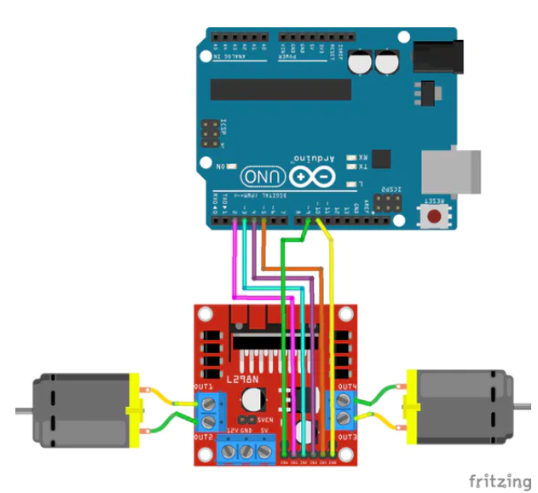
Speed control connections
Not every Arduino pin is capable of PWM. Look at your board carefully before choosing one.
We chose pins
9 -> ENA
10 -> ENB

Slide 29
now that we have connected the pwm
We need to change our Arduino code so that the PWM pins control the speed.
We should declare and initialise 2 variables for the PWM pins.
We should declare 2 new variables to control the left and right speed.
For now, we can set the Arduino car to just move forwards while we test the PWM functions.

Slide 30
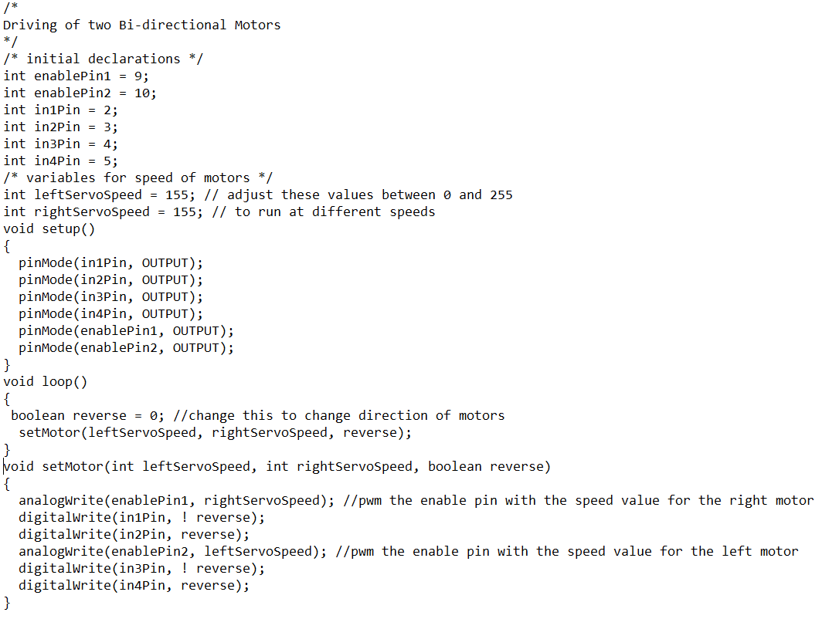

Slide 31
What you will do
You can try connecting the L298 motor driver directly to your robot. As for your Arduino, on the pictures here, you can see that we ran the Arduino from the +5V terminal of the L298.
This is because we need to test how fast our robot can move. We can’t leave it plugged into the USB port while that happens.
We need to try different values between 0 and 255 to try and map our different pin speeds to actual speeds in meters per second.
Our robot takes energy to move, so low values won’t do anything.

Slide 32
You may have noticed that our robot only has 4 input pins for the motors, IN1 – IN4.
This is because the L293 motor driver has many problems.
If you look at the L298 board, you can see the large heatsink on it, this is because the L293D chip gets hot. This means that it is wasting a lot of energy as heat.
It also uses 6 pins from our Arduino.

Slide 33
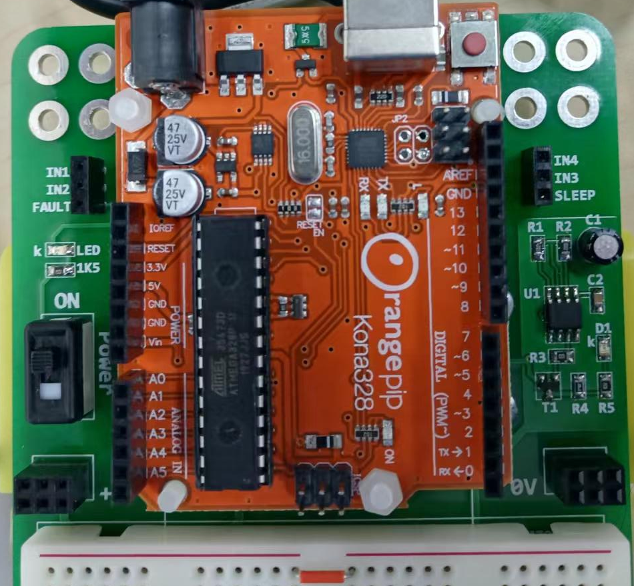

Slide 34
DRV8833
The DRV8833 is a different type of motor driver.
It uses 4 inputs instead of 6, and it doesn’t use a high voltage power supply, which means that the whole board and motors all work on 5V.
The way the motor driver works is very simple. Each motor is controlled by 2 pins, so IN1 & IN2 control one motor, IN3 & IN4 control the other.
To make the motor work, we apply a LOW voltage to one input, and a PWM signal to the other. To make the motor run the opposite way, we switch them around.

Slide 35
IN1 | IN2 | RESULT
LOW | PWM | REVERSE
PWM | LOW | FORWARD
LOW | LOW | STOP

Slide 36
This means that our motor driver will use 4 PWM pins, as any of the inputs could be used.
By convention, we are using pins 5&6 for IN1 & IN2, pins 9&10 for IN3 & IN4.
I have some code

Slide 37
#define MOT_A1_PIN 10
#define MOT_A2_PIN 9
#define MOT_B1_PIN 6
#define MOT_B2_PIN 5
digitalWrite(IN1_PIN, LOW);
analogWrite(IN2_PIN, pwm);
# where pwm is a value between 0-255

Slide 38
This will just control one wheel, but it is easy to extend it to control different wheels.
void set_motor_pwm(int pwm, int IN1_PIN, int IN2_PIN)
{
digitalWrite(IN1_PIN, LOW);
analogWrite(IN2_PIN, pwm);
}
We can call this function using any of our 4 pins, so we can control the motor.
However, we can see that this will only go forwards. There is no option to reverse the direction.

Slide 39
We could use a Boolean variable to control whether to reverse the wheel or not, however, that will take up more of the Arduino’s limited memory.
Another option is with the PWM itself, if we give a positive number it will go forwards, if we give a negative number it will reverse.
void set_motor_pwm(int pwm, int IN1_PIN, int IN2_PIN)
{
if (pwm < 0) { // reverse speeds
analogWrite(IN1_PIN, -pwm);
digitalWrite(IN2_PIN, LOW);
} else { // stop or forward
digitalWrite(IN1_PIN, LOW);
analogWrite(IN2_PIN, pwm);
}
}

Slide 40
Turning the robot
There are different ways to turn the robot. Generally it happens because of a difference in speed between the wheels.
Having one wheel turn forwards whilst another turns backwards produces a very sharp turn.

Slide 41
If your motors make a whining sound and don’t turn, it is because the motor isn’t receiving enough power to turn. You need to increase your PWM values.

Slide 42
TASKS TO BE COMPLETED
  Wire up motors to operate
  Adjust speed of motor by editing code
  Make car run forwards at full speed
  Make car reverse at full speed.
  Make car turn left and right.
  Characterise the robot for driving motors at different speeds as indicated in separate sheet

