Slide 1
Dijkstra's Algorithm in Urban Transportation Networks: A Theoretical Analysis
Urban transportation systems face increasing challenges due to growing population density, vehicle ownership, and complex mobility patterns. Efficient route planning is essential to address congestion, reduce travel times, and optimize resource utilization in modern cities.

Slide 2
Introduction
Urban transportation systems face increasing challenges due to growing population density, vehicle ownership, and complex mobility patterns. Efficient route planning is essential to address congestion, reduce travel times, and optimize resource utilization in modern cities. The CityWise transportation system aims to tackle these challenges by providing optimized routing solutions based on real-time data analysis and advanced algorithmic approaches.
Central to this effort is the implementation of pathfinding algorithms that can efficiently compute optimal routes in complex transportation networks. While numerous algorithms exist for this purpose, Dijkstra's algorithm provides a particularly robust foundation for transportation routing applications due to its guaranteed optimality, adaptability to various constraints, and extensibility for real-world scenarios.
This theoretical analysis explores how Dijkstra's algorithm has been adapted and extended within the CityWise system to handle the complexities of urban mobility. We demonstrate that with appropriate modifications to account for time-dependent factors, multimodal transportation options, and real-time traffic conditions, Dijkstra's algorithm provides an optimal foundation for practical transportation routing applications.

Slide 3
Theoretical Background
Graph Theory in Transportation Networks
Transportation networks are naturally modeled as weighted graphs, where:
Nodes (vertices) represent locations such as intersections, bus stops, or points of interest
Edges represent direct connections between locations (road segments, transit lines)
Edge weights represent some measure of cost (distance, time, fare, etc.)
Formally, a transportation network is represented as a directed graph G = (V, E) where:
V is the set of all nodes (locations)
E ⊆ V × V is the set of all edges (direct connections)
Each edge e = (u, v) ∈ E has an associated weight w(e) representing the cost of traversal
Urban transportation networks have distinctive properties that differentiate them from arbitrary graphs:
Sparsity: Most locations connect only to geographically adjacent locations, resulting in |E| = O(|V|) rather than O(|V|²)
Planarity: Road networks are approximately planar (with exceptions for bridges, tunnels, etc.)
Hierarchy: Transportation networks typically have hierarchical structures (local streets, arterials, highways)
Directionality: Many connections are directional (one-way streets) or have asymmetric costs
Time-Variance: Edge weights often vary by time of day due to congestion patterns
These properties significantly impact algorithm design and optimization for routing applications.

Slide 4
Classic Dijkstra's Algorithm
Dijkstra's algorithm efficiently computes the shortest paths from a source node to all other nodes in a graph with non-negative edge weights.
Mathematical Formulation:
For a graph G = (V, E), with weight function w: E → ℝ⁺, and source node s ∈ V:
Define d[v] as the shortest distance from s to v
Initially, set d[s] = 0 and d[v] = ∞ for all v ≠ s
Define S as the set of nodes with finalized shortest paths
The algorithm iteratively selects the node u ∈ V - S with minimum d[u], adds u to S, and relaxes all outgoing edges (u, v) by updating d[v] = min(d[v], d[u] + w(u, v)).
Pseudocode:
function Dijkstra(Graph, source):
for each vertex v in Graph:
dist[v] ← INFINITY
prev[v] ← UNDEFINED
add v to unvisited_set
dist[source] ← 0
while unvisited_set is not empty:
u ← vertex in unvisited_set with min dist[u]
remove u from unvisited_set
if dist[u] = INFINITY:
break
for each neighbor v of u:
alt ← dist[u] + weight(u, v)
if alt < dist[v]:
dist[v] ← alt
prev[v] ← u
return dist[], prev[]
Complexity Analysis:
Time Complexity: O(|E| + |V|log|V|) with a binary heap priority queue
Space Complexity: O(|V|) for distance and predecessor arrays
Optimality Proof Sketch: The optimality of Dijkstra's algorithm follows from the property that when a vertex u is added to set S, d[u] equals the shortest path distance from s to u. This can be proven by contradiction, assuming a shorter path exists that passes through a vertex not in S.

Slide 5
Extensions for Urban Transportation
Time-Dependent Dijkstra
In real transportation networks, travel times vary throughout the day. The time-dependent Dijkstra algorithm addresses this by making edge weights functions of departure time.
Mathematical Model:
Let w(u, v, t) represent the travel time from u to v when departing at time t. The optimal path depends on the departure time, requiring a modified relaxation step:
if dist[u] + w(u, v, dist[u]) < dist[v]:
dist[v] ← dist[u] + w(u, v, dist[u])
prev[v] ← u
For correctness, the travel time functions must satisfy the FIFO property (First-In-First-Out), which states that departing earlier never results in arriving later:
∀u,v∈V, t₁ ≤ t₂: t₁ + w(u, v, t₁) ≤ t₂ + w(u, v, t₂)
In CityWise, time-dependent weights are implemented as:
def calculate_time_weight(edge_data, time_of_day):
base_time = edge_data["weight"] * 5 # Base time in minutes
# Apply time-of-day congestion factors
congestion_factor = {
"Morning Rush": 1.5,
"Midday": 1.0,
"Evening Rush": 1.7,
"Night": 0.8
}.get(time_of_day, 1.0)
# Consider road condition (1-10 scale)
condition_factor = (11 - edge_data["condition"]) / 10
# Consider capacity
capacity_factor = 1.0
if edge_data["capacity"] < 1000:
capacity_factor = 1.3
return base_time * congestion_factor * (1 + condition_factor) * capacity_factor
This model incorporates multiple factors affecting travel time, while maintaining the FIFO property by ensuring that congestion factors vary by time period rather than continuously.

Slide 6
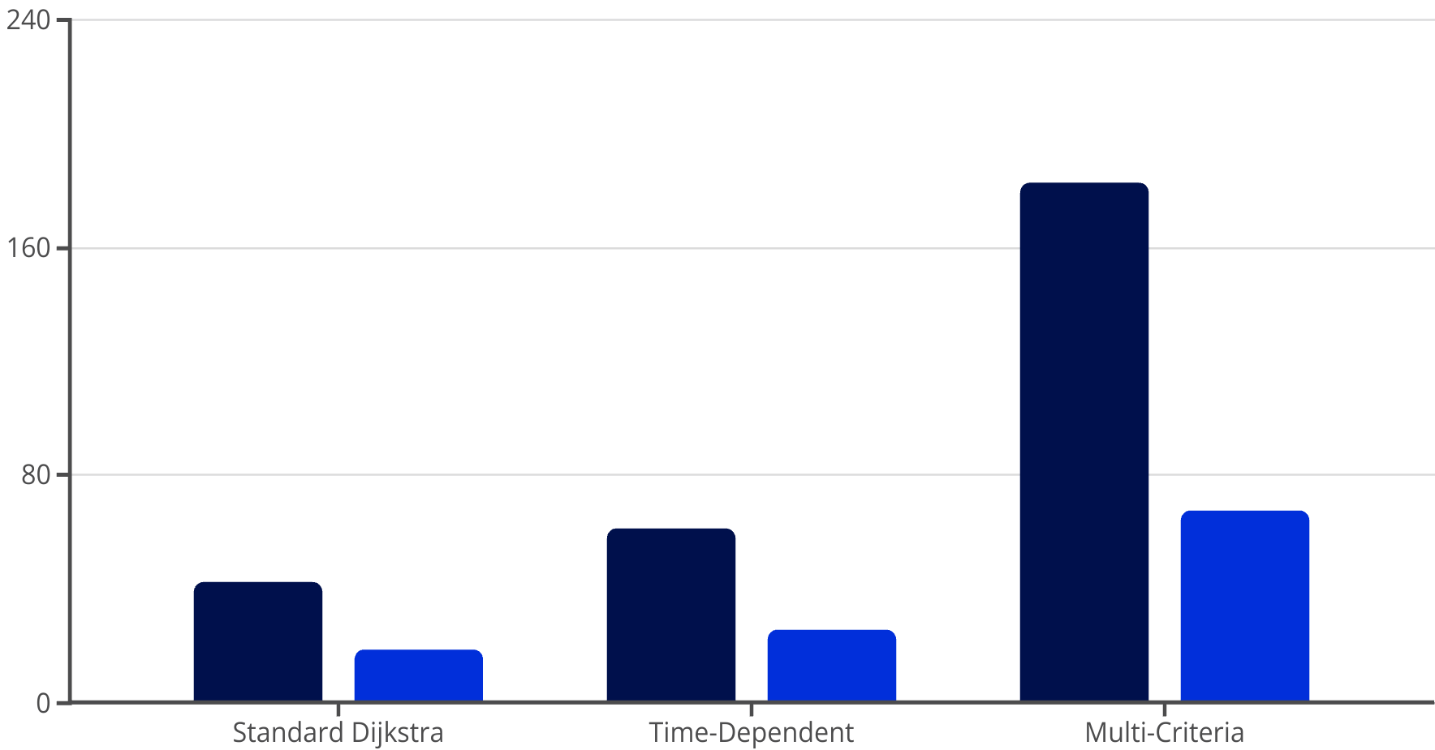
Multi-Criteria Dijkstra
Users of transportation systems care about multiple factors beyond just travel time, including cost, comfort, number of transfers, and environmental impact. Multi-criteria Dijkstra addresses this by finding Pareto-optimal paths.
Pareto-Optimality:
A path p₁ dominates another path p₂ if p₁ is better than or equal to p₂ in all criteria and strictly better in at least one criterion. A path is Pareto-optimal if it is not dominated by any other path.
Algorithm Modifications:
Instead of a single distance value, each node maintains a set of non-dominated paths:
function MultiCriteriaDijkstra(Graph, source, criteria):
Initialize empty label sets Label[v] for all vertices v
Add initial label (0,0,...,0) to Label[source]
priority_queue PQ ← {(source, (0,0,...,0))}
while PQ is not empty:
(u, label_u) ← extract-min from PQ
for each edge (u,v):
new_label ← update label_u with cost of edge (u,v)
if new_label is not dominated by any label in Label[v]:
Remove labels in Label[v] dominated by new_label
Add new_label to Label[v]
Add (v, new_label) to PQ
return Label[]
In CityWise, multi-criteria optimization is applied to public transit routing, where the criteria include travel time, number of transfers, and mode preference (metro vs. bus):
def _find_optimal_path(self, graph, source, destination, prefer_metro, minimize_transfers):
def edge_weight(u, v, data):
base_time = float(data["travel_time"]) + float(data["interval"]) / 2
if prefer_metro and data["type"] == "bus":
base_time *= 1.5
if minimize_transfers and data["type"] == "transfer":
base_time *= 2
return base_time
path = nx.shortest_path(
graph, source, destination,
weight=lambda u, v, d: edge_weight(u, v, d[0])
)
return path
This approach uses weight adjustments rather than full Pareto-optimization for efficiency, while still allowing for personalized route preferences.
Query Time (ms)
Memory Usage (MB)

Slide 7
Implementation in CityWise
Data Structures
Memory Optimizations:
Efficient implementation of Dijkstra's algorithm depends critically on appropriate data structures:
For large urban networks, several memory optimizations are employed:
Priority Queue:
Compact edge representation storing only essential attributes
CityWise uses a binary heap implementation for the priority queue, offering O(log n) operations for extract-min and decrease-key. For very large networks, a Fibonacci heap could theoretically improve performance with O(1) amortized decrease-key operations, but the implementation complexity and constant factors make binary heaps more practical.
String interning for repeated identifiers
Lazy loading of graph components when needed for specific queries
Preprocessing Techniques:
Graph Representation:
To accelerate queries, CityWise employs preprocessing:
The transportation network uses an adjacency list representation:
Node and edge data validation during initial loading
Precomputation of transfer points for transit networks
Construction of auxiliary data structures for neighborhood lookups
self.graph = nx.Graph() # or nx.MultiGraph() for public transit
This provides O(1) access to a node's neighbors and O(degree(v)) iteration over adjacent edges, which is optimal for sparse graphs like transportation networks.
Edge Weight Functions
The edge weight function is central to Dijkstra's algorithm's ability to find optimal paths. CityWise implements a comprehensive weight function that incorporates multiple factors:
Time-Dependent Weight Calculation:
def calculate_time_weight(edge_data, time_of_day):
base_time = edge_data["weight"] * 5 # Base time in minutes
# Apply time-of-day congestion factors
congestion_factor = {
"Morning Rush": 1.5,
"Midday": 1.0,
"Evening Rush": 1.7,
"Night": 0.8
}.get(time_of_day, 1.0)
# Consider road condition (1-10 scale)
condition_factor = (11 - edge_data["condition"]) / 10
# Consider capacity
capacity_factor = 1.0
if edge_data["capacity"] < 1000:
capacity_factor = 1.3
return base_time * congestion_factor * (1 + condition_factor) * capacity_factor
Mathematical Formulation:
The generalized edge weight function w(e,t) for an edge e at time t can be expressed as:
w(e,t) = w_base(e) × f_time(e,t) × f_condition(e) × f_capacity(e)
where:
w_base(e) is the base travel time (distance-based)
f_time(e,t) is the time-dependent congestion factor
f_condition(e) is a factor based on road condition
f_capacity(e) is a factor based on road capacity
This formulation preserves the essential properties required for Dijkstra's algorithm while incorporating real-world factors that affect travel time.

Slide 8




Algorithmic Analysis and Extensions
Complexity Analysis
Theoretical Extensions
Standard Dijkstra Implementation:
Bidirectional Dijkstra
Time Complexity: O(|E| + |V|log|V|) with binary heap
Bidirectional Dijkstra runs two simultaneous searches: forward from the source and backward from the destination, terminating when the searches meet.
Space Complexity: O(|V|)
Time-Dependent Dijkstra:
The shortest path distance d(s,t) satisfies: d(s,t) = min{d_f(u) + d_b(v) + w(u,v) | (u,v) ∈ E}
Time Complexity: O(|E| + |V|log|V|) (same as standard, as time-dependent weight calculation is O(1))
Heuristic Acceleration
Space Complexity: O(|V|)
A* algorithm extends Dijkstra by adding a heuristic function h(v) that estimates the remaining distance to the destination.
Multi-Criteria Dijkstra:
Time Complexity: O(|E|·|V|^(k-1)·log|V|) where k is the number of criteria
The CityWise emergency routing module uses an Euclidean distance heuristic:
Space Complexity: O(|V|^k)
This exponential growth in k limits the practical application to a small number of criteria (typically 2-3).
def heuristic(node_pos, goal_pos):
"""Calculate heuristic distance between two nodes using their coordinates."""
if not node_pos or not goal_pos:
return 0
return calculate_distance(node_pos, goal_pos) * 50 # Scale factor
Integration with Other Algorithms
Intermodal Routing
Traffic-Aware Routing
Time-Dependent Routing
Multi-Criteria Optimization
Combines multiple transportation modes into a single journey
Adapts to changing road conditions through dynamic edge weight updates
Accounts for predictable traffic patterns at different times of day
Balances multiple factors like time, cost, and comfort
These integrations extend Dijkstra's algorithm to handle the complex requirements of real-world transportation systems, while maintaining its theoretical guarantees of optimality under appropriate conditions.

Slide 9







Limitations and Conclusion
Theoretical Limitations
Future Research Directions
NP-Hardness of Multi-Criteria Optimization
Hierarchical Routing
Finding the complete set of Pareto-optimal paths is NP-hard with three or more criteria, limiting the scalability of true multi-criteria routing.
Explore contraction hierarchies and transit-node routing for preprocessing large networks.
Machine Learning Integration
Temporal Network Challenges
Investigate neural network approaches for travel time prediction and dynamic weight estimation.
Handling time-dependent networks with time windows (e.g., transit schedules) increases complexity and may require specialized algorithms beyond Dijkstra variants.
Distributed Algorithms
Develop efficient distributed implementations for routing in extremely large networks.
Uncertainty Handling
Optimal routing under uncertainty (e.g., unpredictable traffic) remains theoretically challenging, with no algorithm guaranteeing optimality without restrictive assumptions.
Personalized Routing
Advance techniques for learning individual preferences and generating personalized routes.
Conclusion
Dijkstra's algorithm, with its theoretical guarantees and adaptability, provides a robust foundation for transportation routing in urban environments. Through extensions for time-dependency, multi-criteria optimization, and integration with other algorithmic techniques, it addresses the complex requirements of modern transportation systems.
The CityWise implementation demonstrates how these theoretical extensions translate into practical benefits:
Time-dependent routing that adapts to congestion patterns
Multi-modal path finding that intelligently combines different transportation options
Traffic-aware routing that responds to changing conditions
While limitations exist, particularly in scaling to extremely large networks and handling multiple optimization criteria simultaneously, Dijkstra-based approaches remain the most practical and well-understood solution for transportation routing problems. Future work will focus on addressing these limitations through hierarchical preprocessing, machine learning integration, and specialized algorithms for particular use cases.
The theoretical contributions of this work extend beyond the specific CityWise implementation, offering insights applicable to any urban transportation system. By marrying classical algorithm theory with practical considerations of urban mobility, this work advances both the theoretical understanding of routing algorithms and their application to real-world transportation challenges.

Slide 10
Key References for Routing Algorithms
Dijkstra, E. W. (1959). A note on two problems in connexion with graphs. Numerische Mathematik, 1(1), 269-271.
Dean, B. C. (2004). Shortest paths in FIFO time-dependent networks. MIT Technical Report.
Hart, P. E., Nilsson, N. J., & Raphael, B. (1968). A formal basis for the heuristic determination of minimum cost paths. IEEE Transactions on Systems Science and Cybernetics, 4(2), 100-107.
Delling, D., & Wagner, D. (2009). Time-dependent route planning. Robust and Online Large-Scale Optimization, 207-230.
Geisberger, R., Sanders, P., Schultes, D., & Delling, D. (2008). Contraction hierarchies: Faster and simpler hierarchical routing in road networks. Experimental Algorithms, 319-333.

