Slide 1
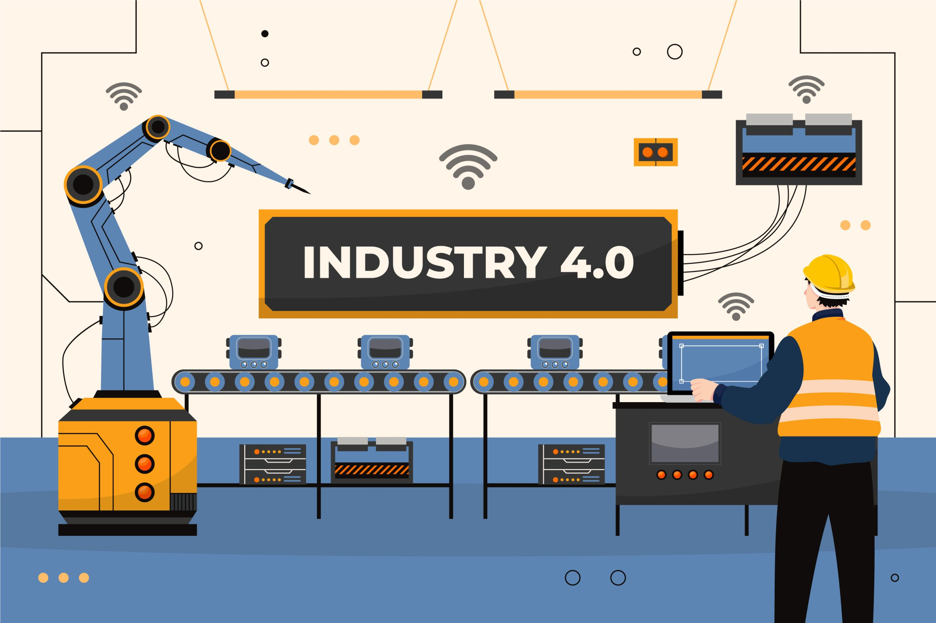

Smart Sensors
& Sensor Fusion
Automation & Industry 4.0
By:
Ramez Al –Masadeh - 20221102027
Bahaa Al-Shorman - 20221102017
Instructor:
Hisham El Moaqet

Slide 2
Agenda
Content of the Presentation
1
2
3
Introduction & Evolution
Inside the Smart Sensor and Fusion Systems
Sensor Fusion Levels: Data, Feature, and Decision level fusion
4
5
6
Applications in Industry
State of the Art & Wolrd Maket
Conclusion

Slide 3
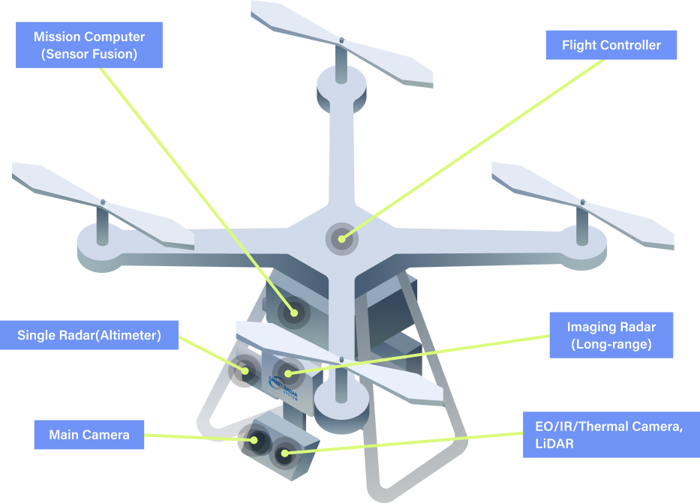
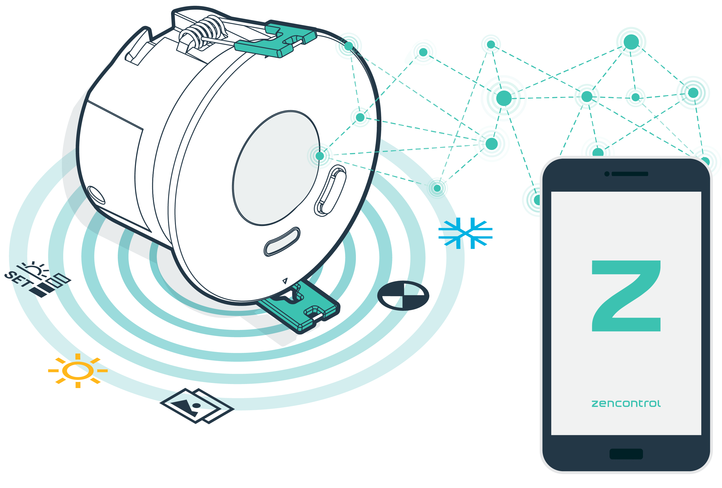
Introduction
Smart Sensors & Sensor Fusion Definitions
Smart Sensors:
Advanced devices that integrate a sensing element with embedded processing (microcontrollers) to collect, analyze, and transmit data locally, rather than just simple detection.
Sensor Fusion:
A multilevel process combining data from multiple sources to generate information that is more precise and reliable than any single sensor can achieve alone.

Slide 4
Introduction
The Evolution of Sensing
Industry 3.0 (Past):
Industry 4.0 (Present):
Future Outlook:
Technology: IO-Link & Smart Sensors.
Function: Bi-directional digital communication. Sensors perform self-diagnosis and dynamic configuration
.
Technology: Wireless IIoT & TinyML.
Function: "Sensor-as-a-Service." Sensors act as intelligent nodes in a global network, using edge AI for cognitive sensing.
Technology: 4-20mA Analog Loops.
Function: Unidirectional communication (One Wire = One Signal). Sensors were "passive" and isolated.

Slide 5

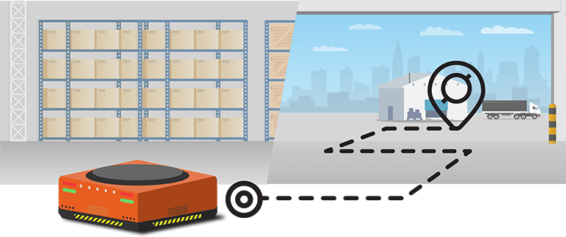



Architecture & Components
Sensor Fusion Levels & Architecture
Medium-Level (Feature Level)
High-Level (Decision Level)
Integration Architecture:
Low level
(Data Level)
Combines raw data from similar sensors (e.g., visual + thermal pixels) to maximize information content.
Extracts specific features (edges, shapes, movement) from different sensors and fuses them. Used in robot navigation (SLAM).
Each sensor makes a local decision (vote), and the system combines them (e.g., voting "danger" for emergency stops).
Ranges from Loosely Coupled (independent solutions blended) to Ultra-Tightly Coupled (raw data fused at signal processing level).

Slide 6






Architecture & Components
Anatomy of a Smart Sensor
Primary Sensing Element (Transducer) :
The interface with the physical world (e.g., MEMS). Converts physical quantities (heat, pressure) into raw electrical signals.
Microcontroller Unit (MCU):
The "Brain" of the sensor. It executes firmware for digital filtering, self-calibration, and local data processing
Anatomy of a Smart Sensor
Signal Conditioning Unit (SCU):
Amplifies weak signals and filters out noise/interference to prepare the signal for digitization
Communication Transceiver:
Handles data transmission. Wired (IO-Link) or Wireless (Bluetooth LE/ZigBee) interfaces to connect to the IIoT network.
Analog-to-Digital Converter (ADC):
The bridge between the analog and digital worlds. Converts voltage into binary code; its resolution determines sensor sensitivity.
Power Management Unit (PMU):
Regulates voltage and manages energy harvesting (vibration/solar) for self-powered, "deploy-and-forget" operations.
Architecture & Components

Slide 7
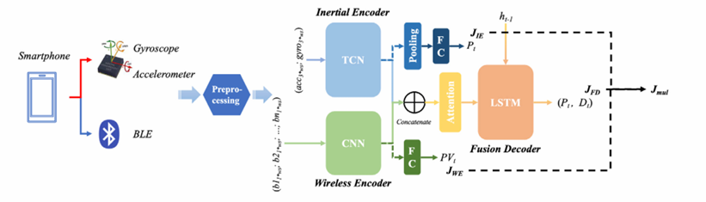


Applications in the Industry
Indoor Positioning (Logistics & Navigation) - Feature Level
Problem Statement:
GPS does not work indoors.
Bluetooth (BLE) signals bounce off factory walls, creating noise.
Motion Sensors (IMU) suffer from drift over time.
Result: Using either technology alone leads to inaccurate tracking of robots and workers
The Solution (SensNet Architecture):
Feature Level Fusion: Instead of calculating two different locations, the system uses Deep Learning (CNN + TCN) to extract abstract "features" from both noisy BLE signals and IMU movement patterns.
Fusion Decoder: An LSTM network fuses these features into a single vector to calculate precise position.
Impact: Achieves high precision with an error rate of only 0.415 meters, far superior to individual sensors.

Slide 8



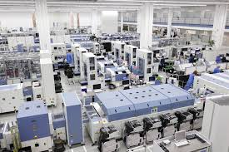

Applications in the Industry
Digital Twins (Siemens Amberg Electronics Plant)
Key Concepts:
Virtual Replica: A precise digital copy of the factory floor capable of running "what-if" simulations (e.g., increasing conveyor speeds).
Sensor Fusion Role:
RFID Systems: Identify 1,200+ product variants to trigger specific production programs.
Vision Sensors: Fuse visual data with CAD models to detect microscopic defects.
Outcome :
The system handles ~50 million data points per day, achieving a 99.9988% quality rate

Slide 9




State of the Art & Market
World Market
(Market Overview):
Market Size: Valued at ~$63 Billion in 2024, projected to reach $136 Billion by 2029 (CAGR ~17%).
.
Siemens AG
Robert Bosch
Regional Dominance
Honeywell
Text Here
(MEMS Leader)
Easy to change colors.
Robert Bosch
~14.3% Share.
~12.7% Share.
The #1 global
Asia Pacific (APAC)
holds the largest share (~40%) due to manufacturing hubs in China/India; North America leads in high-value innovation (Aerospace/Defense).
Leader in industrial automation, specifically pressure and airflow sensors for process control.
Dominates "Digital Factory" solutions, integrating smart sensors directly into PLCs and Digital Twins.
supplier of MEMS sensors (accelerometers/gyroscopes) crucial for logistics and wearables

Slide 10






State of the Art & Market
State of the Art Smart Sensors
Edge Intelligence:
By embedding AI algorithms, sensors can now perform complex pattern recognition and classification locally.
Sensor-as-a-Service:
Through Cloud-based IoT platforms, sensor data is instantly available globally, allowing for "virtualized" control where physical processes are monitored and optimized via digital twins
Deep Integration:
State-of-the-art fusion systems now employ Ultra-Tightly Coupled Integration (UTCI), where raw data from disparate are fused at the signal processing level.
Siemens AG
State of the Art
Energy Harvesting:
Smart sensors use energy harvesting to convert ambient energy, such as vibration, heat, or light into electrical power. Technologies like Piezoelectric Nanogenerators (PENGs) and Triboelectric Nanogenerators (TENGs) enable fully self-sustaining sensor operation
Bi-directional Ecosystems:
The integration of standards like IO-Link Wireless has eliminated the final physical barrier (cables), means that data flows in both directions.
Low-Power Protocols: This is complemented by the adoption of ultra-low-power communication protocols (e.g., Bluetooth Low Energy, ZigBee, and LoRaWAN), ensuring that the harvested energy is sufficient for continuous operation

Slide 11



Conclusion
Pros & Cons
Advantages (Pros):
Precision: Fusion eliminates blind spots (e.g., LiDAR + IMU) and improves accuracy via statistical weighting
Predictive Maintenance: Detects faults (bearing wear) weeks in advance, reducing downtime.
Agility: IO-Link allows instant remote parameter changes for flexible production.
Challenges (Cons):
Cost & Complexity: High initial capital for smart nodes; requires specialized math/AI skills.
Data Overload: Streaming raw data strains bandwidth (solved by Edge computing).
Conclusion:
We are shifting from "Smart Sensing" to "Cognitive Sensing".
Future sensors will be autonomous, self-powered (energy harvesting), and use TinyML to process data at the edge, becoming the intelligent "sensory organs" of Industry 4.0.

