Slide 1
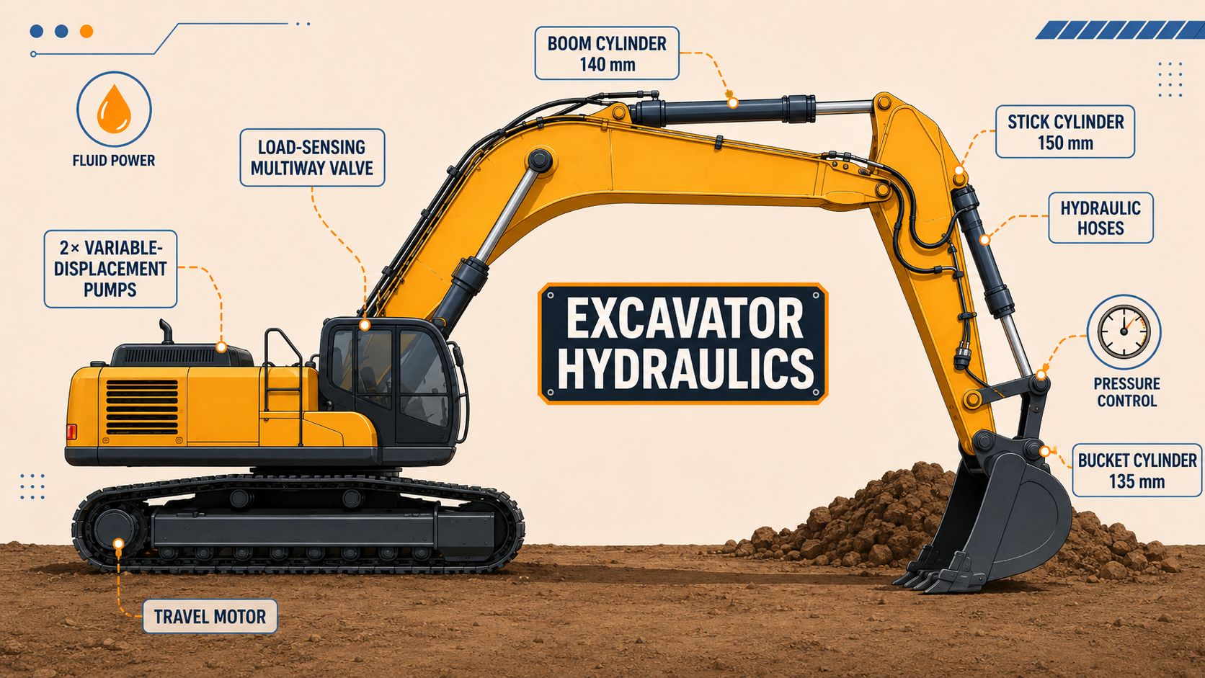

ME0522 · HYDRAULICS & PNEUMATICS
Simplified Performance-Based Hydraulic Excavator Design
A 30-ton excavator hydraulic system, designed from external performance targets inward.
AUTHORS
Ramez Al-Masadeh · Ahmad Al-Amiri
INSTRUCTOR
Dr.-Ing. Natheer Al Mtireen
BENCHMARK
Caterpillar 330 · 350 bar class
Notes:
Good morning. Our project is a performance-based hydraulic design for a thirty-ton class excavator. Rather than copying an existing machine, we start from the external performance targets of the Caterpillar 330 benchmark and work inward, sizing the actuators, pump, motor, and valve needed to meet them. I'm Ramez, presenting with Ahmad.

Slide 2
AGENDA: a· 10 MINUTES Story!
A Designer's Path, From Requirements to Hardware
01
Scope & Design Approach
02
Design Philosophy & Benchmark
The excavator as a hydraulic manipulator
Cat 330 performance targets
03
Simplified Architecture
04
Mechanical Loads & Forces
Pump → valve → actuators
From digging forces to bore sizes
05
Component Selection
06
Losses & Benchmark Comparison
Pump, motor, cylinders, valve
Validation after pressure losses
ME0522 · HYDRAULIC EXCAVATOR DESIGN
Notes:
We'll move through six steps in ten minutes: the scope and motivation, our design philosophy and benchmark targets, the simplified hydraulic architecture, the mechanical load and force analysis, the components we selected, and finally the system losses and how the design compares back to the benchmark.

Slide 3
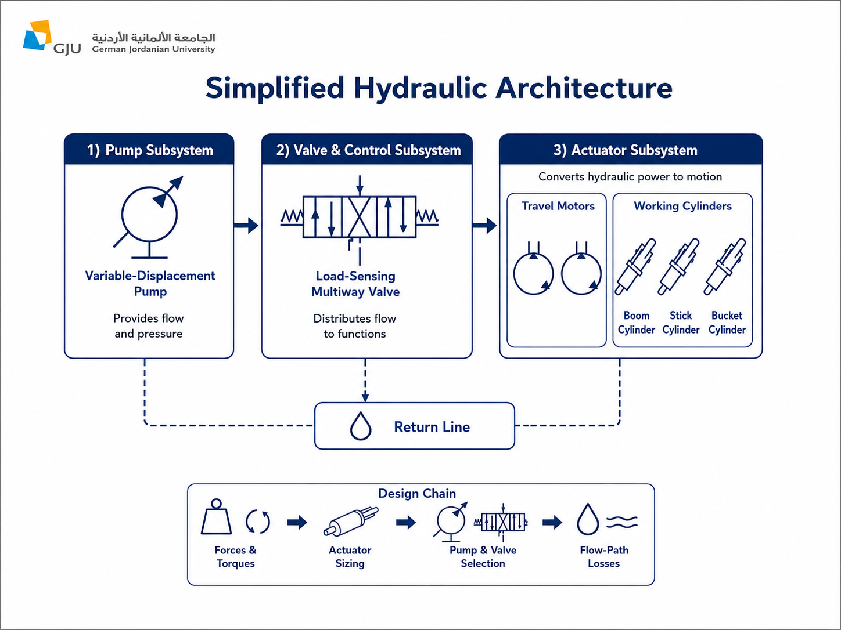
01 · INTRODUCTION
Scope & Design Approach
An excavator converts fluid power into linear and rotary motion — a hydraulic manipulator. We size only the core power path, starting from required forces.
IN SCOPE
The hydraulic power path:
Variable-displacement pump and load-sensing multiway valve
Travel motors driving the crawler tracks
Boom, stick & bucket double-acting cylinders
Boundary: pump outlet → actuator return line
v
EXCLUDED FROM DETAILED SIZING
Out of scope
Engine and prime mover sizing
Swing drive system
Tank, cooler & filtration
Exact proprietary linkage geometry
ME0522 · HYDRAULIC EXCAVATOR DESIGN
Notes:
An excavator is essentially a hydraulic manipulator. Pressurized oil drives the boom, stick, and bucket through double-acting cylinders, while travel and swing run on hydraulic motors, converting fluid power into both linear and rotary motion. Our scope is deliberately simplified. The design boundary starts at the variable pump and ends at the actuator return line; the engine, swing drive, tank, cooler, and filtration are excluded from detailed sizing. What matters is the method: we begin with the forces and torques the machine must produce, then select hydraulic components that satisfy them. Requirements first, hardware second.

Slide 4
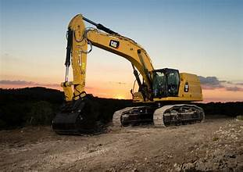
02 · DESIGN PHILOSOPHY
Design Philosophy & Benchmark Targets
A performance-based approach: Cat 330, but meeting its operating requirements. Its published figures become our design inputs.
248 kN
179 kN
145 kN
350 bar
Drawbar pull (travel force target)
Bucket digging force target
Stick digging force target
System pressure class adopted
Benchmark machine: Caterpillar 330, 30-ton class — also targeting ~560 L/min main flow and ~204 kW engine power.
ME0522 · HYDRAULIC EXCAVATOR DESIGN
Notes:
Our philosophy is performance-based. The goal is not to replicate Caterpillar's proprietary geometry, but to build a simplified system that meets comparable operating requirements. The Cat 330 gives us four hard targets: a drawbar pull of two hundred forty-eight kilonewtons, a bucket digging force of one hundred seventy-nine, a stick digging force of one hundred forty-five, and a system pressure of three hundred fifty bar. We adopt that pressure class as our main operating pressure for every component. These benchmark numbers become the design inputs we carry through the entire calculation chain.

Slide 5
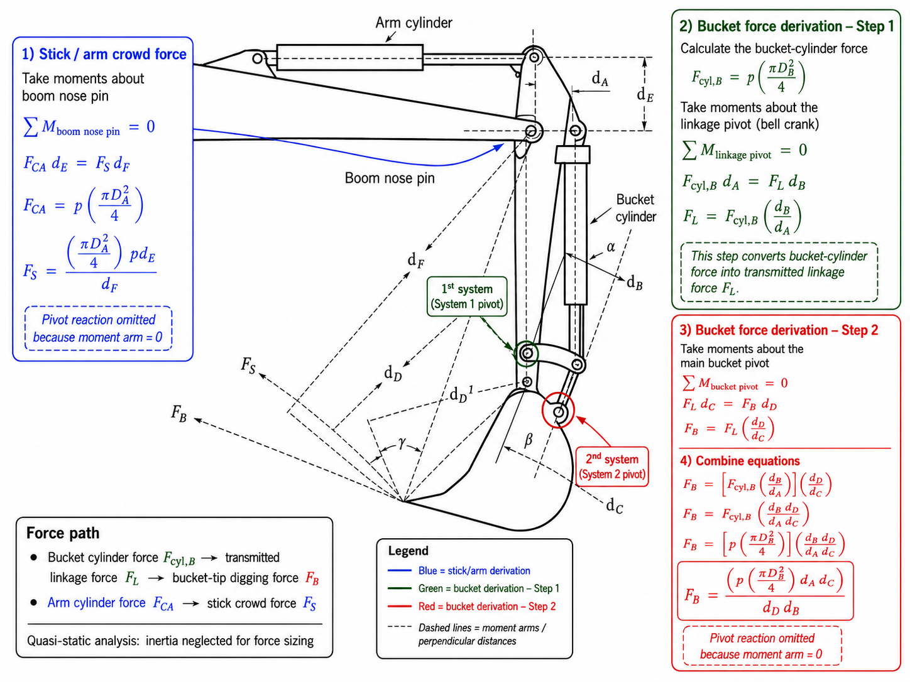
03 · Loads Analysis
Mechanical Loads on Cylinders and Motor
Travel — drawbar to motor torque
F_{track} = F_{drawbar} /2 = 124 kN → T_{motor} ≈ 1200 N·m / side
Implements — force through linkage
F_{cyl} = p · (πD²/4) F_{tip} = k_{L} · F_{cyl}, k_{L} ≈ 0.35
≈ 511 kN
≈ 414 kN
Required bucket-cylinder force
Required stick-cylinder force
Fig. — Linkage moment-equilibrium: cylinder force → bucket-tip force
ME0522 · HYDRAULIC EXCAVATOR DESIGN
Notes:
This is where requirements become numbers. Take the drawbar pull, two hundred forty-eight kilonewtons, split across two tracks, then converted through the sprocket radius and final-drive ratio into a required motor torque of about twelve hundred newton-meters per side. For the implements, cylinder force passes through the boom, stick, and bucket linkage before it reaches the bucket tip, so geometry matters as much as bore. Using an equivalent linkage factor of about zero-point-three-five, the benchmark digging forces translate back to roughly five hundred eleven kilonewtons at the bucket cylinder and four hundred fourteen at the stick. From those forces and the three-hundred-fifty-bar pressure, we solve directly for the required bores.

Slide 6
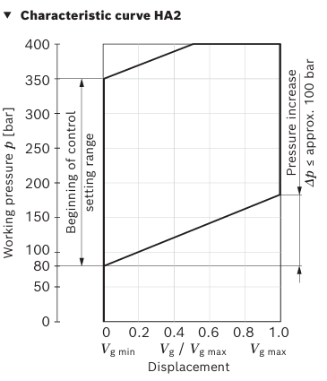
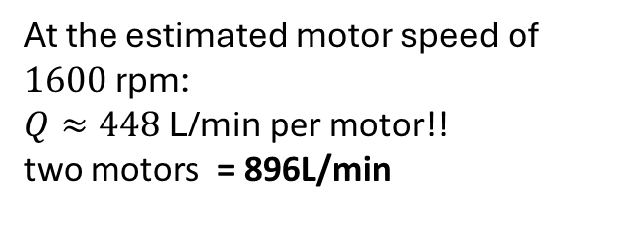

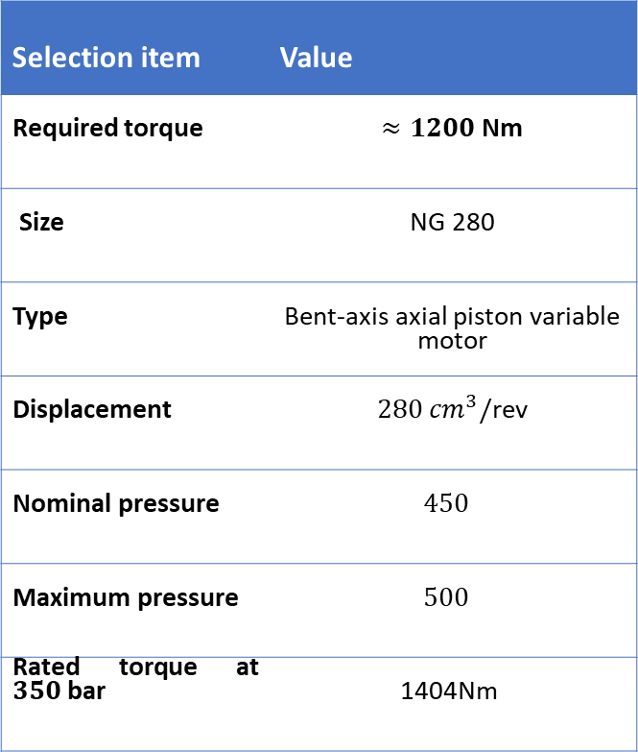
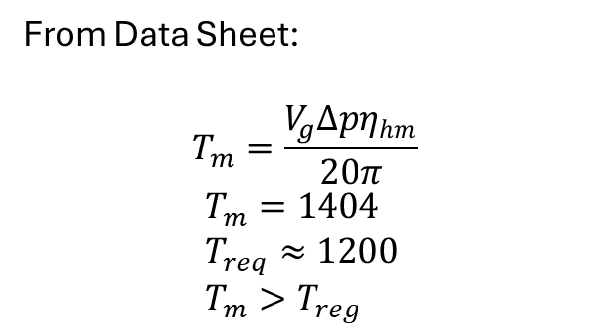
05 · COMPONENT SELECTION
Motor Section: Bosch Rexroth A6VM Series 71, NG280
Operating Data
Toque Validation
A solution
The high flow value is not treated as a continuous operating point.
The A6VM is a variable-displacement motor. As shown by the HA2 characteristic curve, motor displacement changes with working pressure:
High pressure / high load → high displacement for traction torque
Lower load / higher travel speed → reduced displacement to limit flow demand
Therefore, maximum drawbar pull and maximum travel speed are not assumed at the same time.
Selection item | Value
Required torque | $$≈1200 \text{Nm}$$
Size | NG 280
Type | Bent-axis axial piston variable motor
Displacement | $280 {cm}^{3}/$rev
Nominal pressure | $$450$$
Maximum pressure | $$500$$
Rated torque at $350 \text{bar}$ | 1404Nm
From Data Sheet:
$$T_{m}=\frac{V_{g}Δpη_{hm}}{20π}$$
$$T_{m}=1404 \\ T_{req}≈1200 \\ T_{m}>T_{reg}$$
Flow Demand, a problem!
$$Q=V_{d}n$$
Figure 1: HA2 Variable-Displacement Control Curve
At the estimated motor speed of $1600 \text{rpm}$:
$Q≈448 \text{L}\text{/}\text{min}$ per motor!!
two motors = 896L/min
ME0522 · HYDRAULIC EXCAVATOR DESIGN
Notes:
With the requirements set, component selection is straightforward. For the pump, two Bosch Rexroth A11VLO-145 units, each delivering about two hundred seventy-six liters per minute, five hundred fifty-two total, within one-and-a-half percent of the benchmark. For travel, the A6VM Series 71, size two-eighty bent-axis motor, rated at fourteen hundred newton-meters at our pressure, comfortably above the twelve hundred we need. For the implements, double-acting cylinders sized from the force analysis: a one-forty boom, a one-fifty stick, and a one-forty-five bucket, all right on the benchmark dimensions. Flow is distributed by a load-sensing multiway valve block with a dedicated section per function, plus pressure compensators and load-check valves for stable, safe actuation.

Slide 7
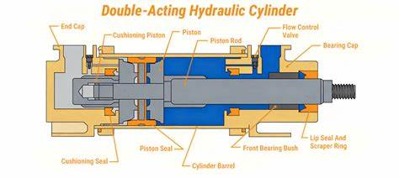
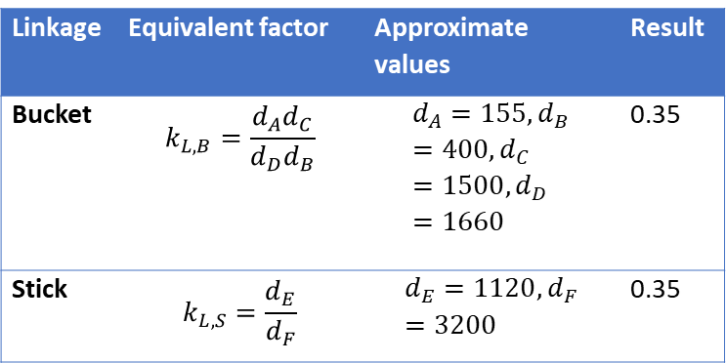
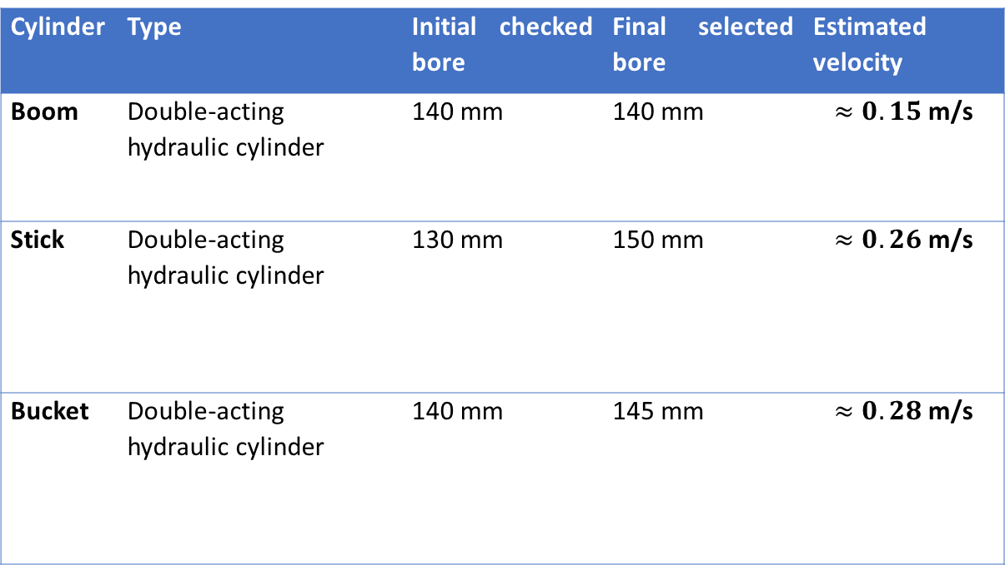
05 · COMPONENT SELECTION
Cylinder Section: Boom, Stick & Bucket Actuators
Cylinder | Type | Initial checked bore | Final selected bore | Estimated velocity
Boom | Double-acting hydraulic cylinder | 140 mm | 140 mm | $$≈0.15 \text{m}\text{/}\text{s}$$
Stick | Double-acting hydraulic cylinder | 130 mm | 150 mm | $$≈0.26 \text{m}\text{/}\text{s}$$
Bucket | Double-acting hydraulic cylinder | 140 mm | 145 mm | $$≈0.28 \text{m}\text{/}\text{s}$$
Benchmark Targets
Bucket = 179 kN
Stick = 145 kN
Linkage | Equivalent factor | Approximate values | Result
Bucket | $$k_{L,B}=\frac{d_{A}d_{C}}{d_{D}d_{B}}$$ | $$d_{A}=155,d_{B}=400,d_{C}=1500,d_{D}=1660$$ | 0.35
Stick | $$k_{L,S}=\frac{d_{E}}{d_{F}}$$ | $$d_{E}=1120,d_{F}=3200$$ | 0.35
Figure 2: Double acting Hydraulic Cylinders
ME0522 · HYDRAULIC EXCAVATOR DESIGN
Notes:
With the requirements set, component selection is straightforward. For the pump, two Bosch Rexroth A11VLO-145 units, each delivering about two hundred seventy-six liters per minute, five hundred fifty-two total, within one-and-a-half percent of the benchmark. For travel, the A6VM Series 71, size two-eighty bent-axis motor, rated at fourteen hundred newton-meters at our pressure, comfortably above the twelve hundred we need. For the implements, double-acting cylinders sized from the force analysis: a one-forty boom, a one-fifty stick, and a one-forty-five bucket, all right on the benchmark dimensions. Flow is distributed by a load-sensing multiway valve block with a dedicated section per function, plus pressure compensators and load-check valves for stable, safe actuation.

Slide 8
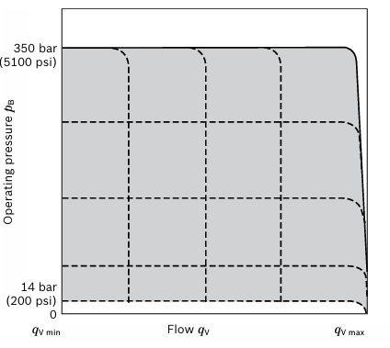
05 · COMPONENT SELECTION
Pump Section: Axial piston, variable · load-sensing (DRS0)
Operating Data
LS Control Margin
Pump Pressure and Flow Curve
Selection item | Value
Pump type | Variable axial piston
Displacement, Vg | 145 cm³/rev
Design speed, n | 2000 rpm
Volumetric efficiency, ηᵥ | 0.95
Nominal pressure | 350 bar
Flow per pump | 276 L/min
Total design flow | 552 L/min
means the pump pressure must be slightly higher than the actuator/load pressure so oil can actually move through the control valve.
it appears as a pressure drop across the valve/control metering path.
ΔpLS ≈ 14 bar.
The 14 bar is therefore a control pressure margin.
It is not pipe friction, but it is pressure reserved for valve control, so it is not fully available at the actuator
The curve shows the pump operating envelope:
Flow increases from qv min to qv max
Pressure is limited near 350 bar
At high pressure, the pump cannot stay at maximum flow continuously
Load-sensing control changes displacement according to valve demand
Figure 1: HA2 Variable-Displacement Control Curve
ME0522 · HYDRAULIC EXCAVATOR DESIGN
Notes:
With the requirements set, component selection is straightforward. For the pump, two Bosch Rexroth A11VLO-145 units, each delivering about two hundred seventy-six liters per minute, five hundred fifty-two total, within one-and-a-half percent of the benchmark. For travel, the A6VM Series 71, size two-eighty bent-axis motor, rated at fourteen hundred newton-meters at our pressure, comfortably above the twelve hundred we need. For the implements, double-acting cylinders sized from the force analysis: a one-forty boom, a one-fifty stick, and a one-forty-five bucket, all right on the benchmark dimensions. Flow is distributed by a load-sensing multiway valve block with a dedicated section per function, plus pressure compensators and load-check valves for stable, safe actuation.

Slide 9
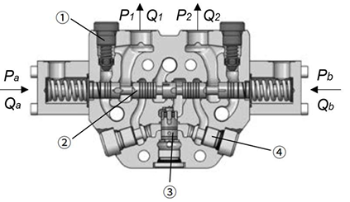
05 · COMPONENT SELECTION
Load Sensing Multiway Valve
LS Control Margin
Pump Pressure and Flow Curve
means the pump pressure must be slightly higher than the actuator/load pressure so oil can actually move through the control valve.
it appears as a pressure drop across the valve/control metering path.
ΔpLS ≈ 14 bar.
The 14 bar is therefore a control pressure margin.
It is not pipe friction, but it is pressure reserved for valve control, so it is not fully available at the actuator
The curve shows the pump operating envelope:
Flow increases from qv min to qv max
Pressure is limited near 350 bar
At high pressure, the pump cannot stay at maximum flow continuously
Load-sensing control changes displacement according to valve demand
Figure 4: Multiway Valve Demonstration
ME0522 · HYDRAULIC EXCAVATOR DESIGN
Notes:
With the requirements set, component selection is straightforward. For the pump, two Bosch Rexroth A11VLO-145 units, each delivering about two hundred seventy-six liters per minute, five hundred fifty-two total, within one-and-a-half percent of the benchmark. For travel, the A6VM Series 71, size two-eighty bent-axis motor, rated at fourteen hundred newton-meters at our pressure, comfortably above the twelve hundred we need. For the implements, double-acting cylinders sized from the force analysis: a one-forty boom, a one-fifty stick, and a one-forty-five bucket, all right on the benchmark dimensions. Flow is distributed by a load-sensing multiway valve block with a dedicated section per function, plus pressure compensators and load-check valves for stable, safe actuation.

Slide 10
06 · SYSTEM LOSSES
Full-System Losses & Validation
SUPPLY
− PIPE & FITTINGS
− LS CONTROL MARGIN
= AT ACTUATOR
350 bar
3.1 bar
14 bar
≈ 333 bar
Pump pressure class
Friction over longest branch
Load-sensing reserve
Pressure available for work
ACTUATOR
@ 350 BAR
@ 333 BAR
REQUIREMENT
RESULT
Travel motor — A6VM NG280
1404 N·m
1336 N·m
≈ 1200 N·m
Suitable
Boom cylinder — Ø140 mm
539 kN
513 kN
benchmark
Suitable
Stick cylinder — Ø150 mm
217 kN
206 kN
145 kN
Suitable
Bucket cylinder — Ø145 mm
203 kN
193 kN
179 kN
Suitable
ME0522 · HYDRAULIC EXCAVATOR DESIGN
Notes:
No design is complete without checking losses. Approximating the longest implement branch, pipe friction and fittings cost about three bar, and the load-sensing control margin adds fourteen, roughly seventeen bar total. So the pressure actually reaching the actuators drops from three hundred fifty to about three hundred thirty-three bar. We re-checked every actuator at that reduced pressure. The travel motor still delivers thirteen hundred thirty-six newton-meters, above requirement. The boom holds. The stick and bucket were marginal at their initial bores, so we increased them, the stick to one hundred fifty millimeters and the bucket to one hundred forty-five, and both clear their targets with margin. Every actuator passes after losses.

Slide 11
APPENDIX A · COST
Bill of Materials
ITEM
QTY
ESTIMATED TOTAL
Main pump — A11VLO 145
2
$8,000
Travel motor — A6VM NG280
2
$6,000
ESTIMATED MAIN HYDRAULIC BOM
Planetary final drive
2
$6,000
$28.9k ++
Order-of-magnitude estimate from current supplier listings — realistic for a 30-ton machine.
Boom / stick / bucket cylinders
4
$5,400
Load-sensing multiway valve block
1
$1,500
Hoses, fittings & safety valves
1 set
$2,000
ME0522 · HYDRAULIC EXCAVATOR DESIGN
Notes:
Briefly on cost. The main hydraulic bill of materials, the two pumps, two travel motors, final drives, four cylinders, the multiway valve block, and supporting hoses and fittings, comes to an estimated range of roughly twenty-nine to sixty-nine thousand dollars, based on current supplier listings. It's an order-of-magnitude estimate, but it confirms the selection is realistic for a thirty-ton machine.

Slide 12
07 · CONCLUSION
Benchmark Comparison & Conclusion
DESIGN ITEM
BENCHMARK / TARGET
FINAL SELECTED
OUTCOME
System pressure
350 bar
350 bar
Same class
Pump flow
560 L/min
552 L/min
Within 1.4%
Travel motor torque
≈ 1200 N·m
1336 N·m
Met after losses
Boom / stick / bucket bore
140 / 150 / 135
140 / 150 / 145
Matches benchmark
Protection & damping
Industry features
Suspension + cushioning
Added for realism
Starting only from external performance targets, the design lands a coherent, simplified hydraulic system suitable as a preliminary design for a 30-ton excavator.
ME0522 · HYDRAULIC EXCAVATOR DESIGN
Notes:
To conclude. The design holds together against the benchmark. We kept the three-hundred-fifty-bar pressure class, pump flow came within one-and-a-half percent of the reference, the travel motor satisfies its torque requirement even after losses, and all three cylinder bores match realistic excavator dimensions. We also added boom suspension and cylinder cushioning to improve realism and protect the actuators. So, starting only from external performance targets, we arrived at a coherent, simplified hydraulic system suitable as a preliminary design for a thirty-ton excavator. Thank you. We're happy to take questions.

