Slide 1


Adaptive Kalman Filter
Based on:
Kalman, R. E. (1960). "A New Approach to Linear Filtering and Prediction Problems.“
Akhlaghi, S., et al. (2017). "Adaptive Adjustment of Noise Covariance in Kalman Filter for Dynamic State Estimation."
Student: Ramez Al-Masadeh
ID: 20221102027
Supervisor: Dr. Sahar Qaadan
Course: Machine Intelligence I

Slide 2


Agenda
1
2
3
4
Cover
Agenda
Introduction
Simulations
5
6
Future Plans
Conclusions

Slide 3
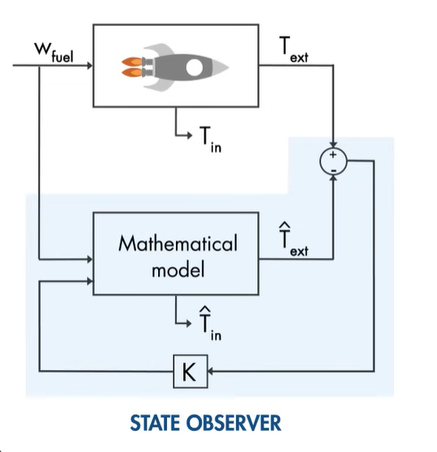

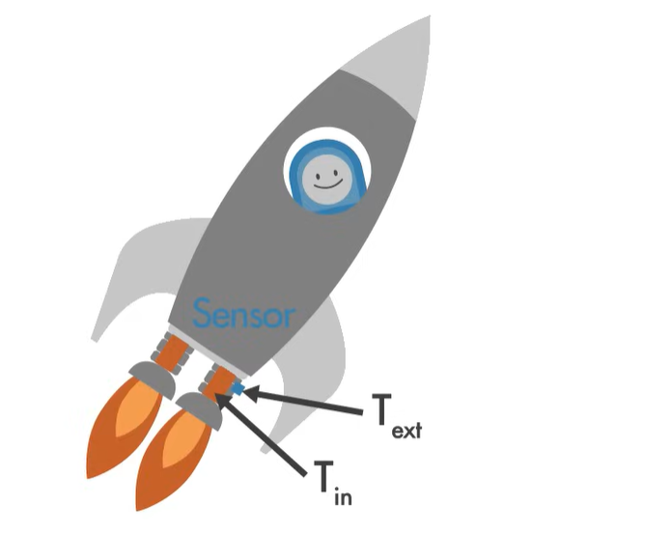
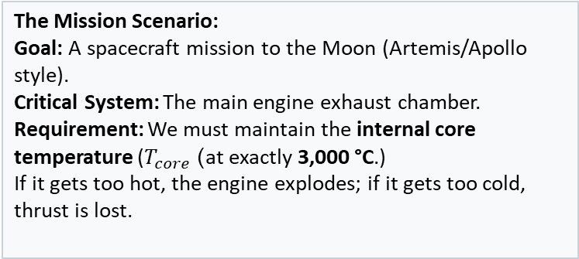
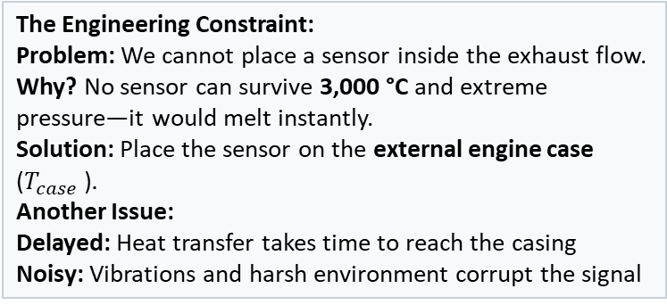
Introduction
Motivation – The Need of State Estimation (The "Hidden State" Problem)
The Mission Scenario:
Goal: A spacecraft mission to the Moon (Artemis/Apollo style).
Critical System: The main engine exhaust chamber.
Requirement: We must maintain the internal core temperature ($T_{core}$) at exactly 3,000 °C.)
If it gets too hot, the engine explodes; if it gets too cold, thrust is lost.
The Engineering Constraint:
Problem: We cannot place a sensor inside the exhaust flow.
Why? No sensor can survive 3,000 °C and extreme pressure—it would melt instantly.
Solution: Place the sensor on the external engine case ($T_{case}$ ).
Another Issue:
Delayed: Heat transfer takes time to reach the casing
Noisy: Vibrations and harsh environment corrupt the signal
Main Solution:
We add a state estimator (observer)
Types of State Estimation:
Luenberger Observer
Linear Quadratic Estimator

Slide 4
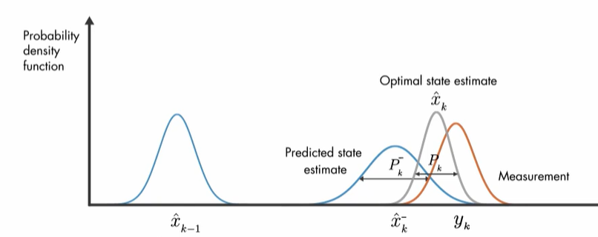
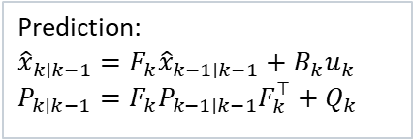
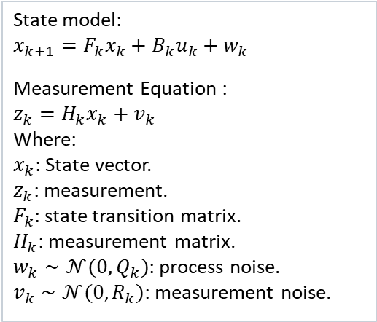
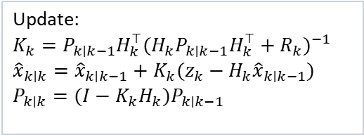
Introduction
Literature Overview (1/2) – Kalman, R. E. (1960). "A New Approach to Linear Filtering and Prediction Problems.“
Kalman introduced an optimal recursive estimator for linear dynamic systems with Gaussian noise, now known as the Kalman Filter.
State model:
$$x_{k+1}=F_{k}x_{k}+B_{k}u_{k}+w_{k}$$
Measurement Equation :
$$z_{k}=H_{k}x_{k}+v_{k}$$
Where:
$x_{k}$: State vector.
$z_{k}$: measurement.
$F_{k}$: state transition matrix.
$H_{k}$: measurement matrix.
$w_{k}∼𝒩(0,Q_{k})$: process noise.
$v_{k}∼𝒩(0,R_{k})$: measurement noise.
Prediction:
$${\hat{x}}_{k∣k−1}=F_{k}{\hat{x}}_{k−1∣k−1}+B_{k}u_{k} \\ P_{k∣k−1}=F_{k}P_{k−1∣k−1}F_{k}^{⊤}+Q_{k}$$
Update:
$$K_{k}=P_{k∣k−1}H_{k}^{⊤}(H_{k}P_{k∣k−1}H_{k}^{⊤}+R_{k})^{−1}$$
$${\hat{x}}_{k∣k}={\hat{x}}_{k∣k−1}+K_{k}(z_{k}−H_{k}{\hat{x}}_{k∣k−1})$$
$$P_{k∣k}=(I−K_{k}H_{k})P_{k∣k−1}$$
Fig.1
What it solves?
The method provides minimum mean-square error (MMSE) state estimates by optimally combining noisy measurements with a system model, overcoming limitations of batch least-squares methods.
The KF is optimal only for linear, Gaussian systems and requires accurate knowledge of 𝑄 and 𝑅.
Metrics :
Mean Squared Error (MSE)
NIS (innovation consistency)
Assumption: linear, Gaussian systems
Types of None-linear Kalman Filer:
Extended KF, Unscented KF.

Slide 5

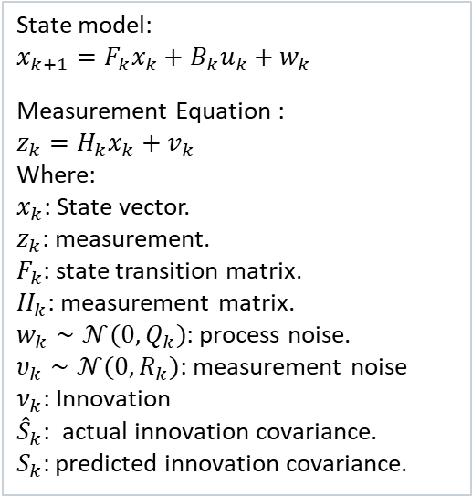
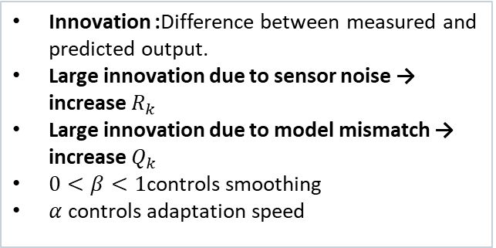
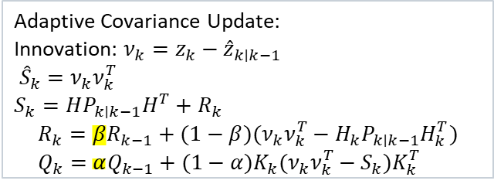
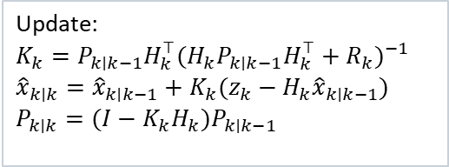
Introduction
Literature Overview (2/2) – Akhlaghi, S., et al. (2017). "Adaptive Adjustment of Noise Covariance in Kalman Filter"
The paper proposes an adaptive Kalman Filter framework that dynamically adjusts the process and measurement noise covariance matrices using innovation-based statistics.
State model:
$$x_{k+1}=F_{k}x_{k}+B_{k}u_{k}+w_{k}$$
Measurement Equation :
$$z_{k}=H_{k}x_{k}+v_{k}$$
Where:
$x_{k}$: State vector.
$z_{k}$: measurement.
$F_{k}$: state transition matrix.
$H_{k}$: measurement matrix.
$w_{k}∼𝒩(0,Q_{k})$: process noise.
$υ_{k}∼𝒩(0,R_{k})$: measurement noise
$ν_{k}$: Innovation
${\hat{S}}_{k}$: actual innovation covariance.
$S_{k}:$ predicted innovation covariance.
Prediction:
$${\hat{x}}_{k∣k−1}=F_{k}{\hat{x}}_{k−1∣k−1}+B_{k}u_{k} \\ P_{k∣k−1}=F_{k}P_{k−1∣k−1}F_{k}^{⊤}+Q_{k}$$
Innovation :Difference between measured and predicted output.
Large innovation due to sensor noise → increase $R_{k}$
Large innovation due to model mismatch → increase $Q_{k}$
$0<β<1$controls smoothing
$α$controls adaptation speed
Update:
$$K_{k}=P_{k∣k−1}H_{k}^{⊤}(H_{k}P_{k∣k−1}H_{k}^{⊤}+R_{k})^{−1}$$
$${\hat{x}}_{k∣k}={\hat{x}}_{k∣k−1}+K_{k}(z_{k}−H_{k}{\hat{x}}_{k∣k−1})$$
$$P_{k∣k}=(I−K_{k}H_{k})P_{k∣k−1}$$
All KF/EKF/UKF versions assume fixed and known noise covariances.
But real systems have:
  Time-varying sensor noise.
  Model uncertainties
  Sensor degradation (e.g., batteries, IMUs, cameras)
  Sudden nonlinear events (e.g., battery voltage knee)
Adaptive Covariance Update:
Innovation: $ν_{k}=z_{k}−{\hat{z}}_{k∣k−1}$
${\hat{S}}_{k}=ν_{k}ν_{k}^{T}$
$$S_{k}=HP_{k∣k−1}H^{T}+R_{k}$$
$$R_{k}=βR_{k−1}+(1−β)(ν_{k}ν_{k}^{T}−H_{k}P_{k∣k−1}H_{k}^{T}) \\ Q_{k}=αQ_{k−1}+(1−α)K_{k}(ν_{k}ν_{k}^{T}−S_{k})K_{k}^{T}$$
The Innovation is the "Surprise" factor. It is the difference between what the sensor actually saw and what the Kalman Filter predicted it would see.

Slide 6
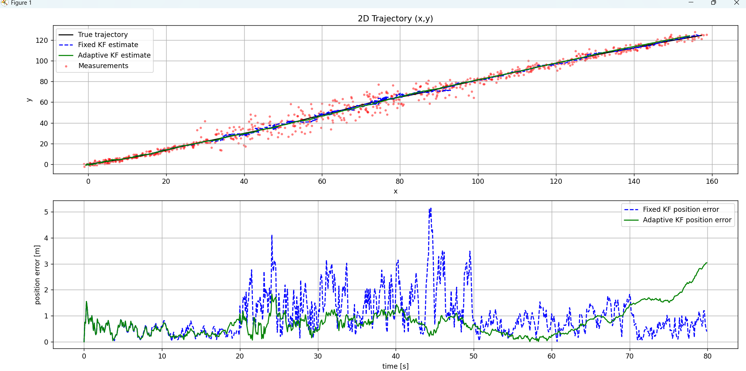
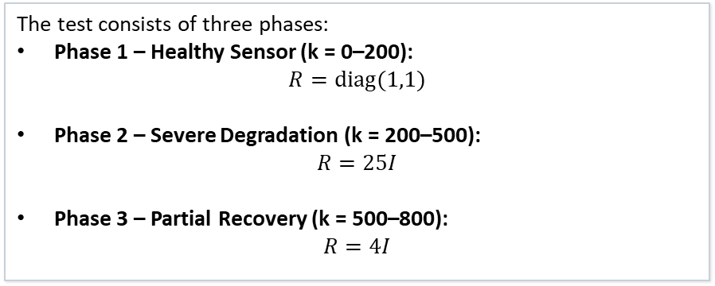
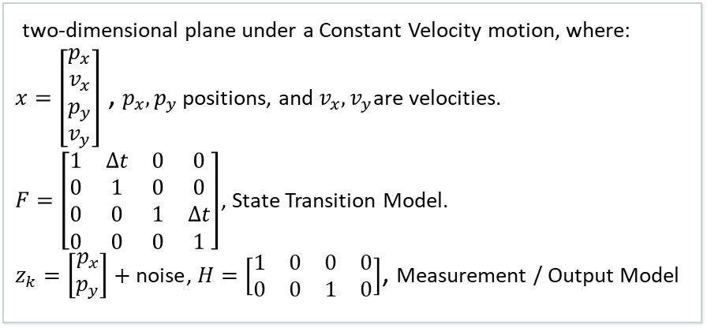
Simulations
2D Tracking Test (1/2) - comparison between Adaptive Kamlan Filter & Basic Kalman Filter
two-dimensional plane under a Constant Velocity motion, where:
$x=\left[\begin{aligned}p_{x} \\ v_{x} \\ p_{y} \\ v_{y}\end{aligned}\right]$ , $p_{x},p_{y}$ positions, and $v_{x},v_{y}$are velocities.
$F=\left[\begin{matrix}1 & Δt & 0 & 0 \\ 0 & 1 & 0 & 0 \\ 0 & 0 & 1 & Δt \\ 0 & 0 & 0 & 1\end{matrix}\right]$, State Transition Model.
$z_{k}=\left[\begin{aligned}p_{x} \\ p_{y}\end{aligned}\right]+\text{noise}$, $H=\left[\begin{matrix}1 & 0 & 0 & 0 \\ 0 & 0 & 1 & 0\end{matrix}\right]$, Measurement / Output Model
The test consists of three phases:
Phase 1 – Healthy Sensor (k = 0–200):
$$R=diag(1,1)$$
Phase 2 – Severe Degradation (k = 200–500):
$$R=25I$$
Phase 3 – Partial Recovery (k = 500–800):
$R=4I$
Fig.2 Trajectory Tracking

Slide 7
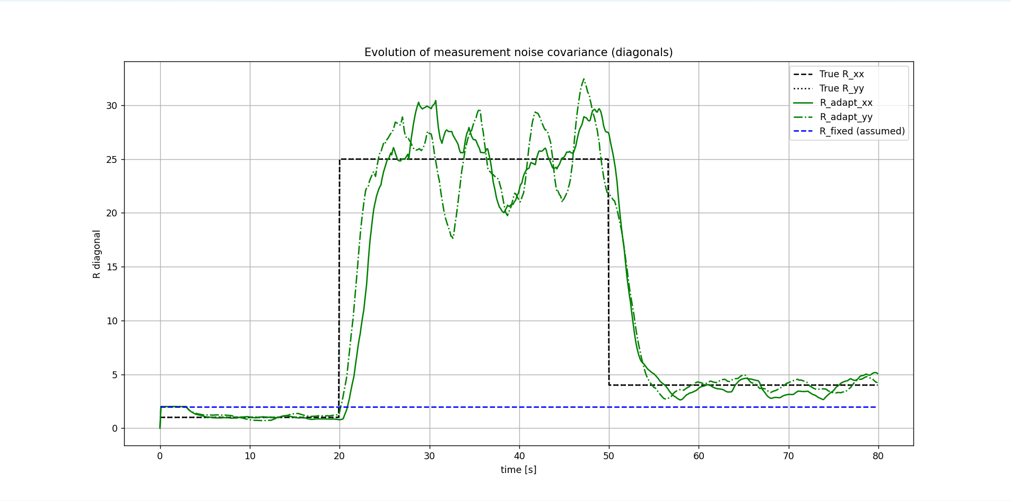
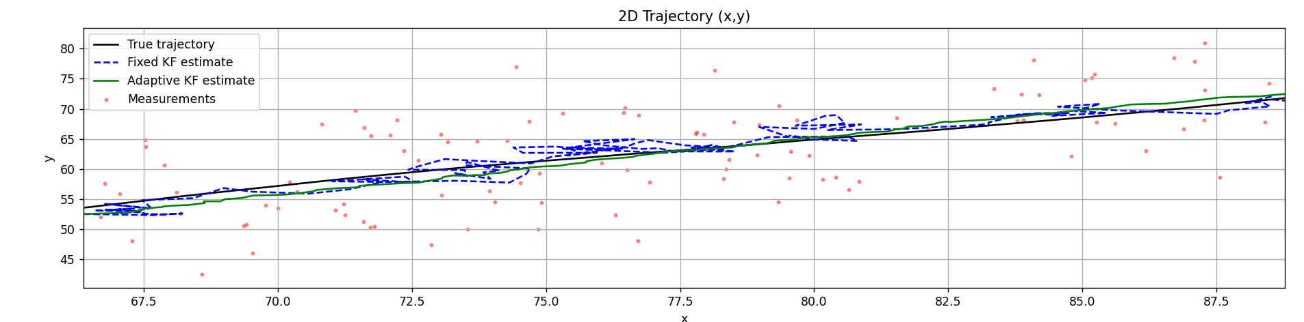
Simulations
2D Tracking (2/2) - comparison between Adaptive Kamlan Filter & Basic Kalman Filter (Results)
Fig.3-Trajectory Tracking (Zoomed)
Fig.4 - Noise Estimation
Root Mean Square Error (RMSE) Comparison:
• Fixed Kalman Filter: 0.8973
• Adaptive Kalman Filter: 0.6723

Slide 8
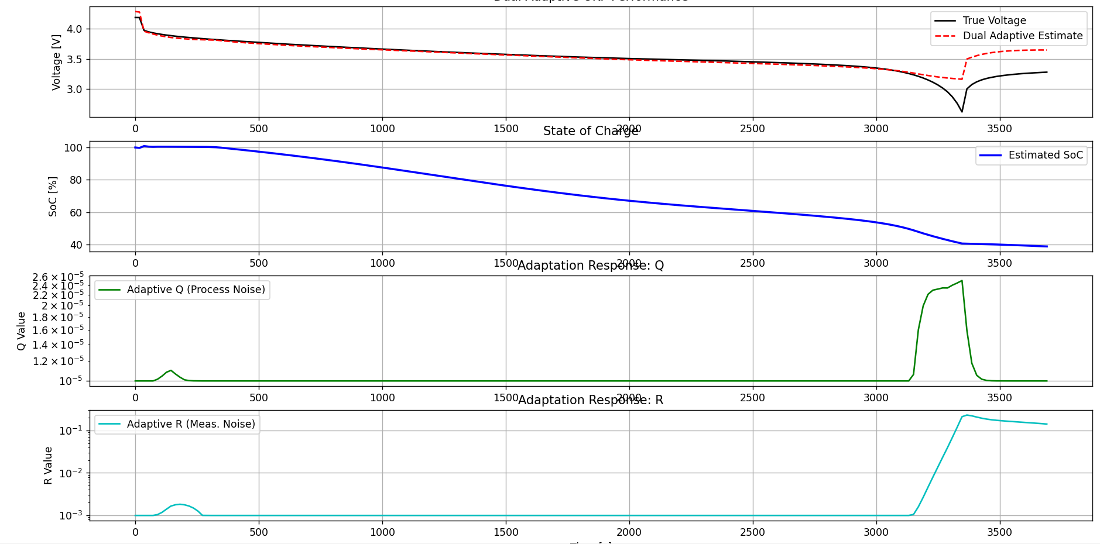
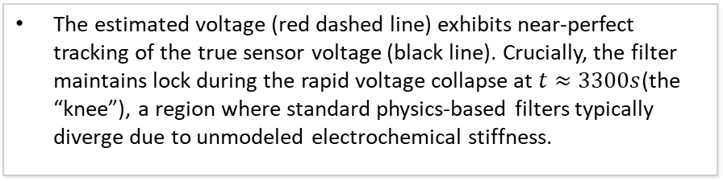
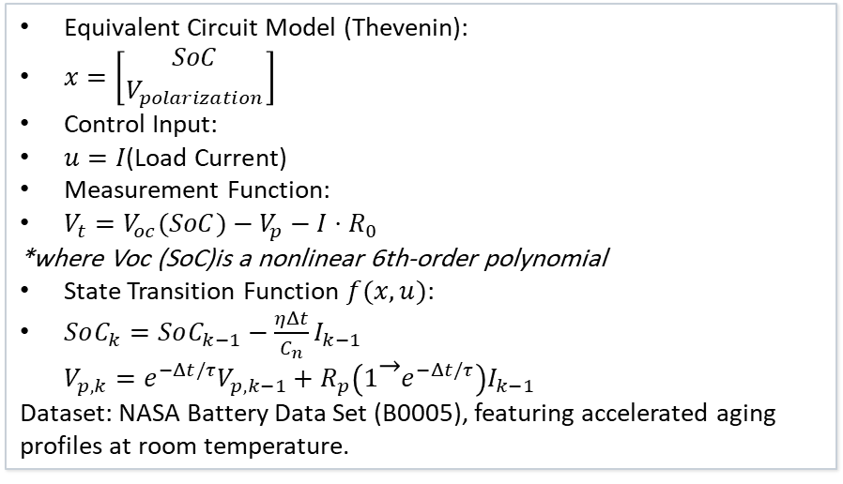
Simulations
Case Study – Battery State of Charge Estimation using Dual – Unscented Adaptive Kalman Filter
Equivalent Circuit Model (Thevenin):
$x=\left[\begin{aligned}SoC \\ V_{polarization}\end{aligned}\right]$
Control Input:
$u=I\text{(}\text{Load} \text{Current}\text{)}$
Measurement Function:
$V_{t}=V_{oc}(SoC)−V_{p}−I⋅R_{0}$
*where Voc (SoC)is a nonlinear 6th-order polynomial
State Transition Function $f(x,u)$:
$SoC_{k}=SoC_{k−1}−\frac{ηΔt}{C_{n}}I_{k−1}$
$V_{p,k}=e^{−Δt/τ}V_{p,k−1}+R_{p}\left(1 − e^{−Δt/τ}\right)I_{k−1}$
Dataset: NASA Battery Data Set (B0005), featuring accelerated aging profiles at room temperature.
The estimated voltage (red dashed line) exhibits near-perfect tracking of the true sensor voltage (black line). Crucially, the filter maintains lock during the rapid voltage collapse at $t≈3300s$(the “knee”), a region where standard physics-based filters typically diverge due to unmodeled electrochemical stiffness.
Fig.4 - DA UFK for Battery State of Charge

Slide 9
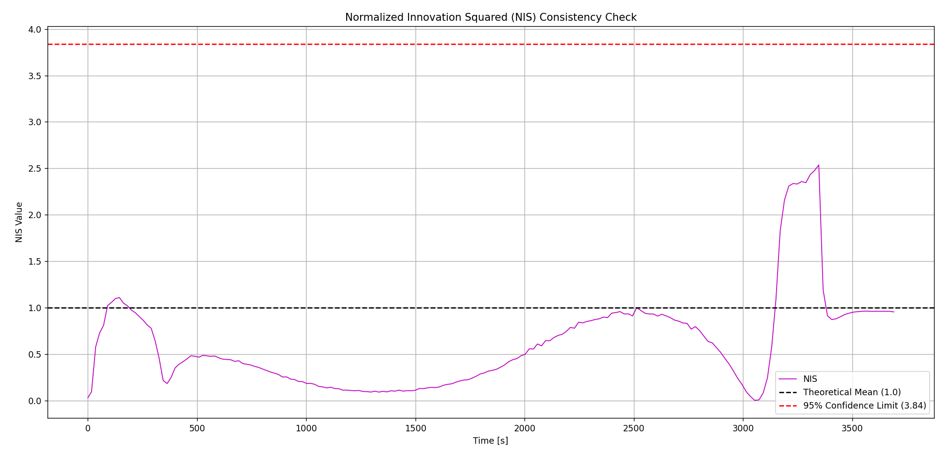
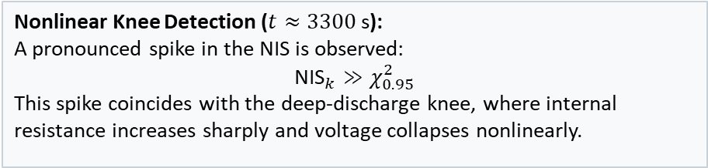
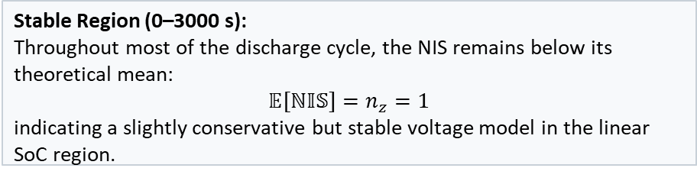
Simulations
Case Study – Battery State of Charge Estimation using Dual – Adaptive Kalman Filter (Results)
[Plot 4: Innovation whiteness / residual analysis]
Fig.4 – Normalized Innovation Squared (NIS)
Stable Region (0–3000 s):
Throughout most of the discharge cycle, the NIS remains below its theoretical mean:
$$𝔼[ℕ𝕀𝕊]=n_{z}=1$$
indicating a slightly conservative but stable voltage model in the linear SoC region.
Nonlinear Knee Detection ($t≈3300$s):
A pronounced spike in the NIS is observed:
$${\text{NIS}}_{k}≫χ_{0.95}^{2}$$
This spike coincides with the deep-discharge knee, where internal resistance increases sharply and voltage collapses nonlinearly.

Slide 10
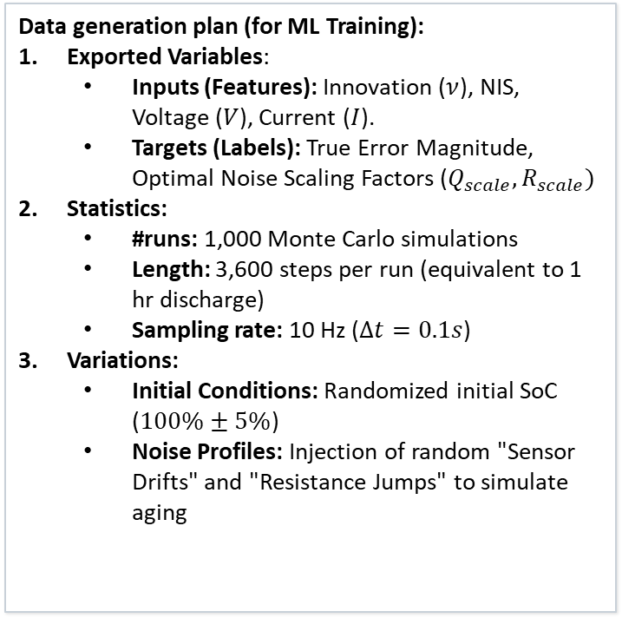
Future Plans
How Simulation Creates Synthetic Data
Data generation plan (for ML Training):
Exported Variables:
  Inputs (Features): Innovation ($ν$), NIS, Voltage ($V$), Current ($I$).
  Targets (Labels): True Error Magnitude, Optimal Noise Scaling Factors ($Q_{scale},R_{scale})$
Statistics:
  #runs: 1,000 Monte Carlo simulations
  Length: 3,600 steps per run (equivalent to 1 hr discharge)
  Sampling rate: 10 Hz ($Δt=0.1s$)
Variations:
  Initial Conditions: Randomized initial SoC ($100\%±5\%$)
  Noise Profiles: Injection of random "Sensor Drifts" and "Resistance Jumps" to simulate aging
Scenario | Noise Level | Parameter Change | #Runs
Baseline | Low Gaussian Noise | Ideal Parameters | 200
Sensor Drift | Linearly Increasing (R) | Bias + 0.1 mV/sec | 300
Model Fail | Standard (Q) | Internal Resistance | 300
Combined | High (R) + High (Q) | Sudden "Knee" & Sensor Noise | 200
Thevenin Physics Model
Monte Carlo (Randomize Noise Params
[Extract Features (NIS, Innovation)]
[Dataset (Train 70% / Val 15% / Test 15%)]

Slide 11
Future Plans
Identified Research Gap
Akhlaghi, S., et al. (2017): Proposed "Innovation Covariance Matching" using a sliding window (e.g. , N = 30 samples) to estimate noise statistics.
Gap Statement (The Limitation):The "Window" Problem: Statistical methods rely on averaging past errors. This creates a mathematical lag. The filter only adapts after the failure has occurred and the window fills up.
Reactive vs. Predictive: The current DA-UKF is reactive—it sees a spike and fixes it. It cannot detect the subtle "precursors" of a battery voltage collapse (the "Knee") before the actual drop happens.
Proposed Contribution (AI / LSTM Integration):
Solution: Replace the statistical sliding window with an LSTM (Long Short-Term Memory) Neural Network.
Why LSTM fills the gap:
Zero-Lag Adaptation: Detects patterns instantly without waiting for a statistical window to fill.
Temporal Memory: Learns cause-and-effect over time (e.g., current load causing later voltage drop) for predictive tuning.

Slide 12
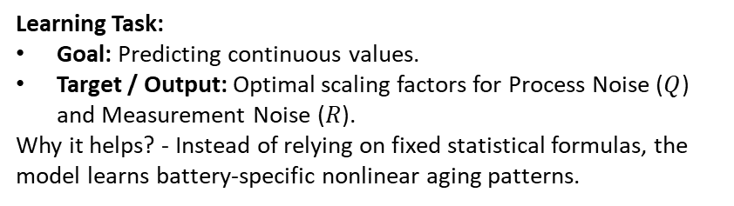
Future Plans
Machine Learning Plan & Features
Dataset design:
Dataset size: ~50,000 samples (Derived from 15 simulation runs × 3,600 time steps).
Split idea: Train 70% / Validation 15% / Test 15%.
Data format: CSV (Time-series matrix).
Learning Task:
Goal: Predicting continuous values.
Target / Output: Optimal scaling factors for Process Noise ($Q$) and Measurement Noise ($R$).
Why it helps? - Instead of relying on fixed statistical formulas, the model learns battery-specific nonlinear aging patterns.
Feature | Source | Purpose
Innovation | Filter Output | The raw error signal (Model vs Sensor).
NIS Score | Filter Output | Statistical trigger for model failure.
Voltage Slope | Sensor | Indicates proximity to the "Voltage Knee."
SoC Estimate | State Vector | Context (Failures occur near 0% SoC).
Candidate Algorithm: Simple LSTM (Long Short-Term Memory).
Reason: LSTMs are lightweight, easy to implement in Python (Keras), and specifically designed to handle time-series memory (understanding that a voltage drop now relates to current usage seconds ago).

Slide 13
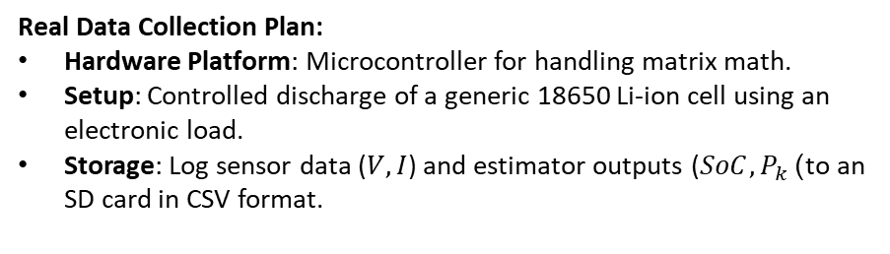
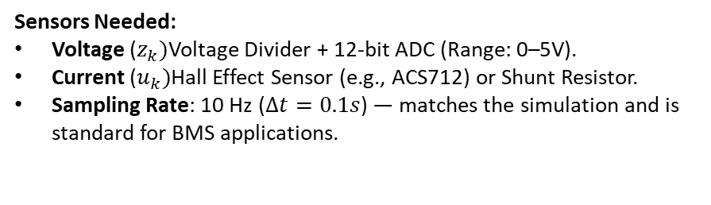
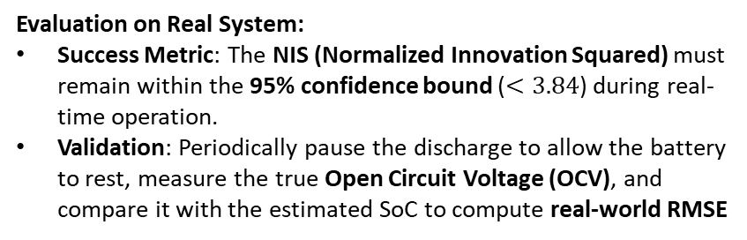
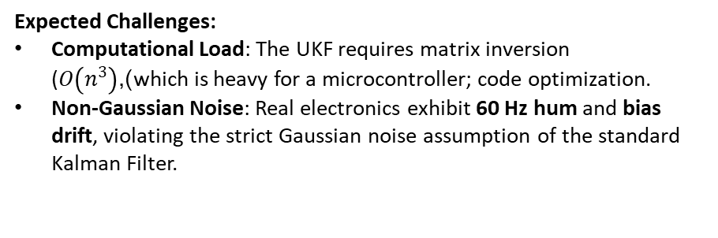
Future Plans
Real Deployment
Sensors Needed:
Voltage ($z_{k})$Voltage Divider + 12-bit ADC (Range: 0–5V).
Current ($u_{k})$Hall Effect Sensor (e.g., ACS712) or Shunt Resistor.
Sampling Rate: 10 Hz ($Δt=0.1s$) — matches the simulation and is standard for BMS applications.
Real Data Collection Plan:
Hardware Platform: Microcontroller for handling matrix math.
Setup: Controlled discharge of a generic 18650 Li-ion cell using an electronic load.
Storage: Log sensor data ($V,I$) and estimator outputs ($SoC,P_{k}$) to an SD card in CSV format.
Expected Challenges:
Computational Load: The UKF requires matrix inversion ($O\left(n^{3}\right)$),which is heavy for a microcontroller; code optimization.
Non-Gaussian Noise: Real electronics exhibit 60 Hz hum and bias drift, violating the strict Gaussian noise assumption of the standard Kalman Filter.
Evaluation on Real System:
Success Metric: The NIS (Normalized Innovation Squared) must remain within the 95% confidence bound ($<3.84$) during real-time operation.
Validation: Periodically pause the discharge to allow the battery to rest, measure the true Open Circuit Voltage (OCV), and compare it with the estimated SoC to compute real-world RMSE

Slide 14
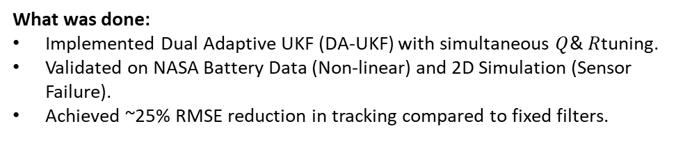
Conclusions
Summary of Simulations
What was done:
Implemented Dual Adaptive UKF (DA-UKF) with simultaneous $Q$& $R$tuning.
Validated on NASA Battery Data (Non-linear) and 2D Simulation (Sensor Failure).
Achieved ~25% RMSE reduction in tracking compared to fixed filters.
What was learned:
Fixed Filters Fail: Static noise parameters cause divergence during degradation.
Adaptation Works: The filter successfully switches trust between Physics and Sensors using the NIS Trigger.
Learning the foundation of Kalman Filter, types, and applications.
What comes next:
AI Integration: Replace statistical formulas with LSTMs for predictive (zero-lag) adaptation.
Hardware: Deploy logic on STM32 microcontrollers for real-time Battery Management Systems testing.

Slide 15
Conclusions
References
Base paper:
Akhlaghi, S., Zhou, N., & Huang, Z. (2017). "Adaptive Adjustment of Noise Covariance in Kalman Filter for Dynamic State Estimation." IEEE Power & Energy Society General Meeting. DOI: 10.1109/PESGM.2017.8273756
Recent gap paper:
Chhabra, A., Venepally, J. R., & Kim, D. (2021). "Measurement Noise Covariance-Adapting Kalman Filters for Varying Sensor Noise Situations." Sensors, 21(24), 8304.
Other supporting papers/tools:
Original Theory: Kalman, R. E. (1960). "A New Approach to Linear Filtering and Prediction Problems." Transactions of the ASME—Journal of Basic Engineering, 82 (Series D): 35–45.
Dataset: NASA Prognostics Center of Excellence (PCoE). "Li-ion Battery Aging Datasets (B0005)." NASA Ames Research Center.
Battery Model: Sun, F., et al. (2011). "State of charge estimation for lithium-ion batteries based on an adaptive unscented Kalman filter." Energy, 36(5)
Software Library: Labbe, R. "Kalman and Bayesian Filters in Python." (filterpy).

