Slide 1
Concept Of Recursion

Slide 2
Table of contents
01
02
03
04
Introduction
When do we use recursion?
EXP Factoriel
Exercice:palindrome

Slide 3
01
Introduction

Slide 4
Recursion!
-The process in which a function calls itself directly or indirectly, this allows the function to be repeated several times
=>This act is called recursion and the corresponding function is called as recursive function

Slide 5
When do we use recursion?
-Recursion is made for solving problems
- It is especially good for working on things that have many possible branches and are too complex for an iterative approach

Slide 6
Base Case:
-One critical requirement of recursive functions is the termination point or base case
-Every recursive program must have a base case to make sure that the function will terminate

Slide 7
Exemple:Factoriel!
To calculate factorial of n we apply this formula :
n! = n x (n-1) x (n-2) x . . . x 2 x 1
“How we calculate factorial of n-1 ?”You can organize your ideas
n-1! = (n-1) x (n-2) x . . . x 2 x 1
n! = n x (n-1)!
The base case: factorial of 0 equals 1

Slide 8
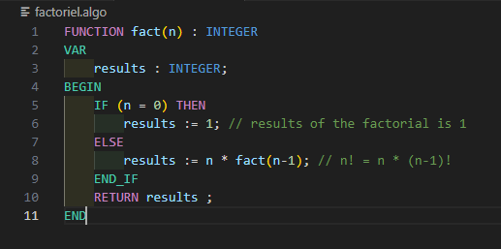

Slide 9

Exercie:Palindrome

Slide 10
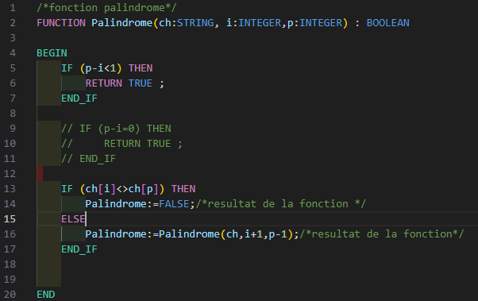

Slide 11
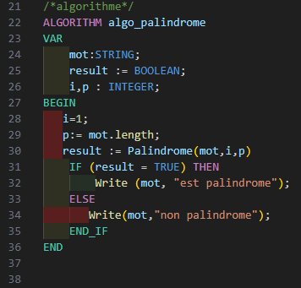


Slide 12
Conclusion
-The recursive form could be very simple and easy to implement.
-But everything comes with a cost, so a recursive function can be inefficient in terms of both time and space. That what's make it a little bit tricky in its use.

Slide 13
Thank you

