Slide 1
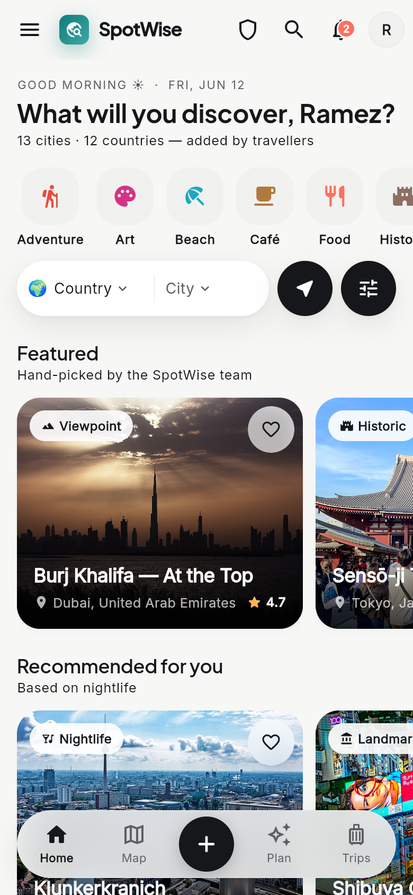
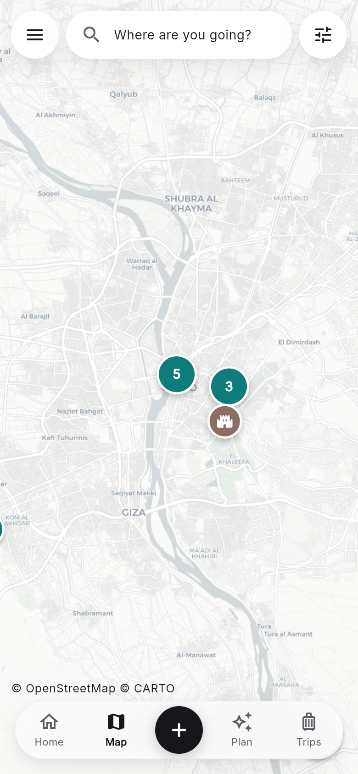
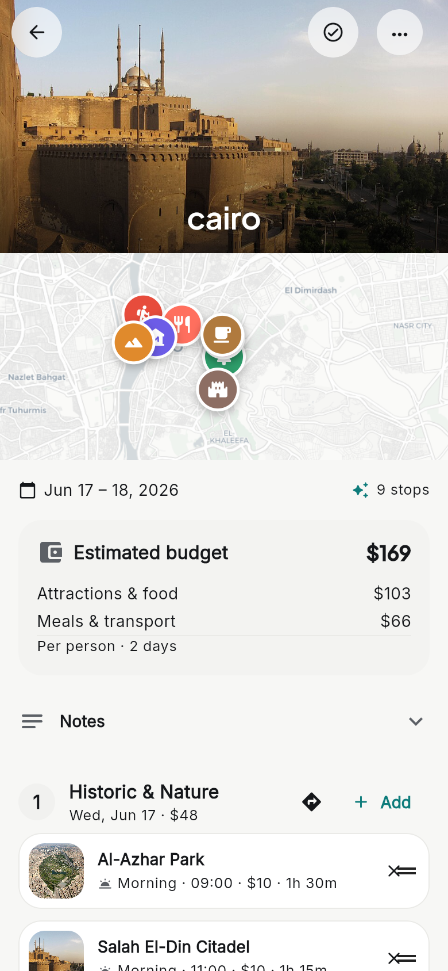
S
SpotWise
Discover.
Plan.
Travel.
A community travel app built with Flutter — real places from real travellers, turned into trips by AI.
Ramez Milad · June 2026
Marwan Moamen
Notes:
Hi everyone. Today I want to show you SpotWise — a travel app I built with Flutter. The idea is simple: travellers know the best places, so why not let them share those places with each other? In this short presentation I'll show you how the app is set up and built, and then walk through its main features: discovering spots, the community side, the AI trip planner, and the admin tools that keep everything safe. Everything you'll see on these slides is a real screenshot taken from the app.

Slide 2
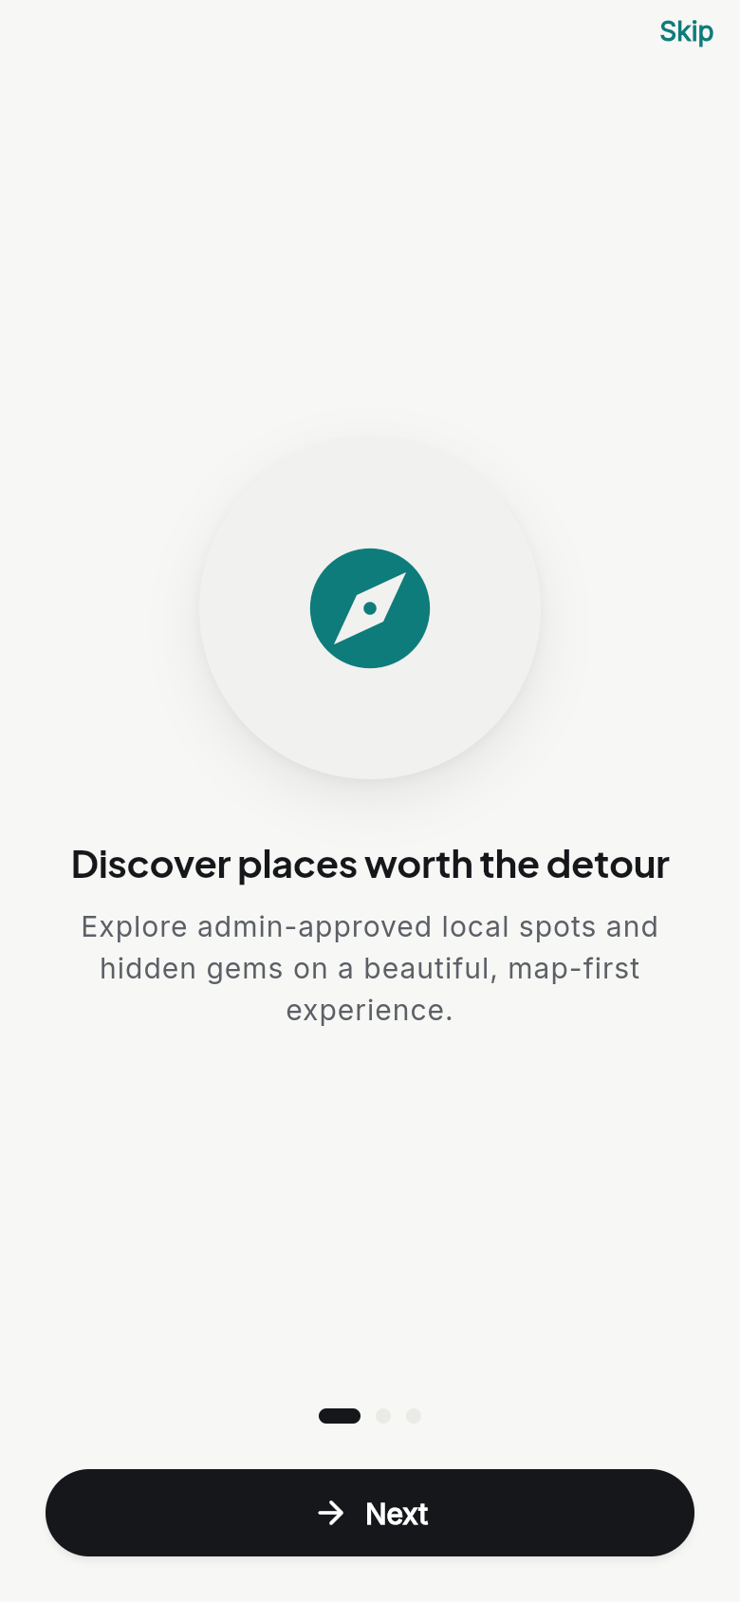
What is SpotWise?
A travel app where people share their favourite places — and AI turns them into real trips.
1
Discover
Browse real places, city by city.
2
Share
Add your own spots and reviews.
3
Plan with AI
Get a ready day-by-day trip.
Notes:
So what is SpotWise? It's a community travel app. Think of it in three steps. First, discover: you browse real places — cafés, beaches, viewpoints, hidden gems — shared by other travellers and organised by country and city. Second, share: any user can add their own favourite spot, with photos and a location, and leave reviews on places they've visited. Third, plan: the app has an AI planner that takes those community spots and turns them into a complete day-by-day trip. The screenshot on the right is the first thing a new user sees when they open the app.

Slide 3
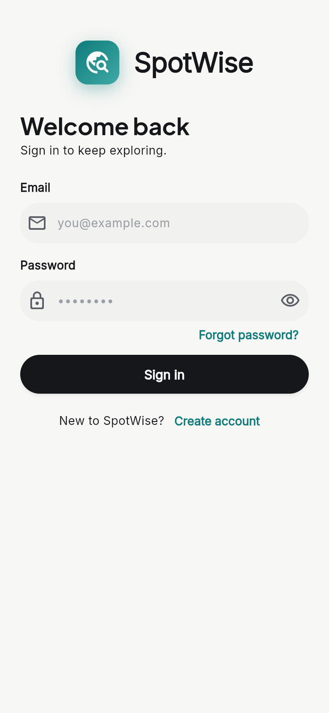
How it's built
Free tools. One codebase. Three keys to set up.
Flutter
Firebase
One app for Android, iOS and web.
Login, live database and photos.
OpenStreetMap
Google Gemini
Free in-app maps and search.
The AI behind trip planning.
SETUP add 3 keys to .env → flutter pub get → flutter run
No keys? It still runs — on built-in demo data.
Notes:
Let me quickly explain how it's built — and how easy it is to set up. The whole app is one Flutter codebase, so the same code runs on Android, iOS and the web. Firebase handles the backend: user accounts, a live realtime database for the spots, and photo storage. The maps come from OpenStreetMap, which is completely free — no paid map keys needed. And the AI planner is powered by Google Gemini. Setup is simple: you clone the project and add three keys to a small .env file — the Firebase database link, the Firebase key, and a Gemini key. Then flutter pub get and flutter run, and you're in. One nice detail: if you leave the keys empty, the app still runs fully, using built-in demo data — so anyone can try it with zero configuration.

Slide 4
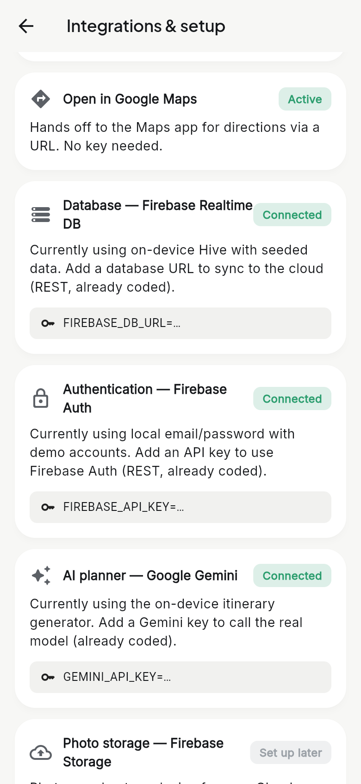
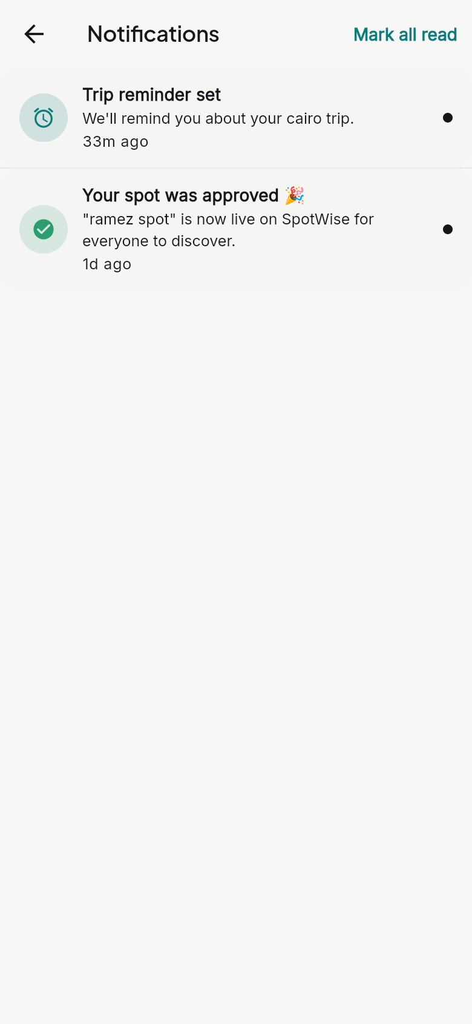
Connected to the cloud
Three services run outside the app — yet it still works free without them.
Firebase
Connected
Accounts, live database and photos.
Google Gemini
Connected
Builds the real AI trip plans.
Push notifications
On Android
Trip reminders on Android.
Notes:
These three things live outside the app itself — they are cloud services the app talks to. First, Firebase: it stores the user accounts, keeps the spots database live across devices, and holds the photos. Second, Google Gemini: this is the real AI that writes the trip plans. Third, push notifications: the app sends reminders — for example before a trip starts — and these work on Android, using on-device notifications now and Firebase Cloud Messaging for cross-device push. The screen on the left is a real page inside the app that shows each service and whether it is connected. The screen on the right shows real notifications the app has sent. And the clever part: all three are optional — if you don't add the keys, the app quietly falls back to on-device data, so it never breaks.

Slide 5
Find places worth visiting
Pick a country and a city — or search anywhere.
Filter by category: food, beach, history and more.
See every spot on a live map.
62 spots · 13 cities · 12 countries
Notes:
This is the heart of the app: finding places worth visiting. On the home screen you pick a country and a city — or just search. You can filter by category: food, beaches, history, nightlife and more. The home feed shows featured spots and personal recommendations. And everything also lives on a live map, so you can see exactly what's around you — the markers group together when you zoom out, like in the screenshot on the right. Right now the demo data already has around 60 spots across 13 cities and 12 countries.

Slide 6
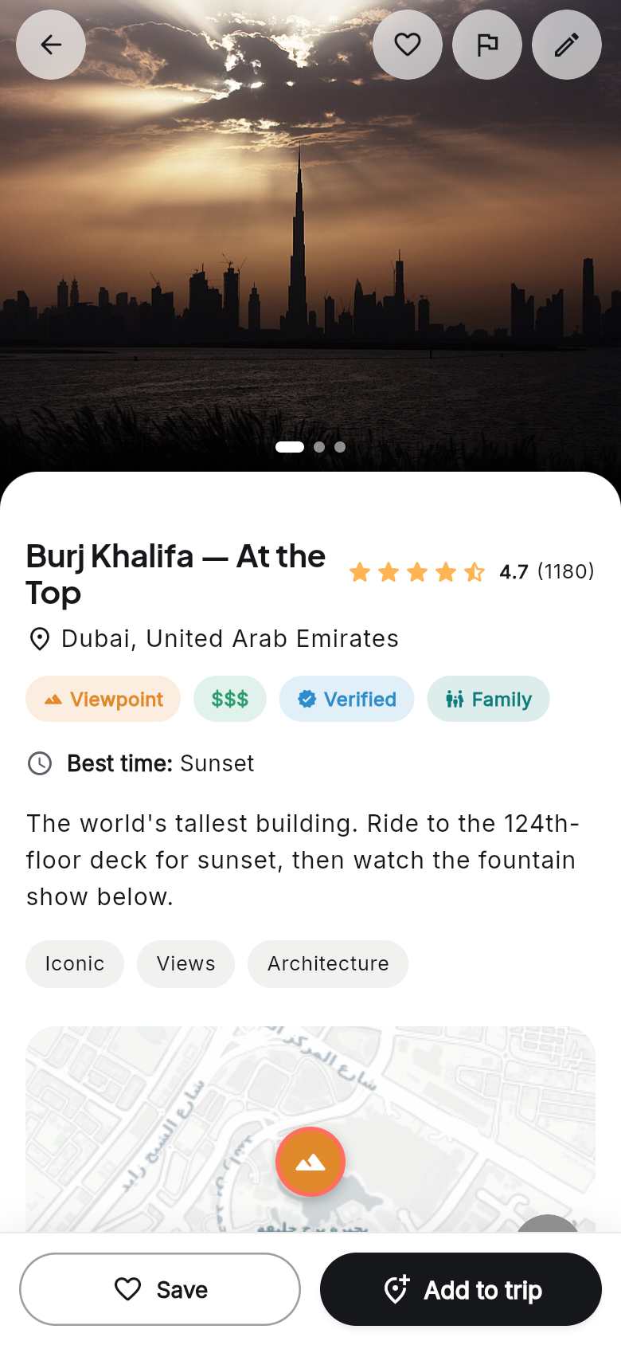
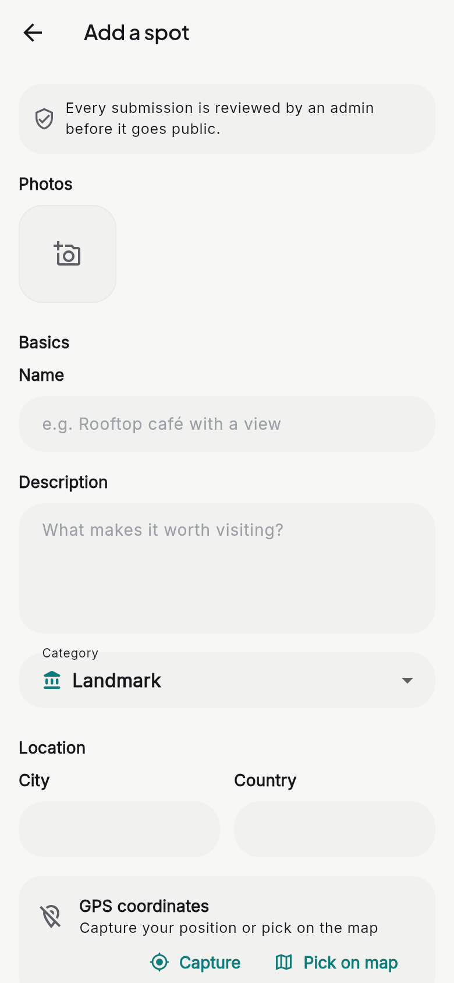
Built by the community
Anyone can add a spot — photos, details and location.
Ratings and reviews from real visitors.
Save favourites and add places straight to a trip.
Add it · Review it · Save it
Notes:
What makes SpotWise special is that the content comes from real people. Adding a spot is one simple form: photos, a name, a short description, a category, and the location — you can capture your GPS position or pick the point on a map. On the left you can see a finished spot page: photo gallery, rating, reviews, tags, a mini map, and one-tap buttons to save it or add it to a trip. Spots can also be marked as verified, so users know which places have been checked.

Slide 7
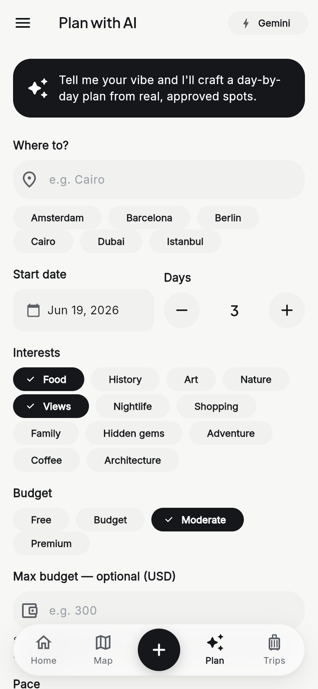
Plan a trip with AI
Tell it where, when, your interests and your budget.
Gemini builds a day-by-day plan from approved spots.
Every trip comes with a cost estimate.
✦ Powered by Google Gemini
Notes:
Now my favourite part — the AI trip planner. You tell it where you want to go, your start date, how many days, what you're interested in — say food and views — and your budget level. Gemini then builds a complete day-by-day plan. The key point: it only uses real, approved spots from the community — not made-up places. Each day has timed stops with prices and durations, and the whole trip gets a cost estimate — you can see the 183-dollar budget breakdown in the screenshot. The result is saved as a trip you can rename, reorder, add notes to, and take with you. And if there's no internet or no API key, a built-in offline generator makes the plan instead, so the feature always works.

Slide 8
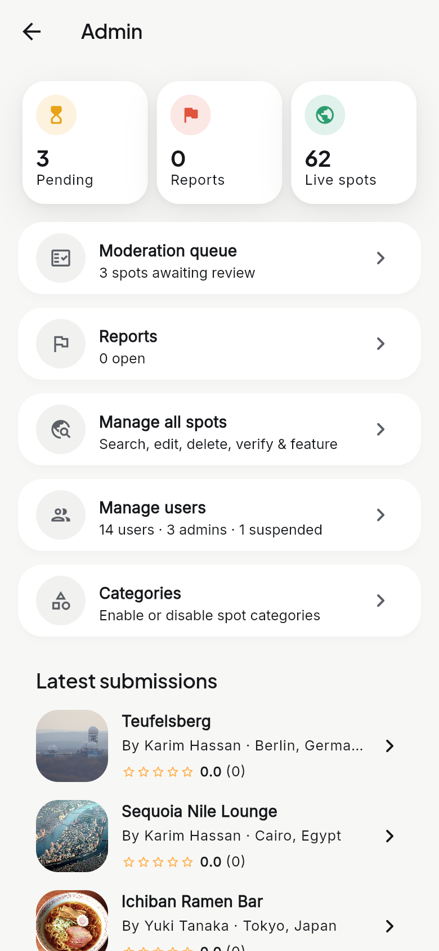
Safe and well managed
Admins approve every new spot before it goes live.
Reports, user roles and category controls.
Live stats for the whole app.
3
0
62
pending review
open reports
live spots
Notes:
Of course, when anyone can add content, you need moderation. Every new spot goes into a queue, and an admin reviews it before it appears in the app — users even see a clear note about this when they submit. Admins also handle reports from users, manage accounts and roles, and control which categories exist. The dashboard gives live numbers at a glance: spots pending review, open reports, and the total number of live spots. This is what keeps the app clean and trustworthy.

Slide 9
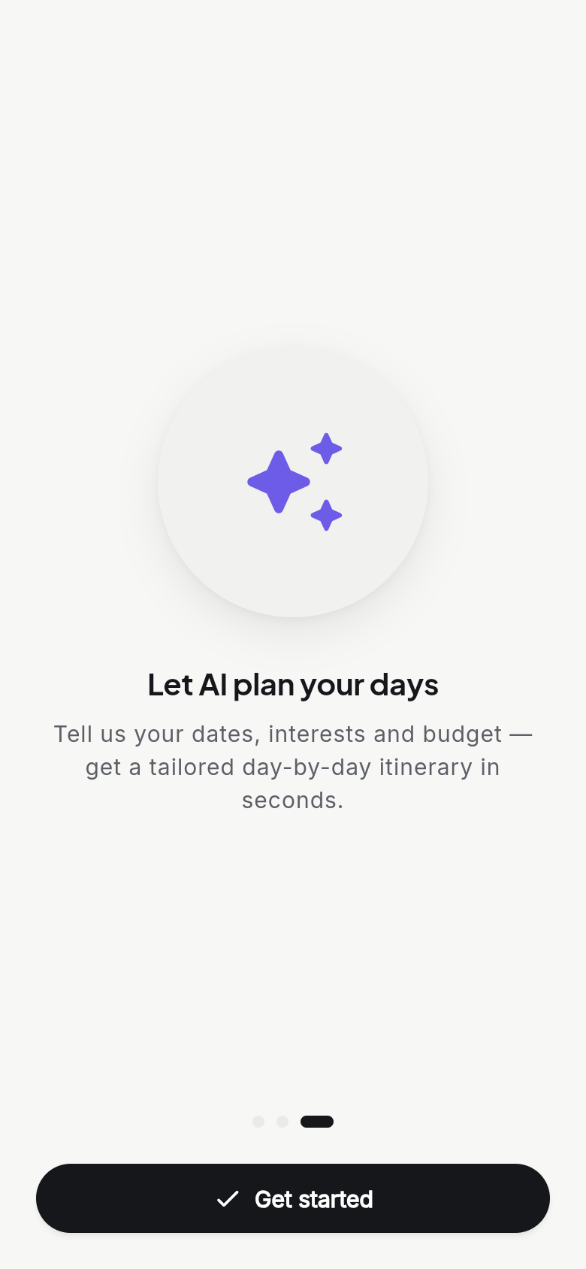
S
SpotWise
Thank you!
SpotWise — real places from real travellers,
turned into trips by AI.
Flutter · Firebase · OpenStreetMap · Google Gemini
Notes:
And that's SpotWise: real places from real travellers, on a free map, with an AI that turns them into trips — all in one Flutter app. Thank you for listening! I'd be happy to show a live demo or answer any questions.

