Slide 1
Topology and Cache Coherence in Knights Landing and Skylake Xeon Processors
John D. McCalpin, PhD
mccalpin@tacc.utexas.edu

Slide 2
Outline
On-Chip Interconnect
Coherence Protocol Changes
Deriving Core and CHA Numbering
Using Topology Information
Notes:
Introducing topics – slides will be available for details
Focus is on changes that impact performance analysis

Slide 3
Outline
On-Chip Interconnect
Coherence Protocol Changes
Deriving Core and CHA Numbering
Using Topology Information
Notes:
Crossbars were acceptable for 2-4 cores, but are not scalable

Slide 4
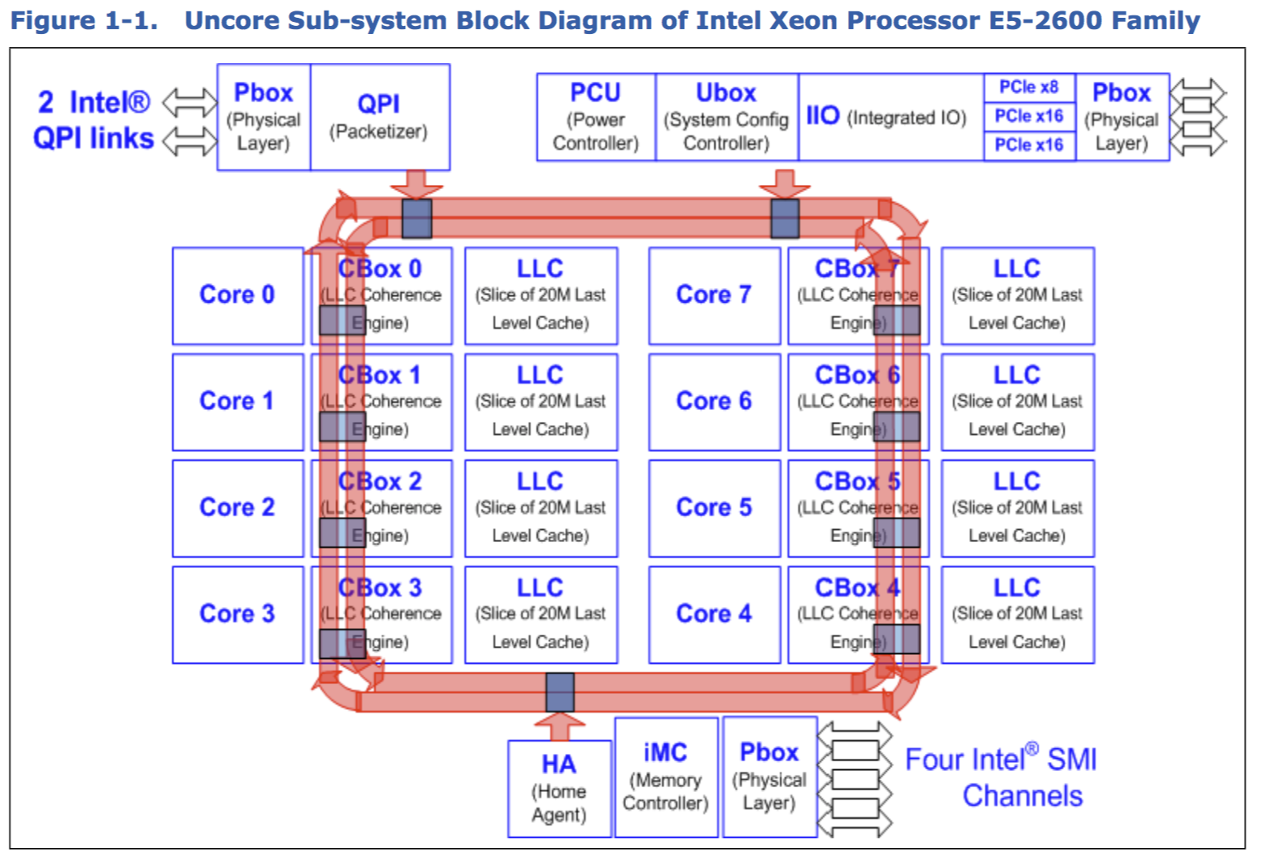
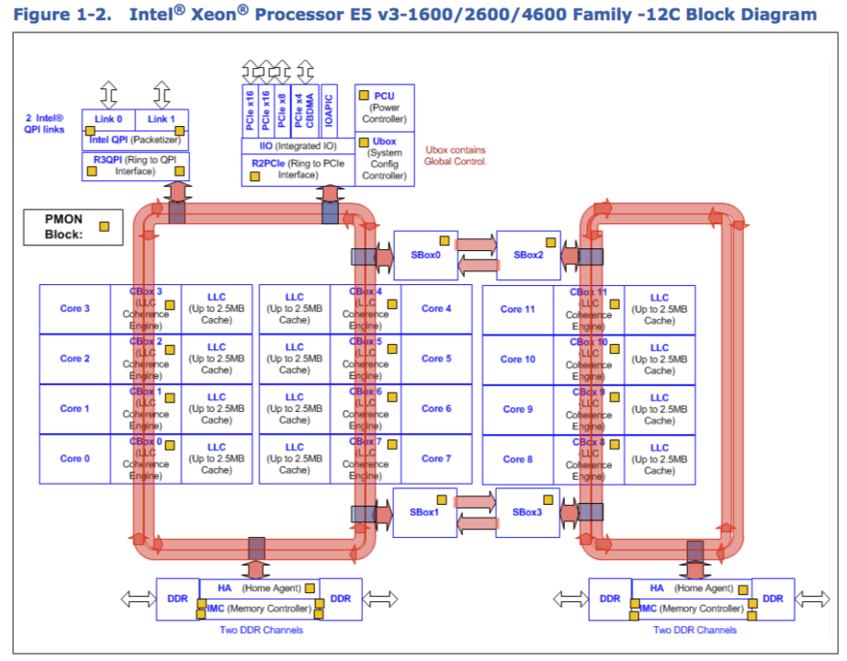
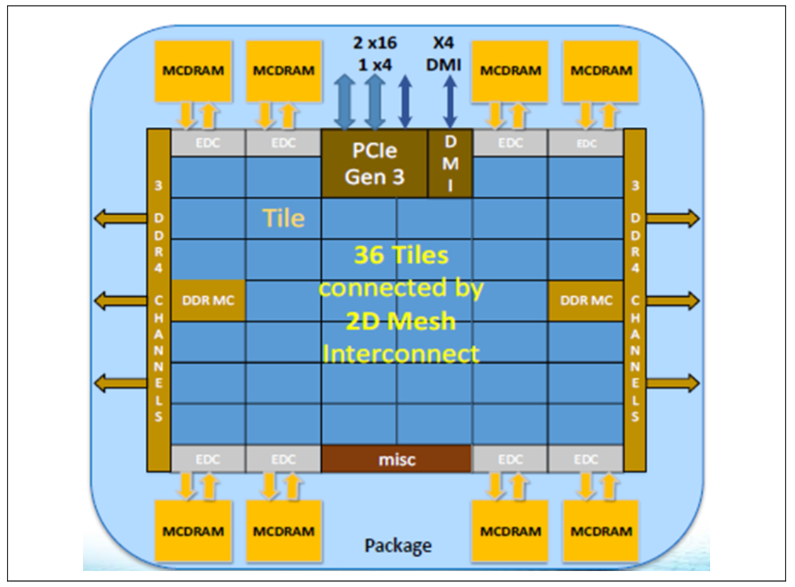
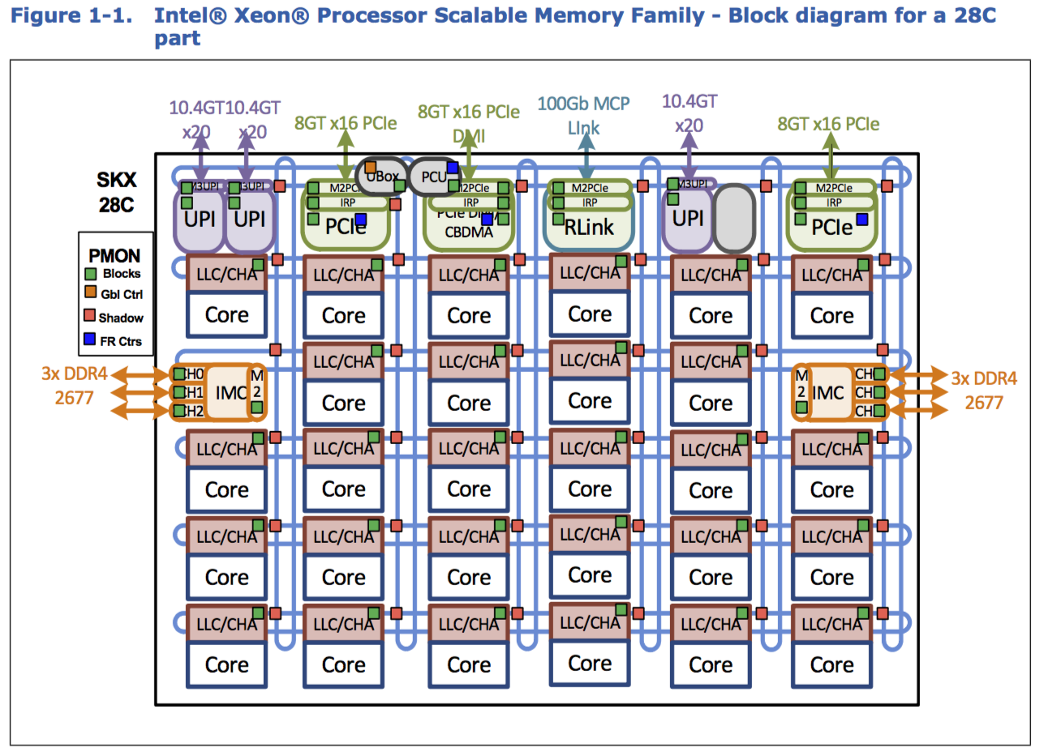
Sandy Bridge EP 2012
Bidirectional Rings
Haswell EP 2014
Two interconnected sets of bidirectional rings
Knights Landing 2016
2D mesh
Skylake Xeon
2017 2D mesh
Notes:
Rings gave some scalability
Mesh is the best that will fit in 2D
KNL and SKX meshes have similar protocols but different topologies

Slide 5
Outline
On-Chip Interconnect
Coherence Protocol Changes
Deriving Core and CHA Numbering
Using Topology Information

Slide 6
Coherence Protocol Changes
Addition of “Memory Directories” (SKX only)
Change from “inclusive” to “non-inclusive” L3 cache (SKX)
Addition of “Snoop Filters” (SKX and KNL)
Notes:
Memory directories are the least documented, but easiest to explain.
Non-inclusive L3 is well-documented, but the required Snoop Filters are barely mentioned.

Slide 7
Memory Directories
Memory latency has been increasing with core count
On an L3 Miss (most systems) do two parallel operations:
Request data from memory
Snoop other socket(s) to see if they have a dirty copy
Snoop response time from the other socket is almost always larger than the latency to get data from DRAM
A Memory Directory is one or more bits per cache line in DRAM that tell the processor whether another socket might have a dirty copy of the cache line
Notes:
Documented implicitly in Xeon Scalable Processor Family Uncore Performance Monitoring Guide.
Directory bit(s) use ECC bits that are not needed with ECC over bursts.

Slide 8
Memory Directories (2)
Advantages
If “clean”, then no need to wait for snoop response
Reduces SKX local memory latency significantly (>20%)
Or snoop can be skipped entirely if directory is clean (at the cost of higher remote latency, since there no overlap) – reducing link traffic
Disadvantages:
Intervention latency not improved & may be worse:
SKX cross-socket interventions are 1.4x to 2.1x slower than HSW
Remote reads can update the directory, forcing the entire cache line to be written back to DRAM
Increased memory traffic can be very confusing!
E.g., read 1 GiB: measure 1 GiB Rd + 1 GiB Wr at memory controller
Notes:
Easy to verify the changes in latency and the extra writes caused by remote reads.

Slide 9
Non-Inclusive L3 cache
Nehalem through Broadwell all used “Inclusive L3” caches
Only need to snoop L3 – if not there, then it is not on this chip
BUT, the 256KiB of data in L2 is replicated in the L3, reducing capacity by 10%
SKX uses a “non-inclusive” L3 cache
Allows a much larger L2 cache (1MiB) without un-necessary replication
But requires many changes in behavior
Incoming data transfers are different now
Before: send cache line to L3 and to L2/L1/Core
Now: send cache line only to L2/L1/Core
Outgoing data transfers are very different
Data gets into the L3 when victimized from the L2
Dirty cache lines usually sent to L3, but can be sent directly to memory
Clean cache lines can be sent to L3, or can be silently dropped
HARDWARE decides which transactions to use, with no user control !!!
Notes:
L3 does cache victims, but based on undocumented heuristics with dynamic inputs.
Similar issues to L2 HW prefetchers in earlier Xeons, but even more complex.

Slide 10
Snoop Filters
Non-inclusive L3 cache must be augmented to track cache lines in L2 or L1 caches – this is the “Snoop Filter” (SF)
Similar to cache tags of an inclusive L3, but without the data
Entries evicted from the Snoop Filter must be invalidated from all L1/L2 caches on the chip!
Similar to invalidations caused by victims from an inclusive L3, but with less documentation….
Uncore CHA performance counter event SF_EVICTION counts how many Snoop Filter evictions invalidate “live” cache lines
Usually much smaller than L2_LINES_IN.ALL, but pathological cases have been seen….
Notes:
Very complex interactions of address hash and high-order physical address bits of the data in use.

Slide 11
Outline
On-Chip Interconnect
Coherence Protocol Changes
Deriving Core and CHA Numbering: Skylake Xeon
Using Topology Information

Slide 12
Methodology: Data Collection
Configure CHA counters to measure traffic up/down/left/right
Set 1: For each core
Pin thread to that core,
Read all CHA counters
Read a block of memory (2GiB)
Read all CHA counters
Set 2: For each core
Similar to set 1, but only read cache lines that are mapped to IMC0 (left side of chip)
Notes:
Static Y-X routing makes identifying most patterns fairly easy.
Only 6 locations will have 1 “up”, only 4 will have no “up”, only 6 will have 1 “down”, 6 2 “down”, 6 3 “down”
Disabled tiles add some complications, since their counters are disabled.
Only the tile co-located with a core will have inputs from 2 sides.

Slide 13
Methodology: Analysis
Routing is Y first, then X
6 locations will have 1 “up”
4 locations will have 0 “up” or “down”
6 locations will have 1 “down”
6 locations will have 2 “down”
6 locations will have 3 “down”
Disabled tiles add confusion, since their counters are disabled
Only the tile co-located with a core will have inputs from 2 sides.
Notes:
Static Y-X routing makes identifying most patterns fairly easy.
Only 6 locations will have 1 “up”, only 4 will have no “up”, only 6 will have 1 “down”, 6 2 “down”, 6 3 “down”
Disabled tiles add some complications, since their counters are disabled.
Only the tile co-located with a core will have inputs from 2 sides.

Slide 14
Methodology: Analysis (2)
Some data made sense
Some data seemed crazy:
E.g., reading from IMC0 produced a mixture of “left” and “right” traffic
Eureka moment:
The meaning of “left” and “right” changes in alternating columns!
Matches mirroring of cores on die photo
This allows manual interpretation of core and tile numbering
What about automation?
Notes:
Static Y-X routing makes identifying most patterns fairly easy.
Only 6 locations will have 1 “up”, only 4 will have no “up”, only 6 will have 1 “down”, 6 2 “down”, 6 3 “down”
Disabled tiles add some complications, since their counters are disabled.
Only the tile co-located with a core will have inputs from 2 sides.

Slide 15
Methodology: automation
CAPID6 is a PCI Configuration Space register with a bit map of the enabled/disabled CHAs
But no documentation of mapping of bits to the die layout
Examining test results several different processor patterns showed the mapping of the bits to the die and a simple mapping from CAPID6 bits to CHA numbers
Testing on 62 Xeon Platinum 8160 (24-core) processors showed the same map of core to tile numbers on every chip – independent of the pattern of disabled tiles
So CAPID6 + core-to-tile map provides full mapping info
Notes:
I started with core numbering, but CAPID6 made CHA numbering easier to understand. These are shown visually on next slide

Slide 16
CAPID6 bit field mapping to tile location
CHA numbers skip over disabled tiles
CAPID6 bits 4,10,17,23 set to zero
UPI 0/1 | PCIe | PCIe | RLink | UPI 2 | PCIe
Bit 0 | Bit 4 | Bit 9 | Bit 14 | Bit 19 | Bit 24
IMC0 | Bit 5 | Bit 10 | Bit 15 | Bit 20 | IMC1
Bit 1 | Bit 6 | Bit 11 | Bit 16 | Bit 21 | Bit 25
Bit 2 | Bit 7 | Bit 12 | Bit 17 | Bit 22 | Bit 26
Bit 3 | Bit 8 | Bit 13 | Bit 18 | Bit 23 | Bit 27
UPI 0/1 | PCIe | PCIe | RLink | UPI 2 | PCIe
Bit 0 | Bit 4 | Bit 9 | Bit 14 | Bit 19 | Bit 24
IMC0 | Bit 5 | Bit 10 | Bit 15 | Bit 20 | IMC1
Bit 1 | Bit 6 | Bit 11 | Bit 16 | Bit 21 | Bit 25
Bit 2 | Bit 7 | Bit 12 | Bit 17 | Bit 22 | Bit 26
Bit 3 | Bit 8 | Bit 13 | Bit 18 | Bit 23 | Bit 27
UPI 0/1 | PCIe | PCIe | RLink | UPI 2 | PCIe
CHA 0 |  | CHA 8 | CHA 12 | CHA 16 | CHA 20
IMC0 | CHA 4 |  | CHA 13 | CHA 17 | IMC1
CHA 1 | CHA 5 | CHA 9 | CHA 14 | CHA 18 | CHA 21
CHA 2 | CHA 6 | CHA 10 |  | CHA 19 | CHA 22
CHA 3 | CHA 7 | CHA 11 | CHA 15 |  | CHA 23

Slide 17
Sample Xeon Platinum 8160 Core & Tile (CHA) numbering
UPI 0/1 | PCIe | PCIe | RLink | UPI 2 | PCIe
c0 t0 |  | c2 t8 | c3 t12 | c4 t16 | c5 t20
IMC0 | c1 t4 |  | c15 t13 | c16 t17 | IMC1
c12 t1 | c13 t5 | c14 t9 | c9 t14 | c10 t18 | c17 t21
c6 t2 | c7 t6 | c8 t10 |  | c22 t19 | c11 t22
c18 t3 | c19 t7 | c20 t11 | c21 t15 |  | c23 t23
Notes:
These are from c591-101, socket 0.

Slide 18
Outline
On-Chip Interconnect
Coherence Protocol Changes
Deriving Core and CHA Numbering: Knights Landing
Using Topology Information

Slide 19
Same Mesh, Different Numbering
KNL x2APIC IDs are not renumbered to skip over disabled cores (as they are on SKX and other Xeons)
CHAs that are co-located with disabled processors are not disabled or renumbered (as they are on SKX, etc)
See backup slides for more details
Methodology followed SKX analysis, but results were quite different….
Logical Processor numbering follows CHA numbering, skipping over disabled tiles (not orthogonal, as on SKX)
Mesh traffic counters have very different symmetries….
Notes:
Different symmetries on die photo lead to different interpretations of traffic counters...

Slide 20
EDC | EDC | PCIe + DMI |  | EDC | EDC
IMC0 |  |  |  |  | IMC1
EDC | EDC | MISC |  | EDC | EDC
“Flipped” orientation
Up is called Down
Right is called Right
“Mirrored + Flipped” orientation
Up is called Down
Right is called Left
“Normal” orientation
Down is called Down
Right is called Right
“Mirrored” orientation
Down is called Down
Right is called Left
KNL die block diagram
Notes:
This pattern is observed in the mesh traffic counts when reading from IMC0 and matches the structures on the die photo.

Slide 21
EDC | EDC | PCIe + DMI |  | EDC | EDC
Tile 0 Cores 0-1 | Tile 12 Core 20 |  |  | Tile 13 Core 22 | Tile 29 Core 52
Tile 4 Core 6 | Tile 16 Core 28 | Tile 28 Core 50 | Tile 1 Core 2 | Tile 17 Core 30 | Tile 33 Core 60
Tile 8 | Tile 20 Core 36 | Tile 32 Core 58 | Tile 5 Core 8 | Tile 21 Core 38 | Tile 37
IMC0 | Tile 24 Core 44 | Tile 36 Core 66 | Tile 9 Core 14 | Tile 25 Core 46 | IMC1
Tile 2 | Tile 14 Core 24 | Tile 26 Core 48 | Tile 3 Core 4 | Tile 15 Core 26 | Tile 27
Tile 6 Core 10 | Tile 18 Core 32 | Tile 30 Core 54 | Tile 7 Core 12 | Tile 19 Core 34 | Tile 31 Core 56
Tile 10 Core 16 | Tile 22 Core 40 | Tile 34 Core 62 | Tile 11 Core 18 | Tile 23 Core 42 | Tile 35 Core 64
EDC | EDC | MISC |  | EDC | EDC
Sample KNL core numbering
Notes:
c458-011, disabled tiles are 2,8,27,37

Slide 22
EDC | EDC | PCIe + DMI |  | EDC | EDC
Tile 0 Cores 0-1 | Tile 12 Core 20 |  |  | Tile 13 Core 22 | Tile 29 Core 52
Tile 4 Core 6 | Tile 16 Core 28 | Tile 28 Core 50 | Tile 1 Cores 2-3 | Tile 17 Core 30 | Tile 33 Core 60
Tile 8 | Tile 20 Core 36 | Tile 32 Core 58 | Tile 5 Core 8 | Tile 21 Core 38 | Tile 37
IMC0 | Tile 24 Core 44 | Tile 36 Core 66 | Tile 9 Core 14 | Tile 25 Core 46 | IMC1
Tile 2 | Tile 14 Core 24 | Tile 26 Core 48 | Tile 3 Core 4 | Tile 15 Core 26 | Tile 27
Tile 6 Core 10 | Tile 18 Core 32 | Tile 30 Core 54 | Tile 7 Core 12 | Tile 19 Core 34 | Tile 31 Core 56
Tile 10 Core 16 | Tile 22 Core 40 | Tile 34 Core 62 | Tile 11 Core 18 | Tile 23 Core 42 | Tile 35 Core 64
EDC | EDC | MISC |  | EDC | EDC
Sample KNL core numbering
Notes:
c458-011, disabled tiles are 2,8,27,37

Slide 23
EDC | EDC | PCIe + DMI |  | EDC | EDC
Tile 0 Cores 0-1 | Tile 12 Core 20 |  |  | Tile 13 Core 22 | Tile 29 Core 52
Tile 4 Core 6 | Tile 16 Core 28 | Tile 28 Core 50 | Tile 1 Cores 2-3 | Tile 17 Core 30 | Tile 33 Core 60
Tile 8 | Tile 20 Core 36 | Tile 32 Core 58 | Tile 5 Core 8 | Tile 21 Core 38 | Tile 37
IMC0 | Tile 24 Core 44 | Tile 36 Core 66 | Tile 9 Core 14 | Tile 25 Core 46 | IMC1
Tile 2 no cores | Tile 14 Core 24 | Tile 26 Core 48 | Tile 3 Core 4 | Tile 15 Core 26 | Tile 27
Tile 6 Core 10 | Tile 18 Core 32 | Tile 30 Core 54 | Tile 7 Core 12 | Tile 19 Core 34 | Tile 31 Core 56
Tile 10 Core 16 | Tile 22 Core 40 | Tile 34 Core 62 | Tile 11 Core 18 | Tile 23 Core 42 | Tile 35 Core 64
EDC | EDC | MISC |  | EDC | EDC
Sample KNL core numbering
Notes:
c458-011, disabled tiles are 2,8,27,37

Slide 24
EDC | EDC | PCIe + DMI |  | EDC | EDC
Tile 0 Cores 0-1 | Tile 12 Core 20 |  |  | Tile 13 Core 22 | Tile 29 Core 52
Tile 4 Core 6 | Tile 16 Core 28 | Tile 28 Core 50 | Tile 1 Cores 2-3 | Tile 17 Core 30 | Tile 33 Core 60
Tile 8 | Tile 20 Core 36 | Tile 32 Core 58 | Tile 5 Core 8 | Tile 21 Core 38 | Tile 37
IMC0 | Tile 24 Core 44 | Tile 36 Core 66 | Tile 9 Core 14 | Tile 25 Core 46 | IMC1
Tile 2 no cores | Tile 14 Core 24 | Tile 26 Core 48 | Tile 3 Cores 4-5 | Tile 15 Core 26 | Tile 27
Tile 6 Core 10 | Tile 18 Core 32 | Tile 30 Core 54 | Tile 7 Core 12 | Tile 19 Core 34 | Tile 31 Core 56
Tile 10 Core 16 | Tile 22 Core 40 | Tile 34 Core 62 | Tile 11 Core 18 | Tile 23 Core 42 | Tile 35 Core 64
EDC | EDC | MISC |  | EDC | EDC
Sample KNL core numbering
Notes:
c458-011, disabled tiles are 2,8,27,37

Slide 25
Outline
On-Chip Interconnect
Coherence Protocol Changes
Deriving Core and CHA Numbering
Using Topology Information

Slide 26
Early testing of SKX cluster showed some nodes always ran STREAM Copy at much lower rates than expected.
All of the slow nodes had one socket with one of five CAPID6 patterns.
Every node with one of these five CAPID6 patterns had slow STREAM Copy performance
Did we find all of the “slow” patterns?
Notes:
These were early SKX processors and the ”slow” patterns may no longer be shipping.
This only effects streaming stores, so is irrelevant for most workloads – it just happened to be one of our acceptance criteria.

Slide 27
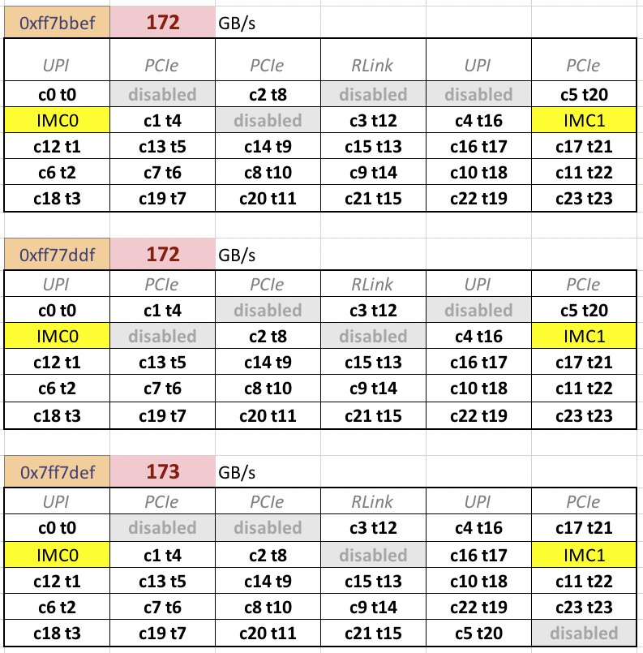
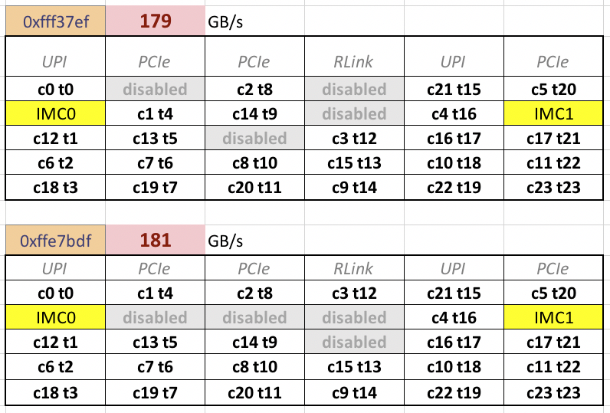
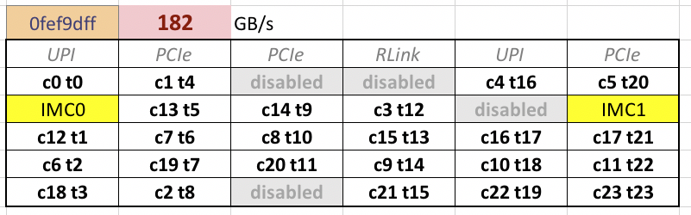
A search on these 8 bits of all CAPID6 values found one more “slow” pattern
The five “slow” CAPID6 patterns initially found
Notes:
The visible pattern led me to test all CAPID6 values for the number of zero bits in the set 4,5,9,10,14,15,19,20 and look for 3 or more.

Slide 28
Summary
Changes in the cache coherence protocol and on-chip interconnect of recent processors have significant implications for the interpretation of performance counter data for cache and memory traffic
Intel does not document low-level numbering schemes, but these can be derived using microbenchmarks and performance counters
The ability to visualize topology and to visualize performance data in the correct topology is valuable for human interpretation and understanding

Slide 29







For more information: www.tacc.utexas.edu
John D. McCalpin, PhD
mccalpin@tacc.utexas.edu
512-232-3754

Slide 30
Backup slides
McCalpin: KNL/SKX Topology & Cache Coherence

Slide 31
References
Diagrams from:
Xeon E5-2600 uncore performance monitoring guide (Intel document 327043)
Xeon E5 v4 uncore performance monitoring guides (Intel document 334291)
KNL Intel Xeon Phi Performance Monitoring Reference Manual, Volume 1: (document 332972)
SKX Intel Xeon Scalable Memory Family Uncore Performance Monitoring Reference Manual (document 336274)
Protocol:
Intel Architectures SW Developer’s Guide, Volume 3 (document 325384), Section 19.2
SKX Intel Xeon Scalable Memory Family Uncore Performance Monitoring Reference Manual (document 336274)
https://www.hotchips.org/wp-content/uploads/hc_archives/hc29/HC29.22-Tuesday-Pub/HC29.22.90-Server-Pub/HC29.22.930-Xeon-Skylake-sp-Kumar-Intel.pdf

Slide 32
On-Chip Interconnect Development
Nehalem/Westmere (2009-2011) use a “buffered crossbar” between the cores (4-6) and a “monolithic” L3
Crossbars are not practically scalable to larger core counts
“Monolithic” cache not scalable to higher bandwidth
All subsequent processors use a distributed L3 with an undocumented mapping of physical addresses to L3 “slices”.
Notes:
References:
NHM/WSM https://www.hotchips.org/wp-content/uploads/hc_archives/hc22/HC22.24.620-Hill-Intel-WSM-EP-print.pdf
SNB-EP/IVB-EP Intel uncore performance monitoring guides (documents 327043 and 329468
HSW-EP/BDW-EP Intel uncore performance monitoring guides (documents 331051 and 334291)
KNL Intel Xeon Phi Performance Monitoring Reference Manual, Volume 1: (document 332972)
SKX Intel Xeon Scalable Memory Family Uncore Performance Monitoring Reference Manual (document 336274)

Slide 33
Sandy Bridge EP 2012
Bidirectional Rings
Notes:
Diagrams from:
Xeon E5-2600 uncore performance monitoring guide (Intel document 327043)
Xeon E5 v4 uncore performance monitoring guides (Intel document 334291)
KNL Intel Xeon Phi Performance Monitoring Reference Manual, Volume 1: (document 332972)
SKX Intel Xeon Scalable Memory Family Uncore Performance Monitoring Reference Manual (document 336274)

Slide 34
Haswell EP 2014
Two interconnected sets of bidirectional rings
Notes:
Diagrams from:
Xeon E5-2600 uncore performance monitoring guide (Intel document 327043)
Xeon E5 v4 uncore performance monitoring guides (Intel document 334291)
KNL Intel Xeon Phi Performance Monitoring Reference Manual, Volume 1: (document 332972)
SKX Intel Xeon Scalable Memory Family Uncore Performance Monitoring Reference Manual (document 336274)

Slide 35
Knights Landing 2016
2D mesh
Notes:
Diagrams from:
Xeon E5-2600 uncore performance monitoring guide (Intel document 327043)
Xeon E5 v4 uncore performance monitoring guides (Intel document 334291)
KNL Intel Xeon Phi Performance Monitoring Reference Manual, Volume 1: (document 332972)
SKX Intel Xeon Scalable Memory Family Uncore Performance Monitoring Reference Manual (document 336274)

Slide 36
Skylake Xeon
2017 2D mesh
Notes:
Diagrams from:
Xeon E5-2600 uncore performance monitoring guide (Intel document 327043)
Xeon E5 v4 uncore performance monitoring guides (Intel document 334291)
KNL Intel Xeon Phi Performance Monitoring Reference Manual, Volume 1: (document 332972)
SKX Intel Xeon Scalable Memory Family Uncore Performance Monitoring Reference Manual (document 336274)

Slide 37
Notes:
Diagrams from:
Xeon E5-2600 uncore performance monitoring guide (Intel document 327043)
Xeon E5 v4 uncore performance monitoring guides (Intel document 334291)
KNL Intel Xeon Phi Performance Monitoring Reference Manual, Volume 1: (document 332972)
SKX Intel Xeon Scalable Memory Family Uncore Performance Monitoring Reference Manual (document 336274)

Slide 38
CAPID6 bit field mapping to tile location
UPI 0/1 | PCIe | PCIe | RLink | UPI 2 | PCIe
Bit 0 | Bit 4 | Bit 9 | Bit 14 | Bit 19 | Bit 24
IMC0 | Bit 5 | Bit 10 | Bit 15 | Bit 20 | IMC1
Bit 1 | Bit 6 | Bit 11 | Bit 16 | Bit 21 | Bit 25
Bit 2 | Bit 7 | Bit 12 | Bit 17 | Bit 22 | Bit 26
Bit 3 | Bit 8 | Bit 13 | Bit 18 | Bit 23 | Bit 27

Slide 39
CAPID6 bits 4,10,17,23 set to zero
UPI 0/1 | PCIe | PCIe | RLink | UPI 2 | PCIe
Bit 0 | Bit 4 | Bit 9 | Bit 14 | Bit 19 | Bit 24
IMC0 | Bit 5 | Bit 10 | Bit 15 | Bit 20 | IMC1
Bit 1 | Bit 6 | Bit 11 | Bit 16 | Bit 21 | Bit 25
Bit 2 | Bit 7 | Bit 12 | Bit 17 | Bit 22 | Bit 26
Bit 3 | Bit 8 | Bit 13 | Bit 18 | Bit 23 | Bit 27

Slide 40
CAPID6 bits 4,10,17,23 set to zero
CHA numbers skip over disabled tiles
UPI 0/1 | PCIe | PCIe | RLink | UPI 2 | PCIe
Bit 0 | Bit 4 | Bit 9 | Bit 14 | Bit 19 | Bit 24
IMC0 | Bit 5 | Bit 10 | Bit 15 | Bit 20 | IMC1
Bit 1 | Bit 6 | Bit 11 | Bit 16 | Bit 21 | Bit 25
Bit 2 | Bit 7 | Bit 12 | Bit 17 | Bit 22 | Bit 26
Bit 3 | Bit 8 | Bit 13 | Bit 18 | Bit 23 | Bit 27
UPI 0/1 | PCIe | PCIe | RLink | UPI 2 | PCIe
CHA 0 |  | CHA 8 | CHA 12 | CHA 16 | CHA 20
IMC0 | CHA 4 |  | CHA 13 | CHA 17 | IMC1
CHA 1 | CHA 5 | CHA 9 | CHA 14 | CHA 18 | CHA 21
CHA 2 | CHA 6 | CHA 10 |  | CHA 19 | CHA 22
CHA 3 | CHA 7 | CHA 11 | CHA 15 |  | CHA 23

Slide 41
The five “slow” CAPID6 patterns initially found

Slide 42
A search on these 8 bits of all CAPID6 values found one more “slow” pattern

Slide 43
Same Mesh, Different Numbering
KNL x2APIC IDs are not renumbered to skip over cores in disabled tiles (as they are on SKX and other Xeons)
CPUID “Extended Topology Enumeration Leaf”
CPUID instruction with %eax 0x0b and %ecx 0x00 or 0x01
x2APIC ID is returned in %edx
Bits 1:0 are thread number
Bits 31:2 are physical core number in range of 0..75
Bits 31:3 are tile number in range of 0..37
Logical processor numbers are contiguously mapped onto the active physical cores, e.g., with physical cores 4-5 disabled
Physical: 0, 1, 2, 3, 6, 7, 8, 9, …
Logical: 0, 1, 2, 3, 4, 5, 6, 7, …

Slide 44
KNL core/tile numbering (cont’d)
Disabled tiles in KNL still have active CHAs with counters
Single-core loads from memory will have one CHA with inputs from two sides
This CHA is co-located with the core performing the loads
CHAs will no co-located (active) cores will not show two-sided inputs from any of the single-core read tests
x2APIC processor tile IDs (%edx bits 31:3) match CHA tile numbers in the cases I have tested.
Next look at mesh routing results to determine locations on the die…

