Slide 1
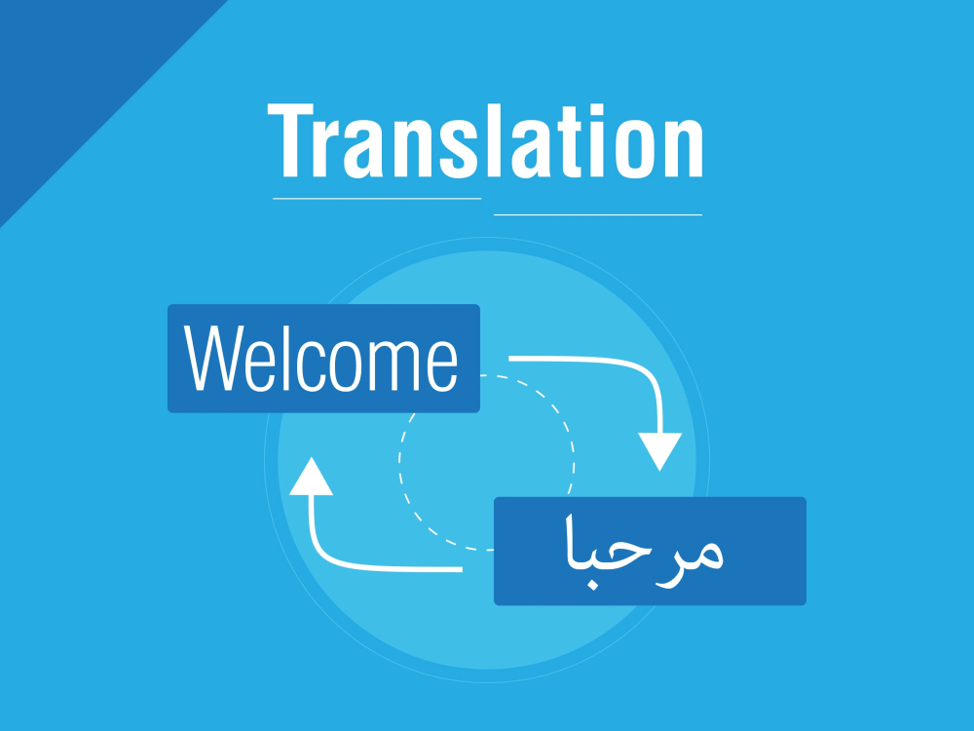

Slide 2

This project is represented by:
ID | NAME
20210196 | ايات احمد محمد
20210170 | الاء مجدي بيومي
20210168 | الاء عاطف مصطفى
20210187 | إنجي موسى محمد
20210071 | احمد عبد الرشيد حسن
20210333 | رمزي اشرف رمزي

Slide 3
ProjectOverview🔍
📥 Data Preparation
🔧 Preprocessing
🧠 Model Fine-tuning
📊 Evaluation
This project focuses on building a Neural Machine Translation (NMT) system to translate Arabic to English using a pretrained transformer-based model from Hugging Face — specifically Helsinki-NLP/opus-mt-ar-en. The model was fine-tuned on a parallel Arabic-English dataset using the Hugging Face Trainer API.

Slide 4
📊 Dataset Information
We used a parallel Arabic-English dataset from GitHub (Arabic-English Parallel Corpus by Samir Moustafa).
The dataset contains 10,742 sentence pairs of Arabic and English. Each line consists of an Arabic sentence and its corresponding English translation, separated by a tab (\t). You can find the dataset here.

Slide 5
📥 Data Preparation
First, we started with preparing our dataset. We used a parallel corpus where each line contains an Arabic sentence and its corresponding English translation, separated by a tab. We cleaned the data to remove any missing or corrupted lines, and then we converted it into a format compatible with the Hugging Face Dataset library.

Slide 6
🔧 Preprocessing
In this step, we used the tokenizer from the same pretrained model to convert the Arabic and English sentences into token IDs.
We applied padding and truncation to make sure all sequences are of equal length, which helps the model learn more efficiently during training.

Slide 7
📝 Fine-Tuning Configuration
🔍 Pretrained Model
Helsinki-NLP/opus-mt-ar-en is a pretrained transformer model designed for Arabic-to-English translation. We used it as a base model and fine-tuned it on our specific parallel dataset.
📊 Number of Epochs (3)
The entire dataset is passed through the model 3 times. More epochs may help the model learn better but also increase the risk of overfitting.
📦 Batch Size (16)
The model processes 16 sentence pairs at a time during training. This affects memory usage and training speed.
🔠 Max Sequence Length (128)
All sentences are padded or truncated to a maximum of 128 tokens to maintain uniform input size.
⚙️ Optimizer (AdamW)
The AdamW optimizer is used to update the model’s weights. It is commonly used in transformer-based models for stable and efficient training.
📉 Learning Rate Scheduler (Linear Decay)
The learning rate starts at an initial value and decreases linearly throughout training for better convergence.
📈 Learning Rate (5e-5)
By default, the learning rate is set to 5e-5 (0.00005). This controls how much the model weights are updated during training.
🔢 Precision (FP16)
Mixed precision training using half-precision floating point (FP16) is enabled if a GPU is available. This reduces memory usage and speeds up training.
💾 Save Steps (500)
A checkpoint of the model is saved every 500 training steps to allow resuming or analyzing intermediate results.
🧾 Logging Steps (100)
Training progress (like loss) is logged every 100 steps to monitor model performance.
Parameter | Value
Pretrained Model | Helsinki-NLP/opus-mt-ar-en
Number of Epochs | 3
Batch Size | 16 (per device)
Max Sequence Length | 128 tokens
Optimizer | AdamW
Learning Rate Scheduler | Linear decay
Precision | FP16 (if GPU is available)
Save Steps | Every 500 steps
Logging Steps | Every 100 steps

Slide 8

📊 Evaluation
After training, we evaluated the model using the BLEU score, which compares the model’s output to the correct translations. Our model achieved a BLEU score of 74.91, which shows that the translations were highly accurate and close to human-level quality.

Slide 9
Translation Process Flow
("البرمجة مفيدة").
["البرمجة", "مفيدة"]
"Programming" → "is" → "useful"
"Programming is useful."
[1254, 7890]
Translation Result:
Input :
"البرمجة مفيده"
Final Output: "Programming is useful."
Input → Tokenization → Encoding → Decoding → Detokenization

Slide 10
⚠️ Model Limitations
Domain Sensitivity The model is pretrained on general-domain data. Accuracy may decrease slightly with domain-specific or highly technical content.
Dialectal Arabic The model handles Modern Standard Arabic well, but performance may vary with dialects or informal language.
Despite these limitations, fine-tuning on our dataset significantly improved the model’s performance and made it more suitable for our specific translation task.

Slide 11

Thank you

