Slide 1
SRI PARAMAKALYANI COLLEGE ALWARKURICHI Department of Computer Science ONLINE JOB PORTAL
PRESENTED BY:
J.Rahul – 20191231506225
P.Ramganesh – 20191231506226
GUIDED BY:
Mr. P. NITHIN ,B.Tech.,M.E

Slide 2
ABSTRACT
Acquiring knowledge and specific job skills have become the main objectives for students in the universal. Knowledge is necessary to make informed decisions especially, in a critical situation. Knowledge and Knowledge management in any organizations are crucial to give it a competitive edge in today’s challenging and globalised environment. In this paper authors have a proposed a design of on-line recruitment system, that allows employers', to post their advertisements. This job portal is able to capture job requirements based on industry needs. To full fill the job needs of the students they can apply through our job portal.

Slide 3
HARDWARE REQUIREMENTS
Processor: Dual Core or above.
Processor Speed: 1.0Ghz or above.
RAM: 4GB RAM or above.
Hard Disk: 500GB hard disk or above.

Slide 4
SOFTWARE REUIUREMENTS
Database Used: MYSQL
Language Used: PHP
Design Interface: HTML, Bootstrap, JavaScript, Ajax
Browser: Chrome, Microsoft Edge
Software: WAMP/ XAMMP

Slide 5
EXISTING SYSTEM
The existing system for job recruitment includes traditional methods like Employment agencies, advertising through newspapers, televisions and radios, college fairs etc., which are too slow and stressful. With the advancement of internet, jobseekers rely on the online job portals, which makes the job search efficient.
This big problem is the searching; sorting and updating of the student data and no any notification method available for giving information to student except the notice board.

Slide 6
PROPOSED SYSTEM
The proposed system is a web based application which allows applicants and employers to register their details. Applicants can browse through the vacancy details that are posted and can apply for the jobs online. Employers can browse through the posted resumes and select suitable candidates. Filter, Search facility for job seekers according to their required vacancy. Daily updates via notifications and other communication media. Sending resume saves effort, time and cost of job seeker All vacancies are available on a single interface Job seeker can set privacy level for different companies Job seeker can save jobs according to their needs Most recent jobs are displayed on the home page Counting the number of times the resume of a job seeker is accessed by the company.

Slide 7
MODULES
ADMIN MODULE
EMPLOYER MODULE
JOB SEEKER MODULE

Slide 8
ADMIN MODULE
This module provides administrator related functionalities. Administrator manages entire application and maintain the profiles of applicants and employers.

Slide 9
EMPLOYERS MODULE
This Module provides functionalities related to employers. Employers can post vacancy details and update the details as and when necessary. Employers can search through applicant resumes based on different criteria

Slide 10
JOB SEEKER MODULE
This Module provides functionalities for job seekers. Applicant can post their resumes with personal and professional details. They can also update the resume as frequently as required. The applicant can also browse through the present.

Slide 11
GENERAL BLOCK DIAGRAM
ADMIN
ADD JOBS
JOB PORTAL
OUTPUT
APPLY
EMPLOYERS

Slide 12
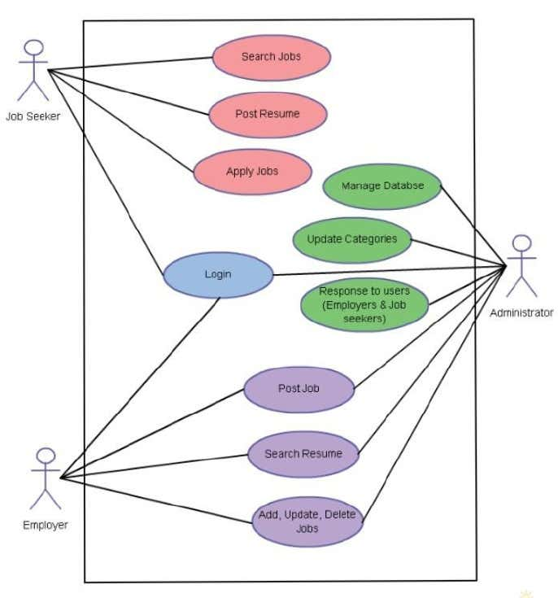
FLOW CHART

Slide 13
DATA FLOW DIAGRAM
DFD is the abbreviation for Data Flow Diagram.
The flow of data of a system or a process is represented by DFD.
ZERO LEVEL DFD DIAGRAM.
FIRST LEVEL DFD DIAGRAM.
SECOND LEVEL DFD DIAGRAM.

Slide 14
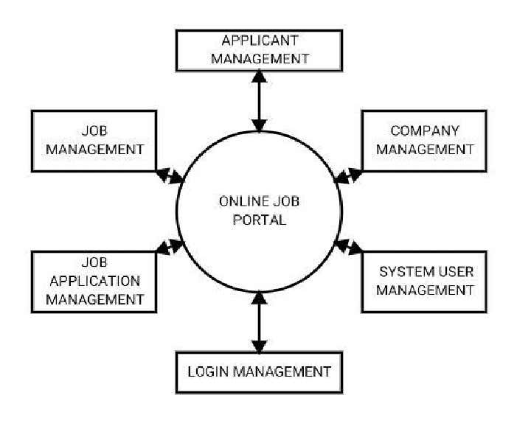
ZERO LEVEL DFD DIAGRAM.

Slide 15
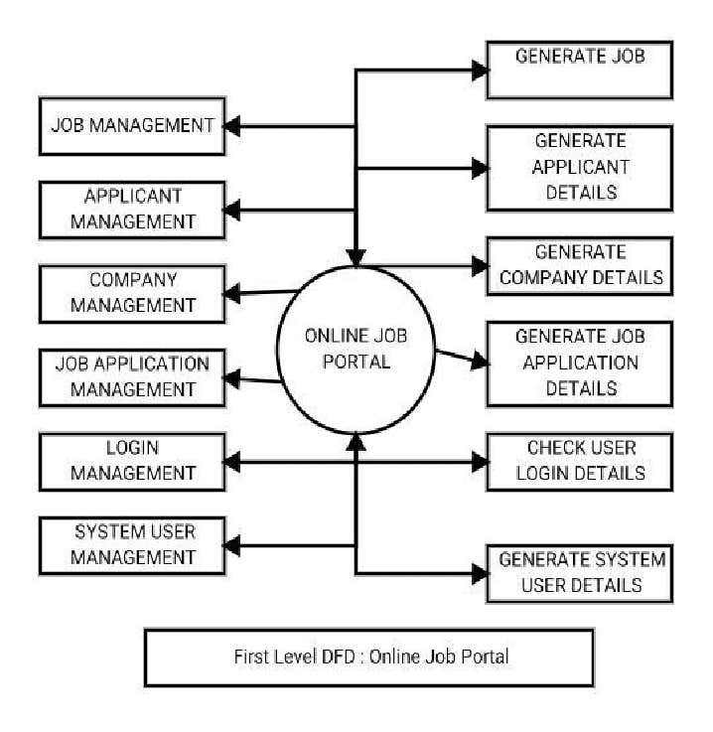
FIRST LEVEL DFD DIAGRAM.

Slide 16
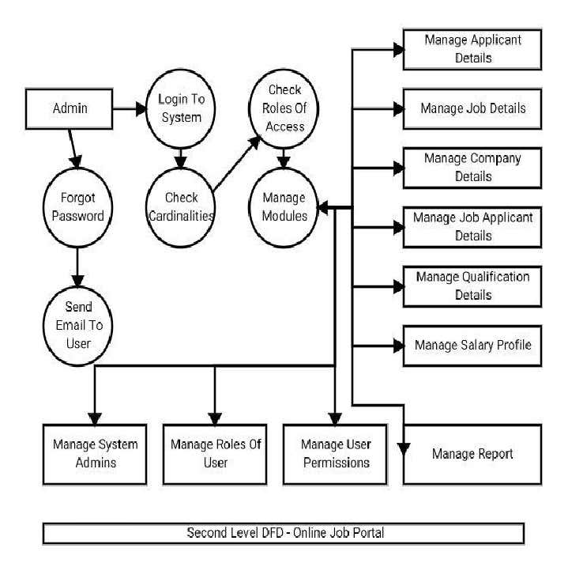
SECOND LEVEL DFD DIAGRAM.

Slide 17
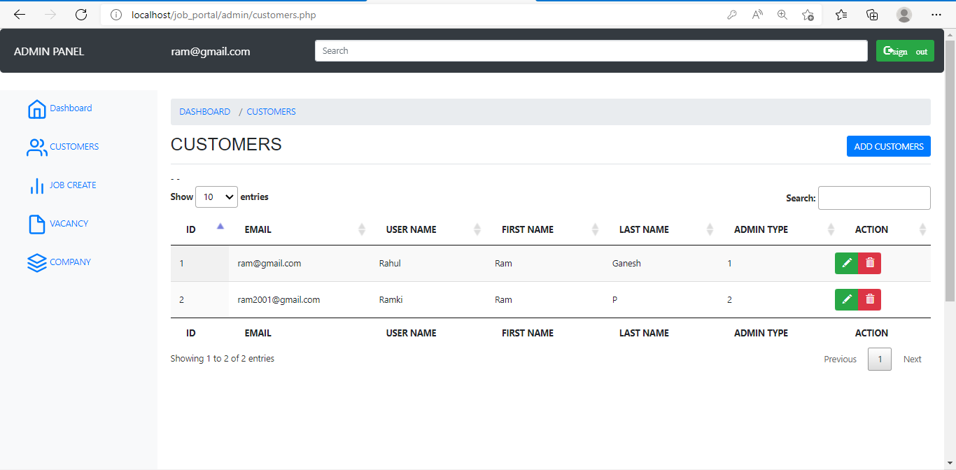

Slide 18
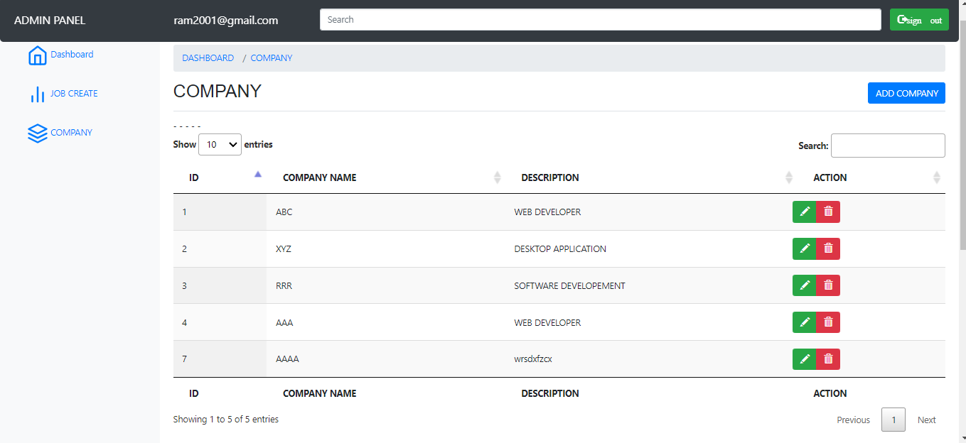

Slide 19
THANK YOU

