Slide 1
Customer segmentation project -Ramguhan

Slide 2
Customer segmentation
To group customers with similar credit card usage patterns, we employed the K-Means clustering algorithm. This allows us to tailor recommendations and services to specific customer segments.

Slide 3
Dataset:
Customer dataset contains the sample credit card usage information. Which is about 9000 entries with 18 columns.

Slide 4
Data columns (total 18 columns):
CUST_ID
BALANCE
BALANCE_FREQUENCY
PURCHASES
ONEOFF_PURCHASES
INSTALLMENTS_PURCHASES
CASH_ADVANCE
PURCHASES_FREQUENCY
ONEOFF_PURCHASES_FREQUENCY
PURCHASES_INSTALLMENTS_FREQUENCY
CASH_ADVANCE_FREQUENCY
CASH_ADVANCE_TRX
PURCHASES_TRX
CREDIT_LIMIT
PAYMENTS
MINIMUM_PAYMENTS
PRC_FULL_PAYMENT
TENURE

Slide 5
Project process:
Research and Business understanding
Data pre processing
EDA
Model Building
Model Deployment

Slide 6
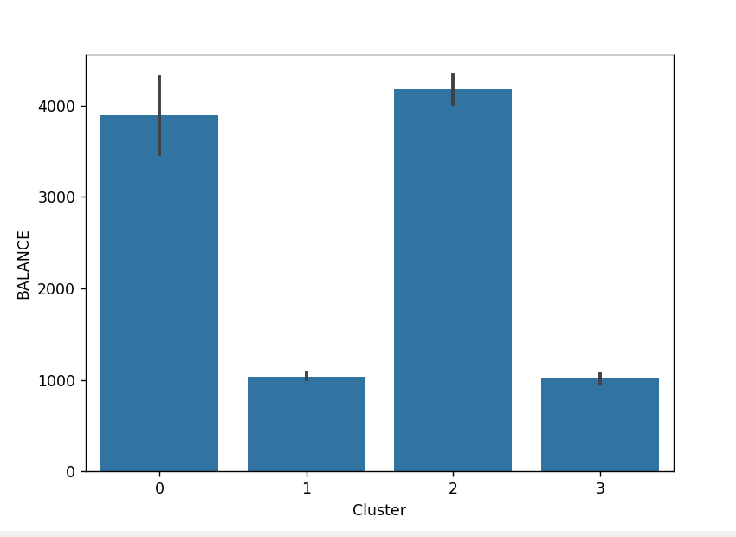
EDA:
We can see that Cluster 0 and 2 are segmented into high balance customers

Slide 7
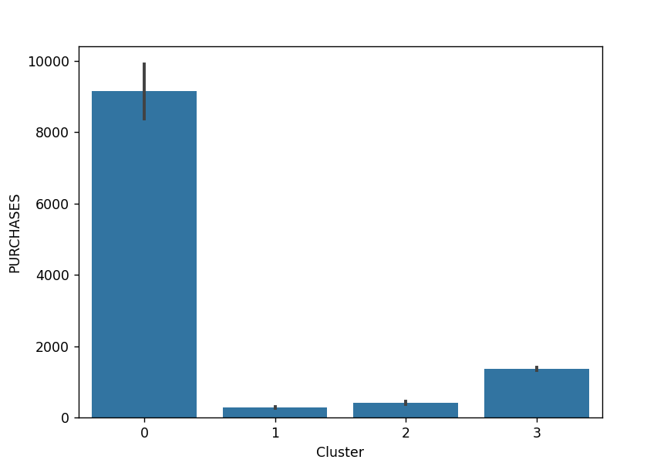
We can see that Cluster 0 segmented into high purchases customers

Slide 8
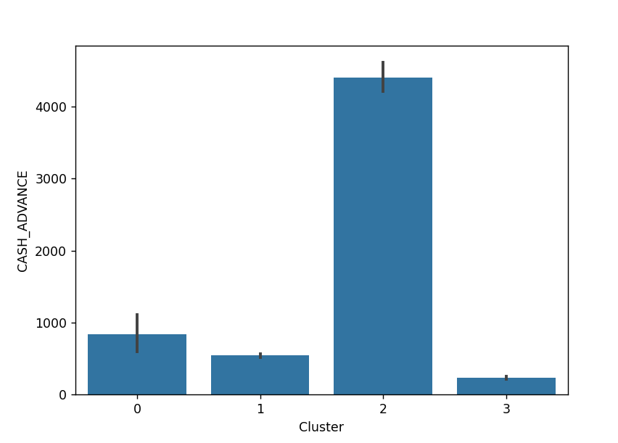
We can see that Cluster 2 segmented into high cash dependent customers

Slide 9
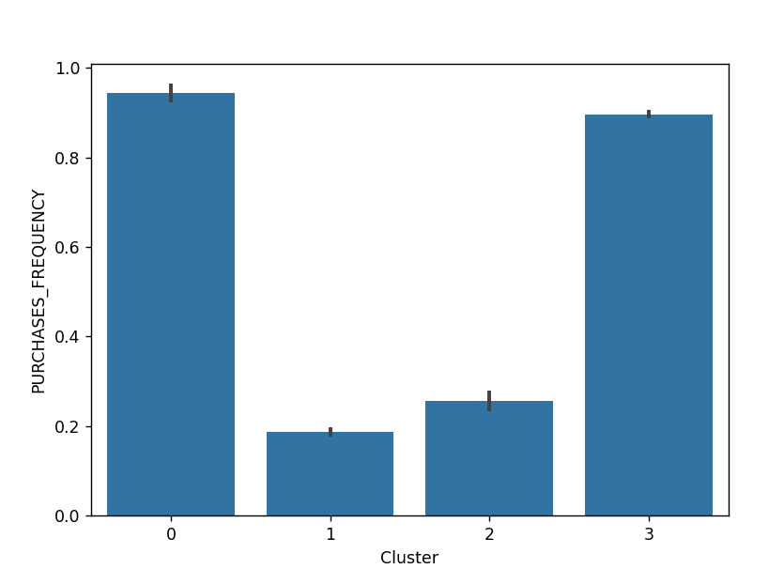
We can see that Cluster 0 and 3 are segmented into customers with high purchase frequency

Slide 10
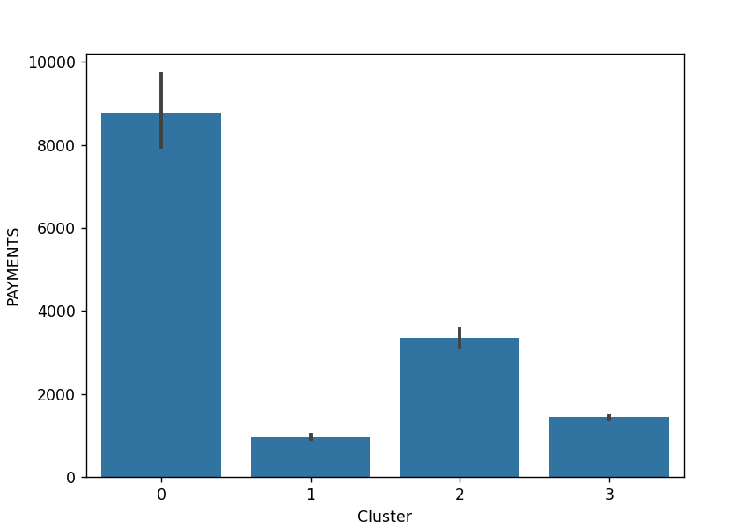
We can see that Cluster 0 are likely more responsible customers, there are paying on time

Slide 11
Models used:
PCA
KMeans
Decision Tree
(Dimensionality reduction)
(Clustering)
(Prediction)

Slide 12
Clusters:
Through Kmeans, I clustered based on important things like balance, purchase, purchase frequency and payment.
Cluster 0: High balance, High purchase frequency
Cluster 1: Low users, low purchase frequency
Cluster 2: High balance but Low purchase frequency
Cluster 3: Moderate balance but high purchase frequency

Slide 13
Recommendations:
Cluster 0: Provide higher credit limits to encourage continued spending.
Cluster 1: Give discounts & coupons on daily purchases. To encourage their spending.
Cluster 2: Offer low interest loan, because they are taking more cash using credit card.
Cluster 3: Offer buy now pay later features.

Slide 14
API Testing on Postman:
{
"BALANCE": 2000,
"BALANCE_FREQUENCY": 0.9,
"PURCHASES": 500,
"ONEOFF_PURCHASES": 200,
"INSTALLMENTS_PURCHASES": 300,
"CASH_ADVANCE": 1000,
"PURCHASES_FREQUENCY": 0.8,
"ONEOFF_PURCHASES_FREQUENCY": 0.6,
"PURCHASES_INSTALLMENTS_FREQUENCY": 0.7,
"CASH_ADVANCE_FREQUENCY": 0.5,
"CASH_ADVANCE_TRX": 3,
"PURCHASES_TRX": 10,
"CREDIT_LIMIT": 5000,
"PAYMENTS": 1200,
"MINIMUM_PAYMENTS": 150,
"PRC_FULL_PAYMENT": 0.4,
"TENURE": 12
}

Slide 15
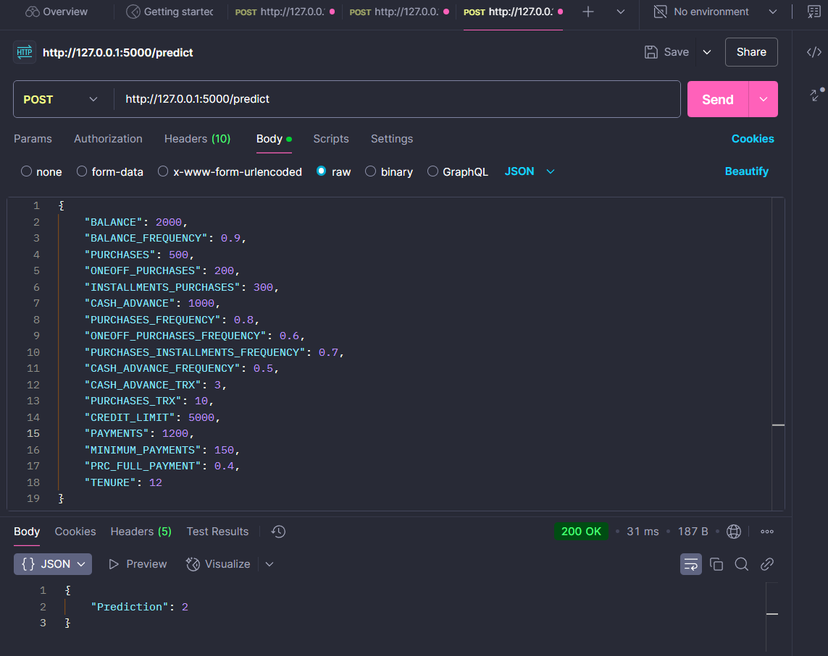

Slide 16
Thank you

