Slide 1

Department of Computer Science and Engineering
(Cyber Security)
Phase I – Project Presentation
2026-2027
Ambient Social Media Forensics
Using Federated Learning: A Privacy-Preserving Framework for Evidence Collection and Chain of Custody
Dr. D. Sivakumar
Professor
Department of Cyber security
Ram Haygrev S
(231901039)
Venselvam V
(231901061)
Notes:
Source: ASMF_Phase_I_Project_Report.pdf. Cover and certificate, PDF pages 1-2.

Slide 2
Introduction
Social media posts, comments and images can support investigations of harassment, fraud and threats. This evidence is volatile: content may be edited or deleted before investigators preserve it. ASMF combines ambient collection, lossless preservation, SHA-256 verification and a traceable custody history. Federated learning trains a shared screening model while raw evidence stays at its source. Investigators review model predictions and record their own conclusions.
Notes:
Source: ASMF_Phase_I_Project_Report.pdf. Introduction, PDF pages 10-12.

Slide 3
Literature Survey
Paper | Main Contribution | Research Gap
Khan et al. (2024) - Base Paper | Ambient collection, FL and social media custody | Ledger coupled to learning, with no repeatable evaluation plan
McMahan et al. (2017) | Federated averaging on decentralized data | Does not address evidence preservation or custody
Miao et al. (2022) | Byzantine-robust FL through blockchain | General training, rather than forensic evidence handling
Khanji et al. (2022) | Blockchain readiness in IoT forensics | Does not cover social media evidence or learning
Notes:
Source: ASMF_Phase_I_Project_Report.pdf. Related work, PDF pages 15-17.

Slide 4
Problem Statement and Motivation
Social media evidence can be edited or deleted before collection
Screenshots lack a verifiable link to the original source
Centralized training concentrates sensitive evidence in one place
Capture, analysis and custody often operate as separate workflows
Existing forensic and learning approaches already support:
Content screening, local training, evidence storage and custody logs. The gap is a consistent link between an exact artifact, its analysis and its handling history.
Our project: an integrated evidence workflow
Capture + Integrity + Custody + Federated Learning
It supports legal procedure and investigator judgment.
+
Notes:
Source: ASMF_Phase_I_Project_Report.pdf. Problem and research gaps, PDF pages 11-12 and 16-17.

Slide 5
Abstract
ASMF proposes a framework for preserving and analysing volatile social media evidence. Ambient agents capture posts, edits and deletions with metadata through permitted interfaces. Lossless normalization retains the original bytes, while SHA-256 digests and an append-only custody trail support later verification. Federated nodes train locally and share signed model updates. A FastAPI backend and React interface connect review and reporting. Original evidence, derived artifacts, observations, inferences, predictions and human conclusions remain separate.
KEYWORDS : Social Media Forensics, Ambient Intelligence, Federated Learning, SHA-256, Chain of Custody, Evidence Preservation
Notes:
Source: ASMF_Phase_I_Project_Report.pdf. Abstract and proposed system, PDF pages 3-4 and 17-18.

Slide 6
Objectives
Evidence Preservation
Capture posts, edits and deletions with source metadata.
Keep original bytes recoverable and verify them with SHA-256.
Custody & Investigator Review
Append handling events without overwriting past records.
Trace analysis to exact artifacts and keep human conclusions separate.
Federated Learning
Compare local-only, centralized, FedAvg and FedProx training under non-IID data. Share signed updates while raw evidence stays local.
Notes:
Source: ASMF_Phase_I_Project_Report.pdf. Objectives and methodology, PDF pages 12 and 31-33.

Slide 7
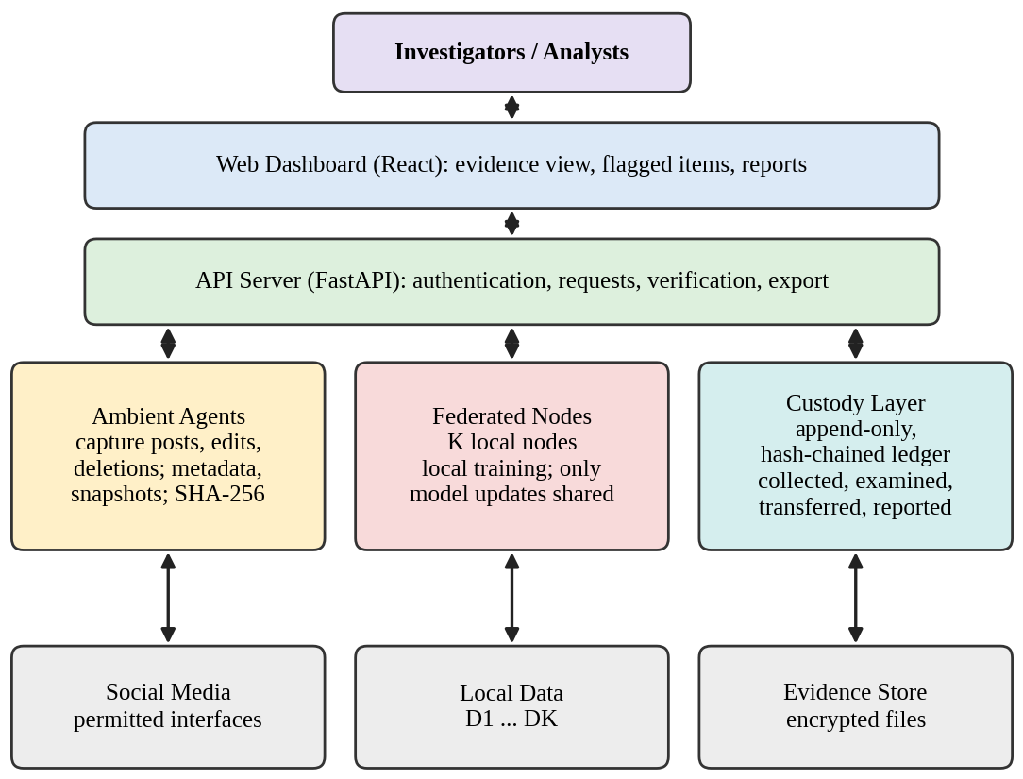
System Architecture
Notes:
Source: ASMF_Phase_I_Project_Report.pdf. Original system architecture figure, PDF page 19. This figure describes the report design, not independently verified deployment.

Slide 8
List of Modules
1. Capture & Preservation Module
Evidence Capture
Edit and Deletion Detection
Lossless Normalization
SHA-256 Verification
Source Metadata and Lineage
2. Custody & Verification Module
Append-only Custody Ledger
Digest and Chain Verification
Digest-only Anchoring
3. Learning & Reporting Module
Federated Training and Registry
Investigator Review
Dashboard and Report Export
SHA-256: the evidence's digital fingerprint
Social_Post_001.json
(original)
a83f7c…92bd
Capture hash
Social_Post_001.json
(modified)
b71e4a…19c6
Current hash
Capture hash differs from current hash: MISMATCH
Illustrative digests. A match verifies bytes since capture, not source truth.
Why a ledger boundary is proposed
Custody records remain off-chain. Only permitted digests and commitments reach the ledger. Raw evidence and personal data stay off-chain.
Notes:
Source: ASMF_Phase_I_Project_Report.pdf. Modules and digest boundaries, PDF pages 21-22 and 30-31.

Slide 9
Module Description
Capture & Preservation Module
Captures permitted social posts and news publications with source metadata. Preserves original bytes in a lossless envelope and stores each edit as a new artifact.
1
Custody & Verification Module
Appends handling events, checks evidence digests and verifies predecessor links. Full custody records stay off-chain, with permitted digests sent for anchoring.
2
Learning & Reporting Module
Trains locally and aggregates signed model updates. Records model versions and investigator conclusions, then exports evidence with its custody trail.
3
Notes:
Source: ASMF_Phase_I_Project_Report.pdf. Module descriptions, PDF pages 21-23.

Slide 10
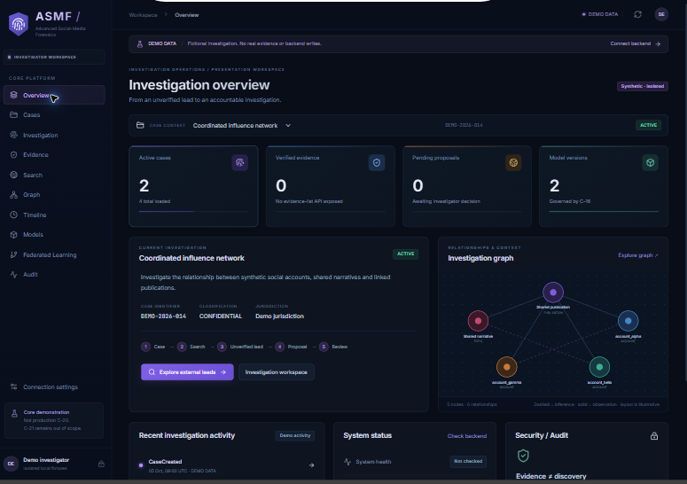
Phase I - Results & Discussion
0.66
Local-only F1
0.79
FedAvg F1
0.81
FedProx F1
Reported custody metrics
Unmodified evidence
100% hash-verification rate
VERIFIED
Injected modifications
100% tamper-detection rate
DETECTED
Deleted-post capture
92% preserved before deletion
92%
Discussion: PDF-reported results from simulated nodes. Dataset and training details remain incomplete. The screenshot shows the demo interface, not experiment verification.
Notes:
Source: ASMF_Phase_I_Project_Report.pdf. Reported results: PDF pages 34-35, Tables 4.1 and 4.3. Centralized F1 is 0.87. Federated nodes are simulated partitions. Dataset identity, exact node count, hyperparameters and seeds are unspecified in the supplied report. These numbers were not independently reproduced. Screenshot: supplied Screenshot 2026-10-06 191047.png. It displays DEMO DATA, no evidence/backend writes, 0 verified evidence and backend system health not checked. It demonstrates the interface only.

Slide 11
Conclusion
Ambient capture preserves posts, edits and deletion events
Original bytes remain recoverable and derivatives retain lineage
SHA-256 and linked custody records support integrity verification
Federated learning shares updates while raw evidence stays local
Predictions support review, with separate investigator conclusions
Future work: secure aggregation, repeated trials and deployment validation
Notes:
Source: ASMF_Phase_I_Project_Report.pdf. Conclusion, limits and Phase II work, PDF pages 38-40. FL alone does not guarantee privacy. Digest verification does not establish source truth or legal admissibility.

Slide 12
References
[1] Khan A.A. et al., "ASMF: Ambient social media forensics chain of custody with an intelligent digital investigation process using federated learning," Heliyon, vol. 10, e23254, 2024.
[2] McMahan B. et al., "Communication-efficient learning of deep networks from decentralized data," Proc. AISTATS, 2017.
[3] Kent K., Chevalier S., Grance T. and Dang H., "Guide to Integrating Forensic Techniques into Incident Response," NIST SP 800-86, 2006.
[4] Bonawitz K. et al., "Practical secure aggregation for privacy-preserving machine learning," Proc. ACM SIGSAC CCS, 2017.
[5] Zhu L., Liu Z. and Han S., "Deep leakage from gradients," Advances in Neural Information Processing Systems, vol. 32, 2019.
[6] Rundgren A., Jordan B. and Erdtman S., "JSON Canonicalization Scheme (JCS)," RFC 8785, 2020.
Notes:
Source: ASMF_Phase_I_Project_Report.pdf. References reproduced from PDF page 41. No external literature claims independently checked.

Slide 13
Paper Status
Paper Title
Ambient Social Media Forensics Using Federated Learning
Status
Conference paper prepared, as stated in the report.
Notes:
Source: ASMF_Phase_I_Project_Report.pdf. Publication appendix, PDF page 42. Conference name, date and submission/acceptance status remain unspecified.

Slide 14
Thank You

