Slide 1
Paradigme de programmation (Python)
mini game

Slide 2
Map
Tile

Slide 3




Tile
Block
Door
Moving
Actor
Potion

Slide 4
Actor
MovingActor
Potion
Block
Door
Player
Enemy

Slide 5
Moving Actor

Slide 6

Moving Actor
Block
Potion
Moving Actor
Player
Enemy

Slide 7
Player / Enemy
Player
Enemy
Attack

Slide 8
Door
Player
Goal
Door
Protect
Enemy

Slide 9
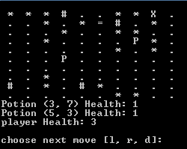
Console
Block (#)
Player (X)
Enemy (*)
Door (=)
Potion (P)
Empty Tile (.)

Slide 10
More
Actor
Multi player
MovingActor
Potion
Block
Door
Player
Enemy
Health Potion
Damage Potion
Zombie
Drakula

