Slide 1
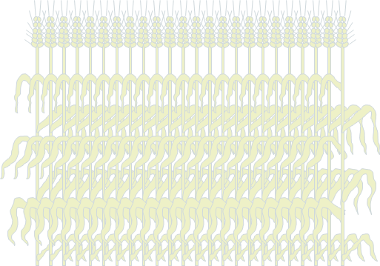
Bigleaf canopy
Layered canopy

Slide 2



$$Lu$$
$$Ll$$
$$Lt$$

