Slide 1
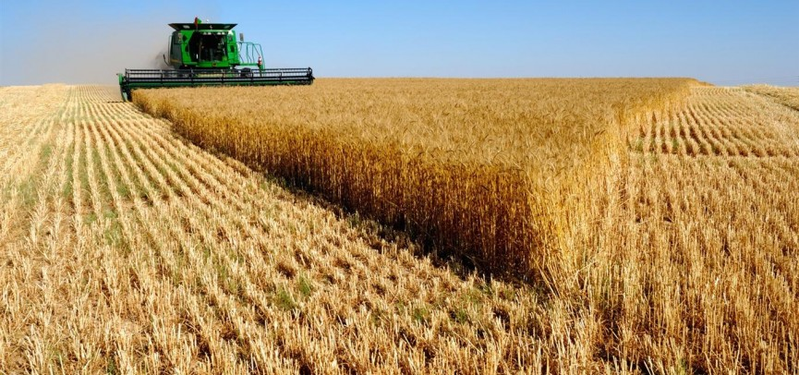
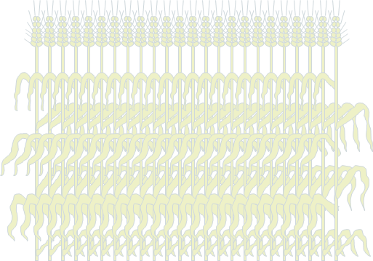



$$x$$
$$y$$
$$z$$

Slide 2
Bigleaf canopy
Layered canopy

Slide 3



$$Lu$$
$$Ll$$
$$Lt$$

Slide 4
Lumped
Sunlit-Shaded
Bigleaf
Layered

Slide 5
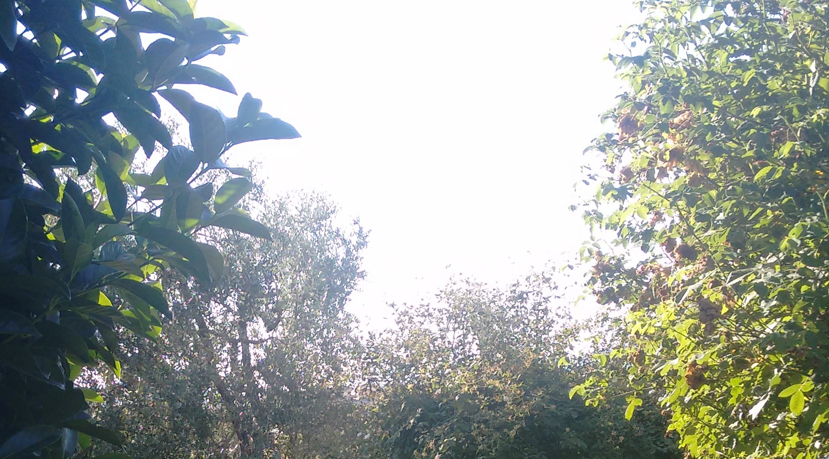
Lumped
Shaded
Sunlit

Slide 6













Sunlit/shaded leaf fractions
Extinction coefficients
$$ρ, τ$$
$$Li$$
$$β$$
Absorbed irradiance per unit ground area
$$k_{dir}$$
$$k_{dir}^{′}$$
$$f_{Sun, i}$$
$$f_{Shade, i}$$
$α$
$$ρ_{dir}$$
$$ISun,i$$
$$ISh,i$$
$$Idir$$
$$Idif$$
$$ρ_{dif}$$
$$Icb, i$$
$$Icd, i$$
$$Ics, i$$
$$k_{dif}$$
absorbed irradiance per unit leaf area of

