Slide 1
Facial Emotion Detection Using Convolutional Neural Networks and Representational Autoencoder Units
Group number – 14
Rami Amasha
Ahmad Bsese

Slide 2
Introduction

Slide 3
Problem definition:
Facial emotion detection is the process of identifying and interpreting the emotions expressed on a person's face. It is important in fields such as psychology, marketing, and human-computer interaction because it can provide valuable information about an individual's mental state and preferences, and can be used to enhance communication and improve the design of products and systems that involve human interaction.

Slide 4
Project goal:
The main goal of this project is to develop an approach for facial emotion detection using convolutional neural networks (CNNs) and autoencoders.
This system would be able to accurately recognize and classify the emotions being expressed in a person's face.

Slide 5
previous approaches
There have been a number of previous approaches to facial emotion detection, including rule-based systems and support vector machines (SVMs). Rule-based systems rely on predefined rules or heuristics to identify emotions, while SVMs use a machine learning algorithm to classify data by finding the hyperplane in a high-dimensional space that maximally separates different classes.
Both of these approaches have their own limitations and may not be as effective as more modern techniques, such as deep learning models like convolutional neural networks.

Slide 6
CNNs and Autoencoders
Convolutional neural networks (CNNs) and autoencoders are powerful tools that can be applied to the problem of facial emotion detection.
CNNs are deep learning models that are well-suited for image classification tasks and can be trained on a dataset of images labeled with the corresponding emotional expressions.
Autoencoders are neural networks that can be used to learn efficient representations of data and can be trained on the same dataset as the CNN to improve its performance by reducing the dimensionality of the input data. Together, these tools can be used to develop systems that can accurately recognize and classify the emotions being expressed in a person's face.

Slide 7
What is CNN ?
Convolutional neural network (CNN) is a type of neural network that is specifically designed to process data with a grid-like topology, such as an image.
They are composed of a series of layers that extract features from the input data, with the layers at the beginning of the network extracting simple features and the layers at the deeper end of the network extracting more complex features.
CNNs are widely used for tasks such as image classification, object detection, and image generation, and are known for their ability to learn features directly from the data and for their robustness to variations in the input data

Slide 8
What is Representational autoencoder units ?
Representational autoencoder units are a type of artificial neural network that can learn a compact, low-dimensional representation of a dataset.
They consist of an encoder and a decoder, with the encoder mapping the input data to a low-dimensional representation and the decoder mapping the encoding back to the original data.
The goal of training an autoencoder is to minimize the reconstruction error between the original data and the data reconstructed by the decoder.
The low-dimensional encoding learned by the autoencoder can be used for tasks such as dimensionality reduction, feature extraction, and data visualization.

Slide 9
Methodology

Slide 10
Jaffe Dataset
The JAFFE (Japanese Female Facial Expression) dataset is a widely used dataset for evaluating facial emotion detection algorithms. It consists of 213 images of Japanese female subjects displaying 7 basic emotions, and was annotated by trained researchers using a manual coding process based on action units and facial muscle movements. The JAFFE dataset is considered to be a relatively small and simple dataset, but is still widely used due to its high quality and controlled collection environment.

Slide 11
Preprocessing steps
We have preprocessed the images by generating 16 smaller images (batches) from each larger image by cropping the larger image into smaller images of size 48x48.
This is a common preprocessing step in image classification and object detection tasks and can help to improve the performance of the model.
It's important to consider the trade-off between image size and model performance when choosing the size of input images.

Slide 12
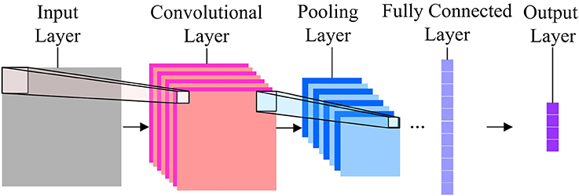
CNN architecture

Slide 13
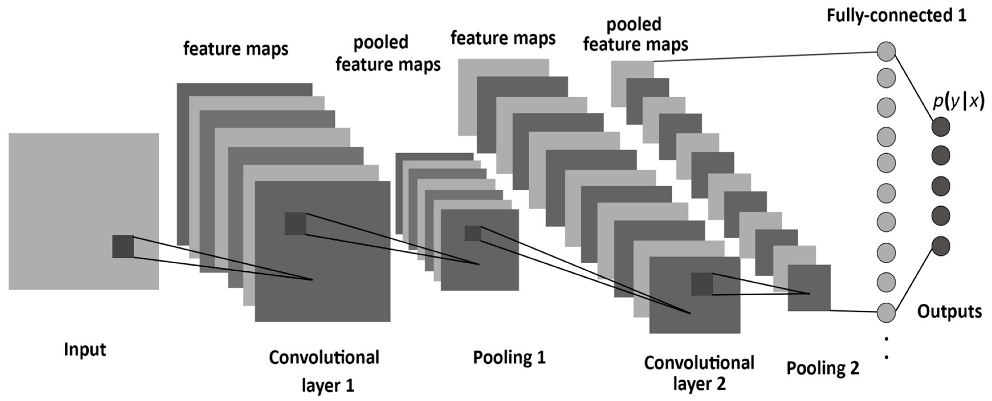
Convolutional layer
They are responsible for learning features from input data.
They perform a dot product between the filters and small region of the input data and apply an activation function to the result.
The resulting feature maps are then passed to the next convolutional layer or to a pooling layer.

Slide 14
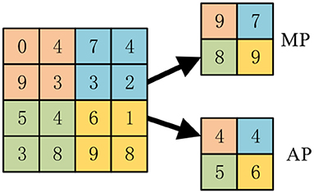
Pooling layer
Pooling layers are used to reduce the size of the feature maps and reduce the computational complexity of the model.
There are several types of pooling, such as max pooling, average pooling and sum pooling.

Slide 15
Fully connected layers
Fully connected layers are used to make predictions on the learned features.
They take the flattened feature maps from the previous layer as an input and apply a dot product with the weights and an activation function to produce the output.

Slide 16
Output layer
The output layer of a neural network is the last layer of a CNN. And its responsible for producing the output of the network.
The number of nodes in the output layer is typically determined by the number of classes the network trying to predict.

Slide 17
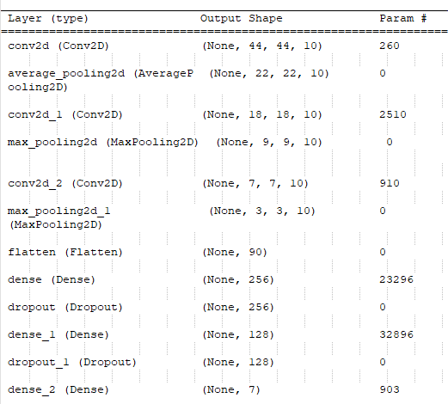
Our CNN Model architecture
We have 3 convolutional layers, the first one with average pooling layer and the two others with max pooling layer.
The model has two dropout layers. (dropout rate -0.5)
Output layer with 7 units.

Slide 18
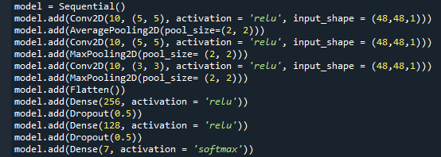
Conv. Layer#1
Average Pooling layer#1
Conv. Layer#2
max Pooling layer#2
Conv. Layer#3
max Pooling layer#3
Fully connected layers
Output layer

Slide 19
Representational Autoencoders Unit architecture
An autoencoder has two parts :
Encoder .
Decoder.
Encoder : maps the input data to a lower-dimensional latent space.
Decoder : maps the latent space back to the original dimensionality of the input data.

Slide 20
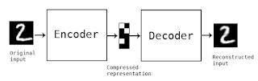
Representational Autoencoders Unit architecture cont.

Slide 21
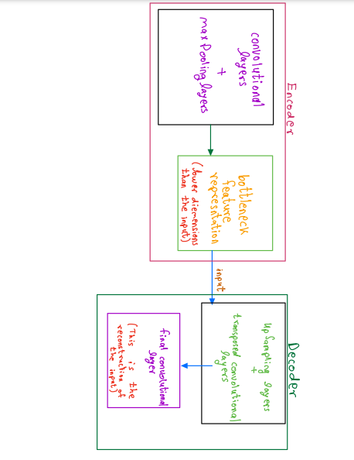
Autoencoder model

Slide 22
Our Autoencoder-CNN model architecture
We used “transfer learning” approach, which is :
technique in machine learning where a model trained on one task is reused as the starting point for a model on a second related task.
This allows the model to leverage the knowledge it has gained from solving the first task, and apply it to the second task.
This technique is especially useful when the data available for the second task is limited or when the second task is similar to the first task.

Slide 23
Training procedures
The Autoencoder-CNN model :
The autoencoder is first trained on the task of reconstructing the input images, and then the learned weights are used as the initial weights for the classifier network, which is trained on the task of classifying the images by emotions.
The encoder part of the autoencoder is used as the feature extractor, which has learned useful representations of the input images during the training process of autoencoder.

Slide 24
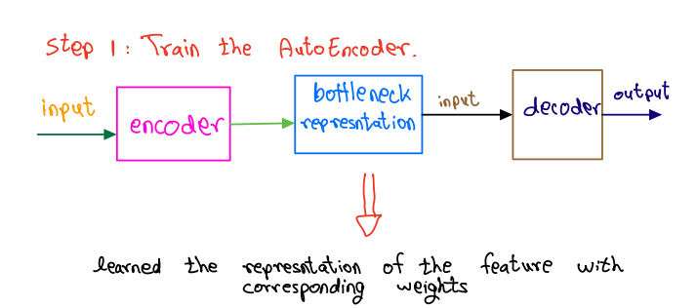
Training procedures Cont.

Slide 25
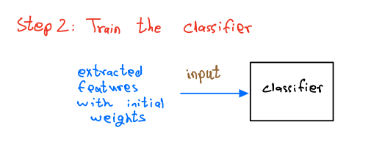
Training procedures Cont.

Slide 26
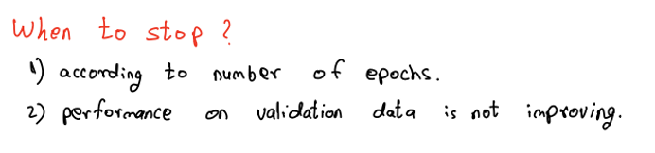
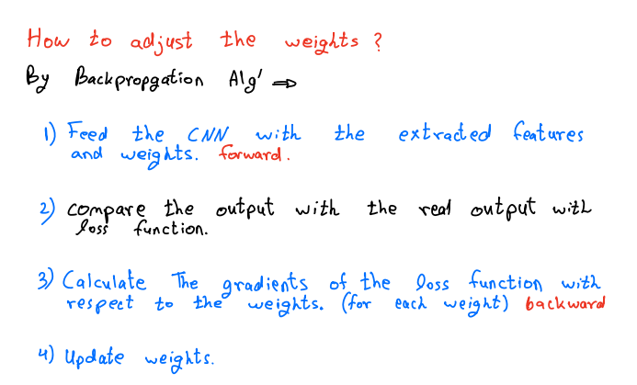
Training procedures Cont.

Slide 27
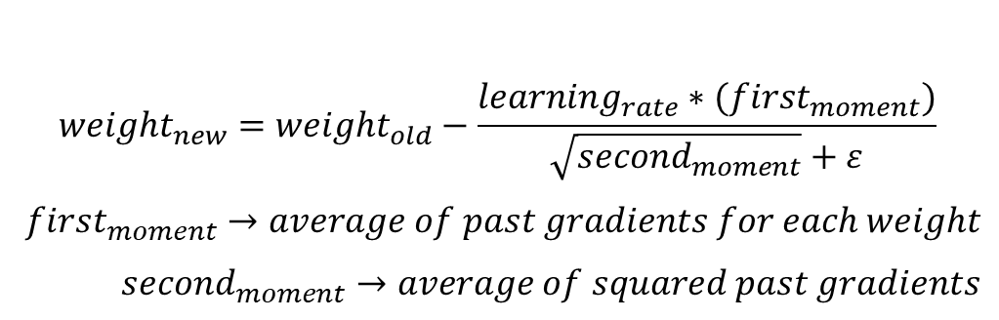

Update weights
Momentum helps to avoid stocking in local minimum
$$velocity=momentum∗velocity−learining_{rate}∗gradient$$
$${weight}_{new}={weight}_{old}+velocity$$
$velocity→accumalted past gradients$
$$momentum→controls the influence of the past gradients$$
$$(high value increase the influence)$$
$$(learning rate is the same for each weight)$$
SGD+MOMENTUM
$${weight}_{new}={weight}_{old}−\frac{learning_{rate}∗(first_{moment})}{\sqrt{{second}_{moment}}+ε}$$
$first_{moment}→average of past gradients for each weight$
${second}_{moment}→average of squared past gradients$
Adam+MOMENTUM
RMSprop help to overcome the oscilations
$$(learning rate can be different for each weight)$$

Slide 28
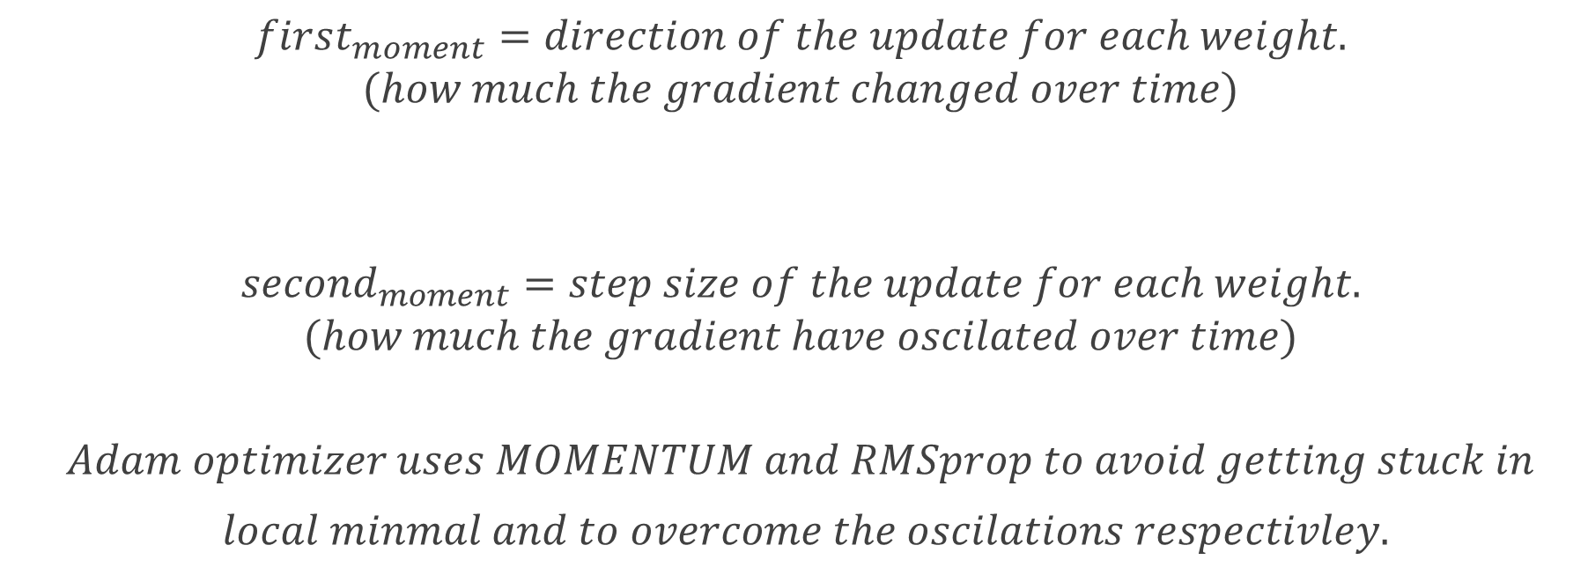
Update weights – Adam + MOMENTUM Cont.
$$first_{moment}=direction of the update for each weight.$$
$$(how much the gradient changed over time)$$
$${second}_{moment}=step size of the update for each weight.$$
$$(how much the gradient have oscilated over time)$$
$$Adam optimizer uses MOMENTUM and RMSprop to avoid getting stuck in$$
$local minmal and to overcome the oscilations respectivley.$

Slide 29
Results

Slide 30
CNN model results
Results for testing the CNN model on JAFFE dataset:
Number of Correct Predictions: 799
Total number of Images: 864
Accuracy: 92.4
Results for testing the CNN model on fer2013 dataset :
Number of Correct Predictions: 2942
Total number of Images: 3,589
Accuracy 81.97

Slide 31
Autoencoder model results
The dataset contains 35,887 grayscale, 48x48 pixel images of faces, each labeled with one of 7 emotional expressions.
The test set is 3,589 images.
Results for testing the model on JAAFE dataset:
1) Test Loss: 0.10. 2) Test Accuracy: 63.65
Results for testing the model on unseen images :
Test Loss on fer2013 dataset: 0.17
test accuracy on fer2013 dataset: 48.9

Slide 32
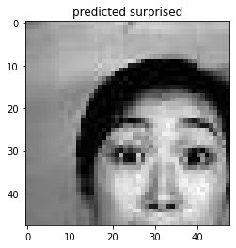
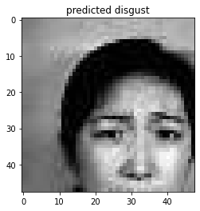
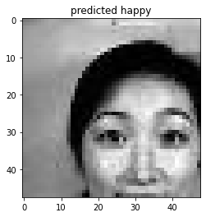
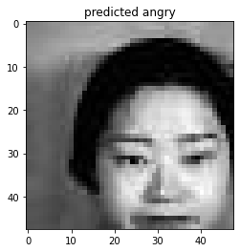
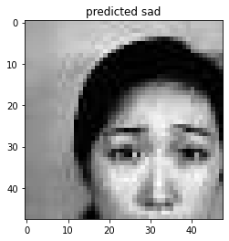
Correct classifications for the Autoencoder-CNN model

Slide 33
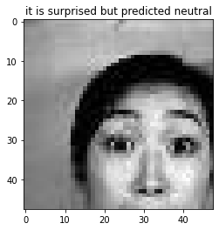
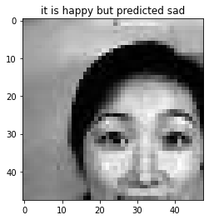

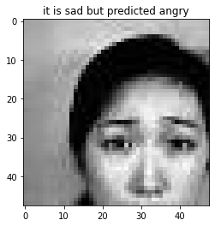
Incorrect predictions for the Autoencoder-CNN model

Slide 34
Conclusions And Future work
The CNN “individual” performed better than the combined model “ autoencoder and CNN” and for this might be many causes, like:
Overfitting: The combined model may be more prone to overfitting, as it has more parameters to train, and the autoencoder may be learning features that are not relevant for the final task.
Feature representation: The features learned by the autoencoder may not be as useful for the final task as those learned by the CNN. The CNN may be better at extracting task-specific features directly from the input, rather than first compressing the input and then extracting features.
Data Quality: The quality of the data could also influence the results, the CNN model could be benefitted from better quality or amount of data.

Slide 35
Future Work
We can change the dataset and use another dataset.
Real-time implementation : The current model is designed to work on images rather than video, the future work could be implementing it on real-time video streams.
Emotion recognition in the wild: The majority of existing datasets for facial emotion recognition consist of images captured in controlled settings, such as studio environments, which might not be representative of real-world scenarios. The future work can focus on developing models that can recognize emotions in the wild, where images may be of lower quality, taken at different angles, and captured under varying lighting conditions.

