Slide 1

TU API Ontology based recommendation system
IT 325 Web Service
major: it minor : ba
Mechergui Rami
e-mail: ramimechergui@tbs.u-tunis.tn
1

Slide 2


https://github.com/RamiMechergui/TU_Ontology_Based_Recommendation_System
https://tuapiontologybased.herokuapp.com/
2

Slide 3
Contents
1 - introduction
2 – proposed solution
3 – ontology graph
4 – example of output
5 - Conclusion
3

Slide 4
1- Getting started with the ontolgy
1.1- INTRODUCTION
While using TU API for the first time , the user will find himself in front of several endpoints . Hence, finding the most suitable endpoint that will lead him to get his data will take time and with non technical background it will take effort to learn how to use the API. That’s why we may ask ourselves how can we offer the user the endpoints that may interest him without taking time and effort ?
6

Slide 5
2- proposed solution
Goals of ontology :
This where the idea of ontology based recommendation system comes from .
Our ontology-based recommender system is a tool that provides personalized recommendations for those endpoints that are most likely to be relevant and interesting to a user in order to help him/her to find the most useful based on their preferences
Recommendation systems have more recently offered personalized and more relevant recommendations. The personalized approach is achieved by using information that is found in certain situations, such as studying various objects, the context and areas of interest, location .
7

Slide 6
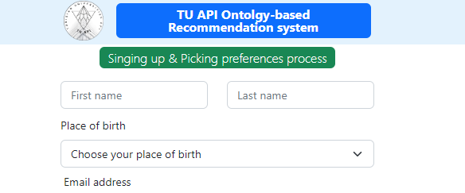
Through signing up we collect the user preferences
Get data about the user like his place of birth
8

Slide 7

Through signing up we collect the user preferences
Like his preferred university
9

Slide 8

Through signing up we collect the user preferences
His preferred topic
10

Slide 9
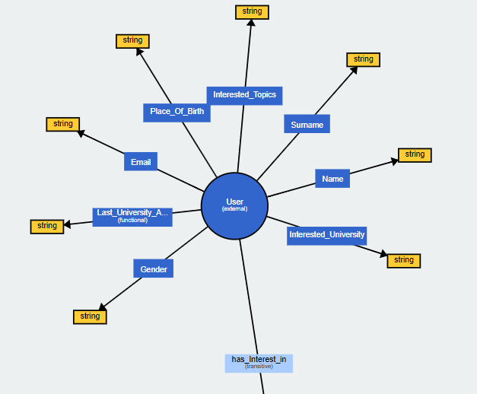
3- Ontology graph
10

Slide 10
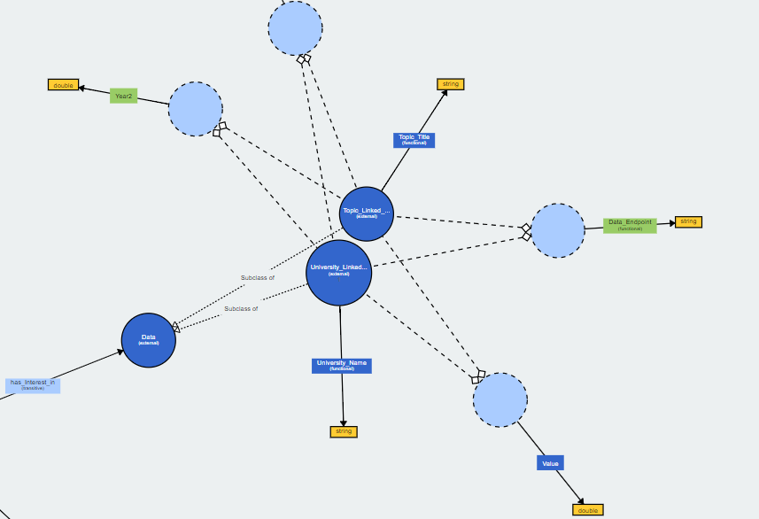
11

Slide 11
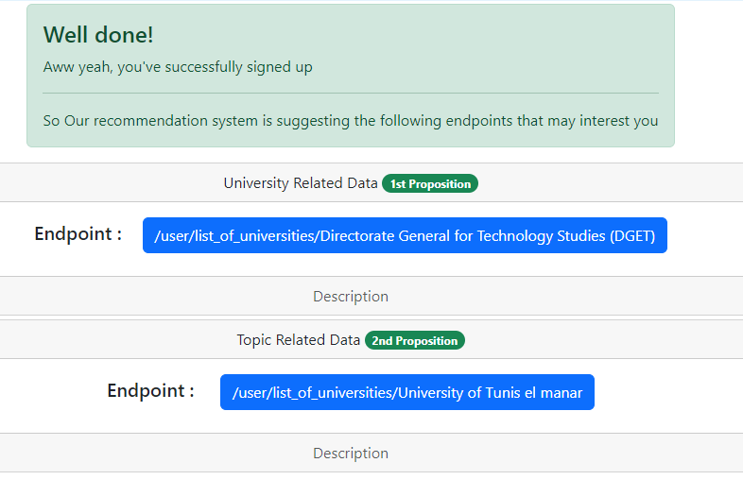
4- example of output
12

Slide 12
5 – conclusion
In an online evaluation, users interact with a running recommender system and receive a recommendation based on their preferences ( the university interested in , the topic that he wants to get data about , the nearest university based on his place of birth ) .
13

