Slide 1

Linking and Analyzing Data on Deaths in US Prison
Team Members: Sam Grossman, Johnathan Ross, Ramil Mammadov
Project Leads: Dr. Lauren Brinkley-Rubinstein, David Cloud
Project Manager: Abdul Wasay
Notes:
Sam

Slide 2
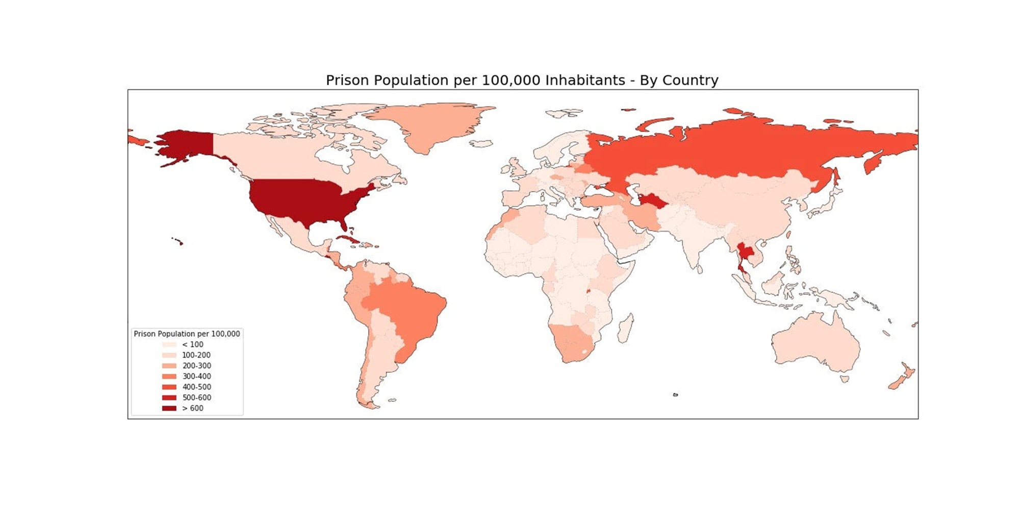
•The US currently has between 1.9 – 2.1 million prisoners
•The US ranks 5th in prisoners per capita
Notes:
Sam

Slide 3
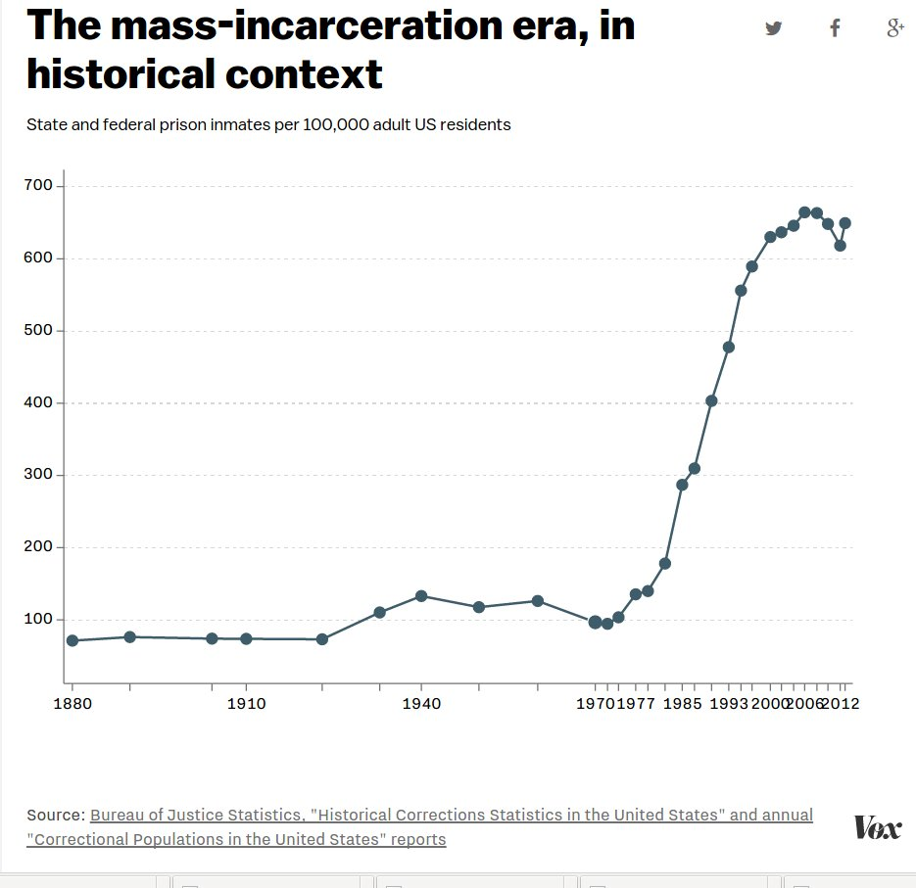
How We Got Here
Only 200,000 US prisoners in 1970 compared to around 2 million today.
1970’s: War on drugs, “Tough on Crime” policies.
1980’s and 1990’s: Mandatory minimum sentencing, Three strikes Laws, Harsher restrictions on parole.
32% of the US prison population is Black, 68% of the prison population is from a minority group.
Notes:
Sam

Slide 4
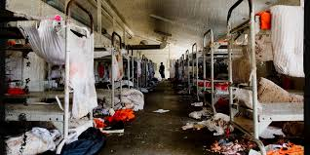
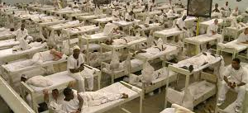
The Prison System Itself
Issues in the US Prison System include:
Overcrowding
Health concerns and limited to no access to healthcare
Physical and mental abuses
Post-release problems
And more
Notes:
Sam

Slide 5
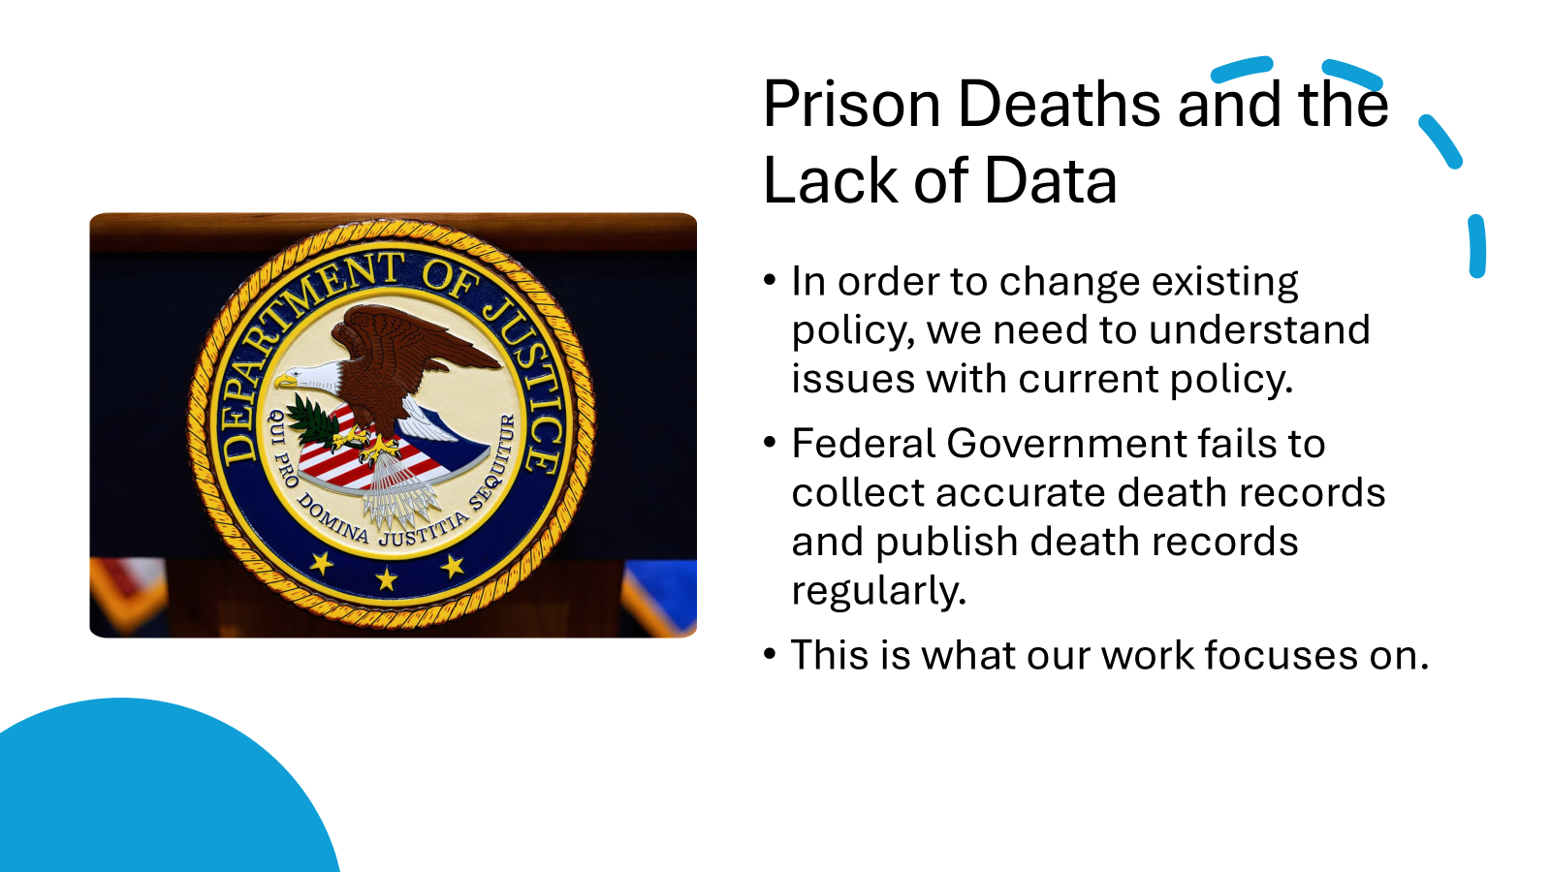
Notes:
Sam

Slide 6

Third City Project
Our project is part of Third City Project’s research
“The Third City Project promotes data transparency for the complete physical, mental, and social well-being of individuals and communities impacted by the criminal legal system, shining light on data behind its walls.”
Notes:
Sam

Slide 7

Analysis Plan
• Data-cleaning and validation steps.
• Statistical or ML approach (e.g., Python/R EDA, clustering, regression).
• Planned visualizations or dashboards.
• Any software, packages, or reproducibility notes.

Slide 8
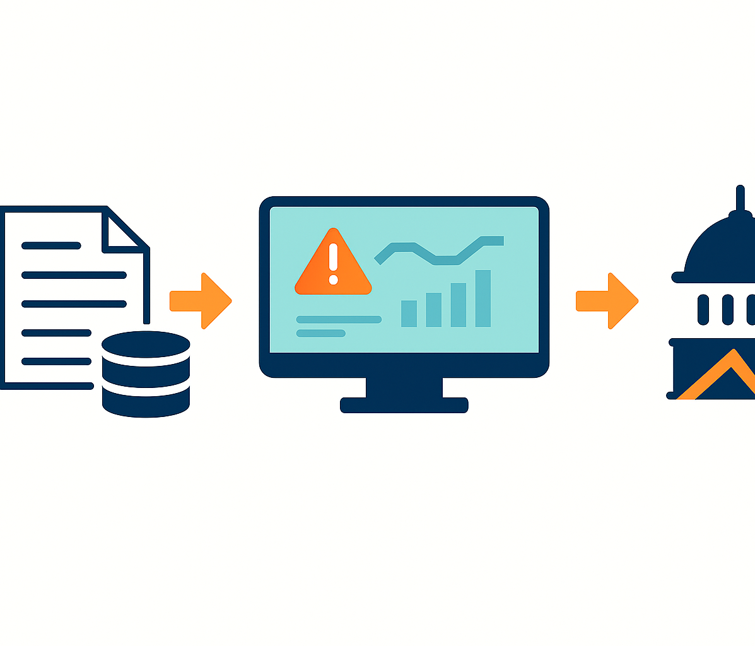
What’s “Cool” about the Project?
Live check: to match press releases with federal counts
Instant alerts: dashboards flag overdose spikes fast
Policy fuel: linked data pushes for quicker, fuller reporting

Slide 9
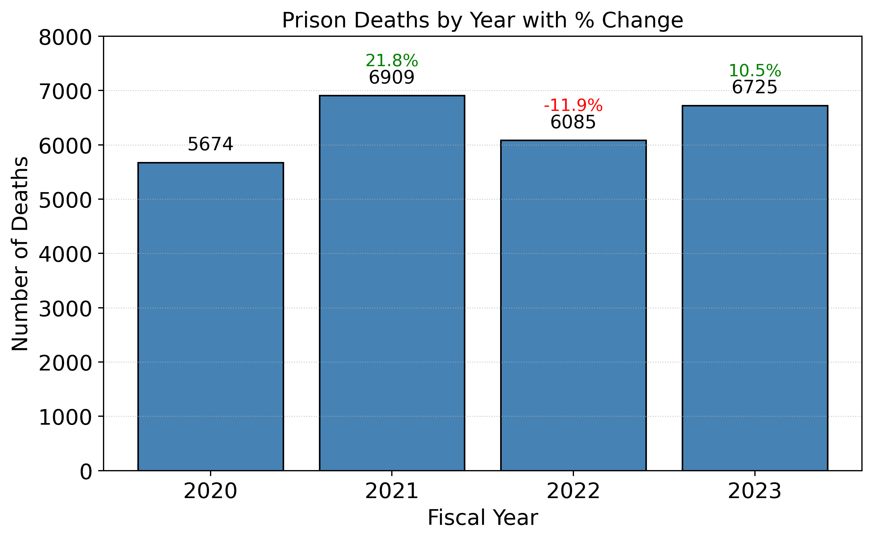
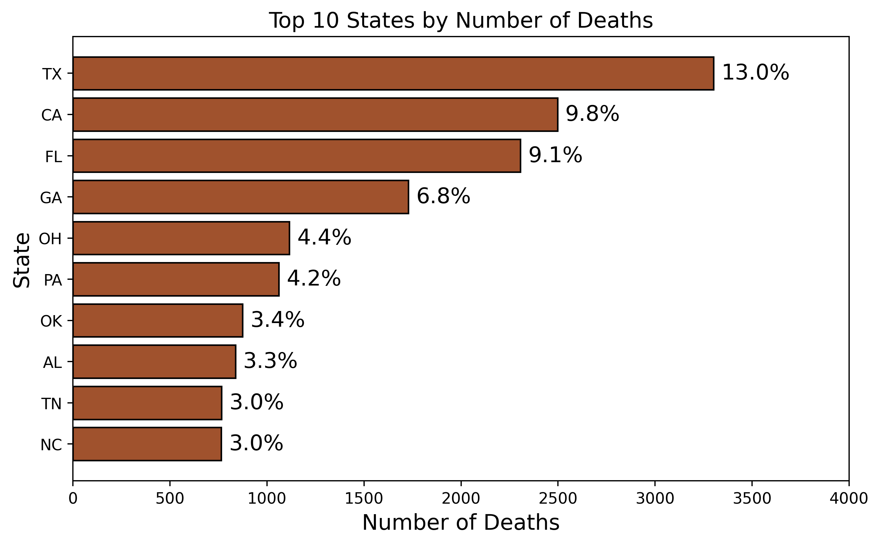
State Hotspots & Year-to-Year Swings (2020-23)
Year-to-year swings: deaths +22 % in 2021, −12 % in 2022, then +10 % in 2023. Net result - about 6.7 k deaths in 2023, up 18 % vs 2020.
Deaths cluster in a few states - Texas tops the list (≈3.3 k / 13%), and the ten highest-count states make up 50 %+ of all prison deaths.

Slide 10
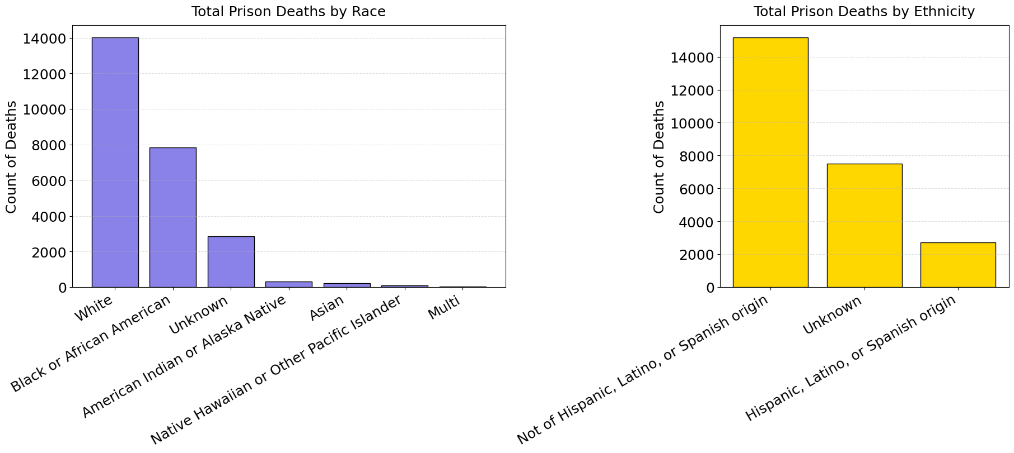
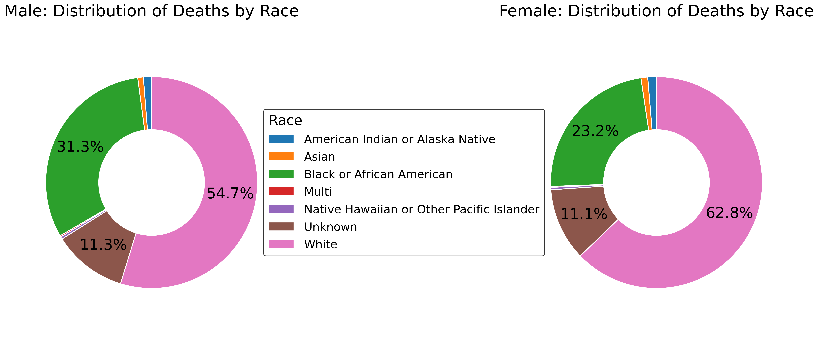
Race & Sex Disparities in Prison Deaths (2020-23)
Deaths are highly concentrated among White prisoners (≈14 k) followed by Black/African-American (≈8 k); other races are an order of magnitude lower.
Sex split shows the same ranking but different weights: among males the share is 55 % White / 31 % Black, while among females it skews even more White (63 %) with a smaller Black share (23 %).

Slide 11
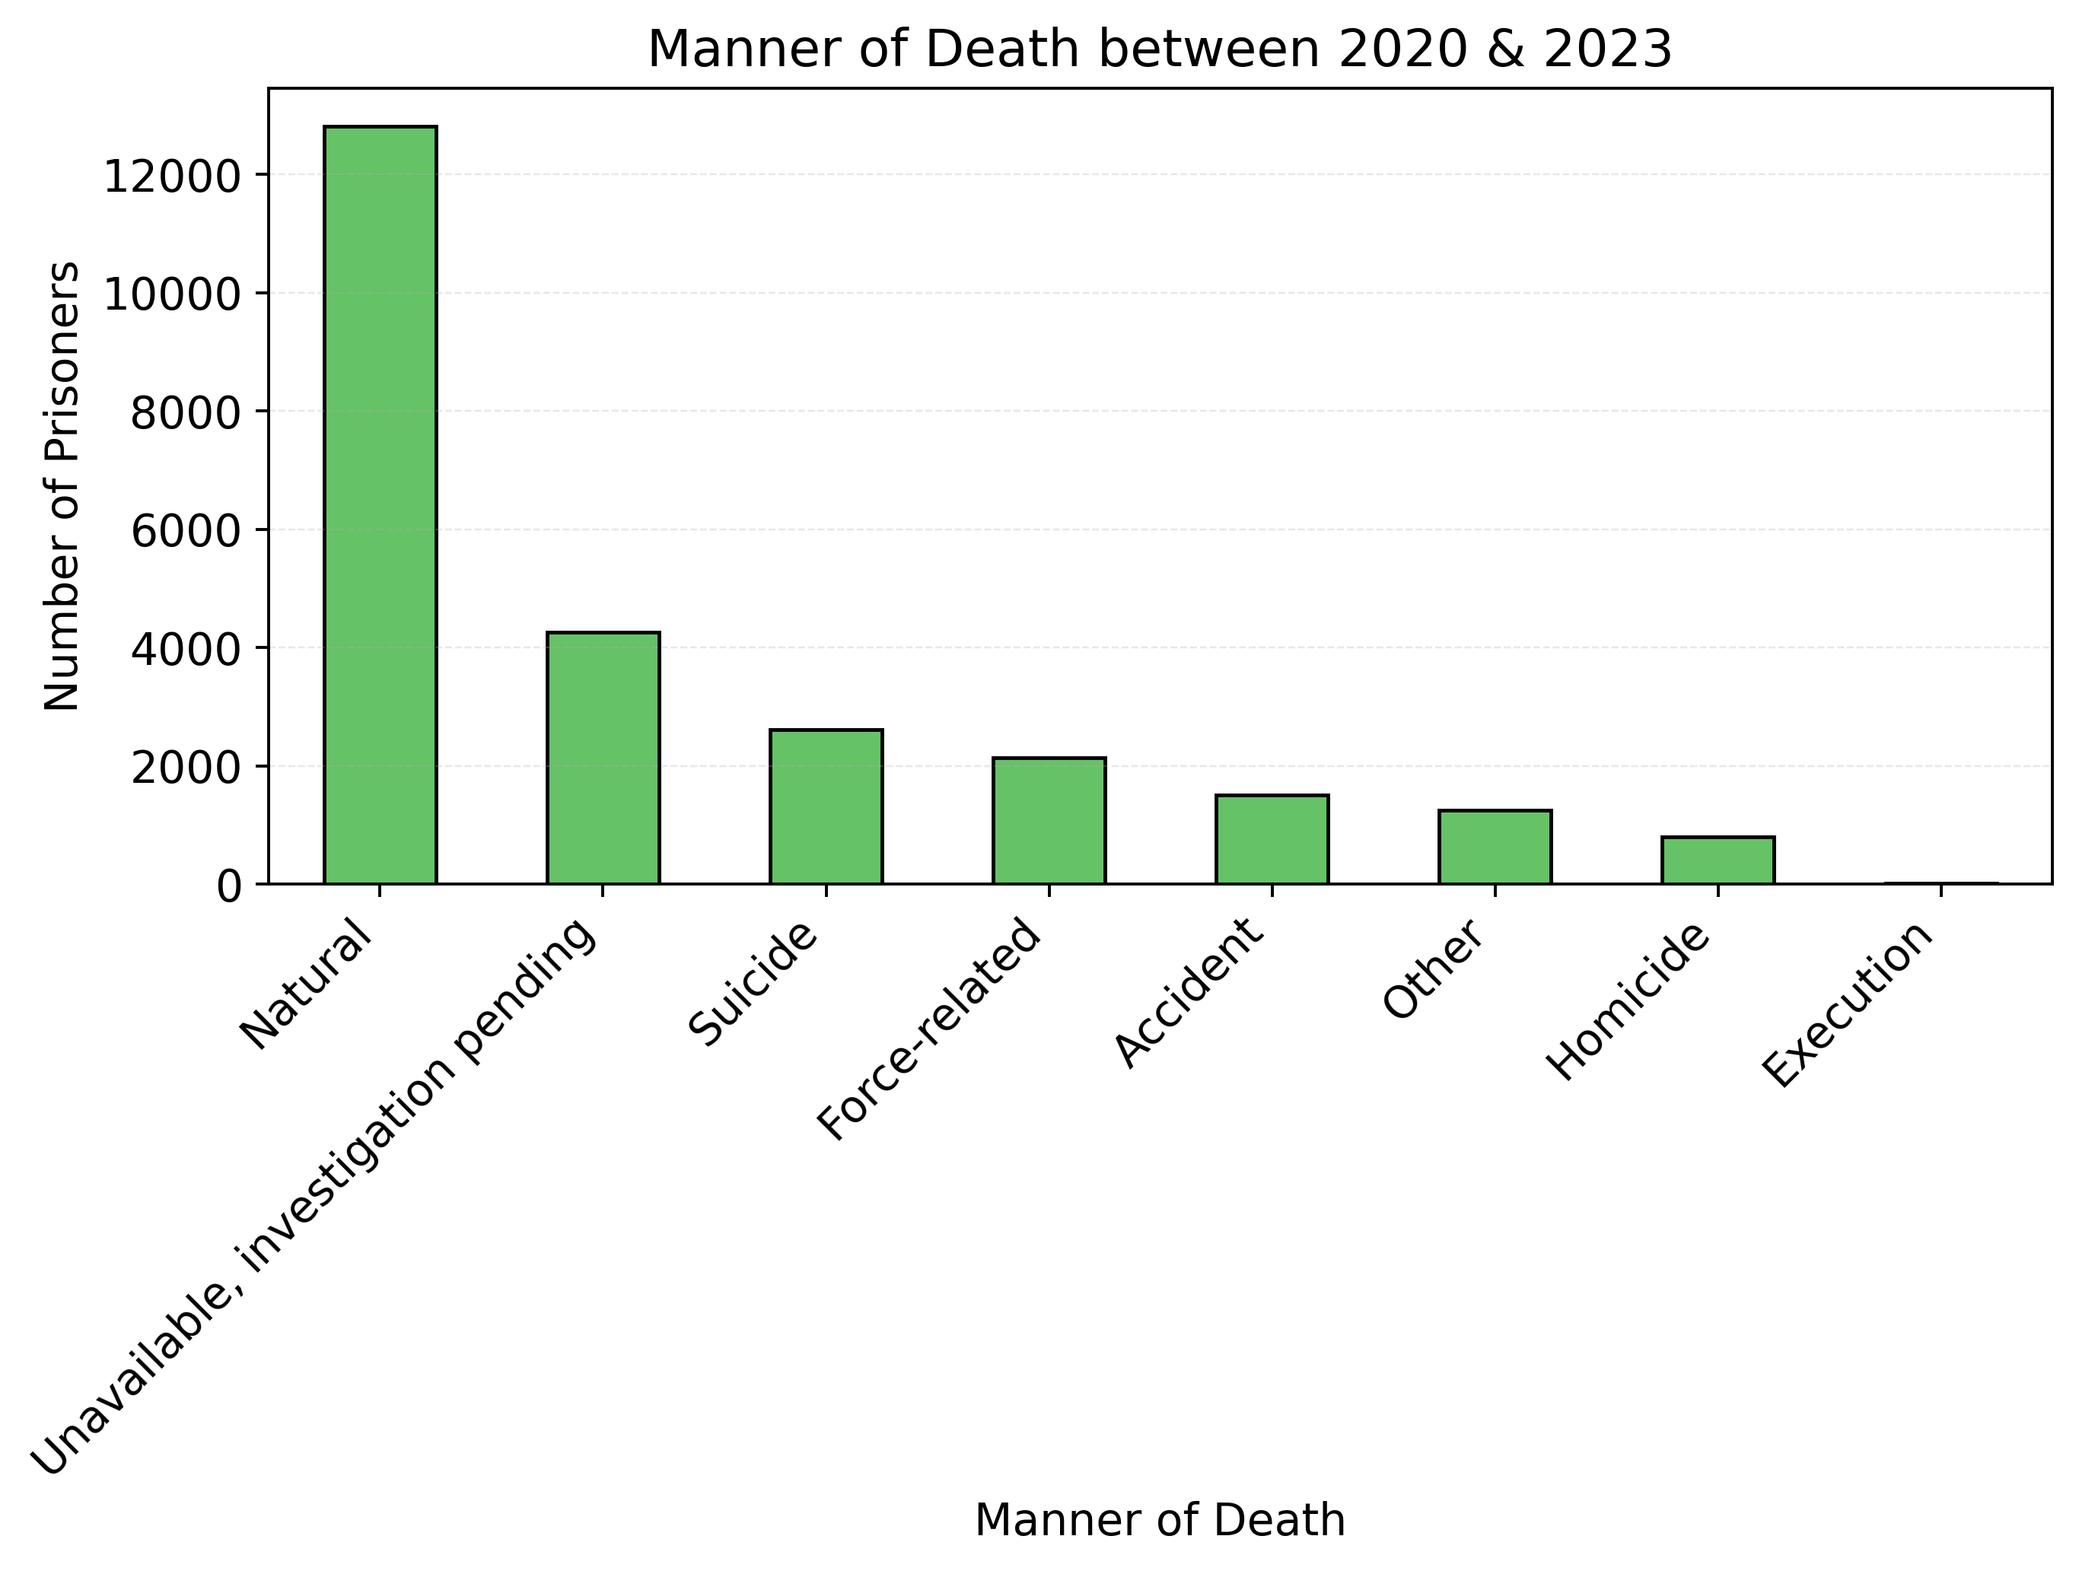
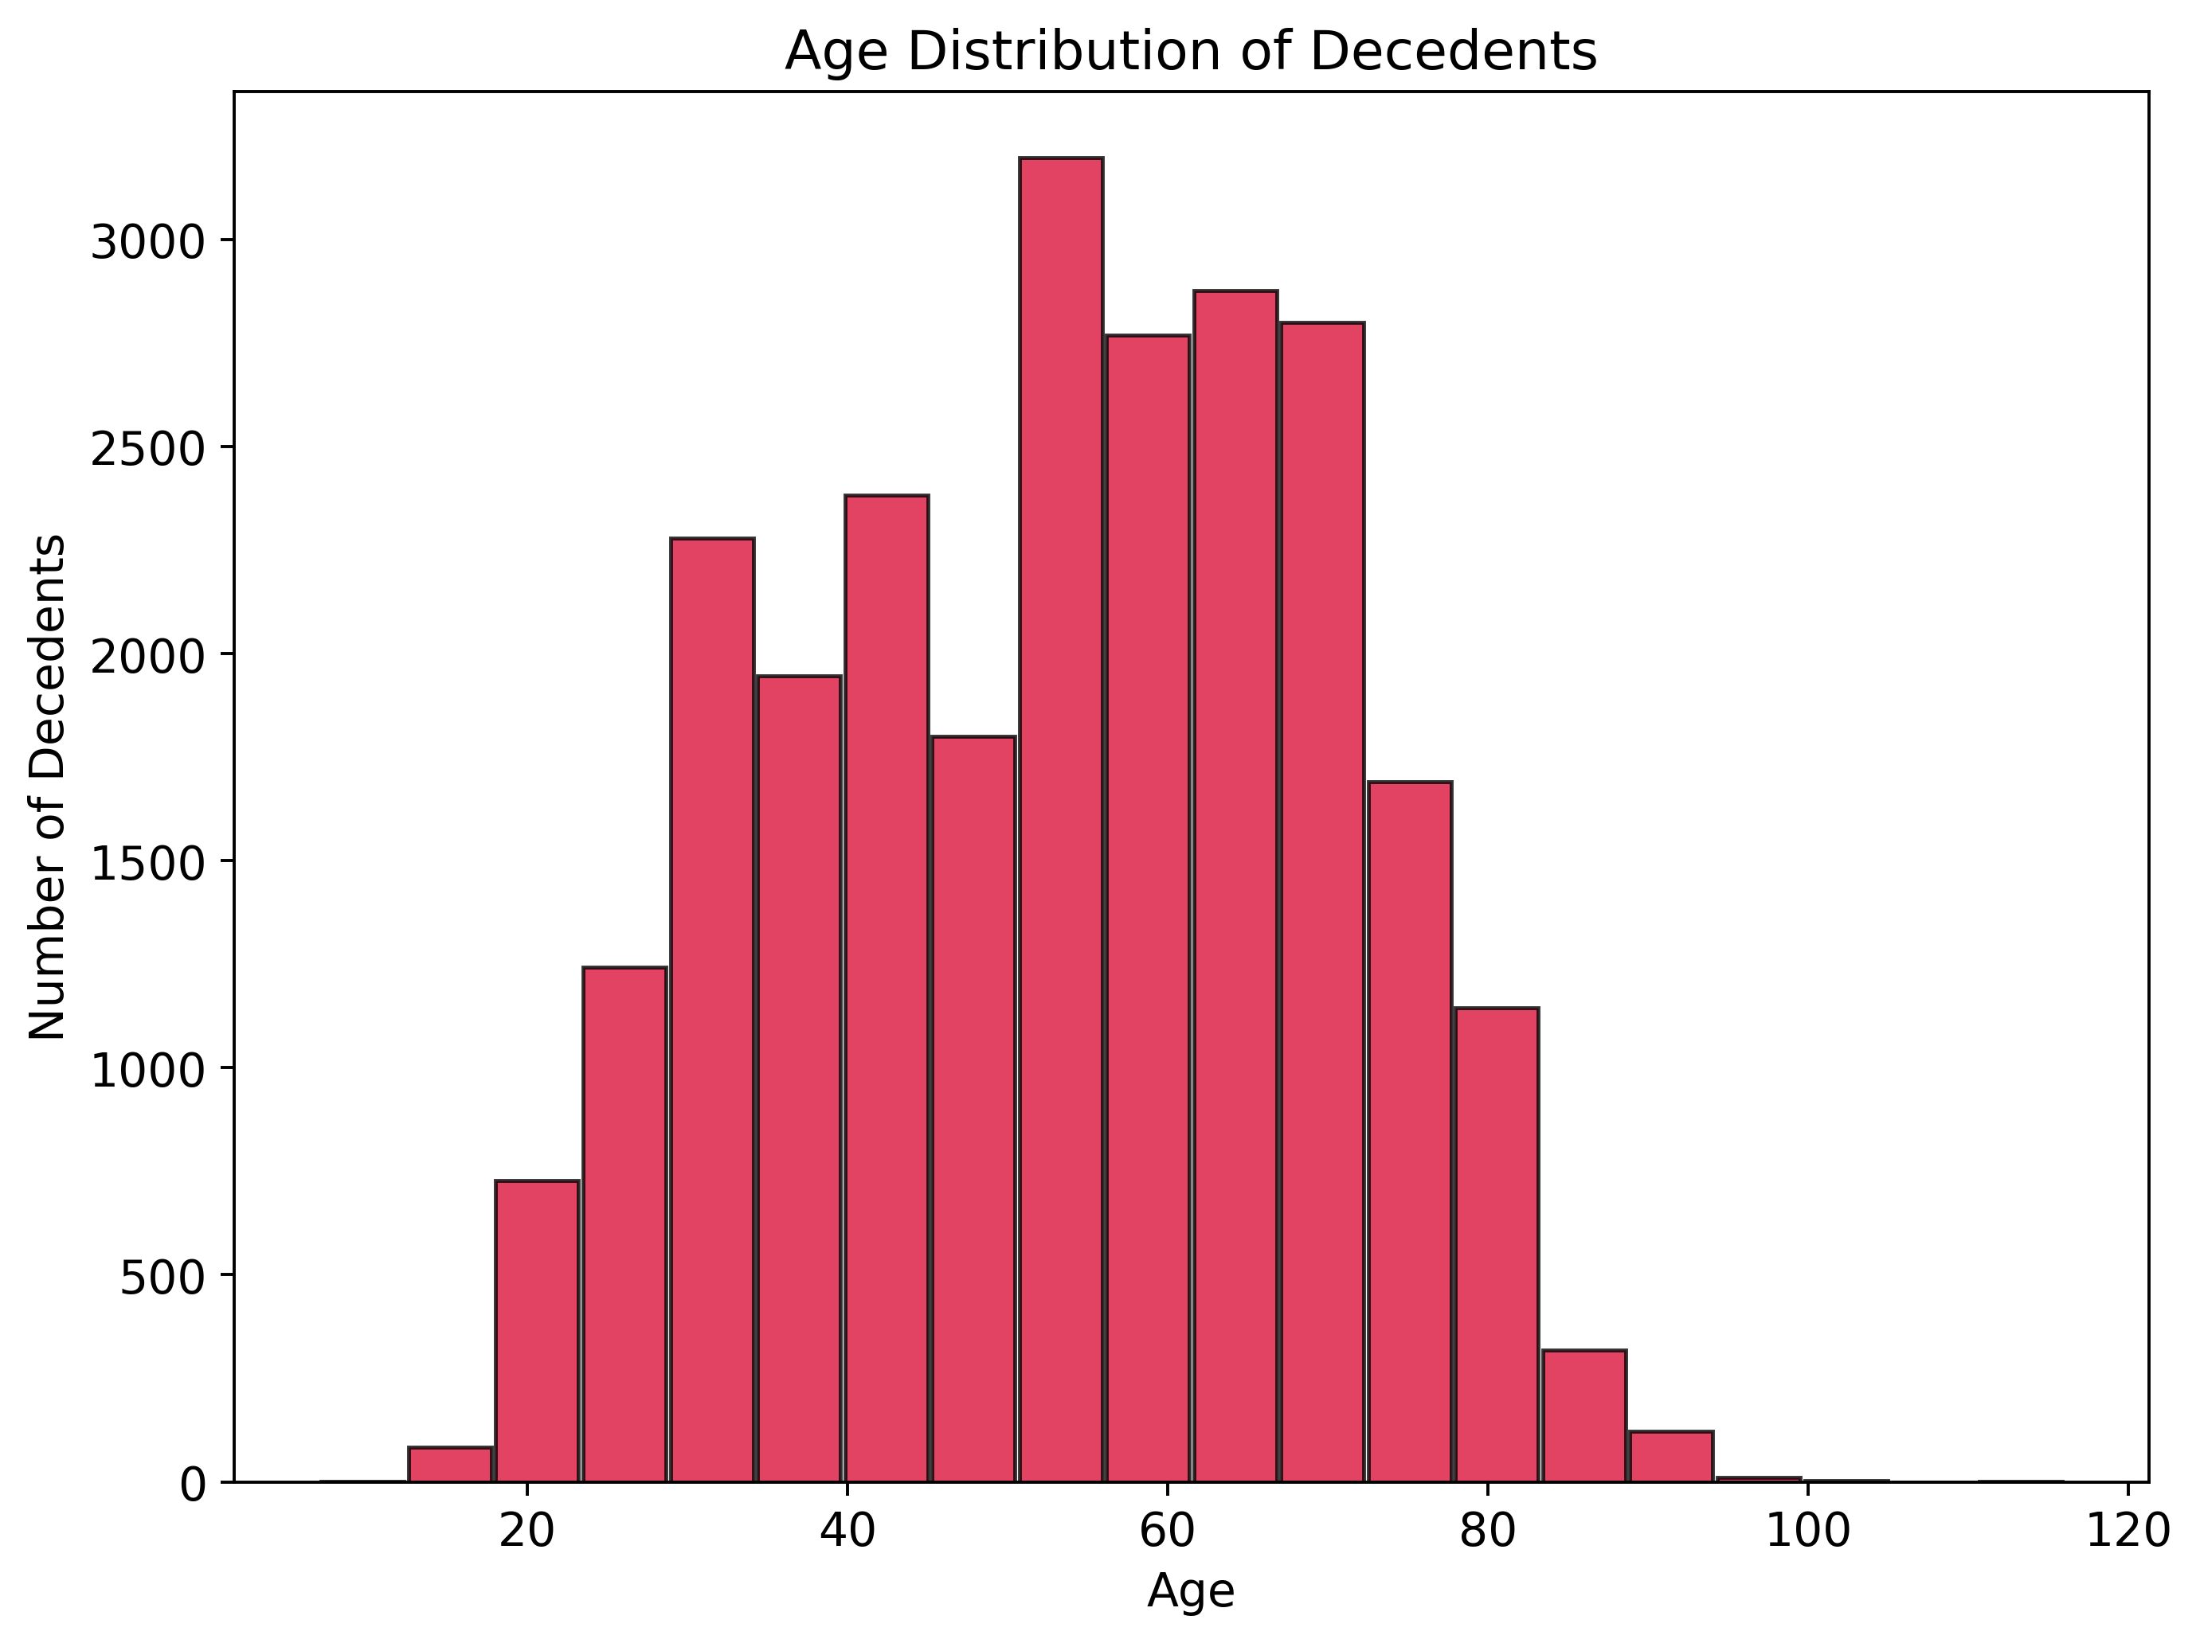
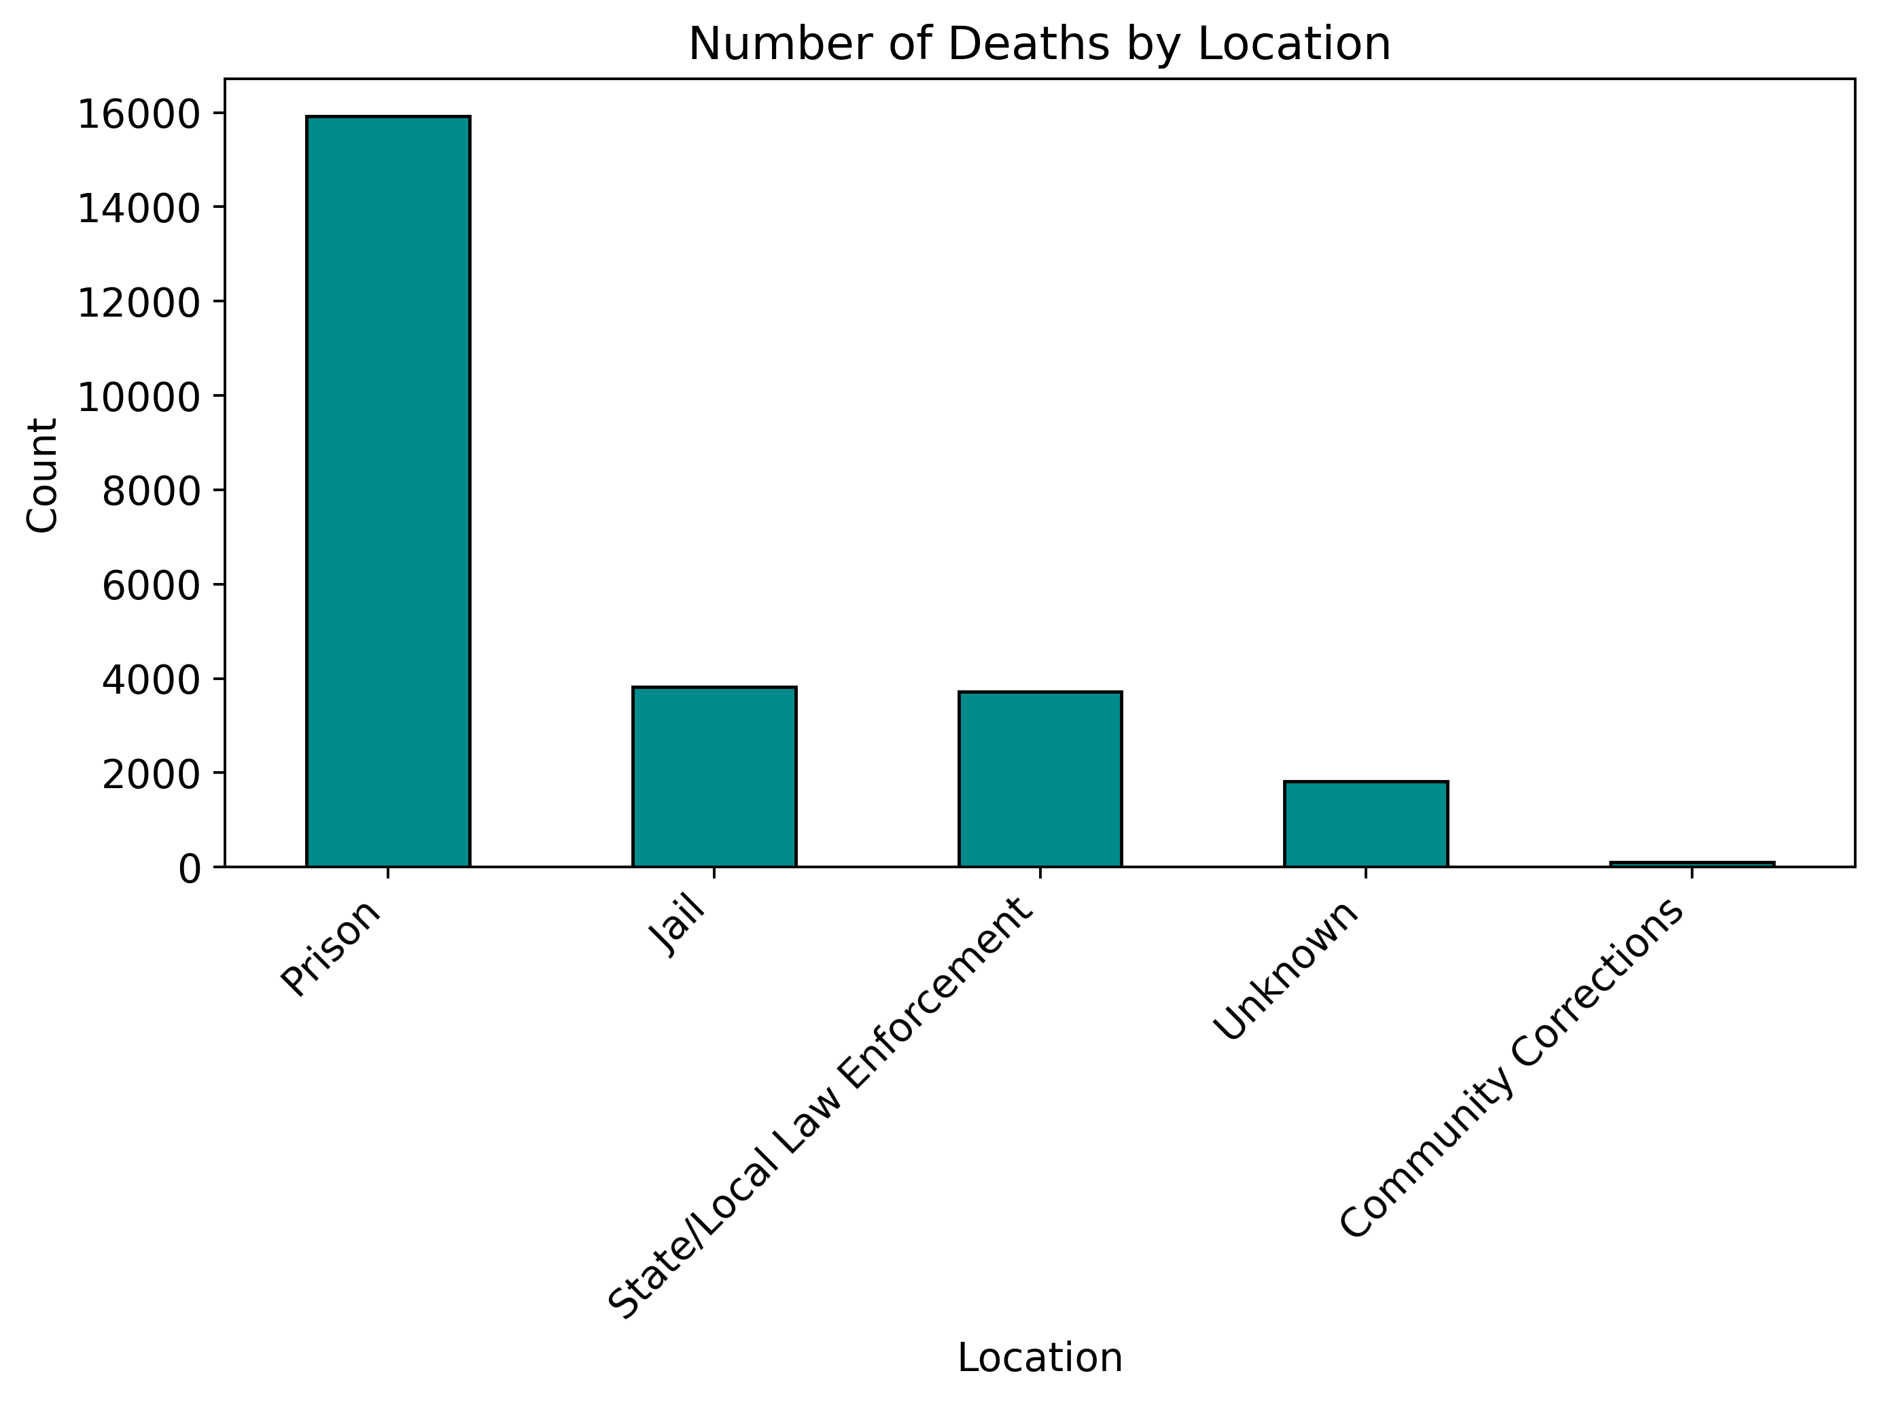
Prison Mortality Snapshot (2020-23)
Natural causes dominate (≈13 k). Pending investigations, suicide and force-related cases make up the next tier; executions and homicides are rare.
Most decedents were 40-70 yrs; deaths peak in the late-50s / early-60s and drop sharply after 80.
Overwhelmingly in state prisons (≈16 k). Jail and state/local law-enforcement facilities each add ≈3-4 k, while community-corrections deaths are negligible.

Slide 12
Updates after Talk 1:
Built a table of Independent Oversight Agencies for correctional facilities by jurisdiction
Built a table of Death in Custody Reporting Laws and Compliance by jurisdiction
Updated data sources
Conducted Exploratory Data Analysis (EDA) on the merged BJA + BJS dataset
Fulfilled project objectives
Compared imprisonment rates and prisoner death rates across states
Built an interactive map with statistical data
Clarified next steps
Notes:
Sam

Slide 13
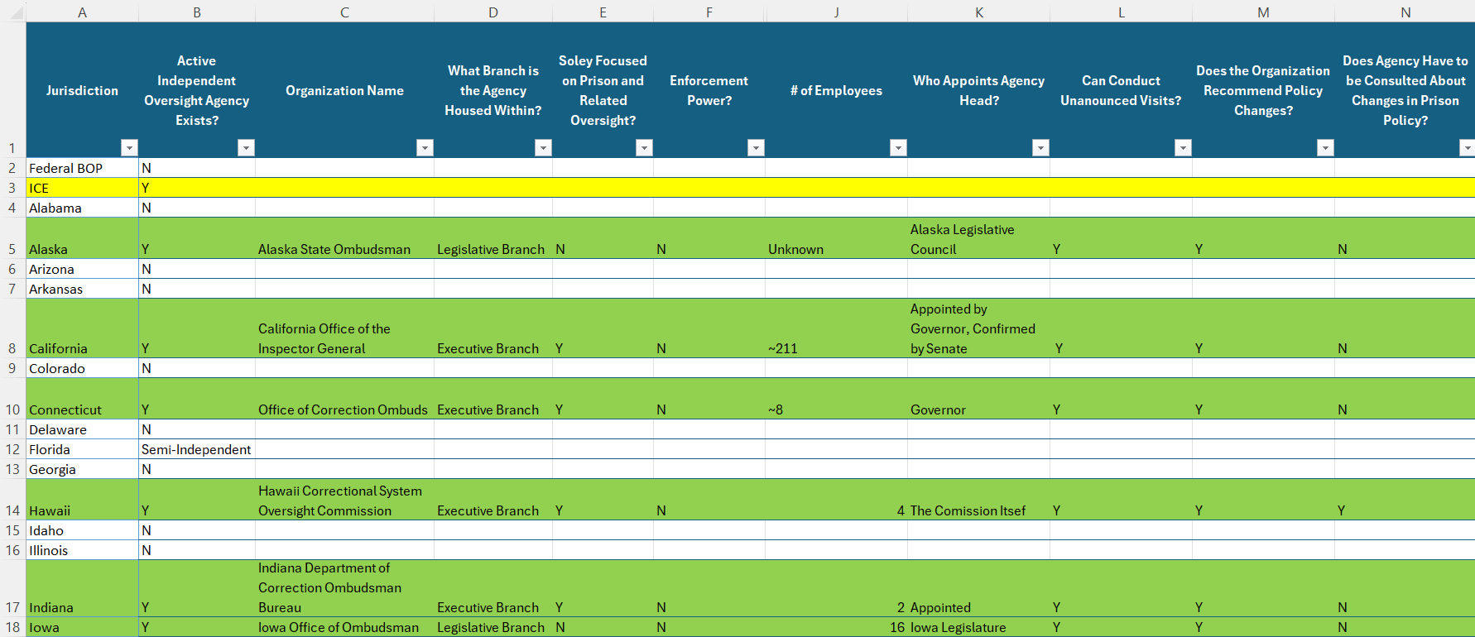
Independent Oversight Agencies for Correctional Facilities by Jurisdiction
Notes:
Sam

Slide 14
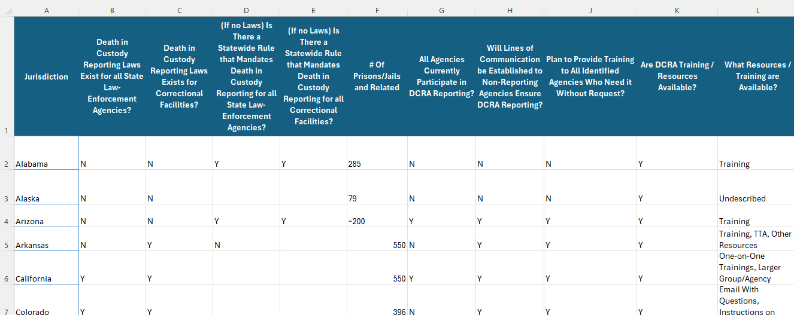
Death in Custody Reporting Laws and Compliance by Jurisdiction
Notes:
Sam

Slide 15
Data Sources
State DOC Press Releases
Structured data entered from state Department of Corrections (DOC) press releases
Captures names, demographics, and causes of death
Bureau of Justice Statistics (BJS)
Individual-level death records in state prisons
Covers years 2015–2019
Includes demographic info and standardized cause-of-death codes
Bureau of Justice Assistance (BJA)
Ongoing data collection through the Deaths in Custody Reporting Program (DCRA)
May vary in structure and detail across states
Notes:
Johnathan

Slide 16
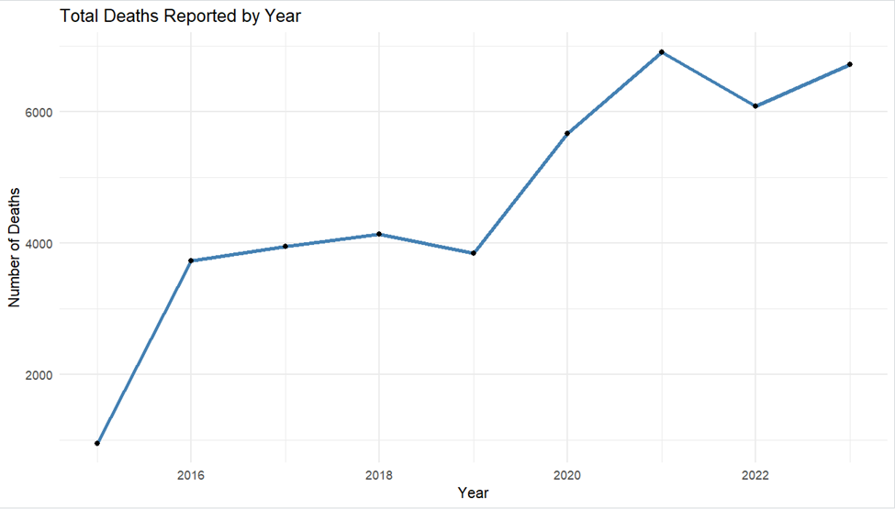
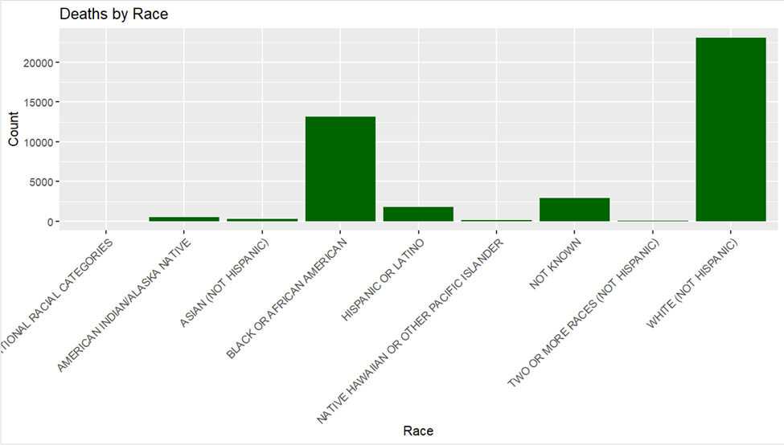
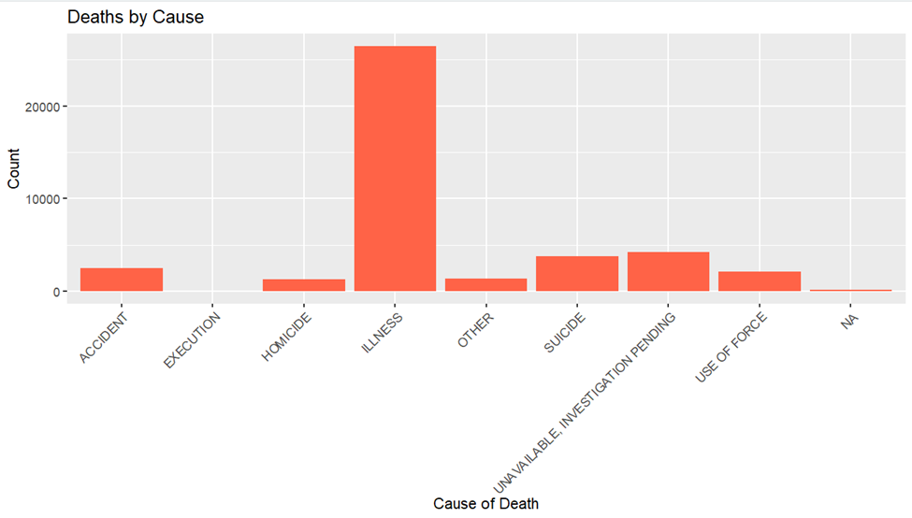
EDA on Merged BJA + BJS Dataset
Notes:
Johnathan

Slide 17
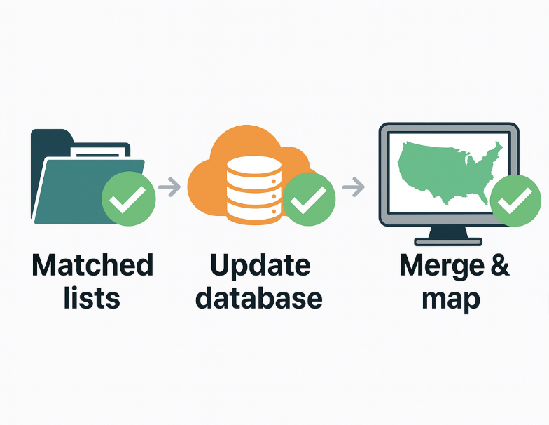
Purposes of the Project
✔ Matched federal death lists with state press releases to identify discrepancies
✔ Added death notices from state releases to Third City Project via Qualtrics
✔ Merged datasets, performed EDA, and built a public interactive map
Notes:
Johnathan

Slide 18
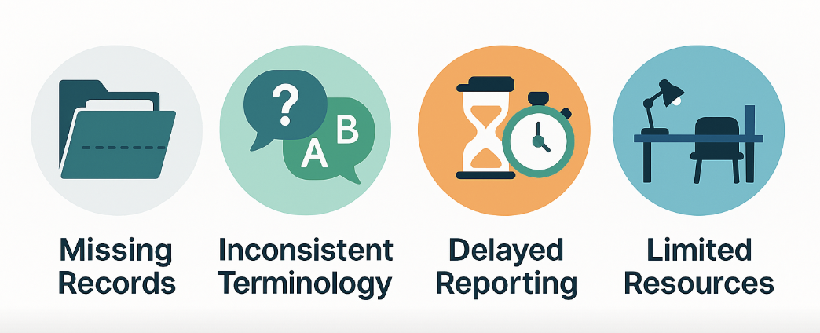
Challenges & Barriers
Some states provide very few death records, or none at all, for entire years
Different terms are used for the same causes of death, and datasets are often incomplete
Late submission of records delays the confirmation of causes of death
Insufficient staffing, funding, and time lead to more errors and reporting gaps
Notes:
Ramil

Slide 19

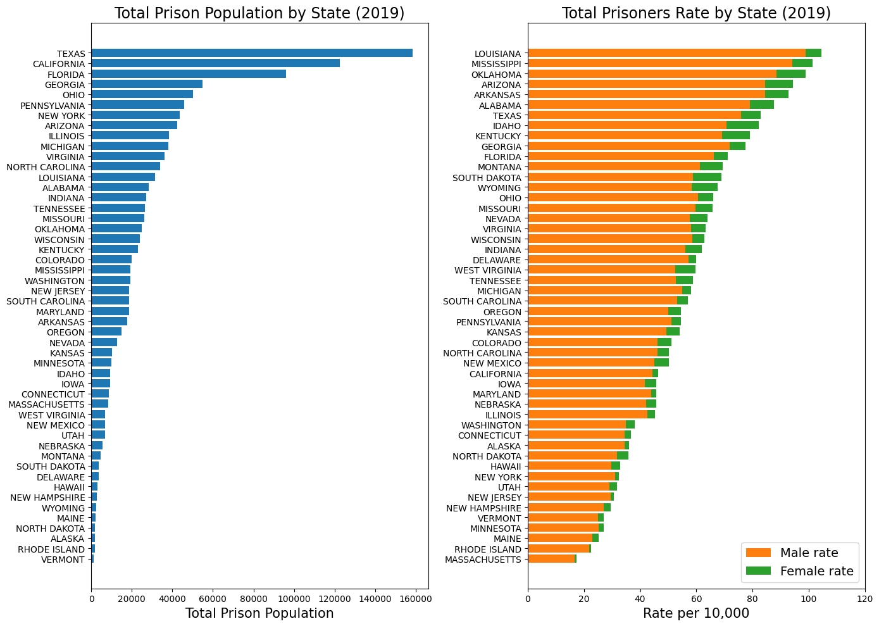
State Prison Population and Imprisonment Rate, 2019
Notes:
Ramil

Slide 20
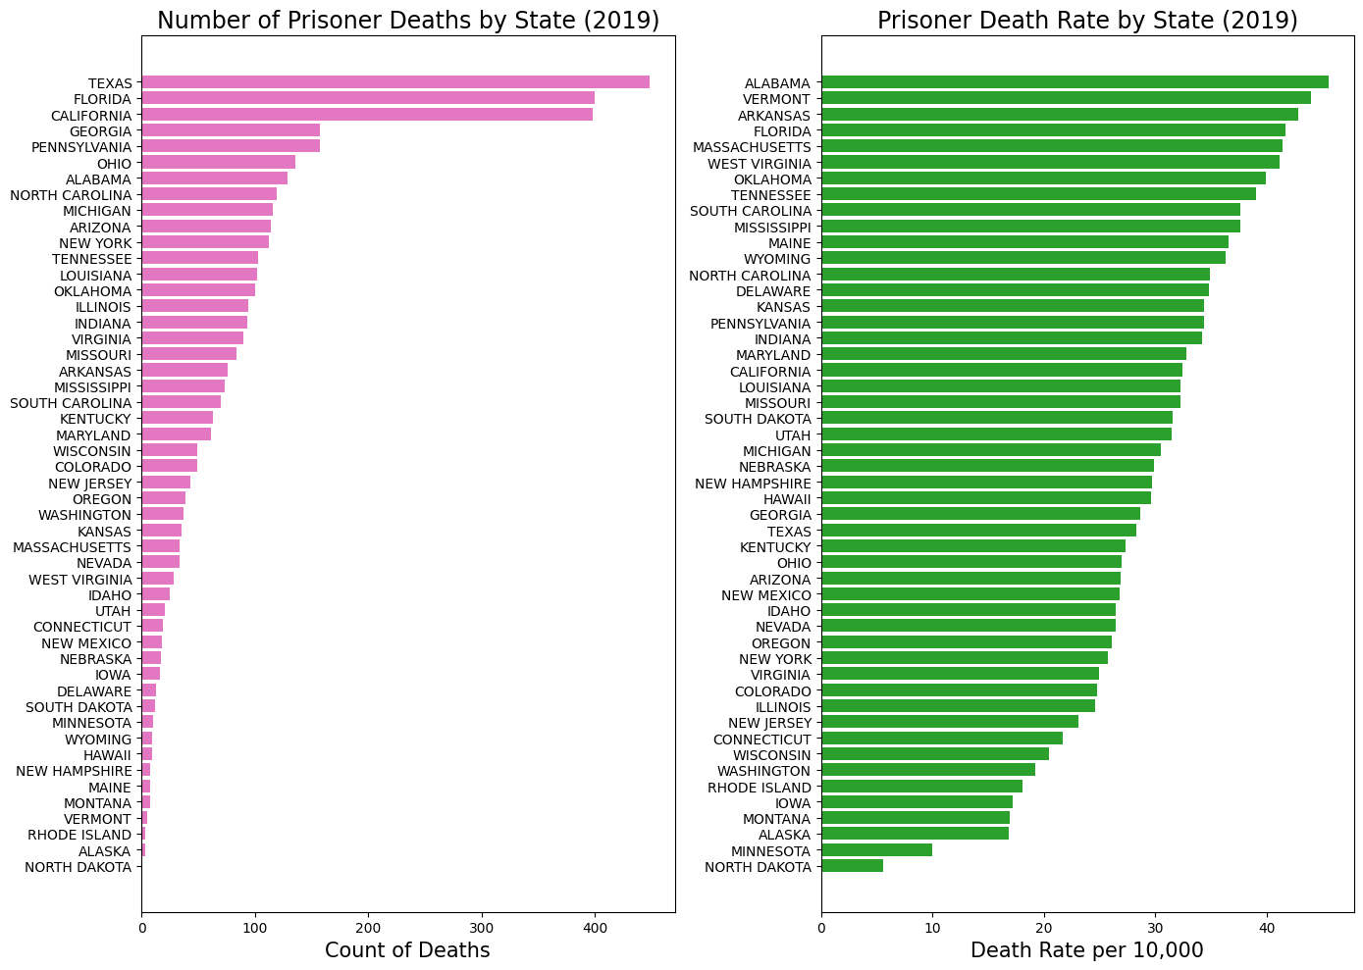
State Prisoner Deaths in 2019: Total Counts and Death Rates
Notes:
Ramil

Slide 21
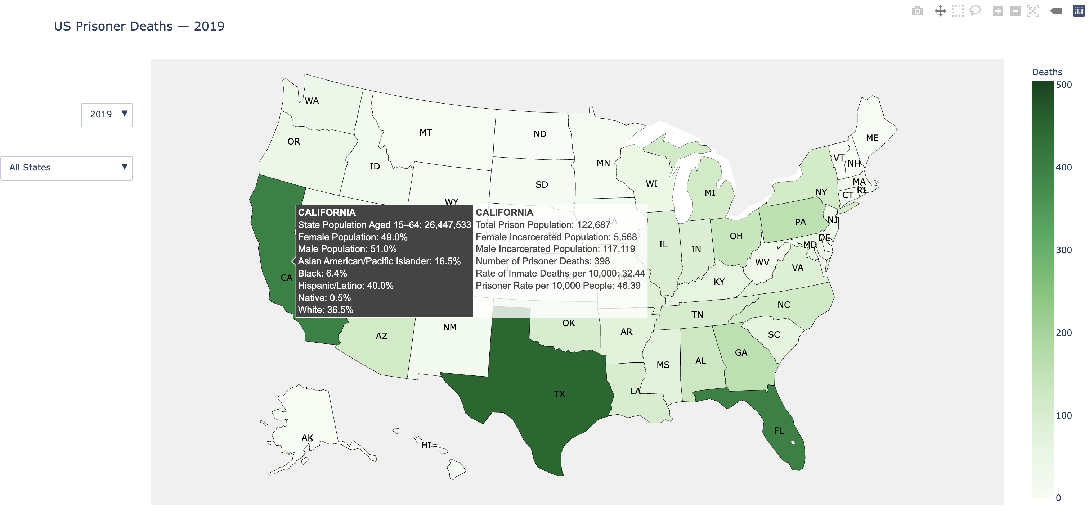
Interactive Map of U.S. Prisoner Deaths by State
Notes:
Ramil

Slide 22

Next Steps
Link federal records with state press releases
Add death records from state releases to 3rd City Project via Qualtrics
Enhance interactive map design, add more stats, and deploy publicly
Apply statistical/ML models where appropriate
Clean & finalize BJA dataset (2020–2024) for EDA & map integration
Meet 3rd City reps to discuss improvements & draft policy memo
Notes:
Ramil

Slide 23

Thank you — questions?

