Slide 1

Sannsynlighet og Statistikk i Data Science
By:
Ramin Hasibi

Slide 2
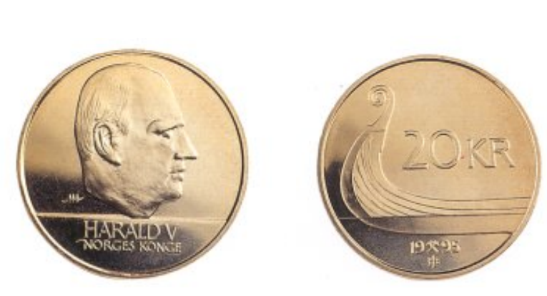
Eksempel: Myntkast

Slide 3
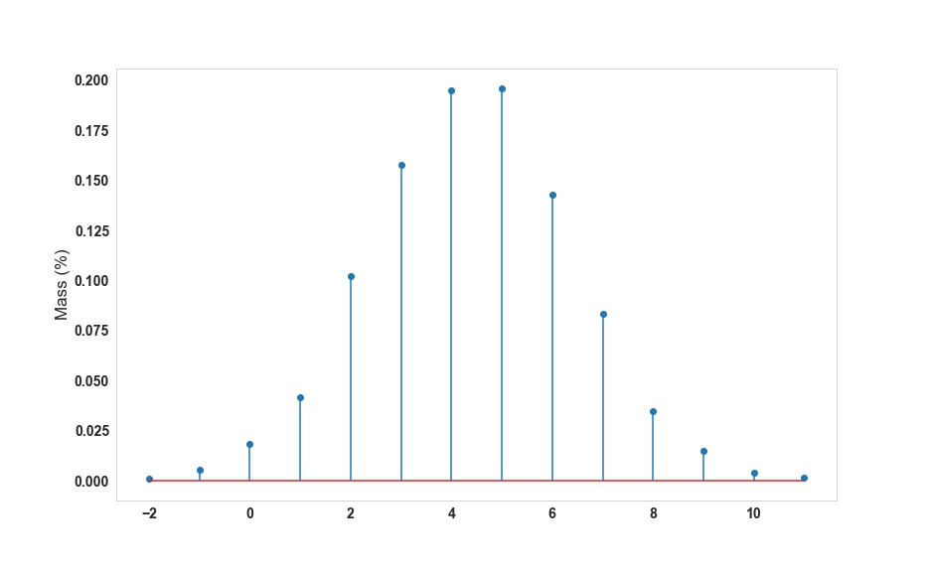
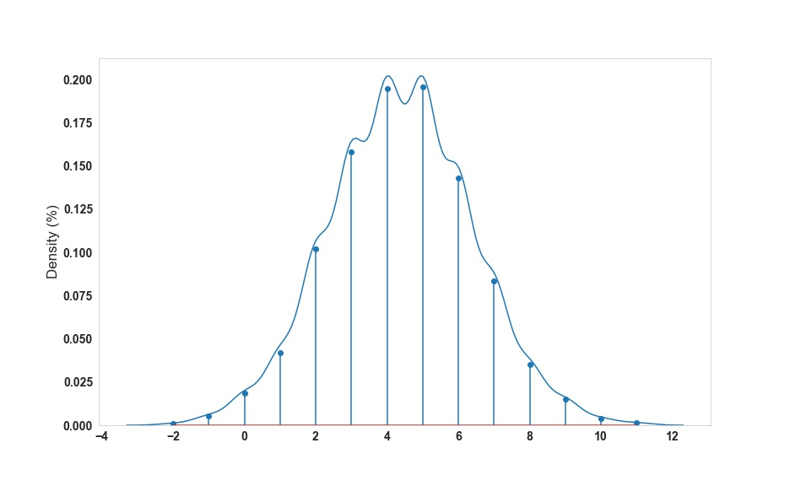
Sannsynlighetsmassefunksjon og tetthetsfunksjon (PMF vs PDF)

Slide 4
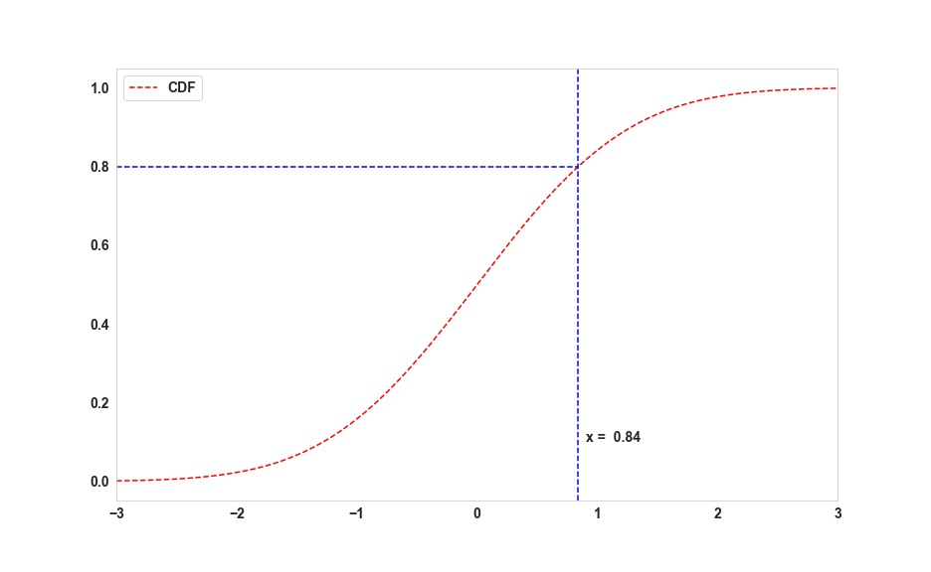
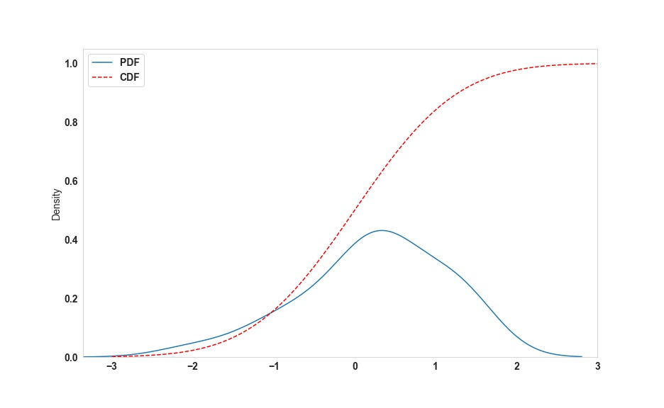
Kumulative fordelingsfunksjonen (CDF)

Slide 5
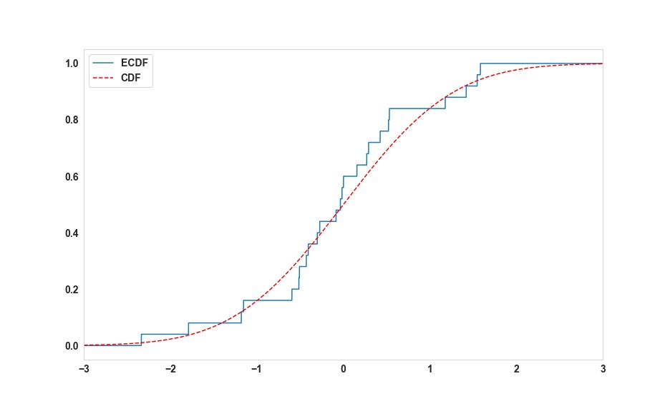
Empiriske kumulative fordelingsfunksjon (ECDF)

Slide 6
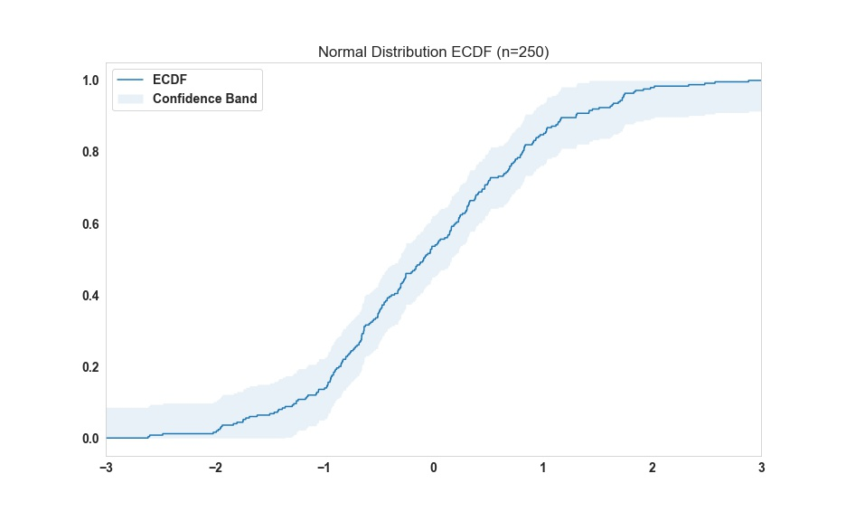
Bounds and confidence interval of ECDF

Slide 7
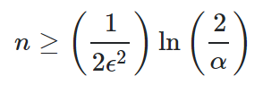
Bounds and confidence interval of ECDF
How good of an estimate is ECDF?
(1-α) is the confidence value
ε is the error from true CDF
Does it represent the whole data?
Do we need to store the whole data for ECDF?
E.g., if you want the ECDF to be within 0.01 of the CDF with 95% confidence, we find by plugging in that n≥18444.4, so n=18445

Slide 8
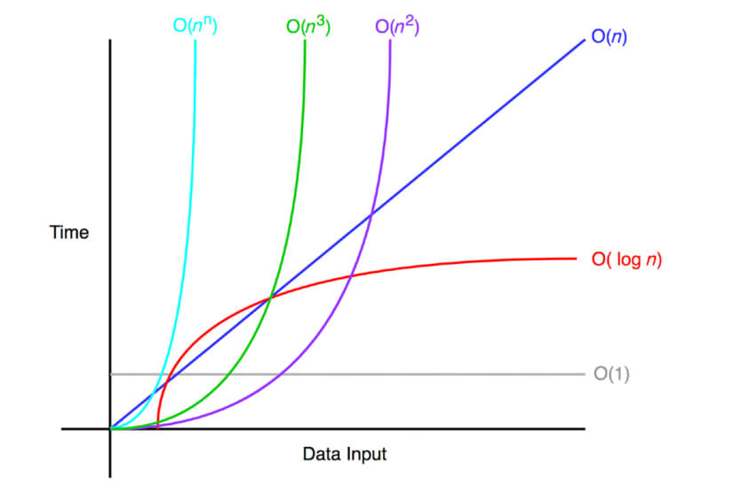
Implementing ECDF
Store, Access and Update
Sorted list
Find the index of the value
Insert at the correct index
Memory
The number of stored samples
Depends on the accuracy of ECDF.
Speed
Creation: O(nlog(n))
Search and insertion: O(log(n))
n1
n2
n3
n4
n5

Slide 9
How good is using ECDF
Easy to use and a pretty good estimate.
Simple solution to implement and the necessary first step.
Performance depends on the load on the server.

Slide 10
Density Estimation Methods and Machine Learning

Slide 11
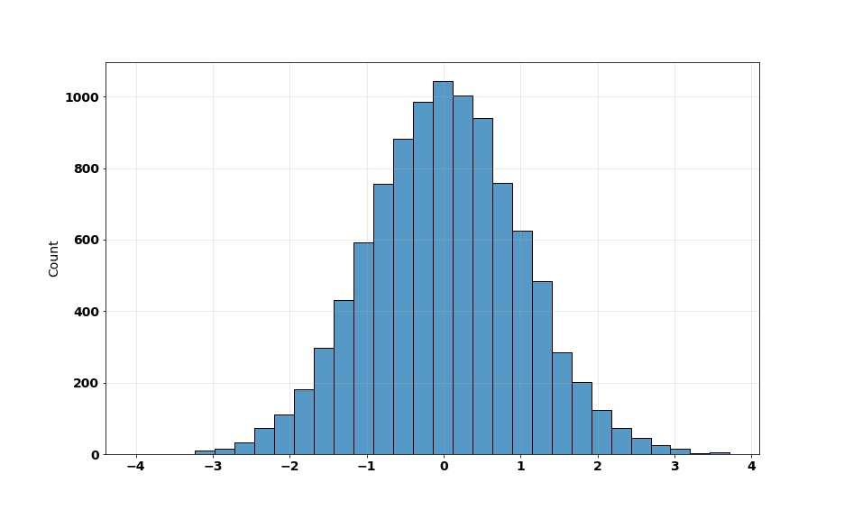
Hva er Density estimation?
Estimate what PDF looks like.
Histogram plot
You are in luck !

Slide 12
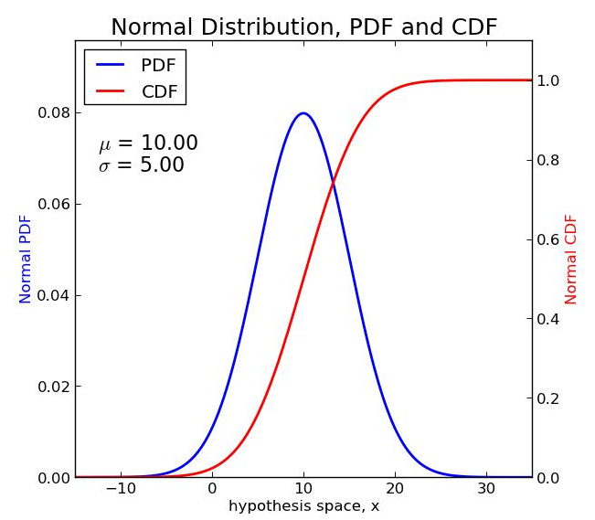
Normalfordeling
Examples:
Height
IQ
Income Distribution
In Economy
4. Grades in an exam.

Slide 13

Parametric Density Estimation with Normalfordeling
Two main parameters of Mean and Variance (µ, ∑):
Always keep track of the online mean and variance of the data.
Calculate the CDF of a value using implemented functions in example libraries.
example code in python:

Slide 14
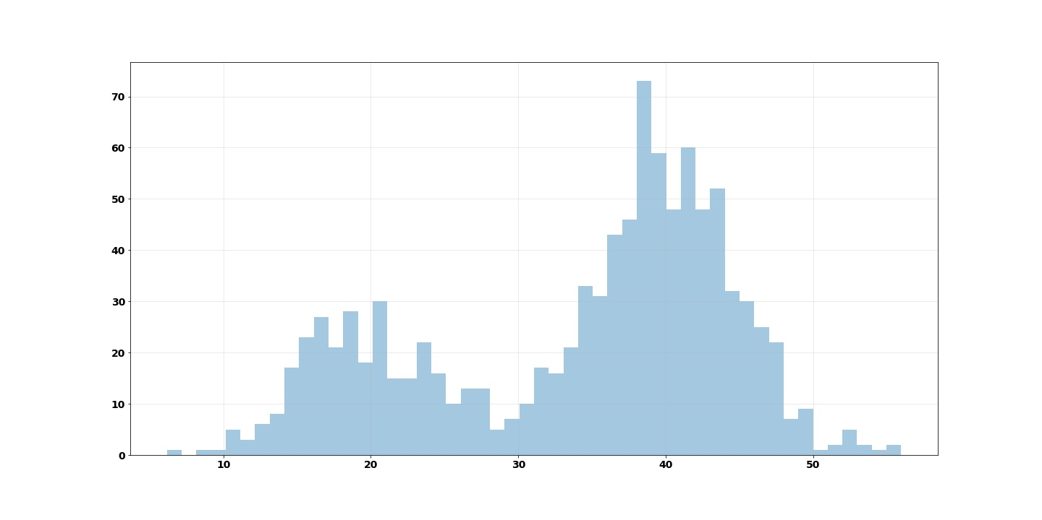
Non-Parametric Density Estimation:

Slide 15
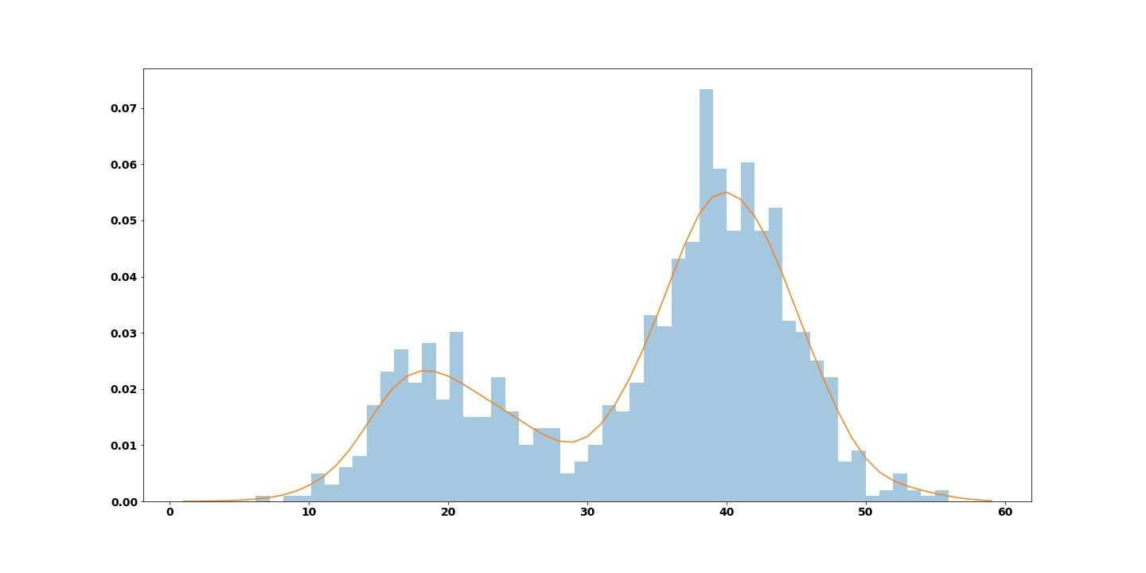
Kernel Density Estimation (KDE):
https://mathisonian.github.io/kde/

Slide 16

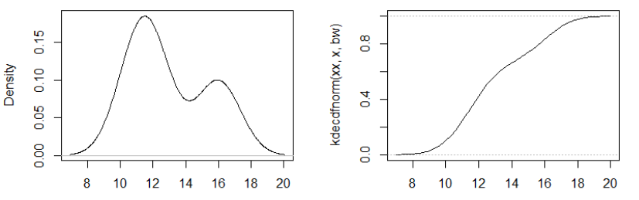
KDE from PDF to CDF
Available libraries compute PDF.
Need to implement for CDF.
Need to choose parameter Bandwidth
Very sensitive to bad choice of Hyperparameter, May converge to wrong distribution.

Slide 17
How to keep track of observations
Offline learning
Keep a list of observations and reset them once in a while (once every month).
Online learning
Choose K as the number of fixed components
For each new observation, update the components based on update rule of Online K-means. (details omitted)
Update can happen every once in a while

Slide 18
Pros and cons of KDE
Pros
Accounts for unseen data
Smooth CDF curve
Can generalize better to unknown distribution
Faster than ECDF
O(K) depends on the number of observations
Generally Needs less observations compared
to ECDF
Cons
Sensitive to bandwidth
Need to tune constantly by an ML expert

Slide 19
Discussion?

