Slide 1
Model Development
Production Jesús Calderón

Slide 2
Introduction

Slide 3
Agenda
5.1 Model Development and Offline Evaluation
Model Development and Training
Ensembles
Experiment Tracking and Versioning
Distributed Training
AutoML
Model Offline Evaluation
5.2 Experiment Tracking
Observability and telemetry
Docker and Portability
Experiment Tracking in Python
Experiment Components

Slide 4
Slides, Notebooks, and Code
These notes are based on Chapter 6 of Designing Machine Learning Systems, by Chip Huyen.
Notebooks
./notebooks/production_5_model_development.ipynb
Code
./src/credit_experiment_*.py

Slide 5
Our Reference Architecture

Slide 6
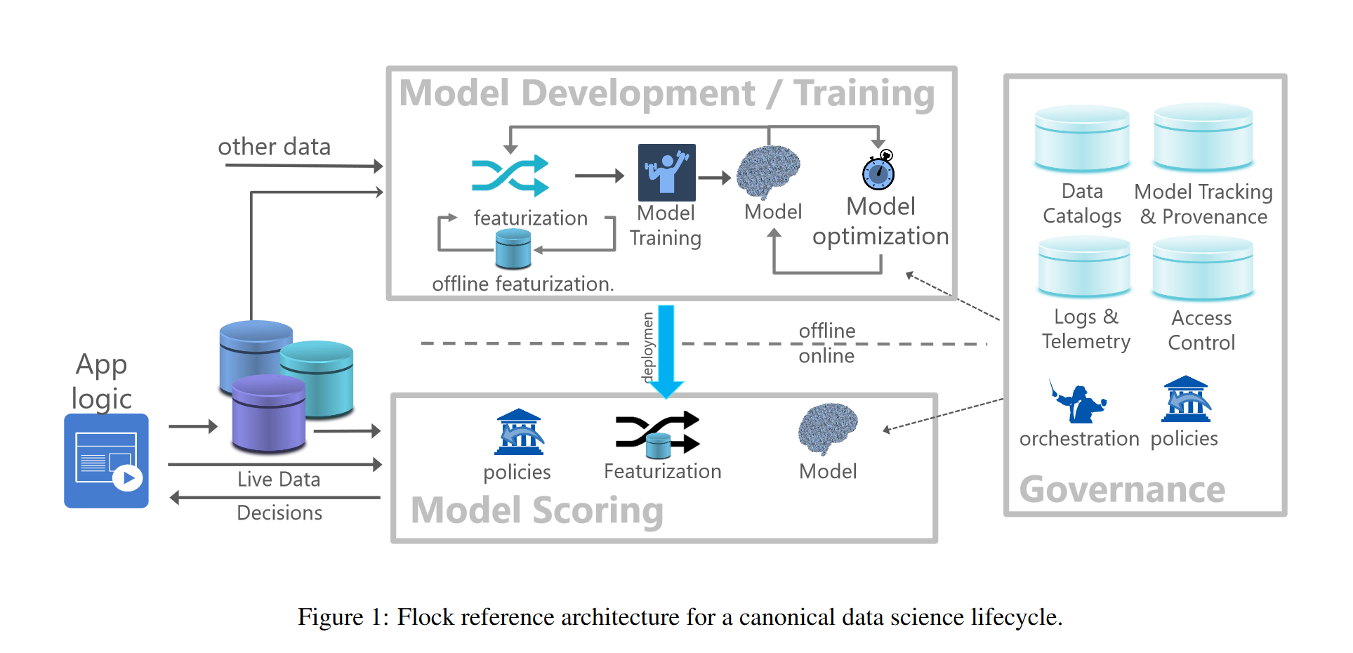
The Flock Reference Architecture
Agrawal et al (2019)

Slide 7
Model Development and Training

Slide 8
Evaluating ML Models
Evaluating ML models in production is a multidimensional problem.
Model performance (of course) is important, but so are how long it takes to train, latency at inference, (cost of) compute requirements, and explainability.
Different types of algorithms require different numbers of labels as well as different amounts of computing power.
Some take longer to train than others, whereas some take longer to make predictions.

Slide 9
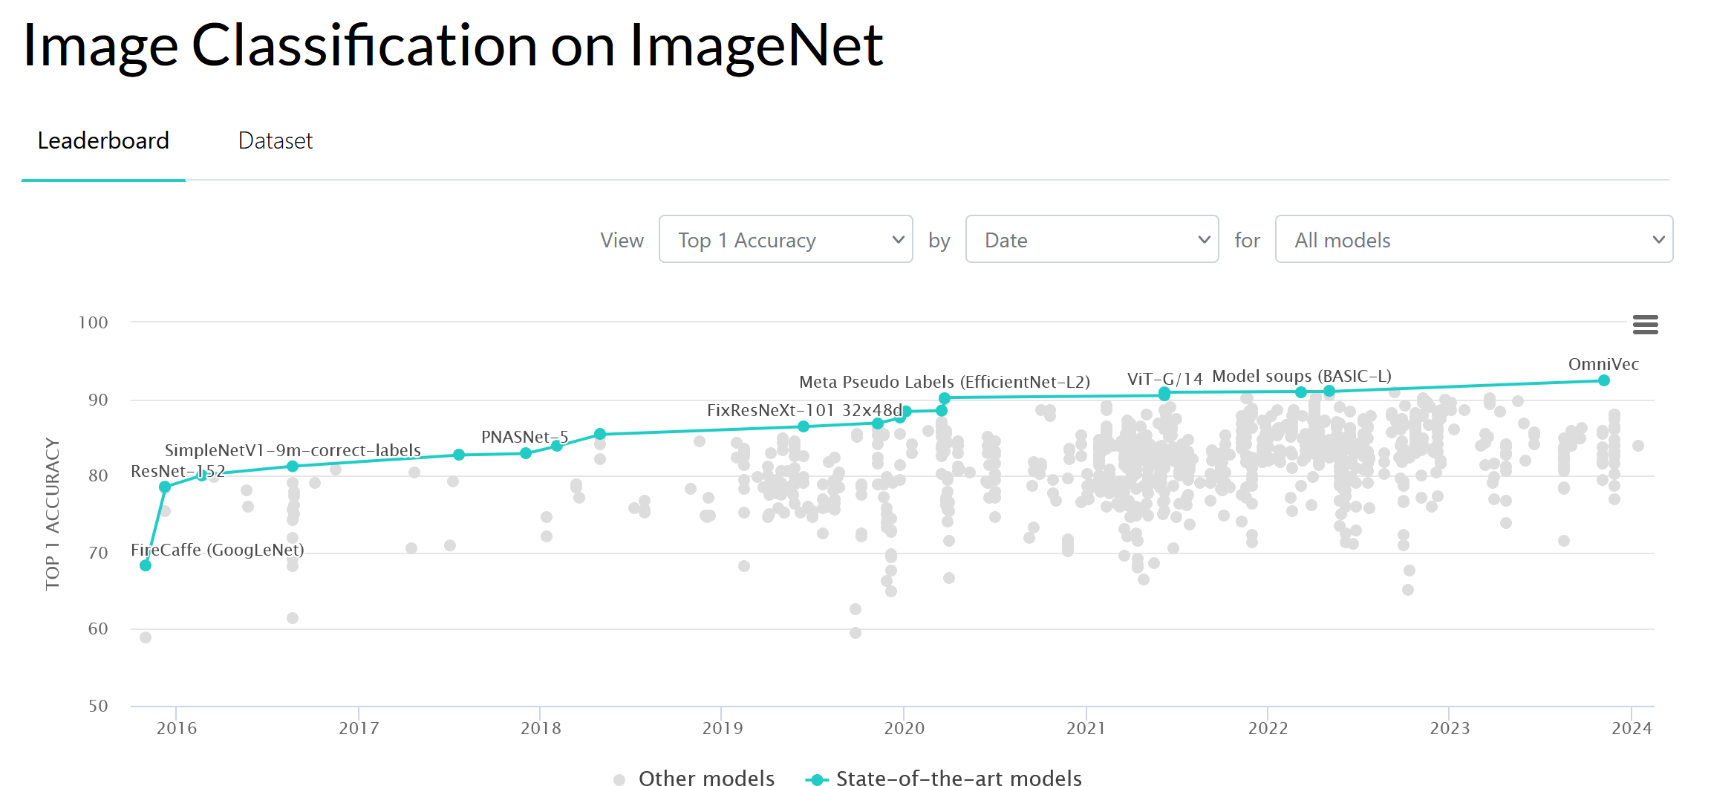
Guidance for Model Selection (1/3)
Avoid the state-of-the-art trap
Researchers evaluate models in academic settings: if a model is state-of-the-art, it performs better than existing models on some static dataset.
It is essential to remain up to date but solve the problem first.
Start with the simplest models
Simple is better than complex: easier to deploy, easier to understand, and serve as a baseline.
Easier to deploy: speeds up the experimentation cycle.
Easier to understand: adds complexity as needed.
Baseline: simple models serve as a starting comparison point for model development.
State of the Art Model Performance on ImageNet (paperswithcode.com)

Slide 10
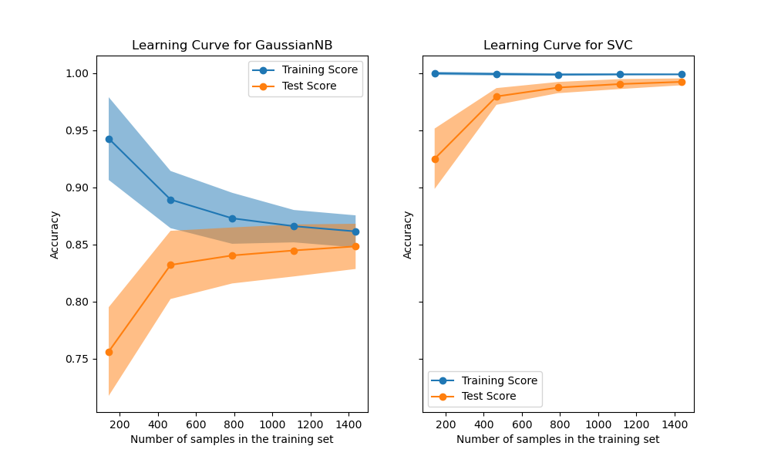
Guidance for Model Selection (2/3)
Avoid human biases in selecting models
Human biases can be introduced throughout the model development process.
Experiment methodically and store results.
Any model has three components: algorithmic logic, code, and data.
Evaluate good performance now versus good performance later
Using learning curves is a simple way to estimate how your model’s performance might change with more data.
While evaluating models, consider their potential for improvement and how easy/difficult it is to achieve.
Learning Curves ( scikit-learn.org )

Slide 11
Guidance for Model Selection (3/3)
Evaluate trade-offs
False positives vs false negatives: reducing false positives may increase false negatives and vice versa.
Compute requirement and model performance: a more complex model may deliver better performance, but at what cost?
Understand your model’s assumptions
Every model comes with its assumptions.
Prediction assumption: every model that aims to predict an output Y from an input X assumes that it is possible to predict Y based on X.
Independent and Identically Distributed: neural nets assume that examples are independent and identically distributed.
Smoothness: supervised learning models assume that a set of functions can transform inputs into outputs such that similar inputs are transformed into similar outputs. If an input X produces Y, then an input close to X would produce an output proportionally close to Y.
Linear boundaries, conditional independence, normally distributed, and so on.

Slide 12
Ensembles

Slide 13
The Wisdom of the Crowds
“Aggregating the judgment of many consistently beats the accuracy of the average member of the group, and is often as startlingly accurate […] In fact, in any group there are likely to be individuals who beat the group. But those bull’s-eye guesses typically say more about the power of luck […] than about the skill of the guesser. That becomes clear when the exercise is repeated many times.”
(Tetlock and Gardner, 2015)

Slide 14
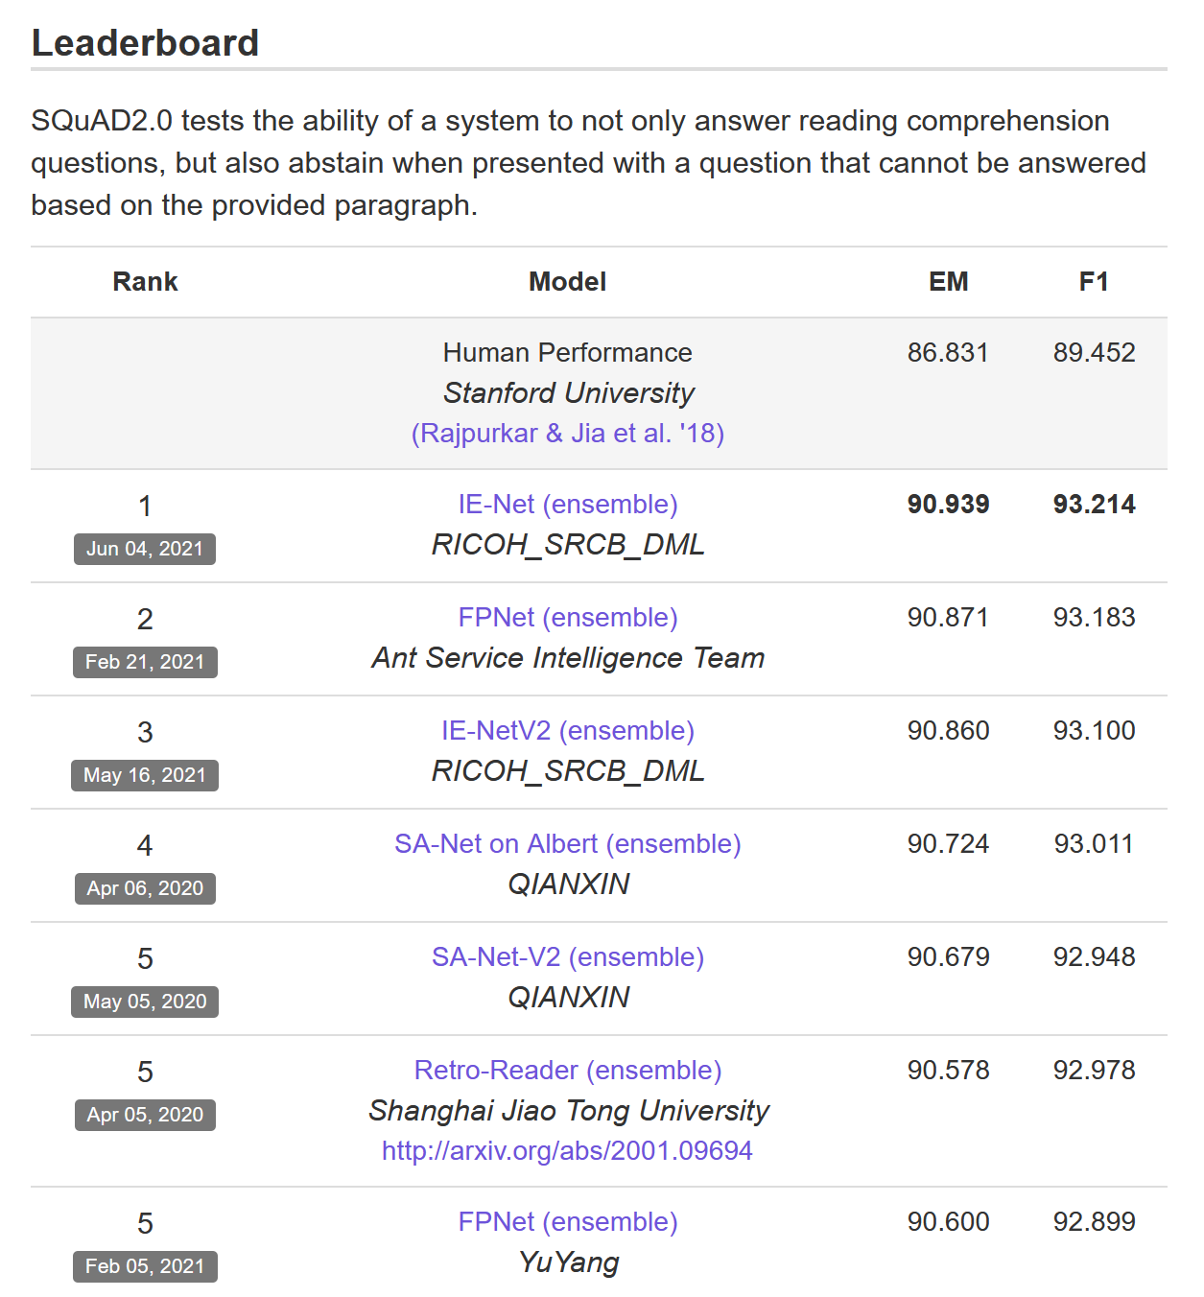
Ensembles
Ensemble methods are less favoured in production because ensembles are more complex to deploy and harder to maintain.
Common in tasks where small performance boosts can lead to substantial financial gains, such as predicting the click-through rate for ads.
Ensembles perform better when underlying classifiers are uncorrelated.
Top Solutions on SQuAD 2.0 ( source )

Slide 15
Possible Outcomes
Outputs of three models | Probability | Ensemble’s output
All three are correct | 0.7 * 0.7 * 0.7 = 0.343 | Correct
Only two are correct | (0.7 * 0.7 * 0.3) * 3 = 0.441 | Correct
Only one is correct | (0.3 * 0.3 * 0.7) * 3 = 0.189 | Wrong
None are correct | 0.3 * 0.3 * 0.3 = 0.027 | Wrong

Slide 16
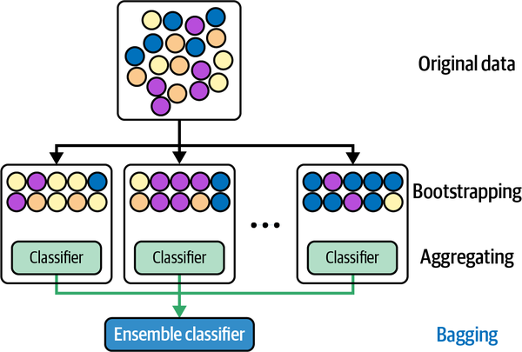
Bagging
Bagging (bootstrap aggregating) is designed to improve ML algorithms’ training stability and accuracy.
Reduces variance and helps avoid overfitting; it improves unstable methods (e.g., tree-based methods)
Outline:
Given a data set, create n data sets by sampling with replacement (bootstrap).
Train classification or regression model on each bootstrap.
If classification, decide by majority vote; if regression, use the mean result.
Sampling with replacement ensures that each bootstrap is created independently from its peers.
(Huyen, 2021)

Slide 17
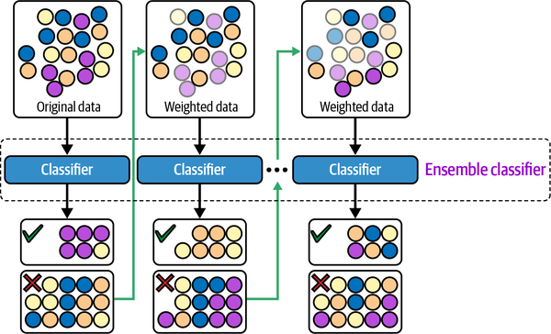
Boosting
Family of iterative ensemble algorithms that convert weak learners to strong ones.
Outline:
Each learner is trained on the same set of samples, but the samples are weighted differently in each iteration.
Future weak learners focus more on the examples that previous weak learners misclassified.
Examples: Gradient Boosting Machine (GBM), XGBoost, and LightGBM.
(Huyen, 2021)

Slide 18
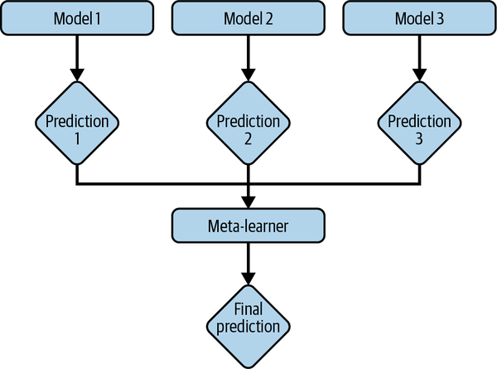
Stacking
Outline:
Create base learners from the training data.
Create a meta-learner that combines the outputs of the base learners to output predictions.
(Huyen, 2021)

Slide 19
Experiment Tracking and Versioning

Slide 20
Experiment Tracking
The process of tracking the progress and results of an experiment is called experiment tracking.
ML Flow and Weights & Balances are experiment tracking tools.
At a minimum, track performance (loss) and time (speed).
Values over time of any parameter and hyperparameter whose changes can affect model performance.
Model performance metrics : on all nontest splits like accuracy, F1, perplexity.
Loss curve: train split and each of the eval splits.
Log of corresponding sample, prediction, and ground truth labels.
Speed of the model: number of steps per second or tokens processed per second.
System performance metrics: memory, CPU, GPU.

Slide 21
Versioning
The process of logging an experiment’s details to recreate it later or compare it with other experiments is called versioning.
ML models in production are part code and part data.
Code versioning has more or less become a standard in the industry.
Data versioning is not standard.
Code versioning tools allow you to switch between versions of the codebase by keeping copies of all the old files. Data may be too large for duplication to be feasible.
Code versioning tools allow several people to work on the same code simultaneously by replicating locally. Data may be too large, as well.
What is a diff when versioning data? DVC, for example, only checks in changes in checksum.
Compliance with GDPR may also be problematic if full history of data is kept.

Slide 22
Making Progress

Slide 23
Debugging: Why ML Models Fail
Theoretical constraints: model assumptions are not met. For example, use a linear model when decision boundaries are not linear.
Poor implementation: The model may be a good fit, but implementation has errors.
Poor choice of hyperparameters: with the same model, one set of hyperparameters can give better results than others.
Data problems: noise and dirty data are everywhere. Also, poor implementation of data flows can induce data problems.
Poor choice of features: Too many features may cause overfitting or data leakage. Too few features might lack predictive power to allow to make good predictions.
Some debugging approaches:
Start simple and gradually add more components.
Overfit a single batch.
Set a random seed.

Slide 24
AutoML
AutoML is the automatic process of finding ML algorithms to solve real-world problems.
The most popular form of AutoML is hyperparameter tuning.
Searching the Hyperparameter space can be time-consuming and resource-intensive.

Slide 25
Model Offline Evaluation
Measure model performance before and after deployment.
Evaluation methods should (ideally) be the same for models during development and production.
Techniques for model offline evaluation:
Use baselines.
Tests: perturbation tests, invariance tests, directional expectation tests, model calibration, confidence measurement, slice-based evaluation.
Baselines
Random baseline: if the model predicts at random, how would it perform?
Simple heuristic: how does the model perform vs a simple (non-ML) rule of thumb?
Zero rule baseline: trivial prediction, always predicts the same thing.
Human baseline: human-level performance may be the required baseline.
Existing solutions.

Slide 26
Evaluation Methods in Production
Perturbation tests: make changes to test splits, such as adding noise to input data. If a model is not robust to noise, it will be difficult to maintain.
Invariance tests: specific input changes should not lead to output changes—for example, protected classes.
Directional expectation tests.
Model calibration or conformal prediction methods:
Idea: If the forecast has a 70% chance of rain, then 70% of the time this forecast was made, it actually rained.
Prediction scores are many times normalized to values between 0 and 1. It is tempting to think of them as probabilities, but they are not necessarily so.
Use conformal prediction methods to calibrate prediction scores.
Confidence measurement: show only predictions where the model is confident.
Slice-based evaluation: model performance is different in subsets of data.

Slide 27
References

Slide 28
References
Agrawal, A. et al. “Cloudy with a high chance of DBMS: A 10-year prediction for Enterprise-Grade ML.” arXiv preprint arXiv:1909.00084 (2019).
Huyen, Chip. “Designing machine learning systems.” O’Reilly Media, Inc. (2021).
Tetlock and Gardner. Superforecasting: The art and science of prediction. Random House (2016).

