Slide 1
Data Distribution Shifts and Monitoring
Production Jesús Calderón

Slide 2
Agenda
7.1. Monitoring
ML System Failures
Data Distribution Shifts
Monitoring and Observability
7.2 Continual Learning and Test in Production
Testing data distribution shifts.

Slide 3
Slides, Notebooks, and Code
These notes are based on Chapter 8 of Designing Machine Learning Systems, by Chip Huyen.
Notebooks
./notebooks/production_7_distribution_shifts.ipynb

Slide 4
Our Reference Architecture

Slide 5
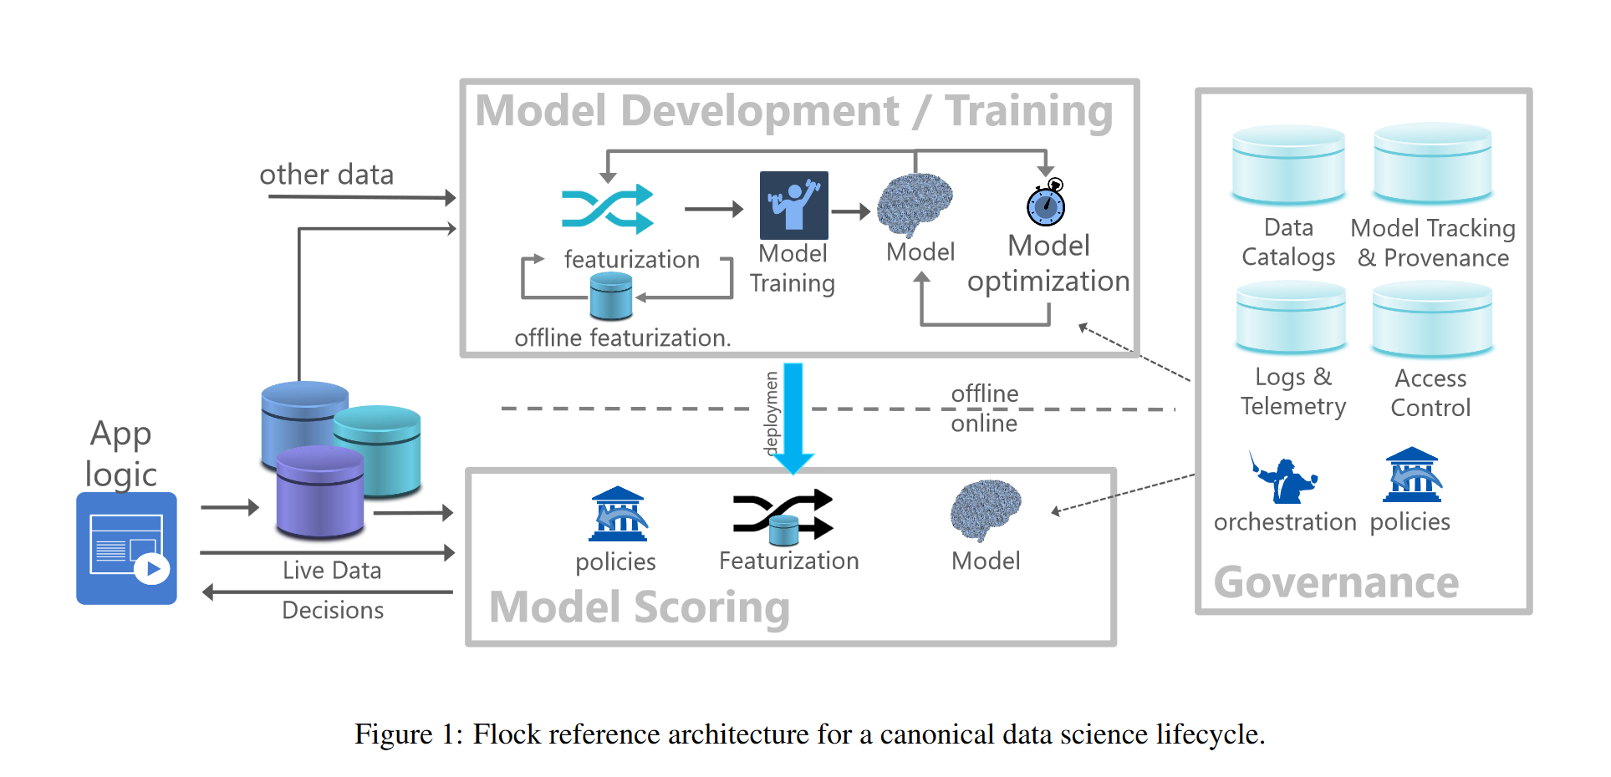
The Flock Reference Architecture
Agrawal et al (2019)

Slide 6
ML System Failures

Slide 7
What is an ML System Failure?
A failure happens when one or more expectations of the system is not met:
Traditional software expectations: the system executes its logic within the expected metrics, such as latency and throughput.
ML performance: performance metrics are met, explanations are given, trust in the system (can be achieved by communicating uncertainty), etc.
Operational expectations can be easier to detect than ML performance expectations.
Understanding why ML systems fail can help monitor ML performance.

Slide 8
Software System Failures
Dependency failure
A package or codebase that the system depends on breaks, which leads to system failure.
Common when the dependency is maintained by a third party.
Can also happen when our model is a dependency of a downstream consumer.
Deployment failure
The root cause is deployment errors: deploy old binaries, permissions are not correctly granted, etc.
Coding errors and integration errors (interface changes).
Hardware failures
Hardware use to deploy the model fails.
Downtime or crashing
Connectivity, security, and other issues may give rise to unreachable servers (AWS, Azure, GCP, etc.)
Distributed systems are complex systems, and the risk of failure increases with complexity.

Slide 9
ML-Specific Failures
Production data is different from training data
A key assumption is that training and unseen data come from the same distribution.
When we say that a model learns from data, we are saying that the model learns the distribution of the training data to use this information on unseen data.
When predictions on unseen data are satisfactory, we say the model “generalizes to unseen data”.
The test data used in the model development phase and the cross-validation are estimates of the error in unseen (production) data.
Reasons for difference:
Data collection, encoding, and instrumentation.
The world changes, and data distributions are not stationary.
Edge cases
An ML model performs well in most cases but fails in a small minority of cases, generally with catastrophic consequences.
Data distribution may have shifted if the number of edge cases increases.
Key concern for safety-critical applications: autonomous vehicles, health systems, risk monitoring, etc.
Degenerate feedback loops
The model’s predictions influence the feedback, which in turn influences the next iteration of the model:
System outputs are used to generate the next set of inputs.
In user-facing applications, this can drive the options or interactions that a user is offered.
User interactions with the system are the training data.

Slide 10
Data Distribution Shifts

Slide 11
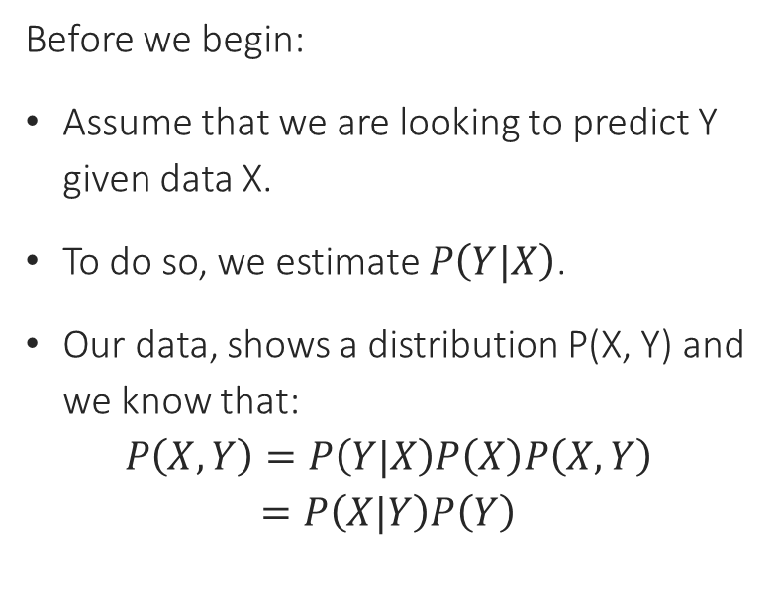
Types of Data Distribution Shifts
Three types of shifts:
Concept drift
Covariate shift
Label shift
Before we begin:
Assume that we are looking to predict Y given data X.
To do so, we estimate $P\left(Y|X\right)$.
Our data, shows a distribution P(X, Y) and we know that:
$$P\left(X,Y\right)=P\left(Y|X\right)P\left(X\right)P\left(X,Y\right)=P\left(X|Y\right)P\left(Y\right)$$

Slide 12
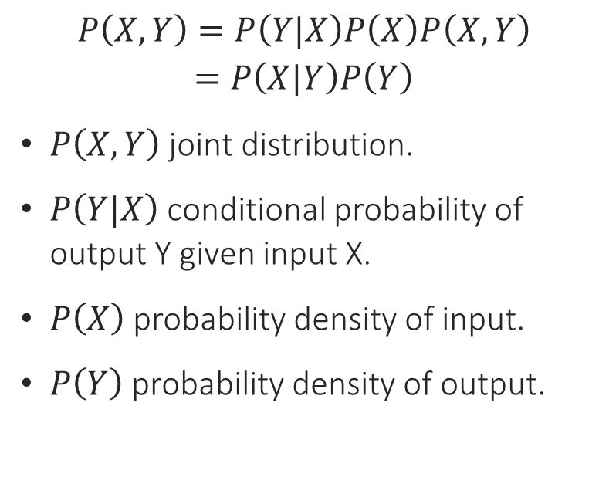
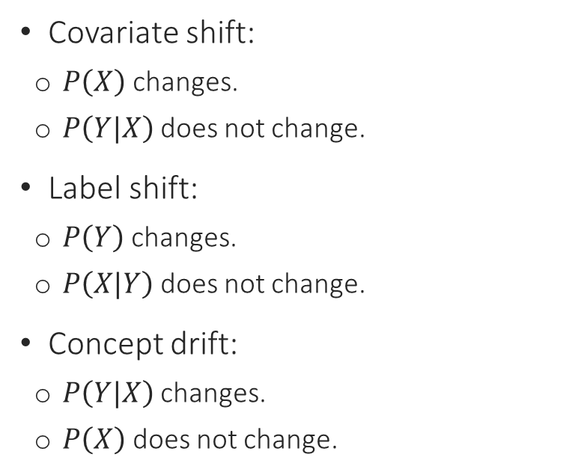
Types of Distribution Shifts
Covariate shift:
$P\left(X\right)$ changes.
$P\left(Y|X\right)$ does not change.
Label shift:
$P\left(Y\right)$ changes.
$P\left(X|Y\right)$ does not change.
Concept drift:
$P\left(Y|X\right)$ changes.
$P\left(X\right)$ does not change.
$$P\left(X,Y\right)=P\left(Y|X\right)P\left(X\right)P\left(X,Y\right)=P\left(X|Y\right)P\left(Y\right)$$
$P\left(X,Y\right)$ joint distribution.
$P\left(Y|X\right)$ conditional probability of output Y given input X.
$P\left(X\right)$ probability density of input.
$P\left(Y\right)$ probability density of output.

Slide 13
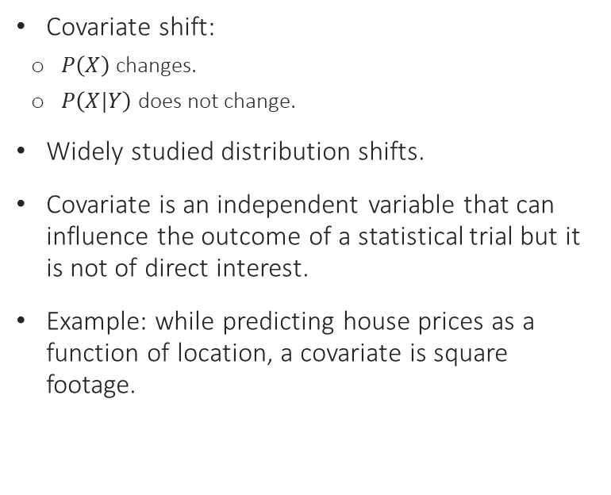
Covariate Shift
Covariate shift:
$P\left(X\right)$ changes.
$P\left(X|Y\right)$ does not change.
Widely studied distribution shifts.
Covariate is an independent variable that can influence the outcome of a statistical trial but it is not of direct interest.
Example: while predicting house prices as a function of location, a covariate is square footage.
Causes:
Sampling methods: example, oversampling of cancer patients over 40.
Training data is artificially altered: applied SMOTE and distribution changed.
Active learning: instead of randomly sampling, use samples most helpful to that model according to some heuristic.
Major changes in the production environment or application: changes in marketing, for example, induce more clients from a certain demographic not previously represented in training data.

Slide 14
Label Shift
Label shift:
$P\left(Y\right)$ changes.
$P\left(Y|X\right)$ does not change.
Also known as prior shift, prior probability shift, or target shift.
The output distribution changes, but for a given output, the input distribution stays the same.
When a covariate shift happens, it could be followed by a label shift.
Methods for detecting covariate and label shifts are similar.

Slide 15
Concept Drift
Concept drift:
$P\left(Y|X\right)$ changes.
$P\left(X\right)$ does not change.
Also known as posterior drift.
Input distribution remains the same, but the conditional distribution of the output given an input changes.
“Same input, different output.”
Can be cyclcic or seasonal.

Slide 16
Detecting Data Distribution Shifts
Exploratory Data Analysis
Compare different quantiles of data distributions and compare: 5th, 25th, 50th, 75th, and 95th.
Comparing mean, median, and standard deviation only may give partial results:
Noticing differences may be indicative of a distribution shift.
Not noticing differences could hide distribution shifts.
Statistical methods
A more robust approach is to use two-sample hypothesis tests.
These tests help us determine if the difference between distributions is statistically significant: if it is, then the probability that the difference is due to random fluctuations is low.
If a difference is detected, it does not necessarily mean it is important. However, if the difference is noticeable in a small sample, it generally indicates that it is important.
Many methods for univariate data. For example, Kolmogorov-Smirnov test.
Other methods for multivariate data: Least Squares Density Difference or Maximum Mean Discrepancy.
In general, these methods are better for low-dimensional data: it may be convenient to reduce the problem’s dimensionality.

Slide 17
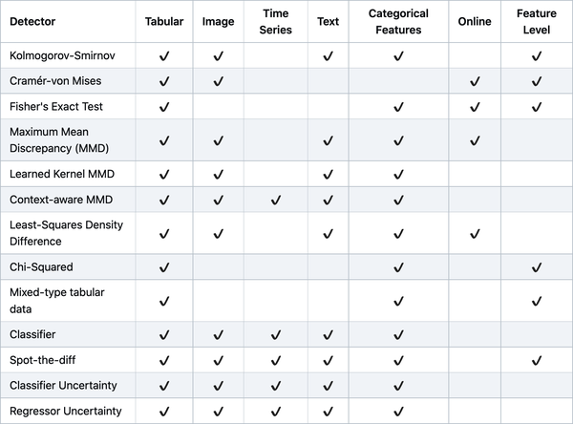
Drift Detection Methods
(Huyen, 2021)

Slide 18
Monitoring and Observability

Slide 19
Monitoring and Observability
Monitoring
Tracking, measuring, and logging different metrics that can help determine when something goes wrong.
Classes of metrics to monitor:
Operational: convey the health of the system. Operational metrics are related to network, machine, and application. Ex.: latency, throughput, prediction requests per unit of time, percentage of successful predictions, CPU/GPU utilization, memory use, etc.
ML Specific Matrics: model performance, predictions, features, and raw inputs.
Observability
Setting up a system in a way that affords us visibility into its inner workings to help us investigate it to solve bugs and produce enhancements.
Logs and reporting.
Instrumentation and telemetry.

Slide 20
Monitoring ML Systems
Monitoring model performance:
Prediction correctness is only part of the story.
Collect performance in terms of usability and trust (preferences).
Collect inferred metrics (clicks, accepted recommendations, etc.)
Monitoring predictions
Monitor distribution shifts.
Slice analysis, backtesting, etc.
Monitoring features
Monitor input features and transformed features.
Easier to validate than raw data because a defined schema exists for features.
Common validation tests:
Min, max, median, and other quantile values.
Values satisfy a certain regular expression.
Values belong to a predefined set.
Values of a feature are always positive, less than one, greater than another feature’s value, etc.
Monitoring raw data
Generally, a responsibility of the data engineering team or data governance.
Automated pipelines and data quality verification.

Slide 21
References

Slide 22
References
Agrawal, A. et al. “Cloudy with a high chance of DBMS: A 10-year prediction for Enterprise-Grade ML.” arXiv preprint arXiv:1909.00084 (2019).
Huyen, Chip. “Designing machine learning systems.” O’Reilly Media, Inc.(2021).

