Slide 1
Infrastructure and Organization
Production Jesús Calderón

Slide 2
Agenda
8.1. Infrastructure for ML
Infrastructure
Storage and Compute
Development Environments
Resource Management
Topic 8.2. The Human Side of ML
Roles, Tasks, and Skills
Where to Focus our Efforts?

Slide 3
Infrastructure

Slide 4
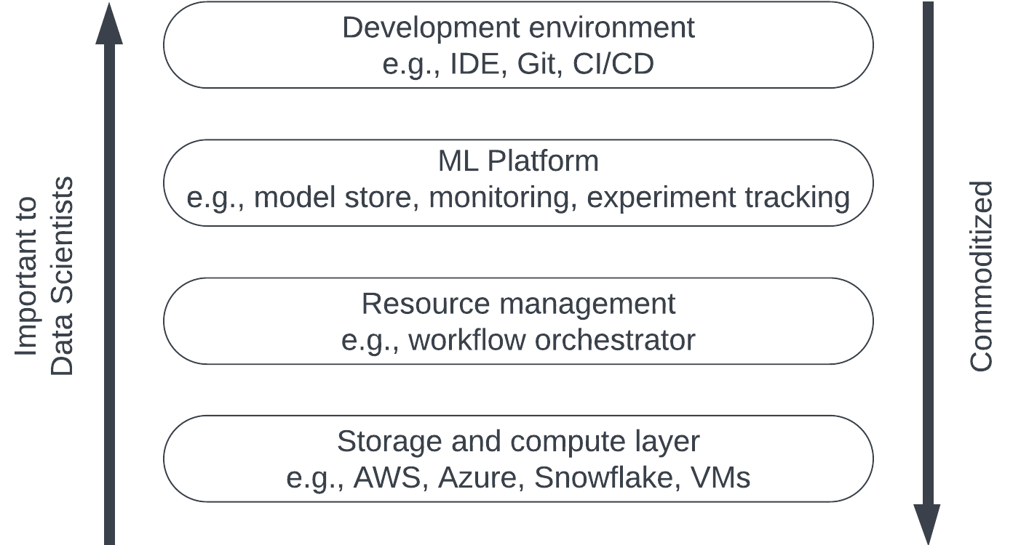
What is Infrastructure?
Infrastructure is the set of fundamental facilities that support the development and maintenance of ML systems.
Four layers can, at least, be considered:
Storage and compute: data is collected and stored in the storage layer. Using the compute layer, we run the ML workloads (training, feature generation, etc.)
Resource management: schedule and orchestrate workloads.
ML Platform: tools to aid the development of ML applications like model stores, feature stores, and monitoring tools.
Development environment: where code is written and experiments are run.
(Adapted from Huyen, 2021)

Slide 5
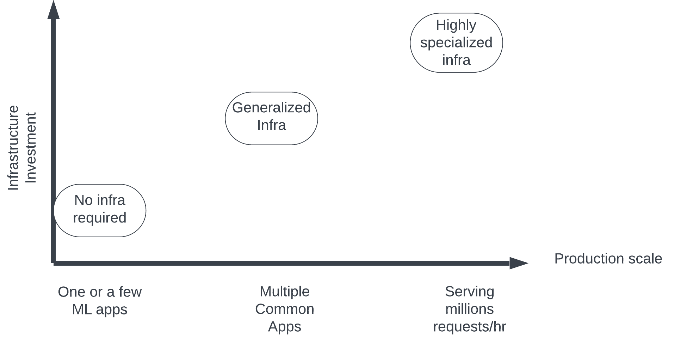
Infrastructure Investment Grows with Scale
(Adapted from Huyen, 2021)

Slide 6
Storage and Compute
ML systems require and produce a lot of data.
Storage layer can be HDD or SDD, but can also be blob (binary large object) storage.
Over the last decade, storage has been commoditized in the cloud.
Compute layer can be sliced into smaller compute units: instead of a large job, some jobs can be partitioned and computed with a distributed cluster of processors.
Compute can be permanent or ephemeral:
Training has spiky compute requirements that tend to be ephemeral.
DB will require some compute to operate and, generally, this compute is permanent.
Compute and storage can scale: cloud infrastructure is attractive for its elasticity (it grows with needs.)
Compute must have access to storage, therefore, it is important to consider the cost of data transmission.

Slide 7
Development Environment
Where ML engineers write code, run experiments, and interact with the production environment.
Consists of IDE, versioning, and CI/CD.
Dev environment setup should contain all the tools that can make it easier for engineers to do their job.
Versioning is fundamental for ML System implementation.
Dev environment should be built for CI/CD:
Automated testing.
Continuous integration.
Andon Cord: capability to revert to latest working verison of system.
Dev Environment should ressemble the production environment as closely as possible.

Slide 8
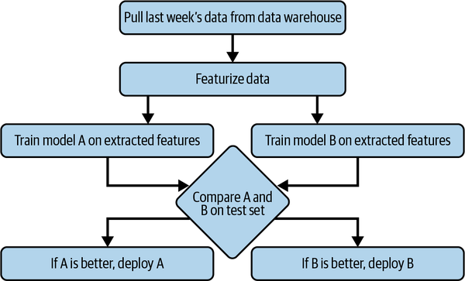
Resource Management
In terrestrial data centres, storage and compute are finite.
With cloud infrastructure, storage and compute are elastic, but they are charged by utilization.
Two key characteristics to consider:
Repetitiveness.
Dependencies.
Tasks can be organized in Directed Acyclical Graphs (DAGs) using orchestrators (Huyen, 2021)

Slide 9
The Human Side of ML

Slide 10
Roles, Tasks, and Skills
CDO/DS Leader:
Bridges the gap between business and datas science.
Defines the vision and technical lead.
Skills: leadership, design thinking, data science/ML, domain experience.
Data engineer:
Implement, test, and maintain infrastructural components for data management.
Define data models and systems architecture.
Skills: SQL/NoSQL, Hive/Pig/HDFS, Python, Scala/Spark.
Analyst:
Collects, cleans, transforms data.
Interprets analytical results, reports and communicates.
Skills: R, Python, SQL, BI Tools.
Visualization Engineer
Makes sense of data and analysis output by showing it in the right context.
Articulate business problems and display solutions with data.
Skills: design thinking, BI Tools, presentation and writing.

Slide 11
Roles, Tasks, and Skills (cont.)
Data Scientist
Solves business tasks using ML and data.
Data preparation, training, and evaluating models.
Skills: R, Python, modelling, data manipulation.
ML Engineer
Combines software engineering and modeling to implement data intensive products.
Deploys models into production and at scale.
Python, Spark, Julia, MLOps, DevOps, CI/CD.
Subject Matter Expert
Applies rigorous methods developed in area of expertise.
Help decision-makers come to conclusions safely beyond ML models.
Ex: Statistician, Actuary, Econometrician, Physicist, Epidemiologist
Model validation
Independently validate models, including their interpretation.
Perform technical testing.
Skills: similar to data scientis/SME.

Slide 12
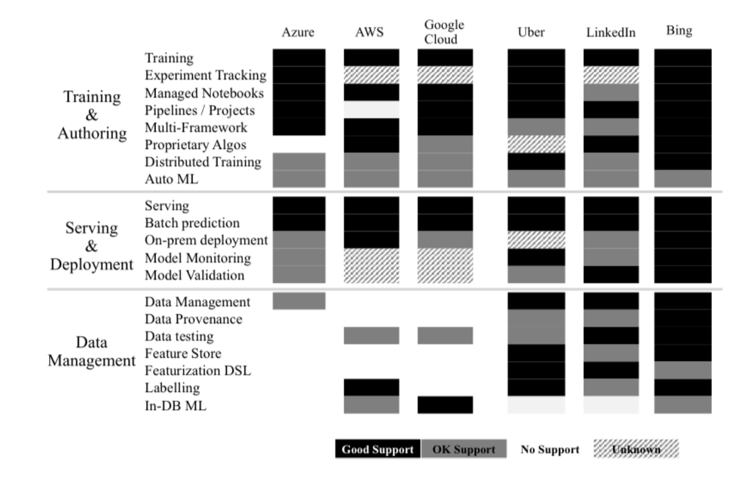
Where to Focus Our Efforts?
Start with the data:
Mature proprietary solutions have stronger support for data management.
Providing complete and useable thrid-party solutions is non-trivial.
There is no data analysis without data.
Then, focus on serving and deployment:
Consider self-service approaches.
Automate, automate, and automate.
(Aggrawal et al. 2020)

Slide 13
References
Agrawal, A. et al. “Cloudy with a high chance of DBMS: A 10-year prediction for Enterprise-Grade ML.” arXiv preprint arXiv:1909.00084 (2019).
Huyen, Chip. “Designing machine learning systems.” O’Reilly Media, Inc.(2022).

