Slide 1
Cadmium on S1

Slide 2
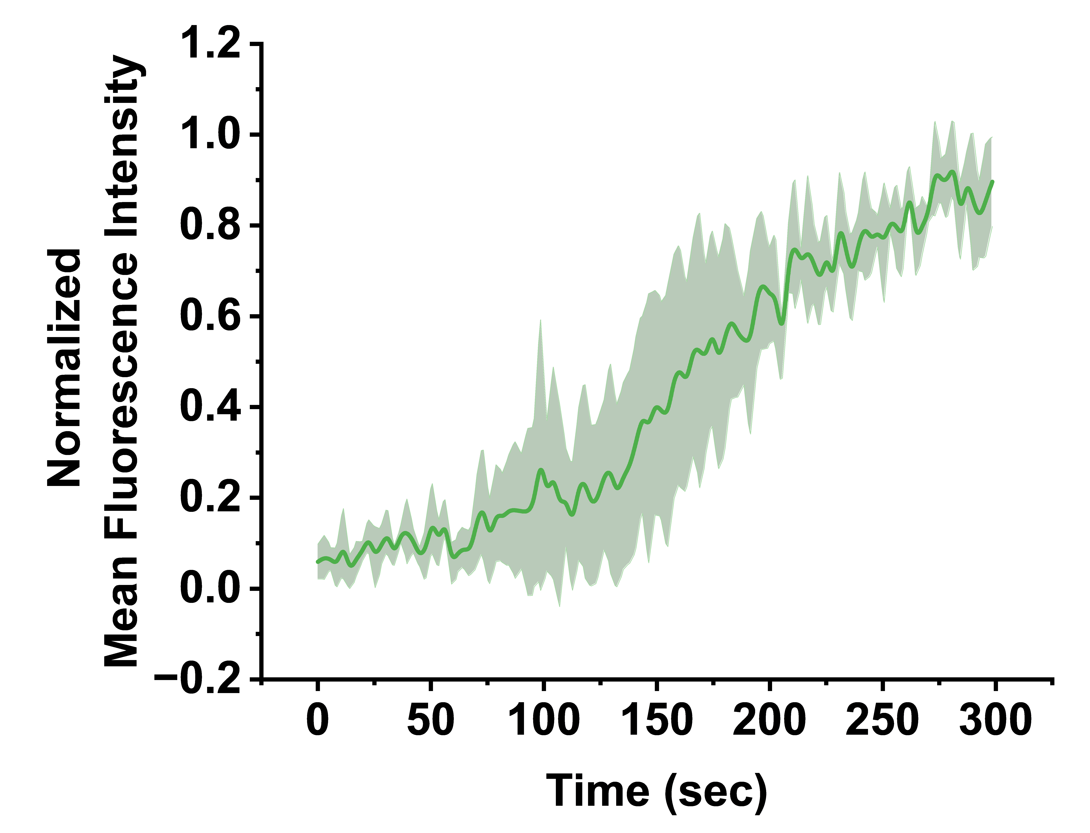
Cadmium 5mM S1 sample

Slide 3
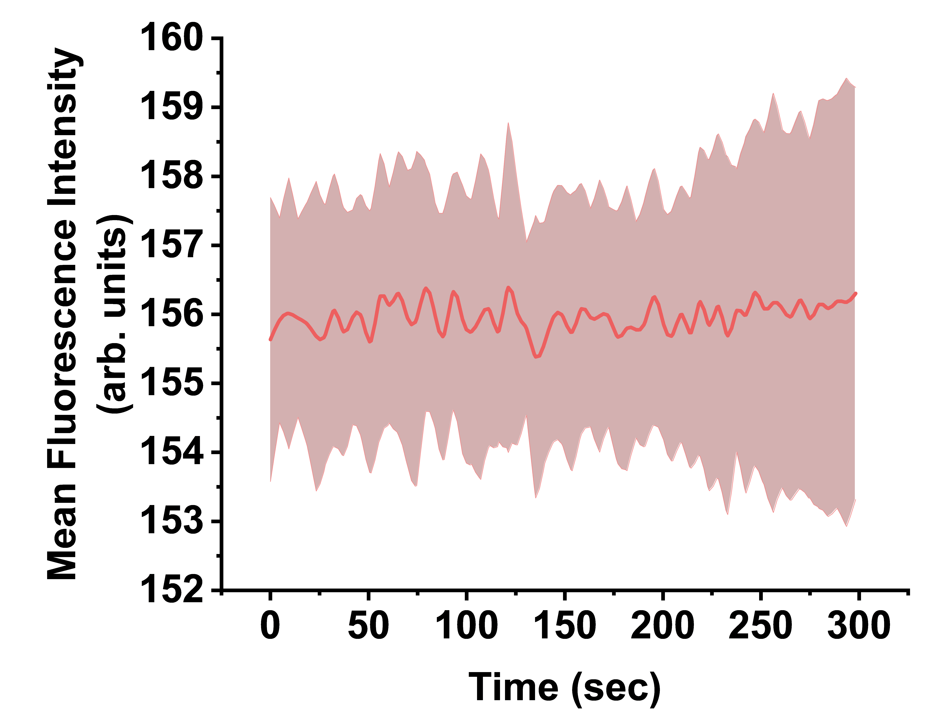
Control (no cadmium) S1 Sample

