Slide 1


Slide 2
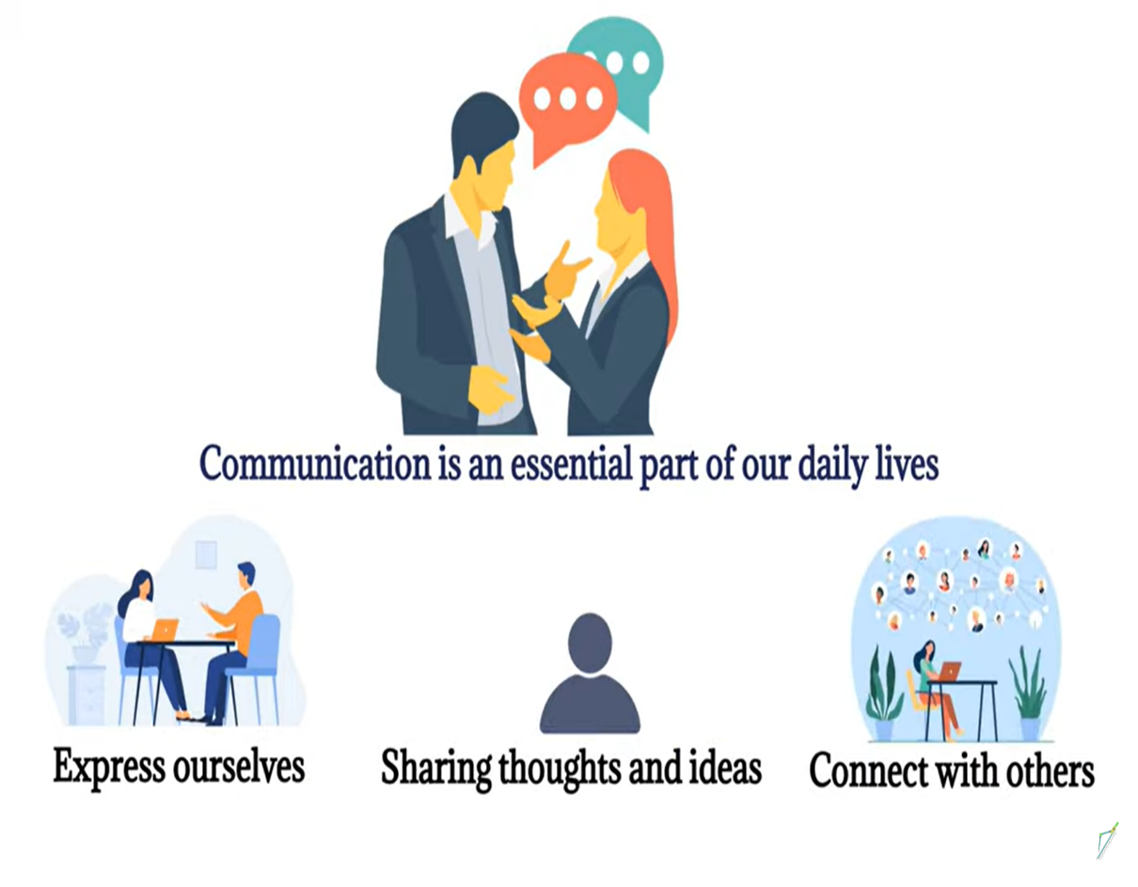
What is Communication?
Communication is mutually exchanging information, ideas, thoughts, feelings with other people.

Slide 3
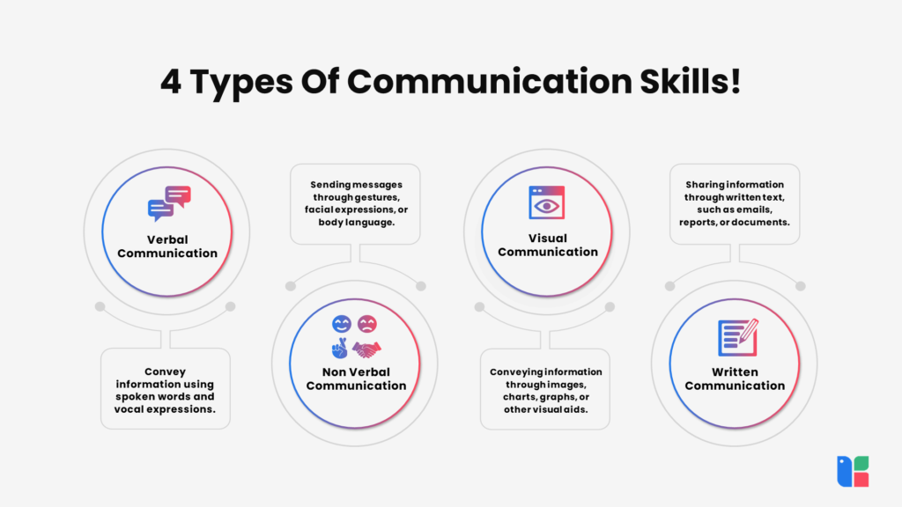

Slide 4
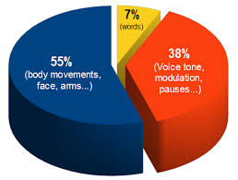
7/38/55 Rule

Slide 5
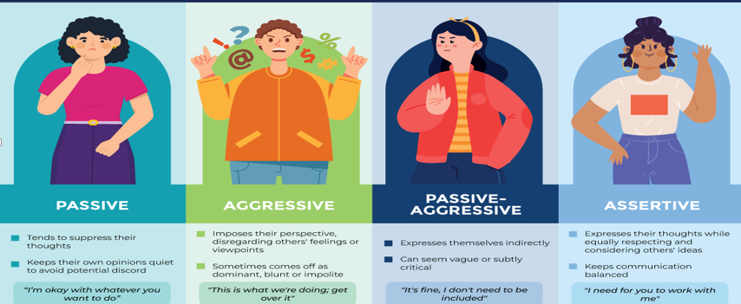
Communication Styles

Slide 6
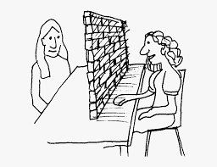
Barriers to Communication
Language
Culture
Gender
Attitude
Poor listening skills
Lack of feedback
Interruptions
Distractions
perception

Slide 7
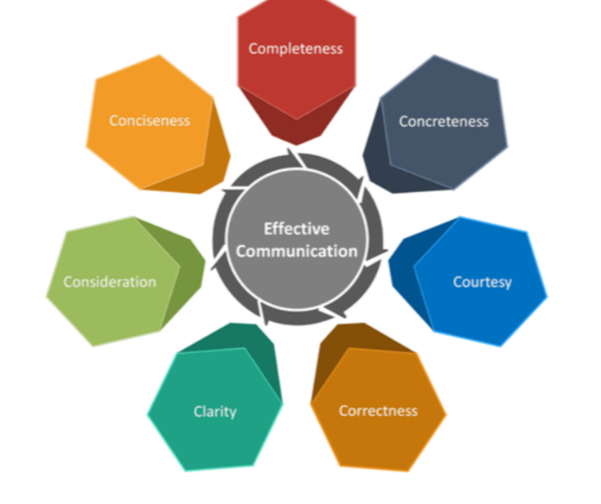
7C’s of Effective Communication

Slide 8
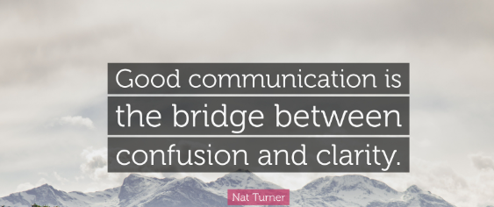

Slide 9


