Slide 1
INFO251 – Applied Machine Learning
Lab 6
Suraj R. Nair

Slide 2
Announcements
Quiz 1 on Feb 27
Lab schedule:
Today: Cross Validation, Normalization, Standardization + Gradient Descent Demo
Feb 21: Gradient Descent (~20 mins) + Review for Quiz 1 (~30 min)

Slide 3
Topics
Gradient descent
Random initialization, learning rate, iterations, stopping conditions
Convexity

Slide 4
Gradient Descent
“A first-order iterative algorithm for finding a local minimum of a differentiable multivariate function.”
Stochastic: 1 example per step
Batch: all data taken into consideration
Mini-batch: use a batch of a fixed number of examples
Random initialization
Step size / learning rate
Stopping conditions (tolerance)

Slide 5
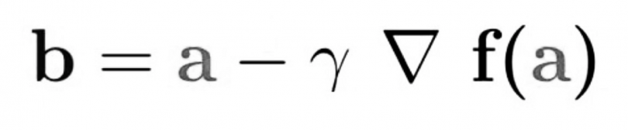
Gradient Descent
Begin at a random point
Calculate the function value at the point and the gradient (partial derivatives)
Pick a new point, move in the direction of steepest descent. The size of the step is governed by the learning rate.
Repeat!

Slide 6
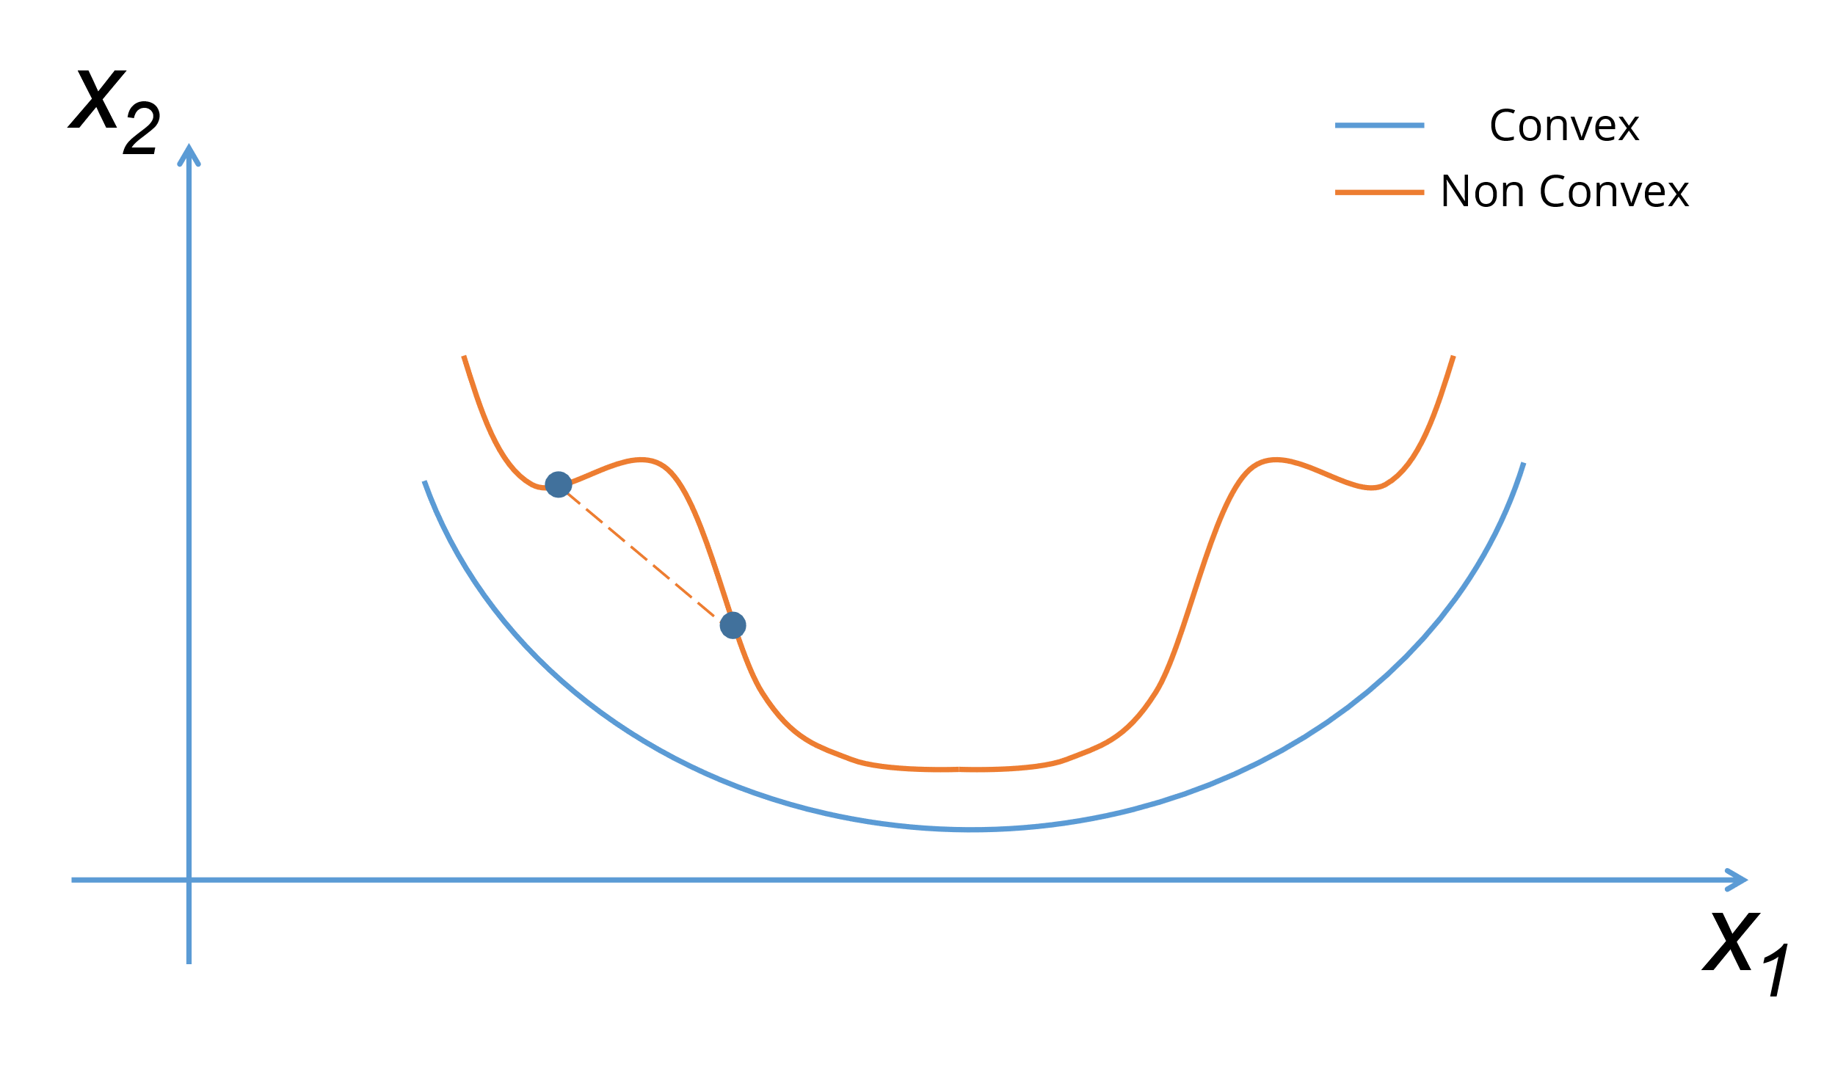
Convexity
Convex function: Second derivative is always nonnegative
Graphical interpretation: Line segment between any two points on the graph of the function does not lie below the graph between the two points

Slide 7
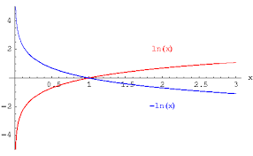
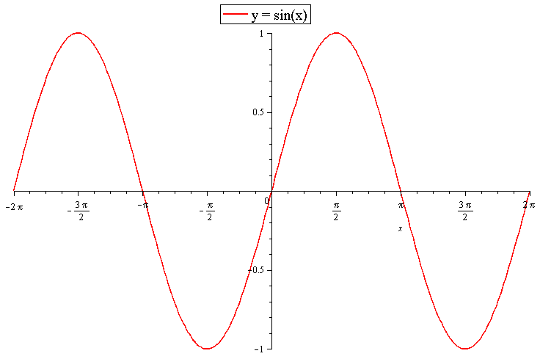
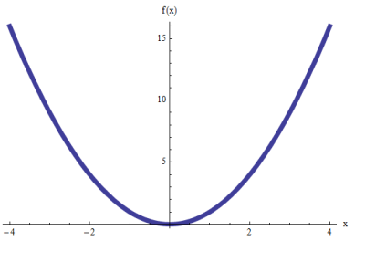
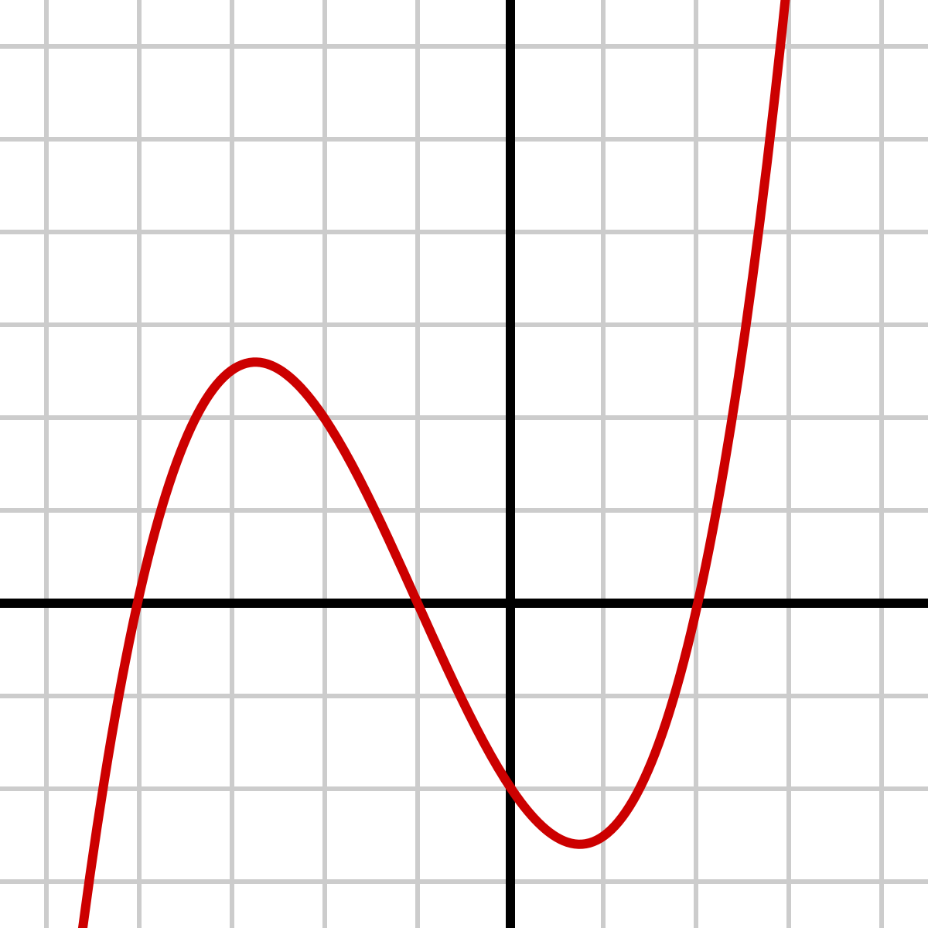
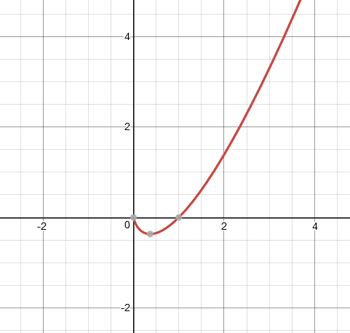
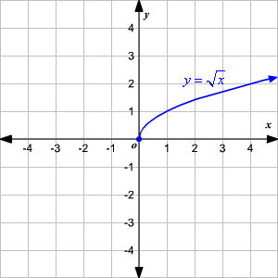
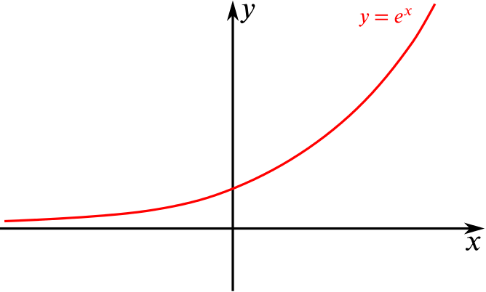
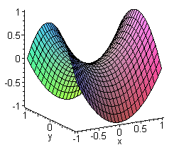
Convexity
f(x) = x²
f(x) = ln(x)
f(x) = sin(x)
f(x) = x³
f(x) = xln(x)
f(x) = |x|
f(x) = x^{1/2}
f(x) = e^{x}
f(x) = ax² - by²

Slide 8
Quiz 1 Review

Slide 9
Regression
When comparing two regression models, the model that produces the higher R2 will provide less biased estimates of the causal impact of the independent variables on the dependent variable:
True
False

Slide 10
Difference-in-difference
The key identifying assumption is
Outcomes in the control and treatment group would have been the same in the absence of treatment
Trends in the control and treatment group would have been the same in the absence of treatment
Outcomes pre- and post-treatment would have been the same in the absence of treatment
Outcomes pre-treatment would have been the same in the absence of treatment

Slide 11
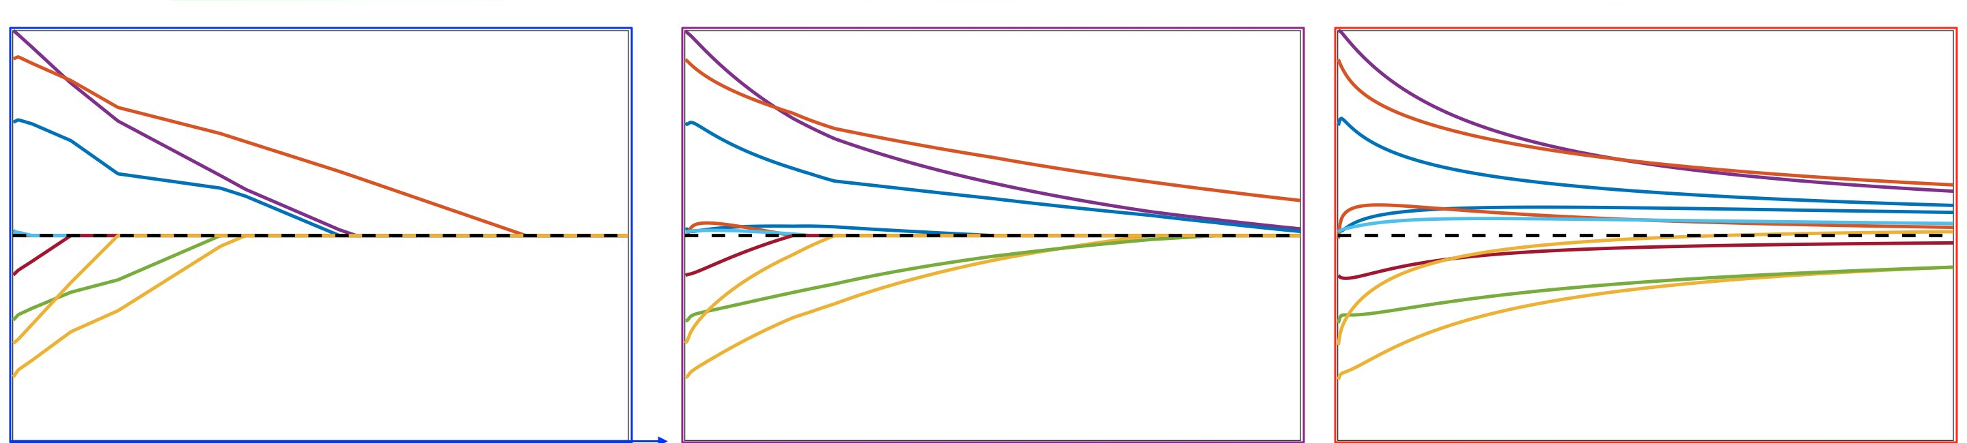
Regularization
Match the penalty (Lasso, Ridge, ElasticNet) to the coefficient plot
A
B
C

Slide 12
Decision Boundaries
Which of the following algorithms recovers non-linear decision boundaries:
K-nearest neighbors (K = 5)
Linear Regression
Logistic Regression
Linear Regression with lasso regularization

Slide 13
Gradient Descent
You are trying to find the parameters for a multivariate linear regression using gradient descent. The algorithm is initialized at some random starting point. However, it is taking very long to converge (> 10,000 iterations). What could be the reason(s)?
Step size is too small
Step size is too large
Data may not have been scaled

Slide 14
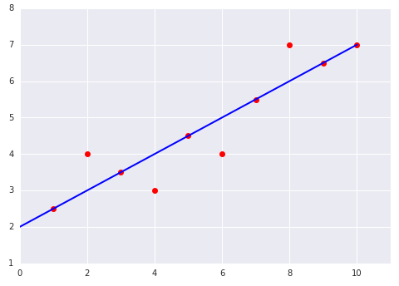
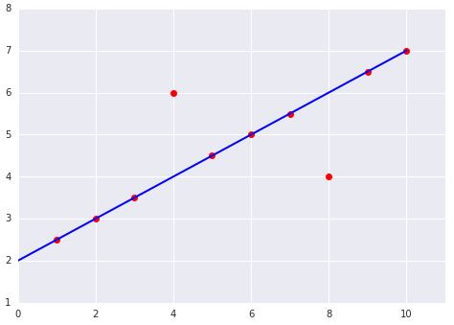
Mean Squared Error
A
Suppose you build a linear regression model which predicts y = f(x). Which of these two cases has a higher MSE?
A
B
B

Slide 15
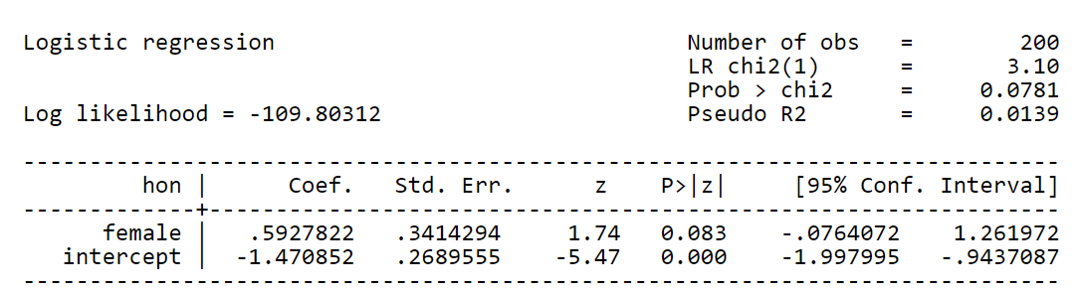
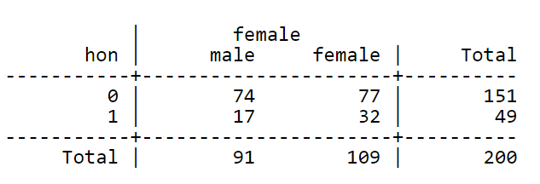

Logistic Regression
Example with single predictor variable
Likelihood of honor student, by major
$logit\left(honor_{i}\right)=α+βSTEM_{i}+ε_{i}$
exp(0.593) = 1.809
(this is the odds ratio)
(corresponds to p=0.644)
The odds radio can also be seen in the cross-tabs:
Odds for non-STEM: 0.23 (17/74)
Odds for STEM: 0.42 (32/77)
Odds for STEM 81% higher
0.42 / 0.23 = 1.809
0.644 / (1-0.644) = 1.809
stem
stem
no yes

