Slide 1
INFO251 – Applied Machine Learning
Lab 5
Suraj R. Nair

Slide 2
Announcements
PS3 due next week
Quiz 1 on Feb 27
Lab schedule:
Today: Cross Validation, Normalization, Standardization + Gradient Descent Demo
Feb 21: Gradient Descent (~20 mins) + Review for Quiz 1 (~30 min)

Slide 3
Topics
Optimization
Convexity
Gradient descent
Random initialization, learning rate, iterations, stopping conditions

Slide 4
Optimization
Optimization: Finding the global minimum of a function
Methods for optimization
Naïve grid search
Gradient descent
Linear programming, quadratic programming
Newton’s method
…many, many more
More on optimization: EECS 127 and EECS 227

Slide 5
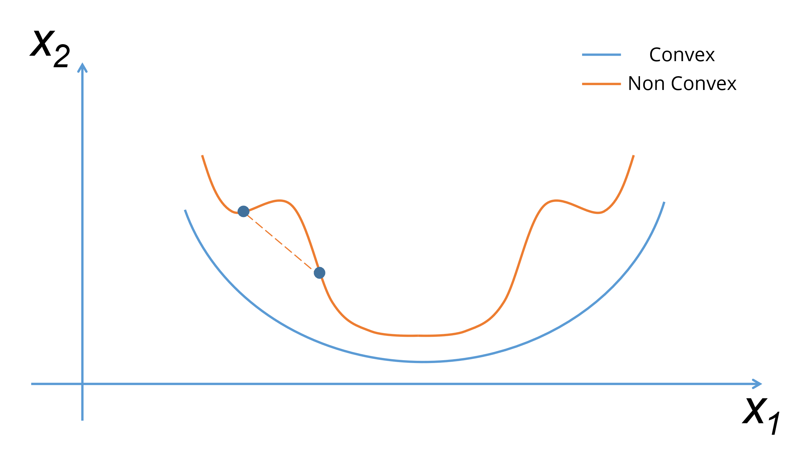
Convexity
Convex function: Second derivative is always nonnegative
Graphical interpretation: Line segment between any two points on the graph of the function does not lie below the graph between the two points

Slide 6
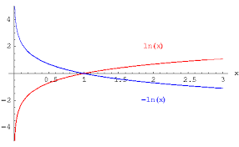
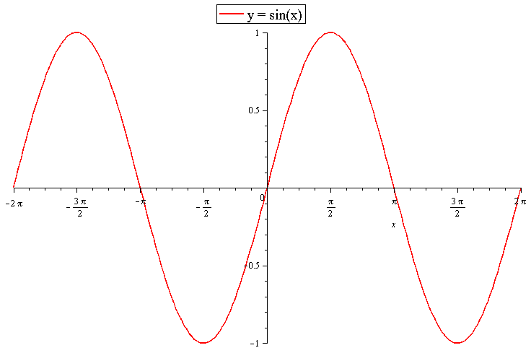
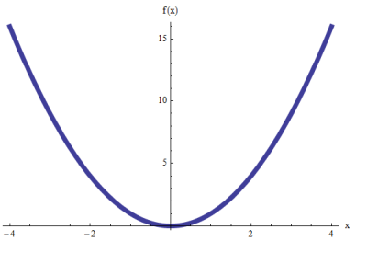
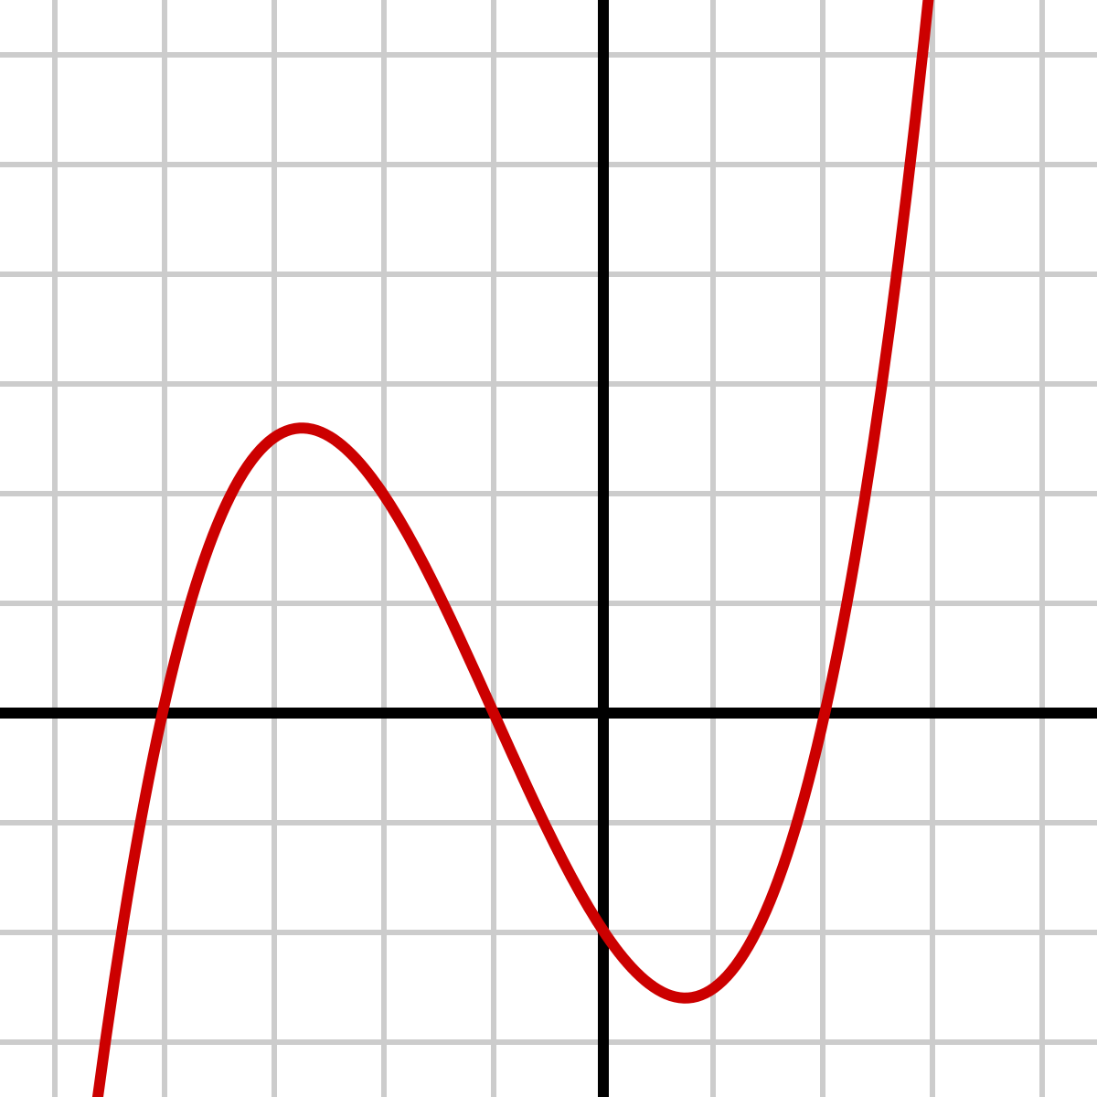
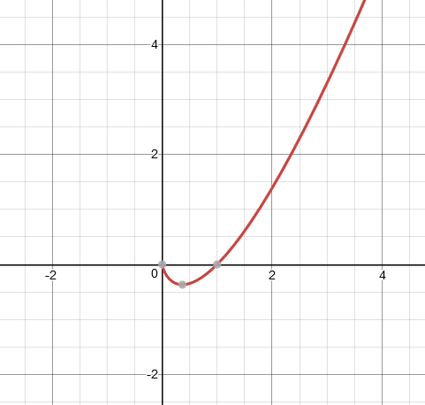
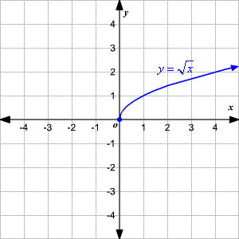
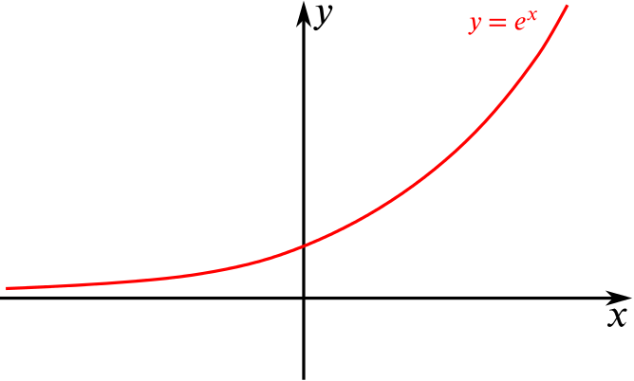
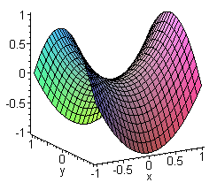
Convexity
f(x) = x²
f(x) = ln(x)
f(x) = sin(x)
f(x) = x³
f(x) = xln(x)
f(x) = |x|
f(x) = x^{1/2}
f(x) = e^{x}
f(x) = ax² - by²

Slide 7
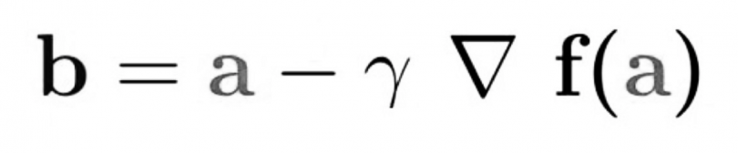
Gradient Descent
Begin at a random point
Calculate the function value at the point and the gradient (partial derivatives)
Pick a new point, by moving in the direction of the gradient. The size of the step is governed by the learning rate.
Repeat!

