Slide 1
INFO251 – Applied Machine Learning
Lab 7
Suraj R. Nair

Slide 2
Announcements
PS4 posted, due Monday March 12. Start early!
Quiz 1 solutions in lecture tomorrow

Slide 3
Today’s Topics
Putting it all together: training an ML algorithm from scratch
Common loss functions
Practice
Bivariate OLS, squared error loss
Multivariate OLS, squared error loss
Multivariate OLS, squared error loss with Ridge regularization
Cross validation for optimal regularization parameter

Slide 4
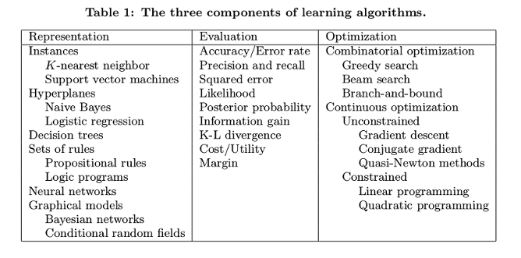
Training ML Algorithms
Domingos, 2016

Slide 5
Training ML Algorithms (Linear Models)
Define a model
Define a loss function
Add regularization to the loss function [find optimal parameter]
Optimization
Gradient Descent [batch size, step size / learning rate, stopping rule]

Slide 6
1. Define a Model
For today: Linear regression models, of the form y = θx
Multivariate models: y = θ₁x₁ + θ₂x₂ + θ₃x₃
Nonlinearities: y = θ_{k}x^{k}
Interaction terms: y = θ₁x₁ + θ₂x₂ + θ₃x₁x₂

Slide 7
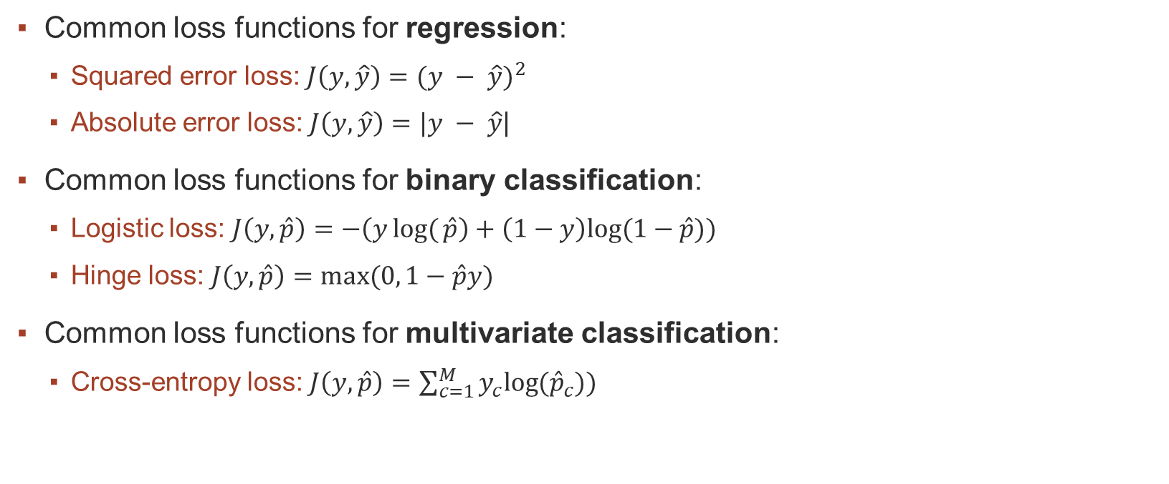
2. Define a Loss Function
Common loss functions for regression:
Squared error loss: $J\left(y, \hat{y}\right)={(y − \hat{y})}^{2}$
Absolute error loss: $J\left(y, \hat{y}\right)=|y − \hat{y}$|
Common loss functions for binary classification:
Logistic loss: $J\left(y, \hat{p}\right)=−\left(ylog⁡({\hat{p}}\right)+\left(1−y\right)log⁡(1−\hat{p}))$
Hinge loss: $J\left(y,\hat{p}\right)=max⁡(0, 1−\hat{p}y)$
Common loss functions for multivariate classification:
Cross-entropy loss: $J\left(y, \hat{p}\right)=\sum_{c=1}^{M}{y_{c}log⁡({\hat{p}}_{c}))}$

Slide 8
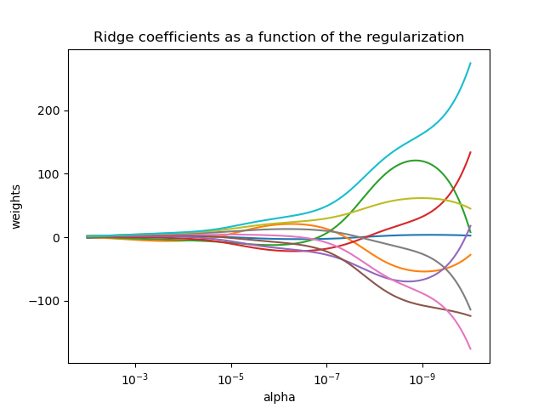
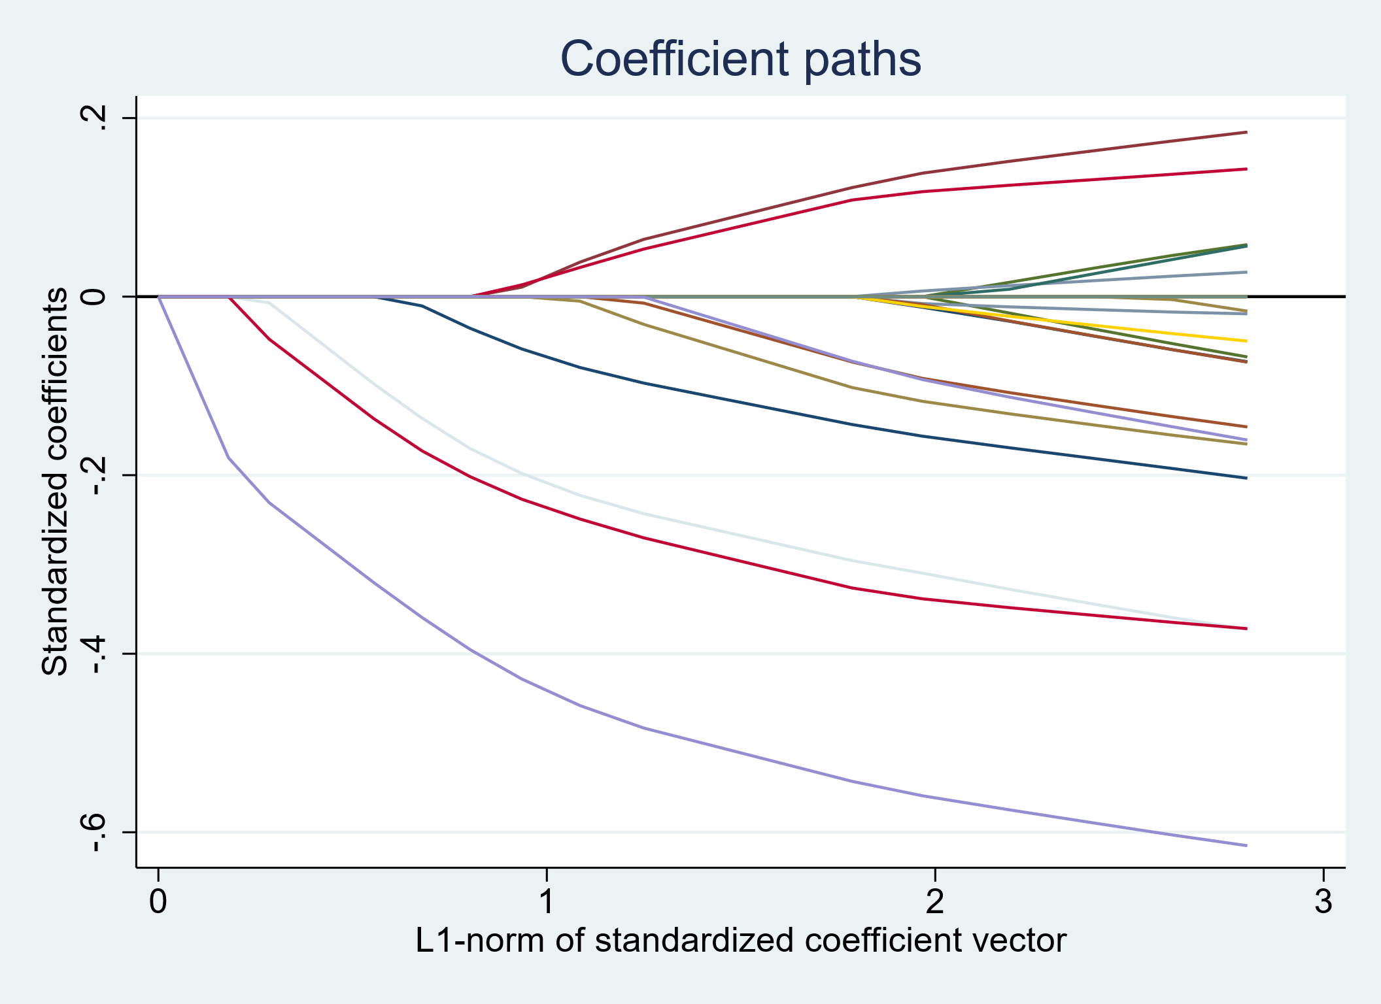

3. Optionally Add Regularization to the Loss
LASSO: $J\left(θ\right)+={\left\|θ\right\|}_{1}= \sum_{j=1}^{k}{\left|θ_{k}\right|}$ Ridge: $J\left(θ\right)+={\left\|θ\right\|}_{2}= \sum_{j=1}^{k}{θ_{k}^{2}}$

Slide 9
4. Gradient Descent
Input:
parameters (θ)
gradient of the loss function with respect to the parameters (dθ),
learning rate (α)
Update parameters: θ_{new} = θ − α× dθ
Output: updated parameters (θ_{new})

Slide 10
Model: Linear regression (univariate) Cost: Squared error
Define the model
Define the loss function
Optionally add regularization to the loss function
Calculate partial derivatives
Write pseudocode

Slide 11
Model: Linear regression (multivariate) Cost: Squared error
Define the model
Define the loss function
Optionally add regularization to the loss function
Calculate partial derivatives
Write pseudocode

Slide 12
Model: Linear regression (multivariate) Cost: Squared error + Ridge regularization
Define the model
Define the loss function
Optionally add regularization to the loss function
Calculate partial derivatives
Write pseudocode

